Slide 1
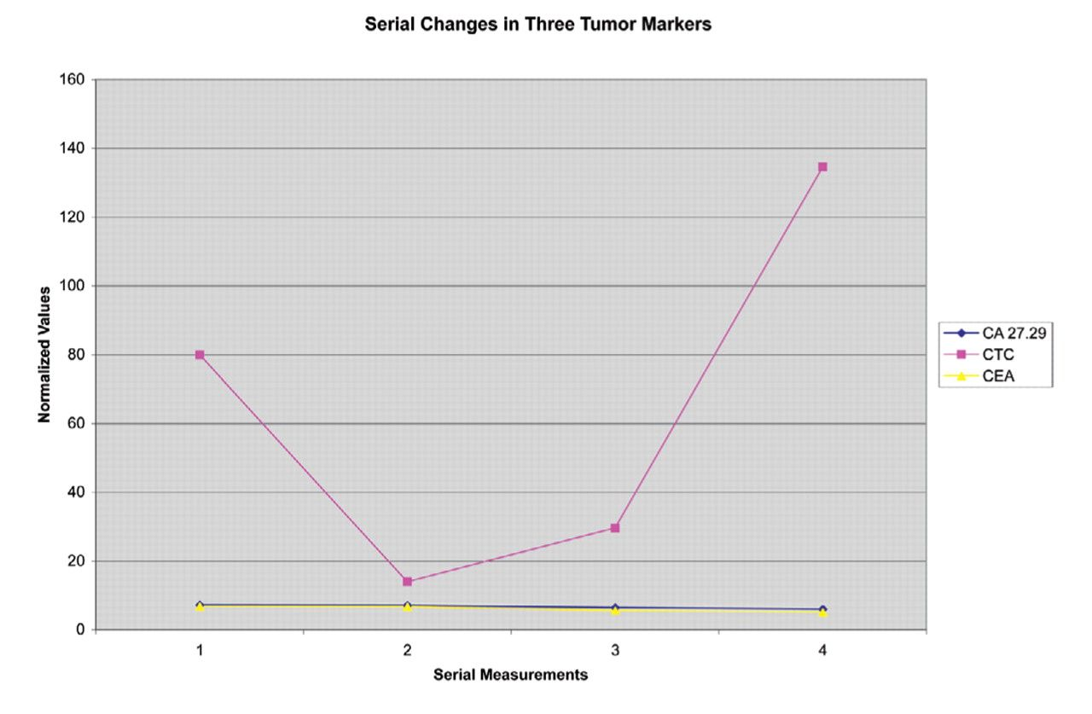
Figure 1 Four serial measurements of 3 tumor markers obtained from a patient with metastatic breast cancer illustrate ...
Notes:
Figure 1 Four serial measurements of 3 tumor markers obtained from a patient with metastatic breast cancer illustrate the variability of marker response to disease status commonly seen in individual patients. While levels of 2 markers remained relatively unchanged (CA 27.29 and CEA), values of the third (circulating tumor cells [CTC]) initially declined with treatment but later increased with the development of brain metastases. Results were normalized by dividing by the upper limit of normal.
Unless provided in the caption above, the following copyright applies to the content of this slide: © American Society of Clinical Pathologists

