Slide 1
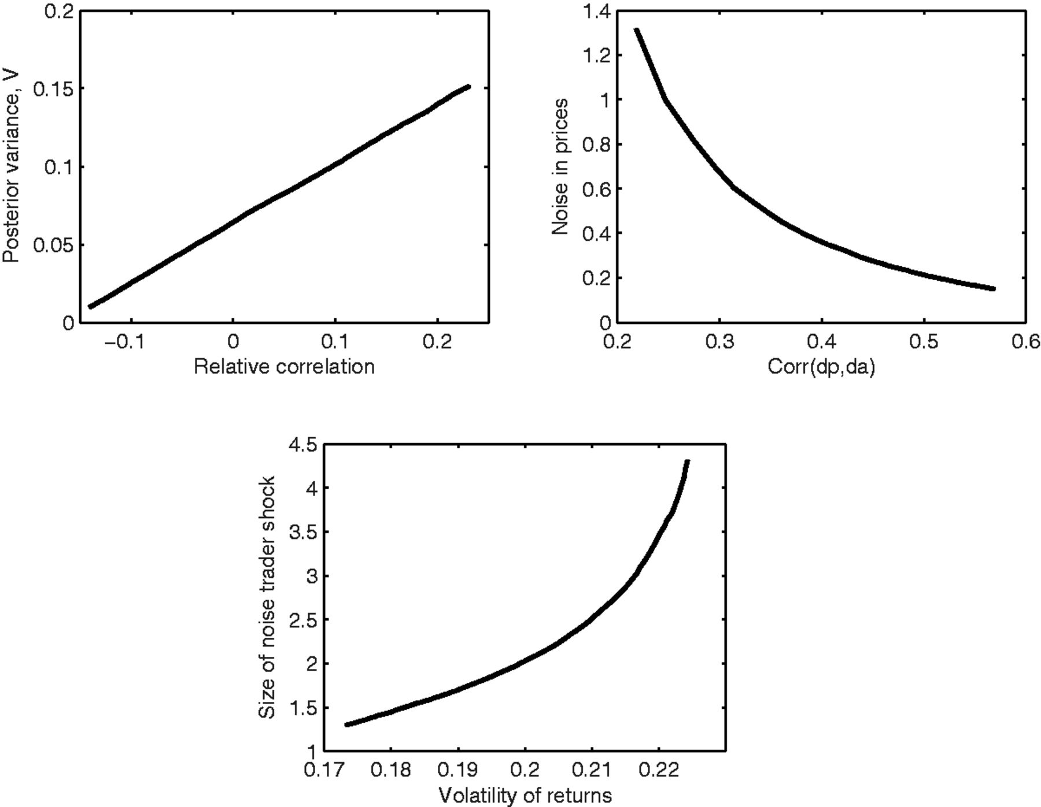
Figure I Identification—Quantitative Model
Notes:
Figure I Identification—Quantitative Model
Unless provided in the caption above, the following copyright applies to the content of this slide: © The Author(s) 2016. Published by Oxford University Press, on behalf of President and Fellows of Harvard College. All rights reserved. For Permissions, please email: journals.permissions@oup.com

Slide 2
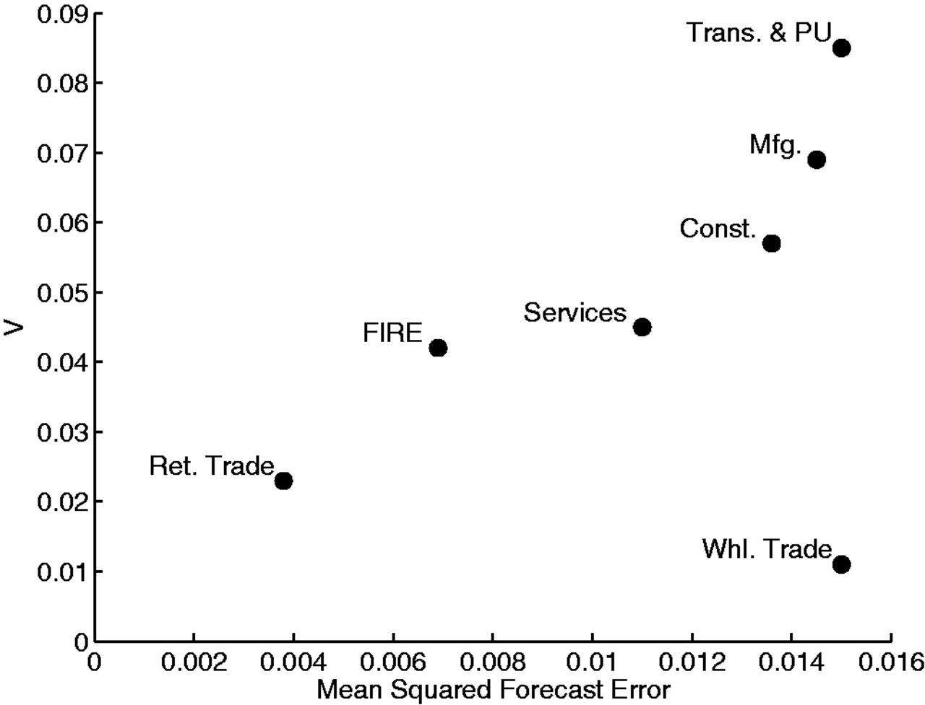
Figure II Uncertainty at the Sectoral Level The top panel displays annual estimates of V . The bottom panel shows ...
Notes:
Figure II Uncertainty at the Sectoral Level The top panel displays annual estimates of V . The bottom panel shows annual estimates of V and annual estimates of micro-uncertainty from Jurado, Ludvigson, and Ng (2013) . All series are detrended and normalized by their standard deviation.
Unless provided in the caption above, the following copyright applies to the content of this slide: © The Author(s) 2016. Published by Oxford University Press, on behalf of President and Fellows of Harvard College. All rights reserved. For Permissions, please email: journals.permissions@oup.com

Slide 3
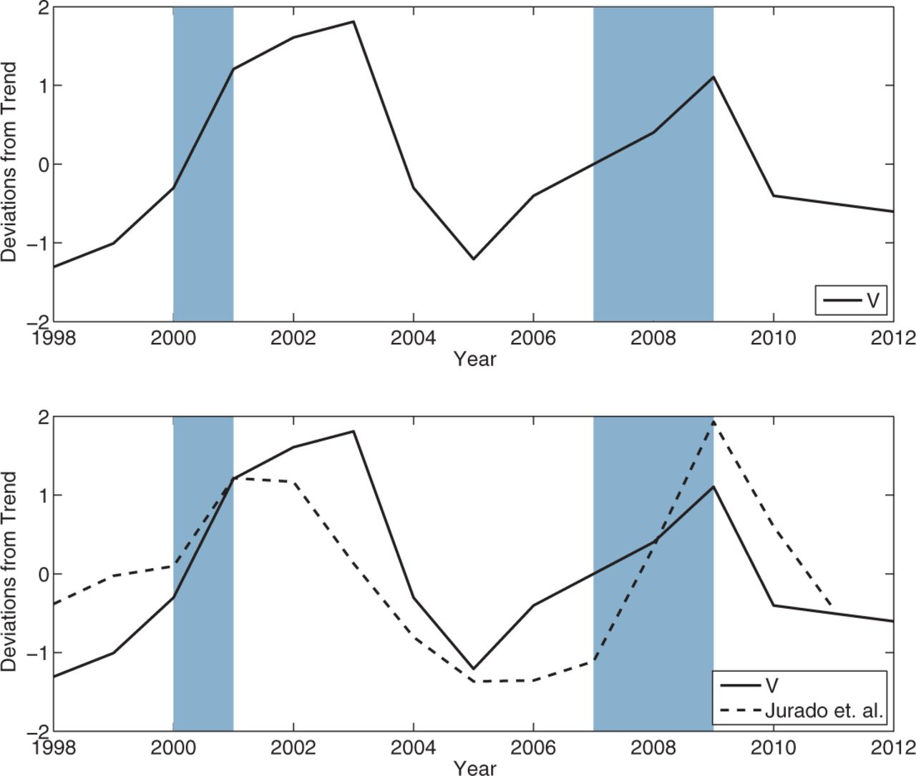
Figure III Uncertainty through Time
Notes:
Figure III Uncertainty through Time
Unless provided in the caption above, the following copyright applies to the content of this slide: © The Author(s) 2016. Published by Oxford University Press, on behalf of President and Fellows of Harvard College. All rights reserved. For Permissions, please email: journals.permissions@oup.com

