Slide 1
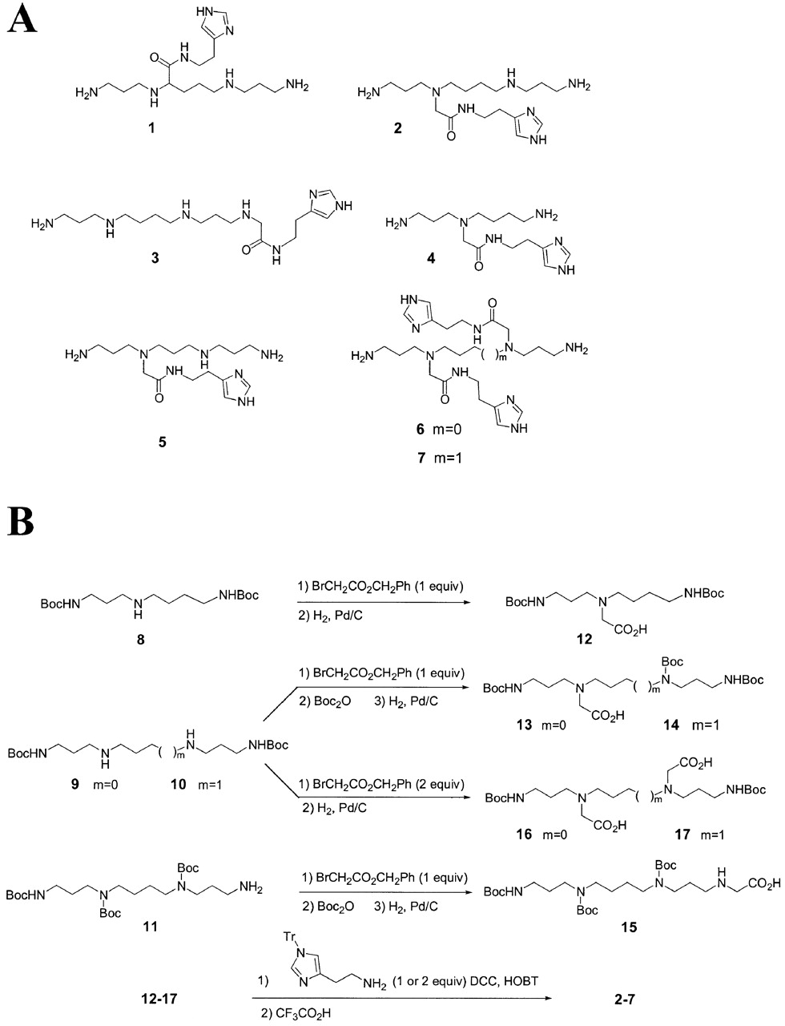
Figure 1. Chemical structures (A) and scheme of synthesis (B) of seven polyamine derivatives for RNA ...
Notes:
Figure 1. Chemical structures (A) and scheme of synthesis (B) of seven polyamine derivatives for RNA hydrolysis.
Unless provided in the caption above, the following copyright applies to the content of this slide: Oxford University Press

Slide 2
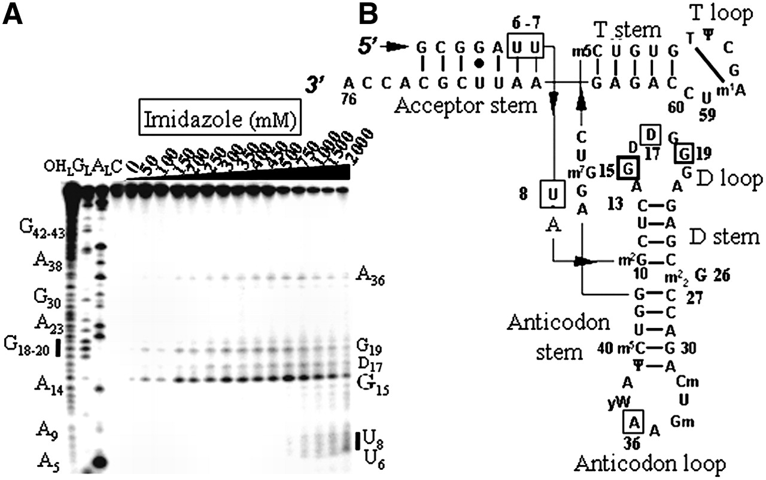
Figure 2. Electrophoregram of the cleavage pattern of labeled tRNA^{Phe} by an imidazole buffer. (A) ...
Notes:
Figure 2. Electrophoregram of the cleavage pattern of labeled tRNAPhe by an imidazole buffer. (A) Lane C, incubation control; lane OHL, alkaline hydrolysis ladder; lane GL, guanine ladder; lane AL, adenine ladder. Sequence is indexed on the left side. Nucleotides indexed on the right side are the cleavage sites. (B) Yeast tRNAPhe secondary structure with imidazole induced cleavage points. Thickness of the symbols (rectangles) is proportional to the intensity of the cuts. Nucleotides at the 5′‐boundary of the cleavage sites are indicated onto tRNAPhe secondary structure, the cleavage sites are at the 3′‐phosphate. This molecule has 11 modified bases: N2‐methylguanosine (m2G), dihydrouridine (D), N2,N2‐dimethylguanosine (m22G), 2′‐O‐methylcytidine (Cm), 2′‐O‐methylguanosine (Gm), wybutosine (yW), pseudouridine (Ψ), 5‐methylcytidine (m5C), 7‐methylguanosine (m7G), 5‐methyluridine (m5U) and 1‐methyladenosine (m1A).
Unless provided in the caption above, the following copyright applies to the content of this slide: Oxford University Press

Slide 3
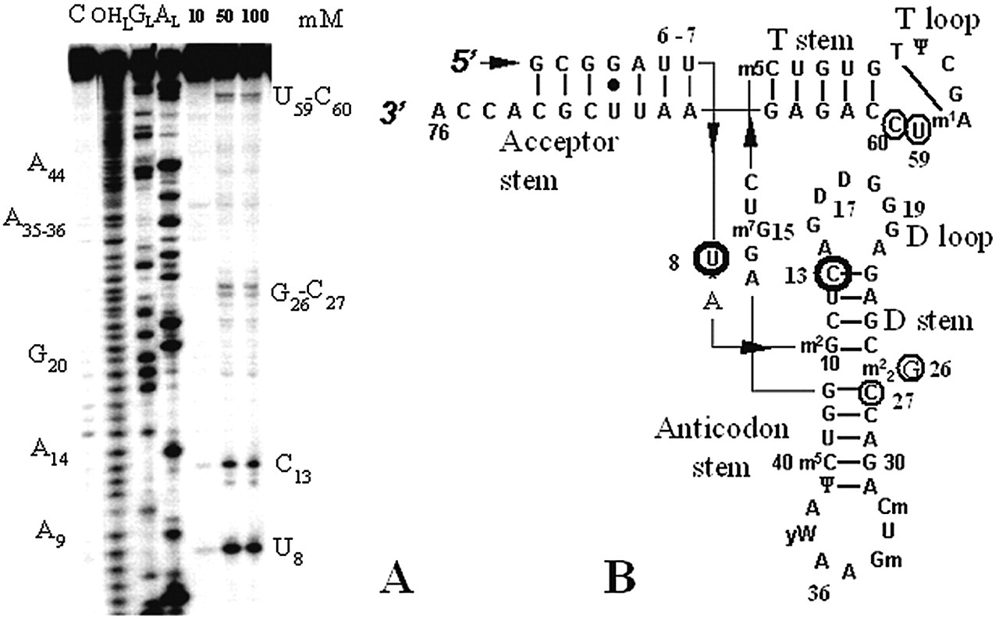
Figure 3. Yeast tRNA^{Phe} hydrolysis by compound 1. (A) Electrophoregram of the cleavage pattern. ...
Notes:
Figure 3. Yeast tRNAPhe hydrolysis by compound 1. (A) Electrophoregram of the cleavage pattern. The indications provided are as in Figure 2A. (B) Cleavage points (circles, with a thickness that is proportional to the intensity of the cuts) mapped onto yeast tRNAPhe secondary structure.
Unless provided in the caption above, the following copyright applies to the content of this slide: Oxford University Press

Slide 4
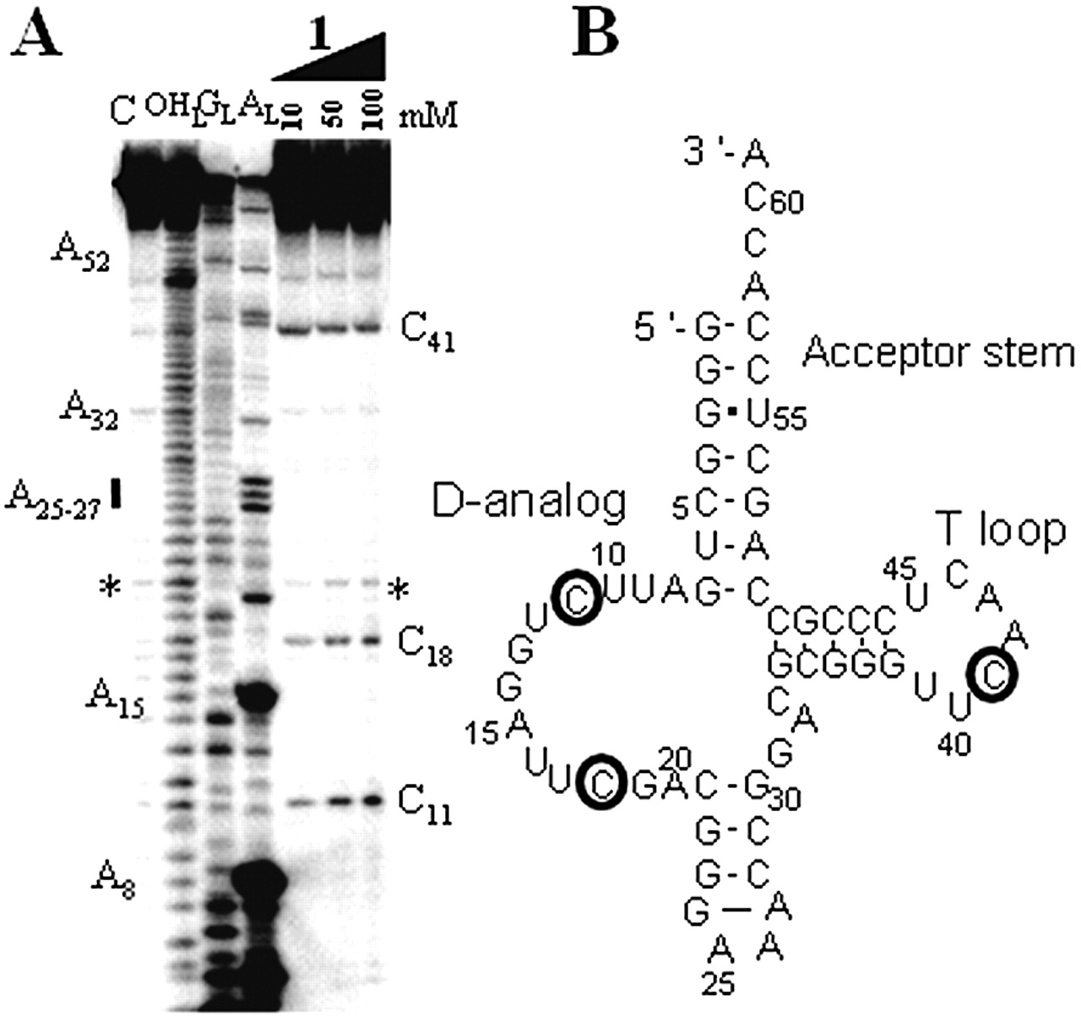
Figure 4. Hydrolysis of the tRNA portion of tmRNA by compound 1. (A) Electrophoregram of the cleavage ...
Notes:
Figure 4. Hydrolysis of the tRNA portion of tmRNA by compound 1. (A) Electrophoregram of the cleavage pattern. The indications provided are as in Figure 2A. The star shows an example of a cleavage site that was not retained since it is already present in the control lane. (B) Cleavage points mapped onto the RNA secondary structure (27).
Unless provided in the caption above, the following copyright applies to the content of this slide: Oxford University Press

Slide 5
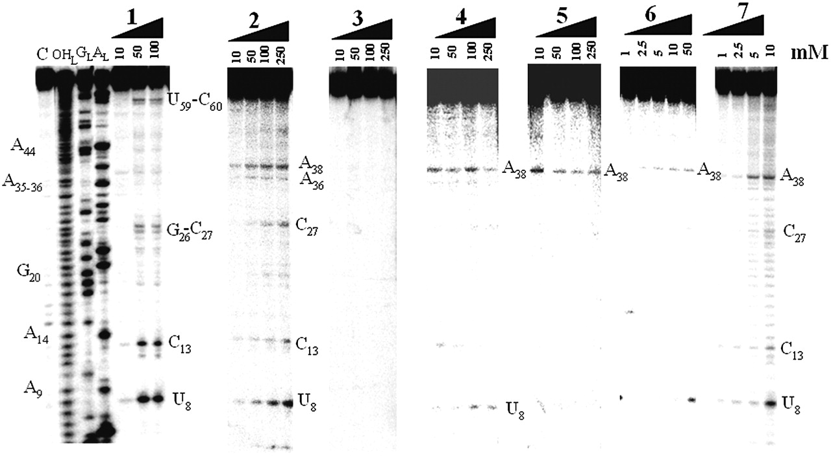
Figure 5. Site‐selected hydrolysis of yeast tRNA^{Phe} by compounds 1–7. The indications provided are ...
Notes:
Figure 5. Site‐selected hydrolysis of yeast tRNAPhe by compounds 1–7. The indications provided are as in Figure 2A.
Unless provided in the caption above, the following copyright applies to the content of this slide: Oxford University Press

Slide 6
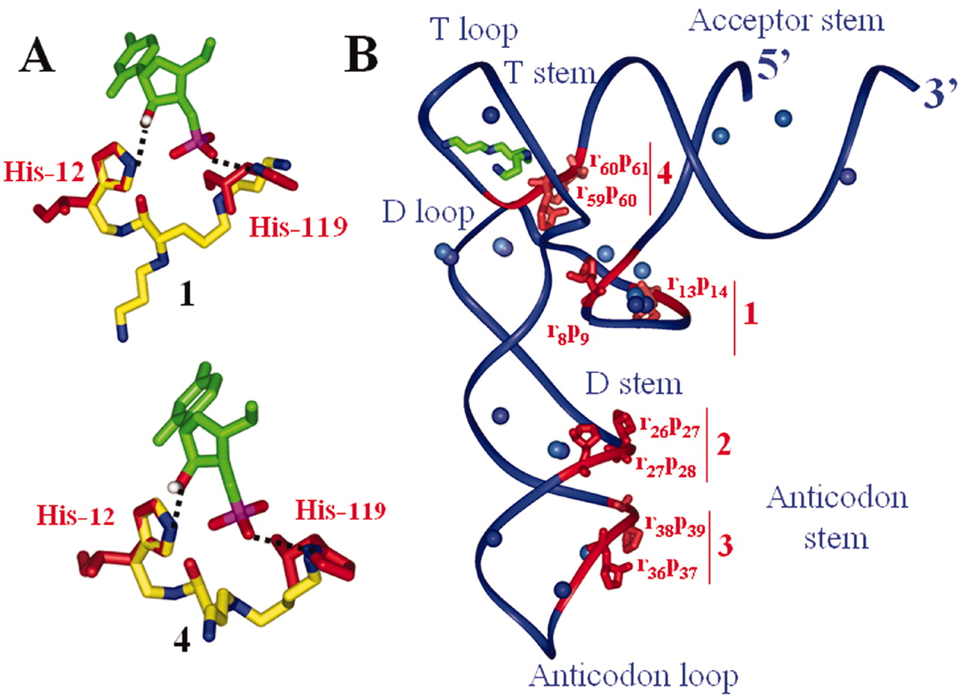
Figure 6. (A) Superimposing 1 and 4 (yellow‐blue) onto RNaseA active site (red) in complex with cytidine ...
Notes:
Figure 6. (A) Superimposing 1 and 4 (yellow‐blue) onto RNaseA active site (red) in complex with cytidine 3′‐monophosphate (green). (B) tRNAPhe tertiary structure (blue backbone following the ribose‐phosphate chain) with the cleavage sites (red), magnesium ions (blue), spermine (green‐blue). The four main cleavage sites are denoted 1–4. Conjugate 1 cleaves sites 1, 2 and 4, conjugate 2 cleaves sites 1–3, conjugates 4 and 6 cleave sites 1 and 3 and conjugate 5 cleaves only at site 3.
Unless provided in the caption above, the following copyright applies to the content of this slide: Oxford University Press

