Slide 1
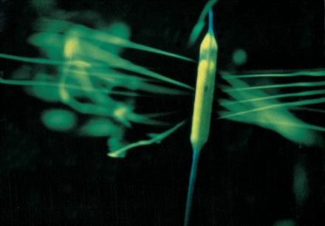
Fig. 1 Porous SI III balloon, demonstrating jet streaming using a fluorescent agent.
Notes:
Fig. 1 Porous SI III balloon, demonstrating jet streaming using a fluorescent agent.
Unless provided in the caption above, the following copyright applies to the content of this slide: Copyright © 1998, European Society of Cardiology

Slide 2
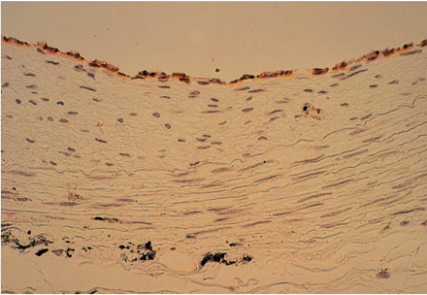
Fig. 3 Light micrograph of a rabbit carotid artery after 28 days of electrical stimulation. Endothelial cells that ...
Notes:
Fig. 3 Light micrograph of a rabbit carotid artery after 28 days of electrical stimulation. Endothelial cells that are polygonal in shape and to some extent orientated towards the vessel lumen. Black staining is derived from the graphite coated cuff electrode. PECAM 1-staining. Magnification ×500.
Unless provided in the caption above, the following copyright applies to the content of this slide: Copyright © 1998, European Society of Cardiology

Slide 3
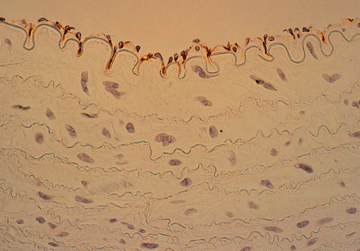
Fig. 2 Light micrograph of a rabbit carotid artery (control without any intervention) showing morphological features ...
Notes:
Fig. 2 Light micrograph of a rabbit carotid artery (control without any intervention) showing morphological features of endothelial cells. Normal endothelial cells demonstrate a granular staining for PECAM 1 and line the luminal surface of a control vessel. PECAM 1-staining. Magnification ×500.
Unless provided in the caption above, the following copyright applies to the content of this slide: Copyright © 1998, European Society of Cardiology

Slide 4
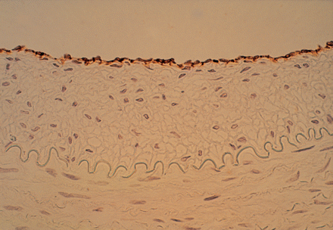
Fig. 8 Carotid artery with local delivery of LMWH at day 14 after BA. Luminal surface almost completely covered by ...
Notes:
Fig. 8 Carotid artery with local delivery of LMWH at day 14 after BA. Luminal surface almost completely covered by densely arranged ECs. PECAM 1-staining. Magnification ×500.
Unless provided in the caption above, the following copyright applies to the content of this slide: Copyright © 1998, European Society of Cardiology

Slide 5
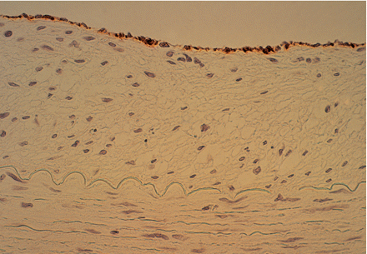
Fig. 7 Carotid artery with subcutaneous treatment at day 14 after BA. PECAM 1-staining. Magnification ×500.
Notes:
Fig. 7 Carotid artery with subcutaneous treatment at day 14 after BA. PECAM 1-staining. Magnification ×500.
Unless provided in the caption above, the following copyright applies to the content of this slide: Copyright © 1998, European Society of Cardiology

Slide 6
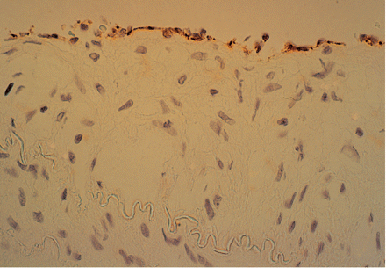
Fig. 6 Untreated carotid artery at day 14 after BA. In this group there are still foci of denuded endothelium. PECAM ...
Notes:
Fig. 6 Untreated carotid artery at day 14 after BA. In this group there are still foci of denuded endothelium. PECAM 1-staining. Magnification ×500.
Unless provided in the caption above, the following copyright applies to the content of this slide: Copyright © 1998, European Society of Cardiology

Slide 7
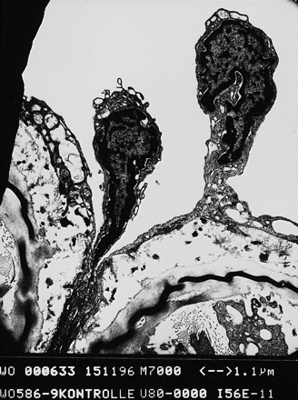
Fig. 5 Scanning electron microscopy of two endothelial cells protruding into the lumen surface 3 days after balloon ...
Notes:
Fig. 5 Scanning electron microscopy of two endothelial cells protruding into the lumen surface 3 days after balloon angioplasty without treatment. The scale bar represents 1.1 μm.
Unless provided in the caption above, the following copyright applies to the content of this slide: Copyright © 1998, European Society of Cardiology

Slide 8
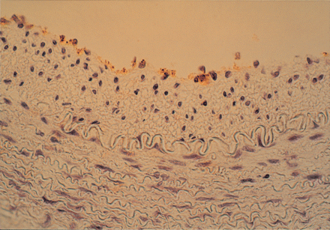
Fig. 4 Histological cross section of carotid artery at day 3 after BA without LMWH treatment. Extensive areas of ...
Notes:
Fig. 4 Histological cross section of carotid artery at day 3 after BA without LMWH treatment. Extensive areas of endothelial cell loss are present. The few remaining cells are polygonal and have an irregular size. PECAM 1-staining. Magnification ×500.
Unless provided in the caption above, the following copyright applies to the content of this slide: Copyright © 1998, European Society of Cardiology

