Slide 1
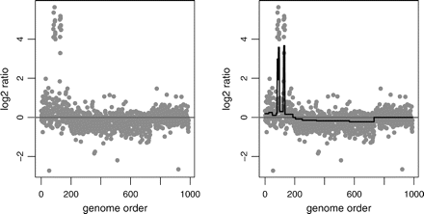
Fig. 1. Fused lasso applied to some GBM data. The data are shown in the left panel, and the solid line in the right ...
Notes:
Fig. 1. Fused lasso applied to some GBM data. The data are shown in the left panel, and the solid line in the right panel represents the inferred copy number β^ from the fused lasso. The grey line is for y = 0. 1
Unless provided in the caption above, the following copyright applies to the content of this slide: © The Author 2007. Published by Oxford University Press. All rights reserved. For permissions, please e-mail: journals.permissions@oxfordjournals.org.

Slide 2
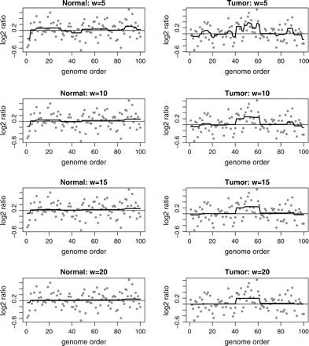
Fig. 2. Simulated data: the effect of parameter w (the average length of alterations) on the fused lasso solution. ...
Notes:
Fig. 2. Simulated data: the effect of parameter w (the average length of alterations) on the fused lasso solution. The panels of the left column represent a chromosome with no copy number alteration; the panels of the right column represent a chromosome with an amplification region of genes 40–60. The solid lines illustrate the estimated copy numbers of fused lasso; a horizontal line is drawn at y = 0.
Unless provided in the caption above, the following copyright applies to the content of this slide: © The Author 2007. Published by Oxford University Press. All rights reserved. For permissions, please e-mail: journals.permissions@oxfordjournals.org.

Slide 3
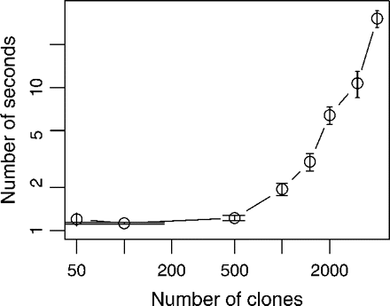
Fig. 3. Number of CPU seconds required for the fused lasso algorithm as a function of the number of clones.
Notes:
Fig. 3. Number of CPU seconds required for the fused lasso algorithm as a function of the number of clones.
Unless provided in the caption above, the following copyright applies to the content of this slide: © The Author 2007. Published by Oxford University Press. All rights reserved. For permissions, please e-mail: journals.permissions@oxfordjournals.org.

Slide 4
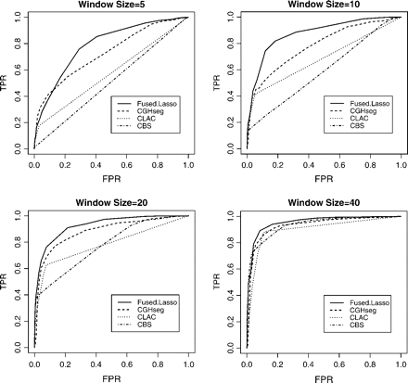
Fig. 4. TPR = (the number of probes within the aberration width that is above a threshold)/(the total number of ...
Notes:
Fig. 4. TPR = (the number of probes within the aberration width that is above a threshold)/(the total number of probes within the aberration width); FPR = (the number of probes outside the aberration width that is above a threshold)/(the total number of probes outside the aberration width).
Unless provided in the caption above, the following copyright applies to the content of this slide: © The Author 2007. Published by Oxford University Press. All rights reserved. For permissions, please e-mail: journals.permissions@oxfordjournals.org.

Slide 5
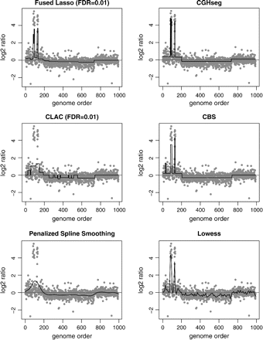
Fig. 5. Chromosome 7 and chromosome 13 from 2 GBM tumors.
Notes:
Fig. 5. Chromosome 7 and chromosome 13 from 2 GBM tumors.
Unless provided in the caption above, the following copyright applies to the content of this slide: © The Author 2007. Published by Oxford University Press. All rights reserved. For permissions, please e-mail: journals.permissions@oxfordjournals.org.

Slide 6
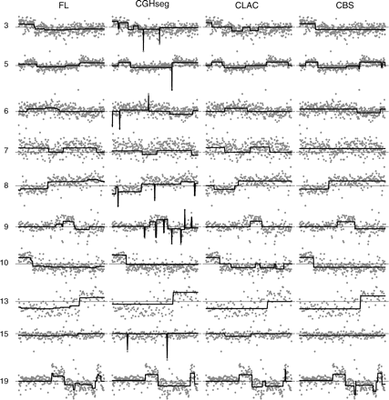
Fig. 6. Array CGH profile of 10 chromosomes of breast cancer cell line MDA157. Panels in the same row are for the ...
Notes:
Fig. 6. Array CGH profile of 10 chromosomes of breast cancer cell line MDA157. Panels in the same row are for the same chromosome. The integers at the beginning of each row are chromosome indexes. The dark black line in each panel represents the estimated copy number of a particular method, whose name is shown on the top of each column. The black horizontal line in each panel represents y = 0.
Unless provided in the caption above, the following copyright applies to the content of this slide: © The Author 2007. Published by Oxford University Press. All rights reserved. For permissions, please e-mail: journals.permissions@oxfordjournals.org.

