Slide 1
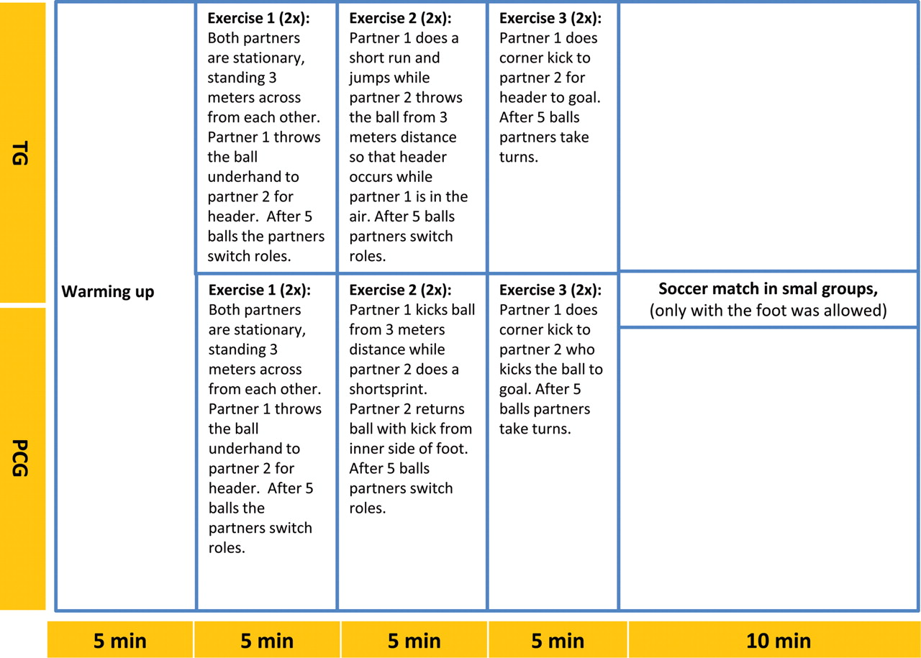
Fig. 1. Course of training sessions for TG and PCG.
Notes:
Fig. 1. Course of training sessions for TG and PCG.
Unless provided in the caption above, the following copyright applies to the content of this slide: © The Author 2011. Published by Oxford University Press. All rights reserved. For permissions, please e-mail: journals.permissions@oup.com.

Slide 2
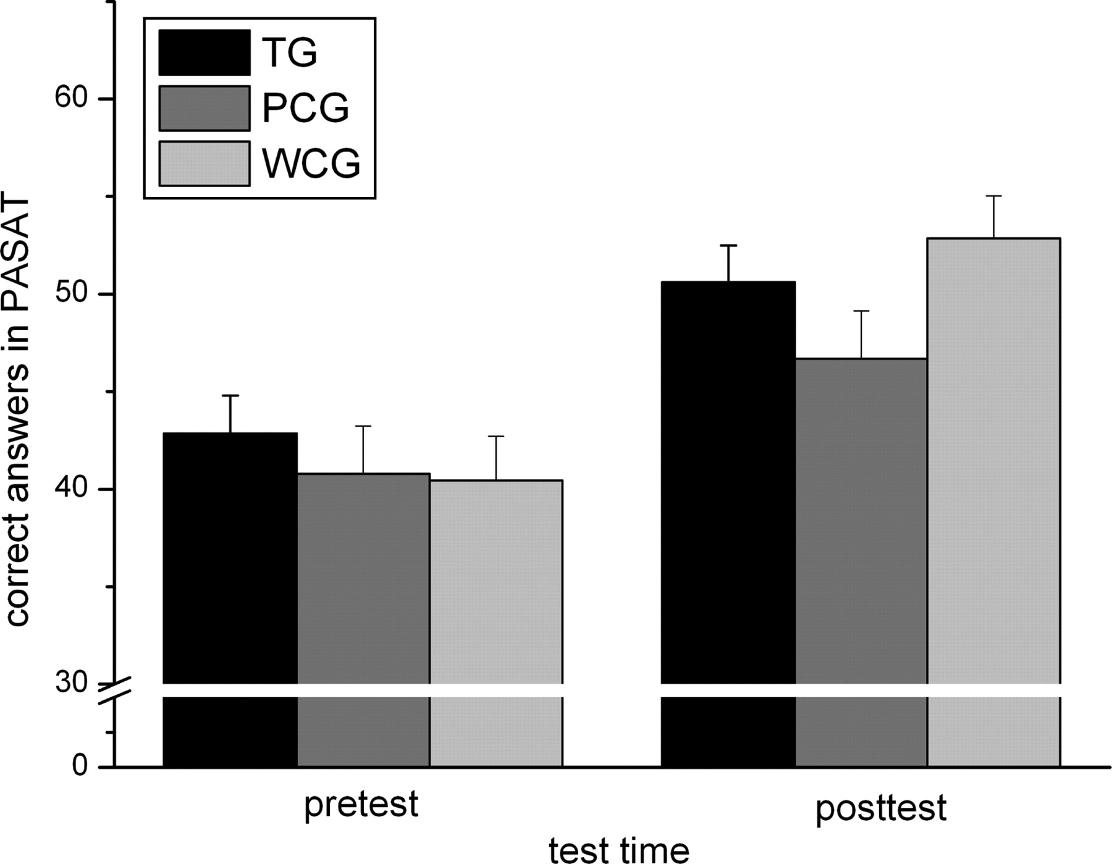
Fig. 2. Mean and standard error of correct answers in the PASAT dependent on test time and group.
Notes:
Fig. 2. Mean and standard error of correct answers in the PASAT dependent on test time and group.
Unless provided in the caption above, the following copyright applies to the content of this slide: © The Author 2011. Published by Oxford University Press. All rights reserved. For permissions, please e-mail: journals.permissions@oup.com.

