Slide 1
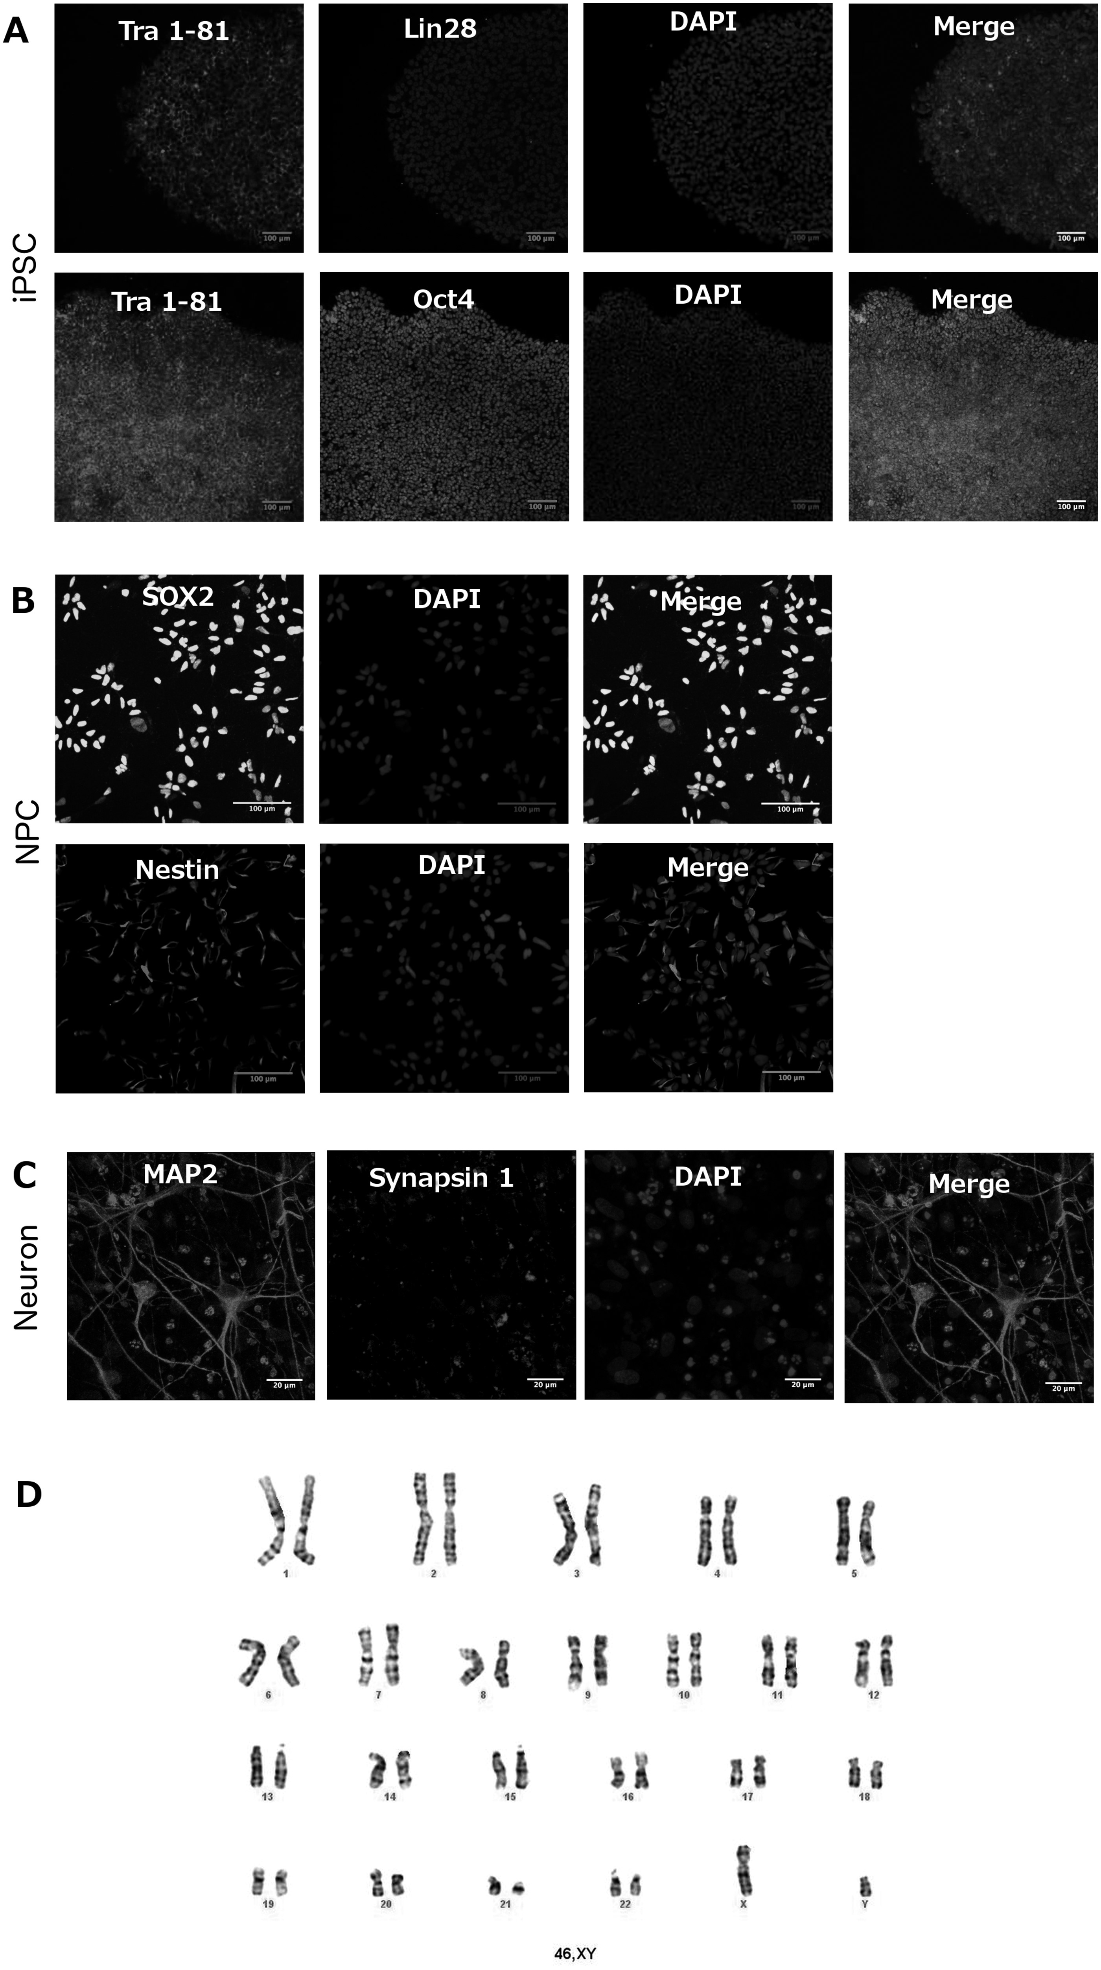
Figure 1 Cell characterization shows specific markers for each cell stage - iPSC, NPC and neurons – according to the ...
Notes:
Figure 1 Cell characterization shows specific markers for each cell stage - iPSC, NPC and neurons – according to the cell type, chromosome number matches with normal karyotyping. (A) Immunofluorescence images of induced Pluripotent Stem Cells (iPSC) showing the expression of specific markers for this type of cell after approximately 5–6 days of colony passage. Top: Tra 1-81, Lin28, DAPI and Merge. Bottom: Tra 1-81, Oct4, DAPI and, Merge. Scale bar = 100 μm. (B) Immunofluorescence images of Neural Progenitor Cells (NPC) expressing specific markers for this type of cell after confluence of approximately 50%. Top: SOX2, DAPI and Merge. Bottom: Nestin – NES, DAPI and, Merge. Scale bar = 100 μm. (C) Immunofluorescence images of Neurons showing the expression of specific markers for this type of cell after six weeks of induced differentiation. Synapsin 1, MAP2, DAPI and, Merge. Scale bar = 20 μm. (D) Images representing cell karyotyping at NPC stage showing that the studied cells present normal chromosome number (46,XY) and that its origin is from male control and affected subjects. Banding method (resolution): G-Banding; number of cells counted: 20; number of cells karyotyped: 5.
Unless provided in the caption above, the following copyright applies to the content of this slide: © The Author 2016. Published by Oxford University Press. All rights reserved. For Permissions, please email: journals.permissions@oup.com

Slide 2
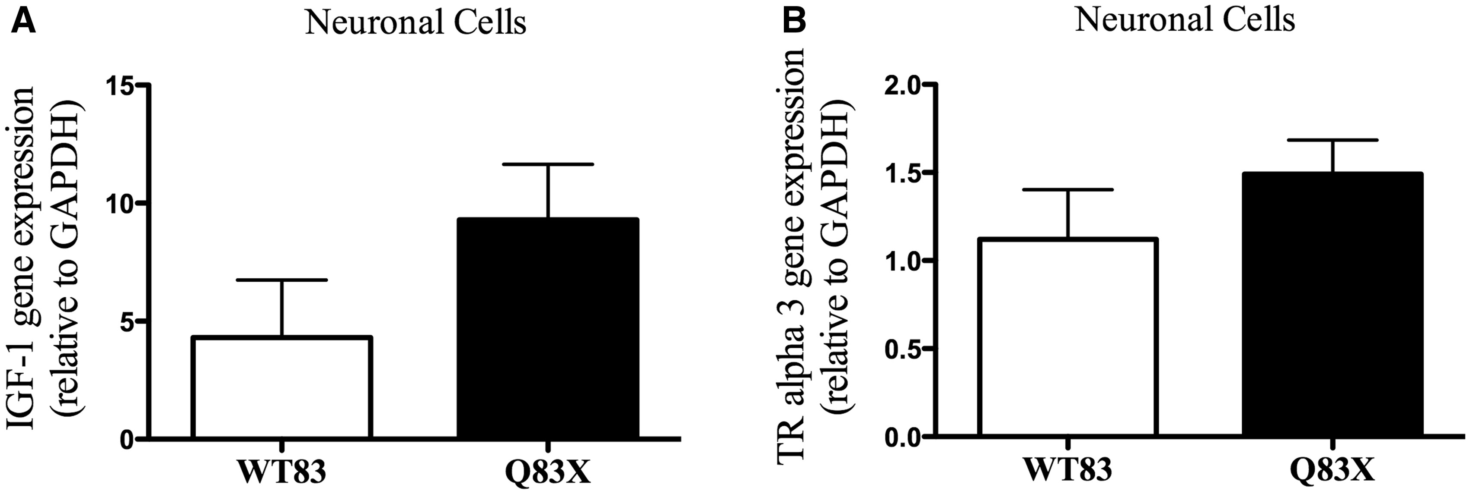
Figure 2 IGF1 and TRalpha3 gene expression do not change in Rett Syndrome affected subject compared to control. (A) ...
Notes:
Figure 2 IGF1 and TRalpha3 gene expression do not change in Rett Syndrome affected subject compared to control. (A) Graphic representation of IGF1 gene expression on stage of neural cells. There is no significant change in Rett Syndrome subject (Q83X) IGF1 gene expression compared to control (WT83). P = 0.1981 (n = 5–9). (B) Graphic representation of TRalpha3 gene expression on stage of neural cells. There is no significant change in Rett Syndrome subject (Q83X) TRalpha3 gene expression compared to control (WT83). P = 0.2863 (n = 5–9). All graphical data are ± SEM. Unpaired t test with equal SD.
Unless provided in the caption above, the following copyright applies to the content of this slide: © The Author 2016. Published by Oxford University Press. All rights reserved. For Permissions, please email: journals.permissions@oup.com

Slide 3
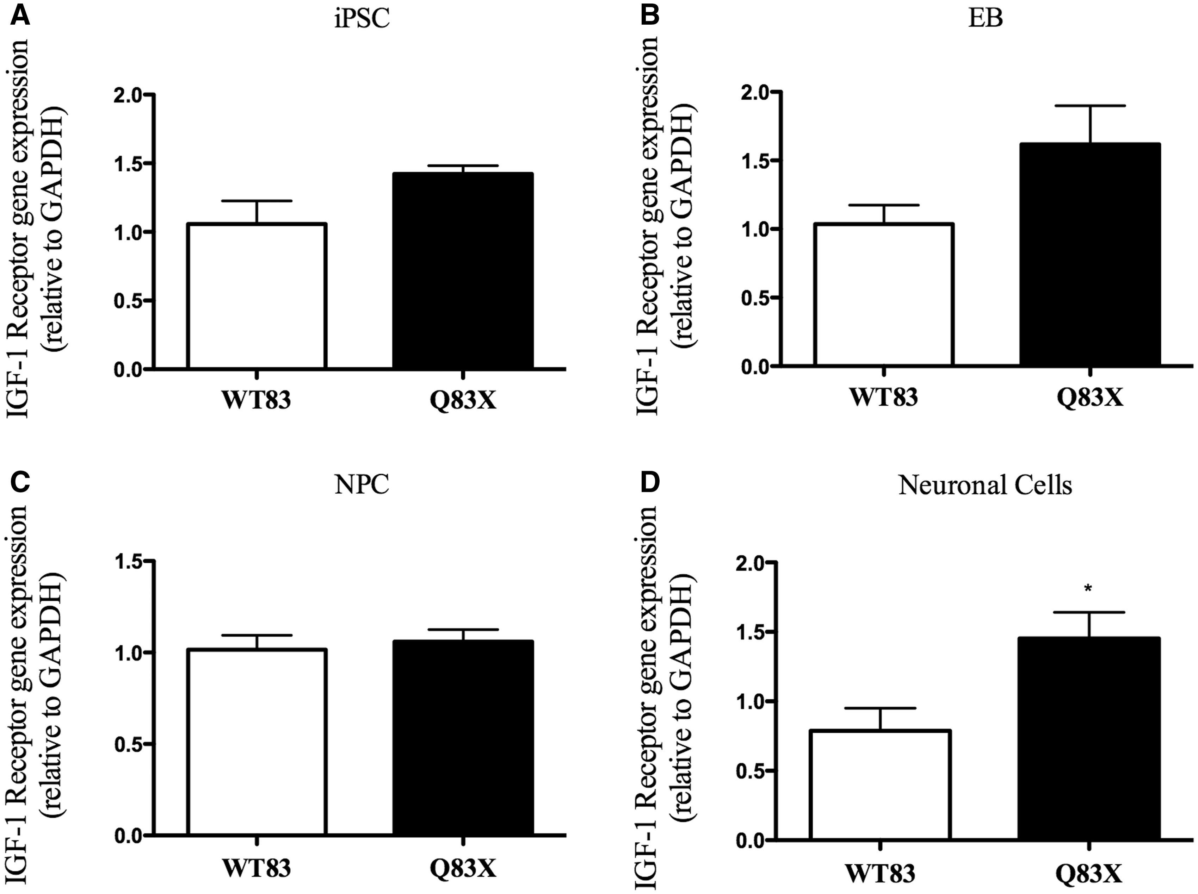
Figure 3 IGF1 receptor gene expression is increased in Rett Syndrome at neural cell stage. (A) Graphic representation ...
Notes:
Figure 3 IGF1 receptor gene expression is increased in Rett Syndrome at neural cell stage. (A) Graphic representation of IGF1 receptor gene expression in iPSC. There is no significant change in gene expression in Q83X compared to WT83. P = 0.0680 (n = 6). (B) Graphic representation of IGF1 receptor gene expression in Embryoid Body (EB). There is no significant change in gene expression in Q83X compared to WT83. P = 0.1350 (n = 6–9). (C) Graphic representation of IGF1 receptor gene expression in Neural Progenitor Cells (NPC). There is no significant change in gene expression in Q83X compared to WT83. P = 0.6957 (n = 6–12). (D) Graphic representation of IGF1 receptor gene expression in neural cells. At this stage of cell differentiation IGF1 receptor is increased in Rett Syndrome (Q83X) compared to control (WT83). *P < 0.05 (n = 5–9). All graphical data are ± SEM. Unpaired t test with equal SD of IGF1 Receptor.
Unless provided in the caption above, the following copyright applies to the content of this slide: © The Author 2016. Published by Oxford University Press. All rights reserved. For Permissions, please email: journals.permissions@oup.com

Slide 4
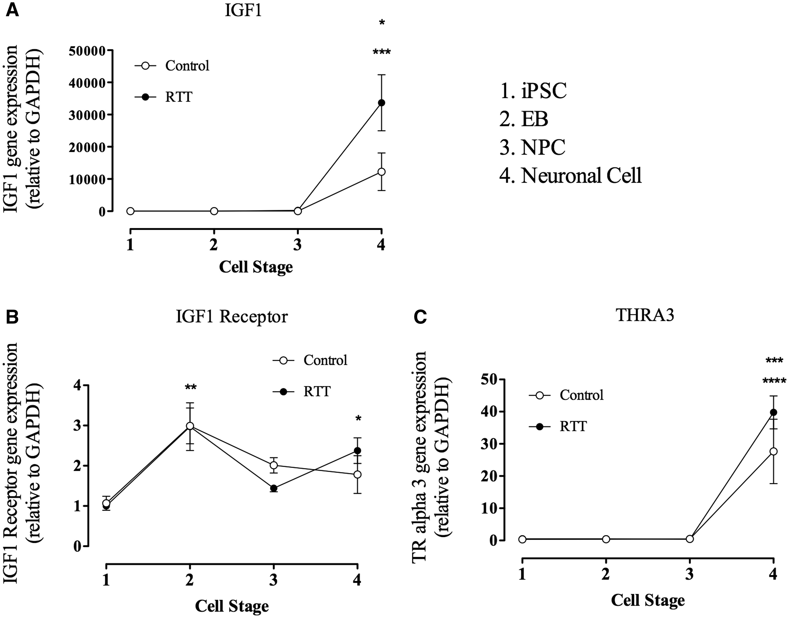
Figure 4 IGF 1 receptor gene expression is presented during all cell differentiation, since iPSC until Neural cells, ...
Notes:
Figure 4 IGF 1 receptor gene expression is presented during all cell differentiation, since iPSC until Neural cells, while IGF 1 gene expression occurs only during neural mature cell which may be related with TRalpha3 expression. (A) Graphic representation of IGF 1 gene expression from iPSC until neural cells. The graphic is representing control (WT83) and Rett Synrome (RTT) gene expression. Data shown as mean ± SEM (n = 5–12). (open circle) *P = 0,0141 vs. all; (closed circle) ***P < 0.0001 vs. all. (B) Graphic representation of IGF 1 receptor gene expression from iPSC until neural cells. The graphic is representing control (WT83) and Rett Synrome (RTT) gene expression. Data shown as mean ± SEM (n = 5–12). (open circle) **P = 0.0053 vs. iPSC; (closed circle) **P = 0.0007 vs. iPSC and NPC, *P < 0.05 vs. iPSC. (C) Graphic representation of TRalpha3 gene expression from iPSC until neural cells. The graphic is representing control (WT83) and Rett Synrome (RTT) gene expression. Data shown as mean ± SEM (n = 5–12). (open circle) **P = 0.0018 vs. all; (closed circle) ***P < 0.0001 vs. all.
Unless provided in the caption above, the following copyright applies to the content of this slide: © The Author 2016. Published by Oxford University Press. All rights reserved. For Permissions, please email: journals.permissions@oup.com

Slide 5
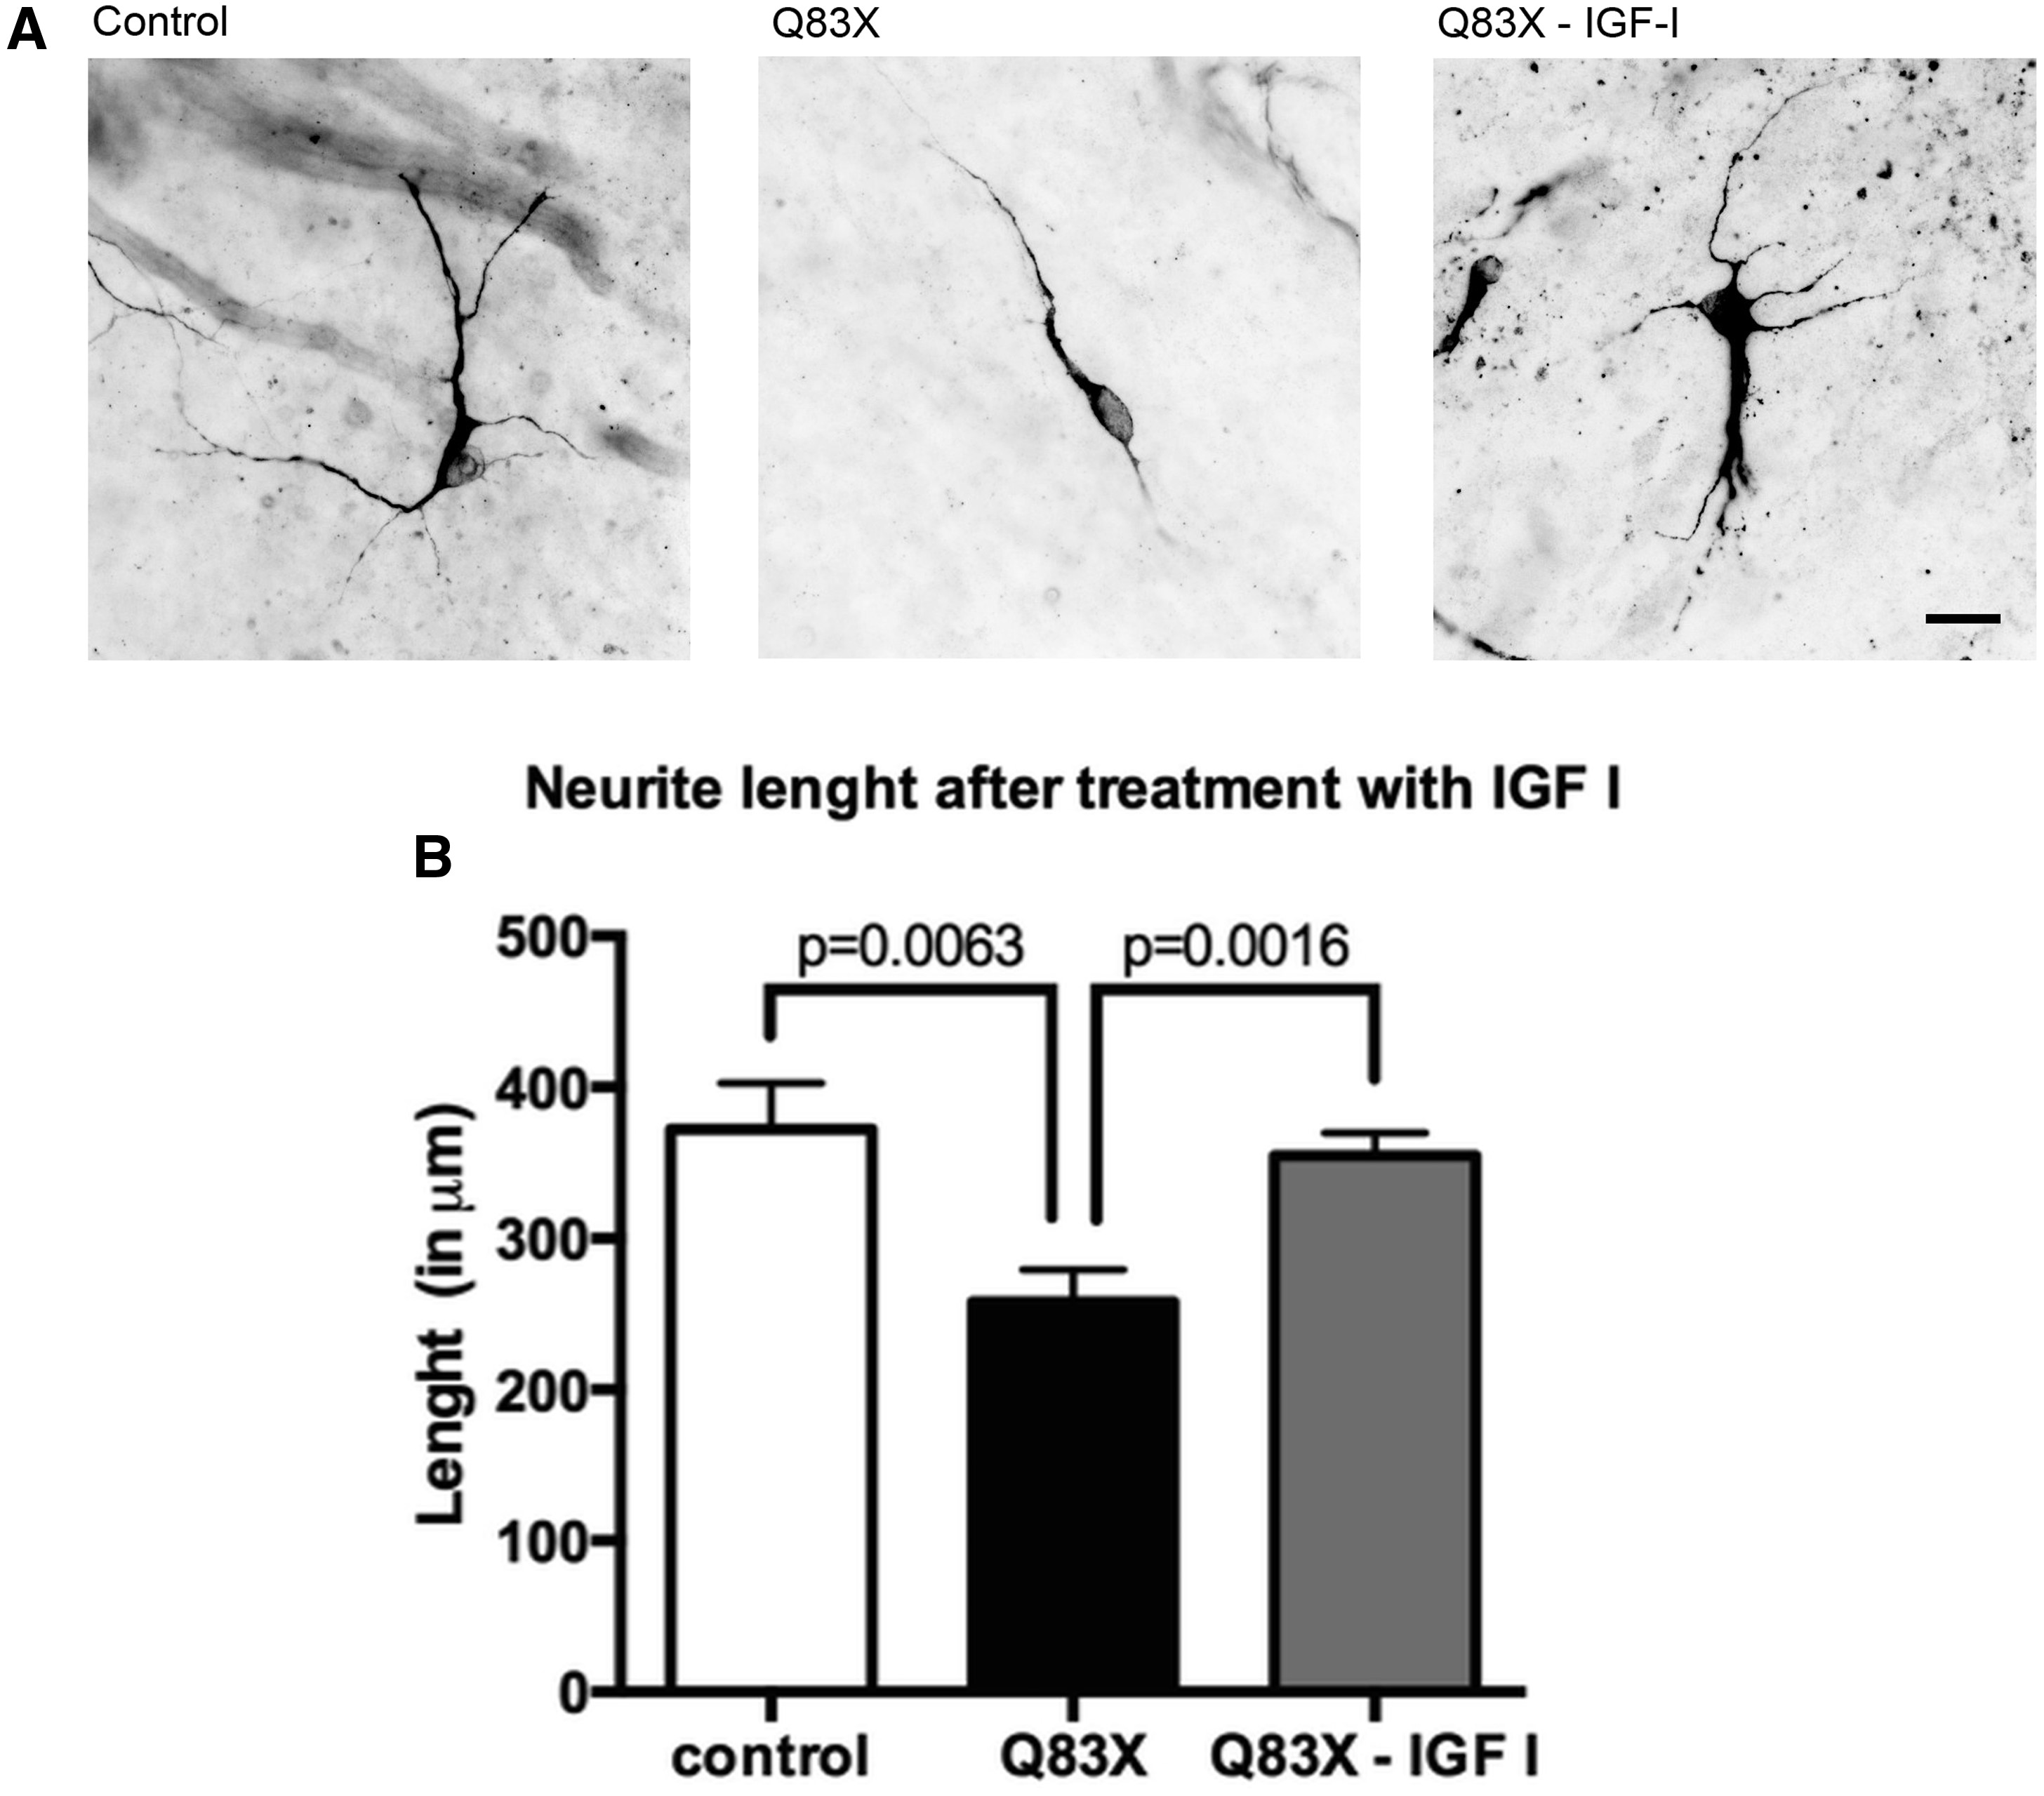
Figure 5 Rett Syndrome neurons treated with IGF1 recover their neurite length compared to control and untreated cells. ...
Notes:
Figure 5 Rett Syndrome neurons treated with IGF1 recover their neurite length compared to control and untreated cells. (A) Representative images of neurites length of control cells, affected cells (Q83X) and affected cells treated with IGF1 (Q83X + IGF1). Neurons were stained with MAP2 ab and imaged under 40X Zeiss microscope. The scale bar represents 20 μm. Tracing in NeuronJ (ImageJ). (B) Graphic representation of neurite length in each condition tested. Total length sum (in μm) of primary and secondary neurites are shown. S.E.M. was used to plot the error bar. 4 weeks neurons (n = 10).
Unless provided in the caption above, the following copyright applies to the content of this slide: © The Author 2016. Published by Oxford University Press. All rights reserved. For Permissions, please email: journals.permissions@oup.com

Slide 6
Figure 6 Thyroid hormone receptors gene expression is altered in RTT. (A–C) Graphic representation of gene expression ...
Notes:
Figure 6 Thyroid hormone receptors gene expression is altered in RTT. (A–C) Graphic representation of gene expression of Thyroid Hormone Receptors in iPSC (THRB2) and EB (THRA1 and RXRG) compared control and RTT cells. *P < 0.05 vs. control. Values are the mean ± SEM (n = 5–12).
Unless provided in the caption above, the following copyright applies to the content of this slide: © The Author 2016. Published by Oxford University Press. All rights reserved. For Permissions, please email: journals.permissions@oup.com

Slide 7
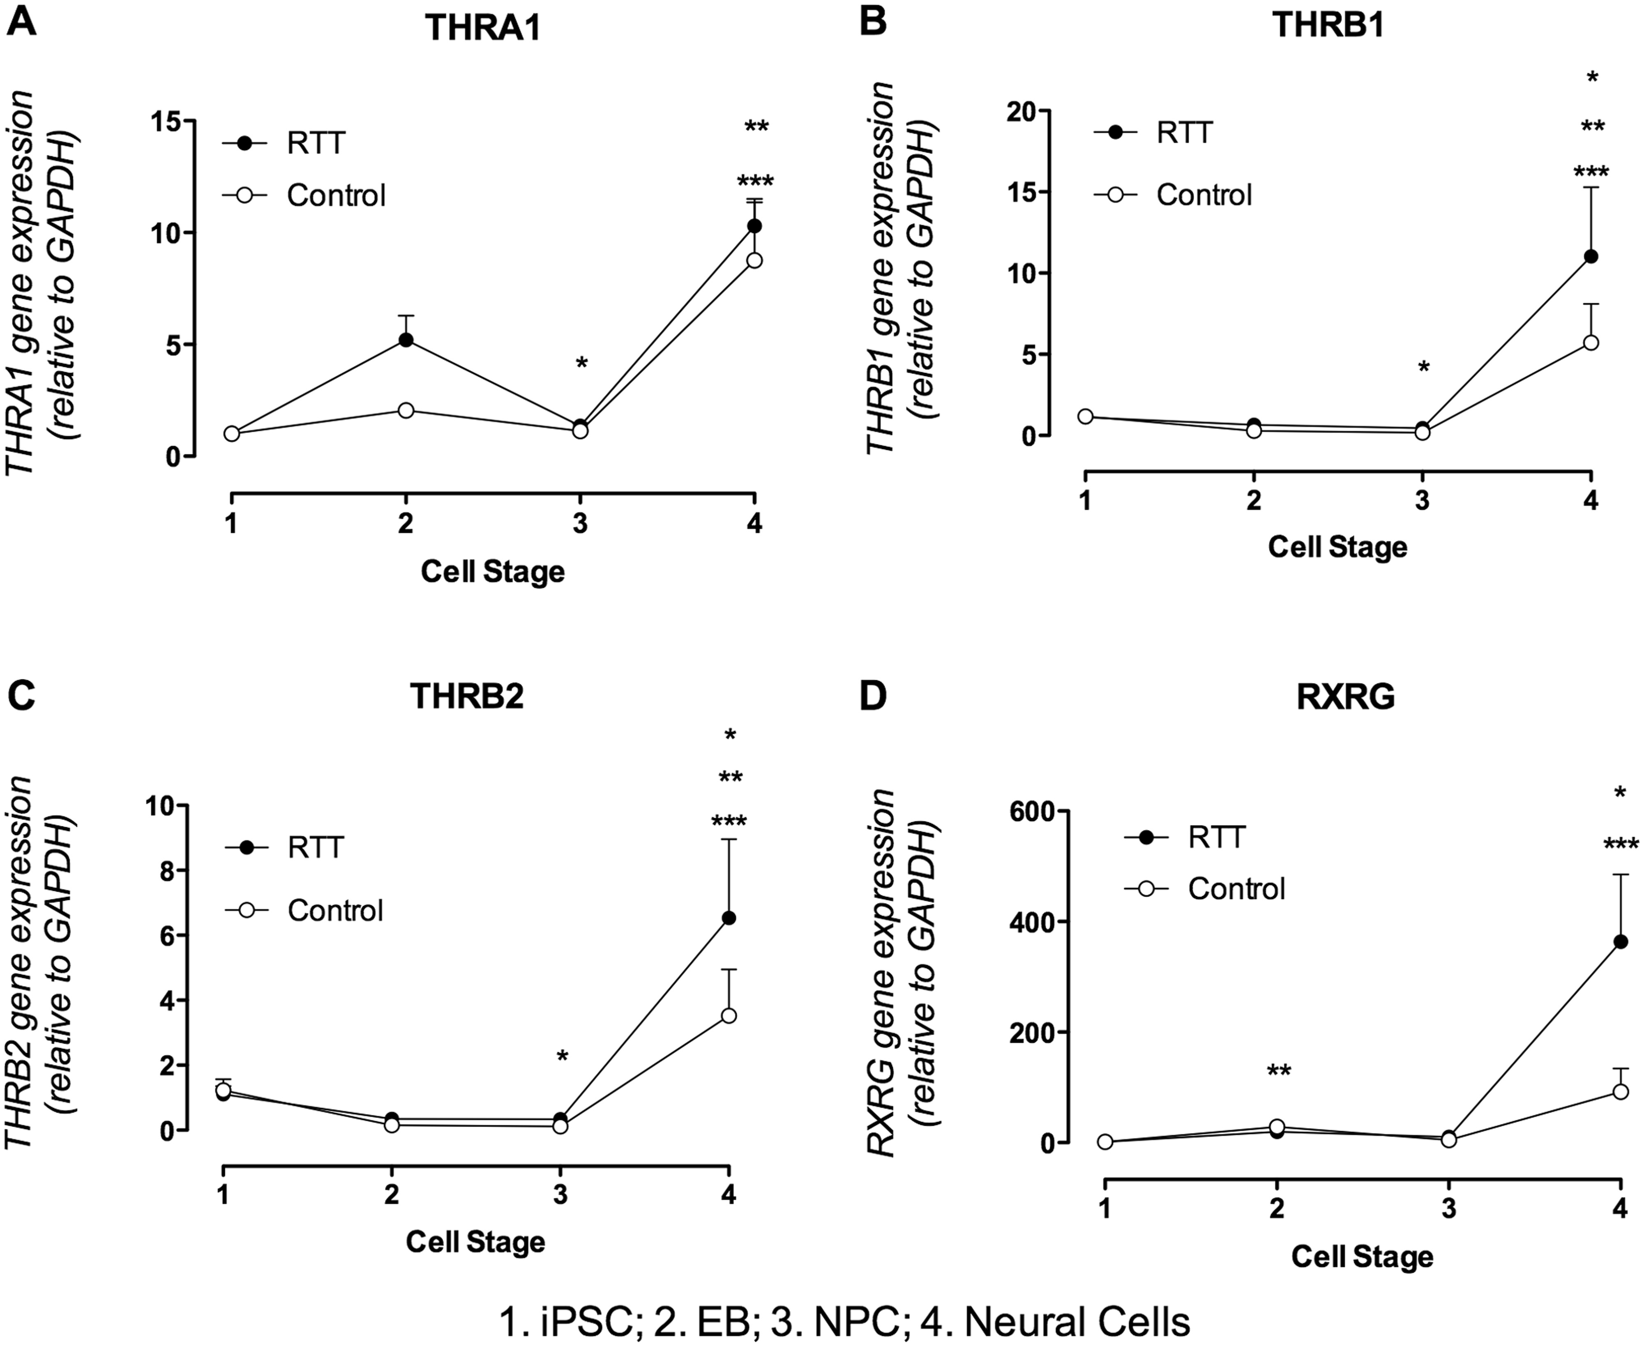
Figure 7 Thyroid hormone receptors gene expression profile. (A) Graphic representation of THRA1 gene expression during ...
Notes:
Figure 7 Thyroid hormone receptors gene expression profile. (A) Graphic representation of THRA1 gene expression during cell differentiation. There are significant changes in gene expression during differentiation of control cells (open circle) and RTT derived cells (filled circle). Control - **P < 0.01 vs. iPSC and NPC. RTT - ***P < 0.001 vs. iPSC and NPC; *P < 0.05 vs. EB. (B) Graphic representation of THRB1 gene expression during cell differentiation. There are significant changes in gene expression during differentiation of control cells (open circle) and RTT derived cells (filled circle). Control - **P < 0.01 vs. NPC; *P < 0.05 Neural cells vs. EB and NPC vs. iPSC. RTT - ***P < 0.001 vs. NPC; *P < 0.05 vs. EB. (C) Graphic representation of THRB2 gene expression during cell differentiation. There are significant changes in gene expression during differentiation of control cells (open circle) and RTT derived cells (filled circle). Control - **P < 0.001 vs. NPC; *P < 0.05 Neural cell vs. EB and NPC vs. iPSC. RTT - ***P < 0.001 vs. NPC; **P < 0.01 vs. EB. (D) Graphic representation of RXRG gene expression during cell differentiation. There are significant changes in gene expression during differentiation of control cells (open circle) and RTT derived cells (filled circle). Control - **P < 0.001 vs. iPSC; *P < 0.05 vs. iPSC. RTT - ***P < 0.001 vs. iPSC and NPC.
Unless provided in the caption above, the following copyright applies to the content of this slide: © The Author 2016. Published by Oxford University Press. All rights reserved. For Permissions, please email: journals.permissions@oup.com

