Slide 1
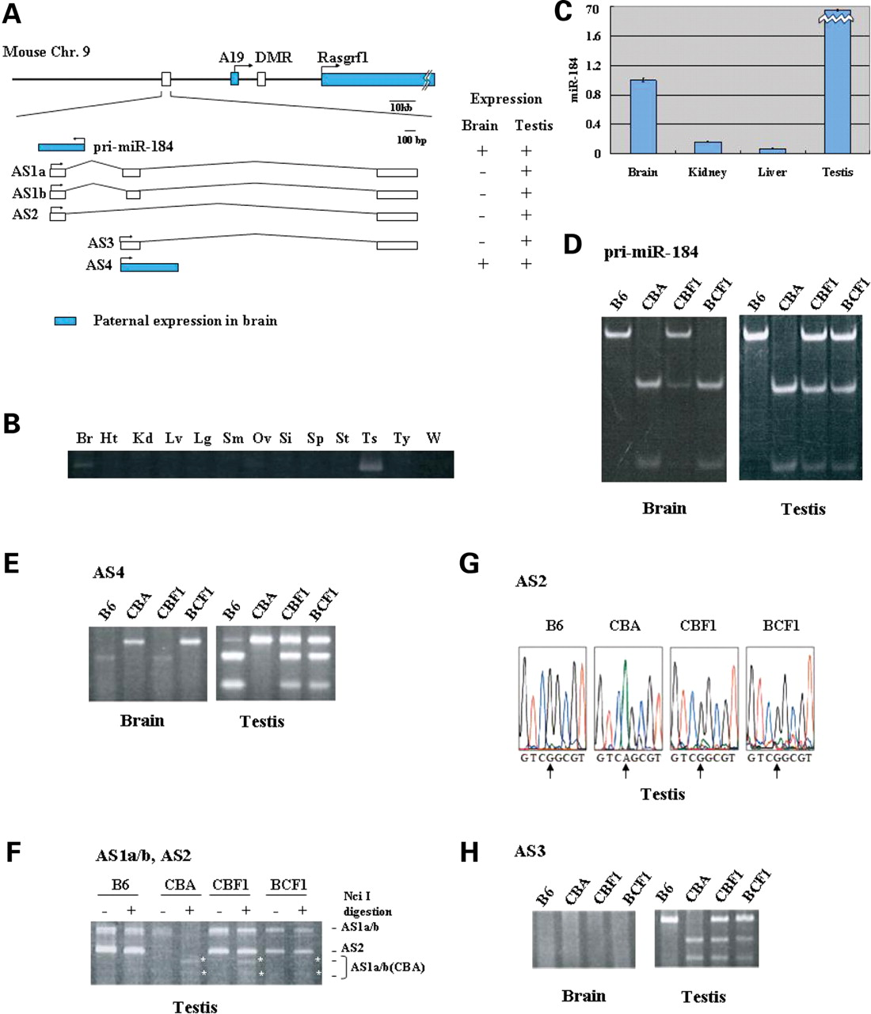
Figure 1. Brain-specific imprinting of the transcript encoding miR-184. (A) A map of around pri-miR-184 on mouse ...
Notes:
Figure 1. Brain-specific imprinting of the transcript encoding miR-184. (A) A map of around pri-miR-184 on mouse chromosome 9. The structures of the primary transcript of miR-184 and five alternative antisense transcripts are shown magnified. Brain-specific paternally expressed genes are indicated as blue boxes. (B) Expression of pri-miR-184 in several tissues. All RNAs were derived from the C57BL/6 strain. Lanes: Br, brain; Ht, heart; Kd, kidney; Lv, liver; Lg, lung; Sm, skeletal muscles; Ov, ovary; Si, small intestine; Sp, spleen; St, stomach; Ts, testis; Ty, thymus; W, water. (C) Expression of mature miR-184. All RNAs were obtained from C57BL/6 strain and were analyzed by TaqMan microRNA assays. Results shown are for the average of three experimental replicates and represented as fold changes relative to the expression in brain. Data are presented as mean ± SEM. (D) The paternal allele-specific expression of pri-miR-184 in brain and bi-allelic expression in testis. RT–PCR followed by RFLP analysis was performed for pri-miR-184 in adult brain and testis RNA from C57BL/6 (B6), CBA and reciprocally crossed F1 animals of these parental strains. RT–PCR products were treated with NciI and resolved by 12% PAGE. Only the CBA allele was cleaved with NciI. (E) The paternal allele-specific expression of AS4 in brain and bi-allelic expression in testis. RT–PCR was followed by digestion with BsaAI. Only the CBA allele was cleaved with BsaAI. (F) Bi-allelic expression of AS1a/b in testis. RT–PCR simultaneously amplified both AS1a/b and AS2. Digestion with NciI distinguished the CBA allele of AS1a/b from the B6 allele of AS1a/b and AS2. Asterisks indicate the cleaved products of AS1a and AS1b derived from the CBA allele. These transcripts were not expressed in brain (data not shown). (G) Strain-specific expression of AS2. Direct sequencing of AS2 was performed with the gel-purified RT–PCR products of CBF1 and BCF1. The sequences from genomic DNA of C57BL/6 (B6) and CBA are shown as controls. The polymorphic site is indicated by arrows. (H) Bi-allelic expression of AS3 in testis. RT–PCR followed by digestion with NciI. Only the CBA allele can be cleaved with NciI.
Unless provided in the caption above, the following copyright applies to the content of this slide: © The Author 2008. Published by Oxford University Press. All rights reserved. For Permissions, please email: journals.permissions@oxfordjournals.org

Slide 2
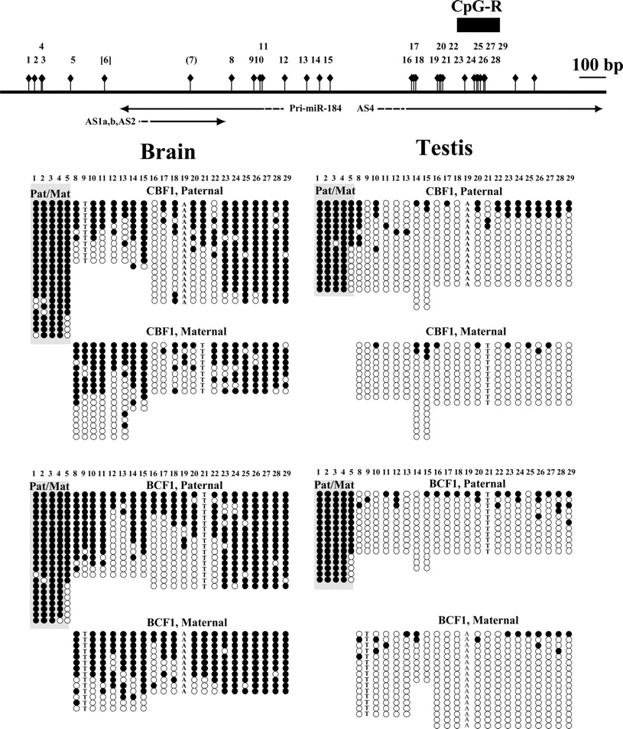
Figure 2. DNA methylation of miR-184 locus. DNA methylation status around the miR-184 locus. The methylation status of ...
Notes:
Figure 2. DNA methylation of miR-184 locus. DNA methylation status around the miR-184 locus. The methylation status of the 29 CpG sites (1–29) within a 1.5 kb region containing putative promoters for pri-miR-184 and antisense transcripts was assayed by bisulfite sequencing. Genomic DNA samples were extracted from adult brain and testis of BCF1 or CBF1 animals and subjected to a bisulfite sequencing analysis. Each clone was distinguished between the parental alleles by SNPs. But no SNPs were available for the amplified region, including the first to fifth CpG sites [shaded box with Pat (paternal allele)/Mat (maternal allele)]. Each row of circles represents the single cloned allele and each circle represents a single CpG site (open circle, non-methylated; filled circle, methylated).
Unless provided in the caption above, the following copyright applies to the content of this slide: © The Author 2008. Published by Oxford University Press. All rights reserved. For Permissions, please email: journals.permissions@oxfordjournals.org

Slide 3
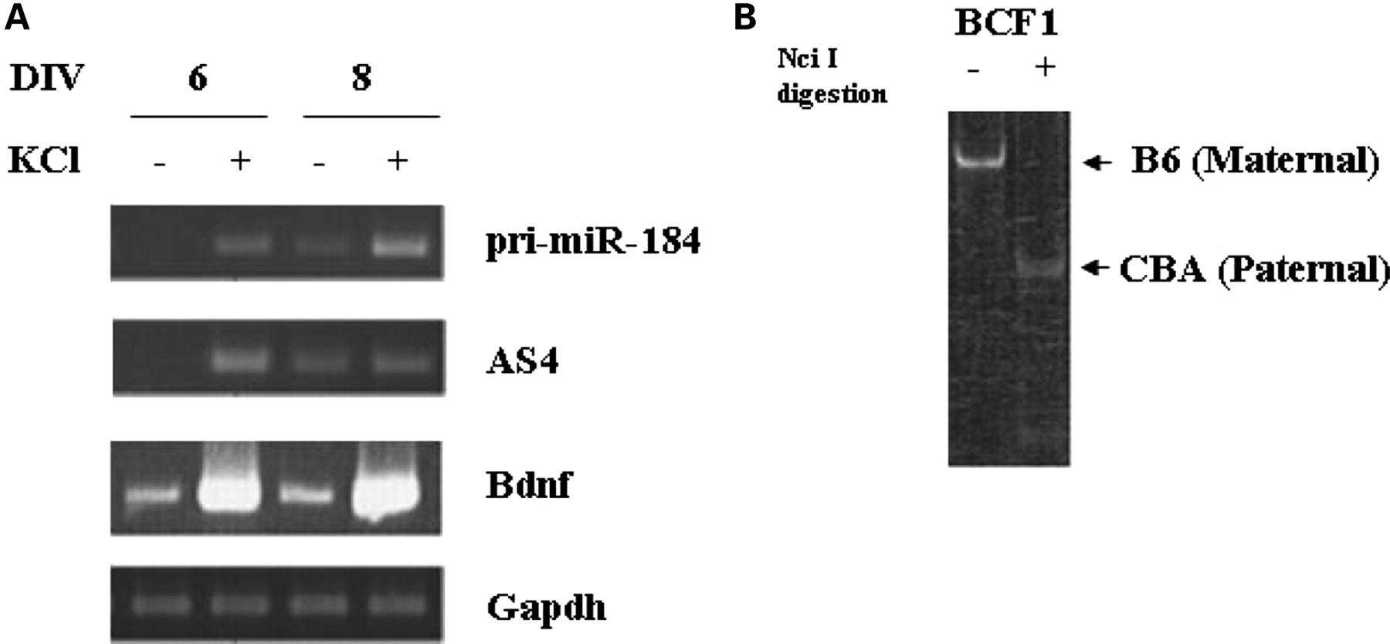
Figure 3. Activity-dependent expression in cultured neurons. (A) Cortical neurons from the brain of E16 C57BL/6 (B6) ...
Notes:
Figure 3. Activity-dependent expression in cultured neurons. (A) Cortical neurons from the brain of E16 C57BL/6 (B6) mice were cultured for the indicated periods in vitro (DIV). Membrane depolarization was caused by 50 mm KCl treatment for 4 h. Gapd was served as a control for quantification. (B) The paternal allele-specific upregulation of pri-miR-184 in BCF1 cortical neurons. RT–PCR was followed by digestion with NciI. Only the paternal CBA allele can be cleaved with NciI.
Unless provided in the caption above, the following copyright applies to the content of this slide: © The Author 2008. Published by Oxford University Press. All rights reserved. For Permissions, please email: journals.permissions@oxfordjournals.org

Slide 4
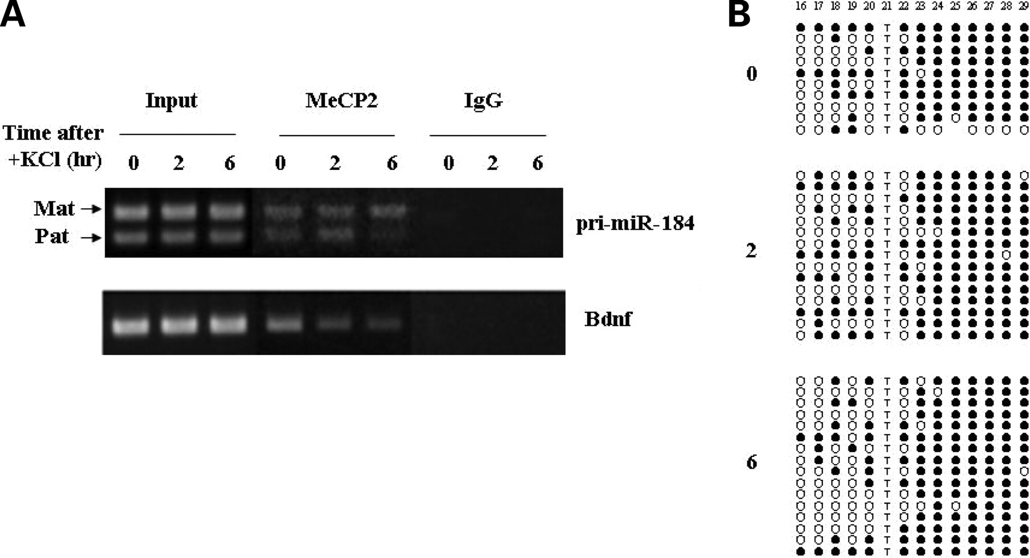
Figure 4. The paternal allele-specific activity-dependent release of MeCP2. (A) ChIP assays were performed using BCF1 ...
Notes:
Figure 4. The paternal allele-specific activity-dependent release of MeCP2. (A) ChIP assays were performed using BCF1 cortical neurons cultured with or without 50 mm KCl for 2 or 6 h. The miR-184 CpG-R and the Bdnf exon IV promoter were amplified from the immunoprecipitate with anti-MeCP2 antibody or control IgG. Mat indicates the maternal allele and Pat indicates the paternal allele. (B) CpG methylation patterns within the miR-184 locus with or without 50 mm KCl for 2 or 6 h. CpG methylation in miR-184 CpG-R was examined by bisulfite sequencing method.
Unless provided in the caption above, the following copyright applies to the content of this slide: © The Author 2008. Published by Oxford University Press. All rights reserved. For Permissions, please email: journals.permissions@oxfordjournals.org

Slide 5
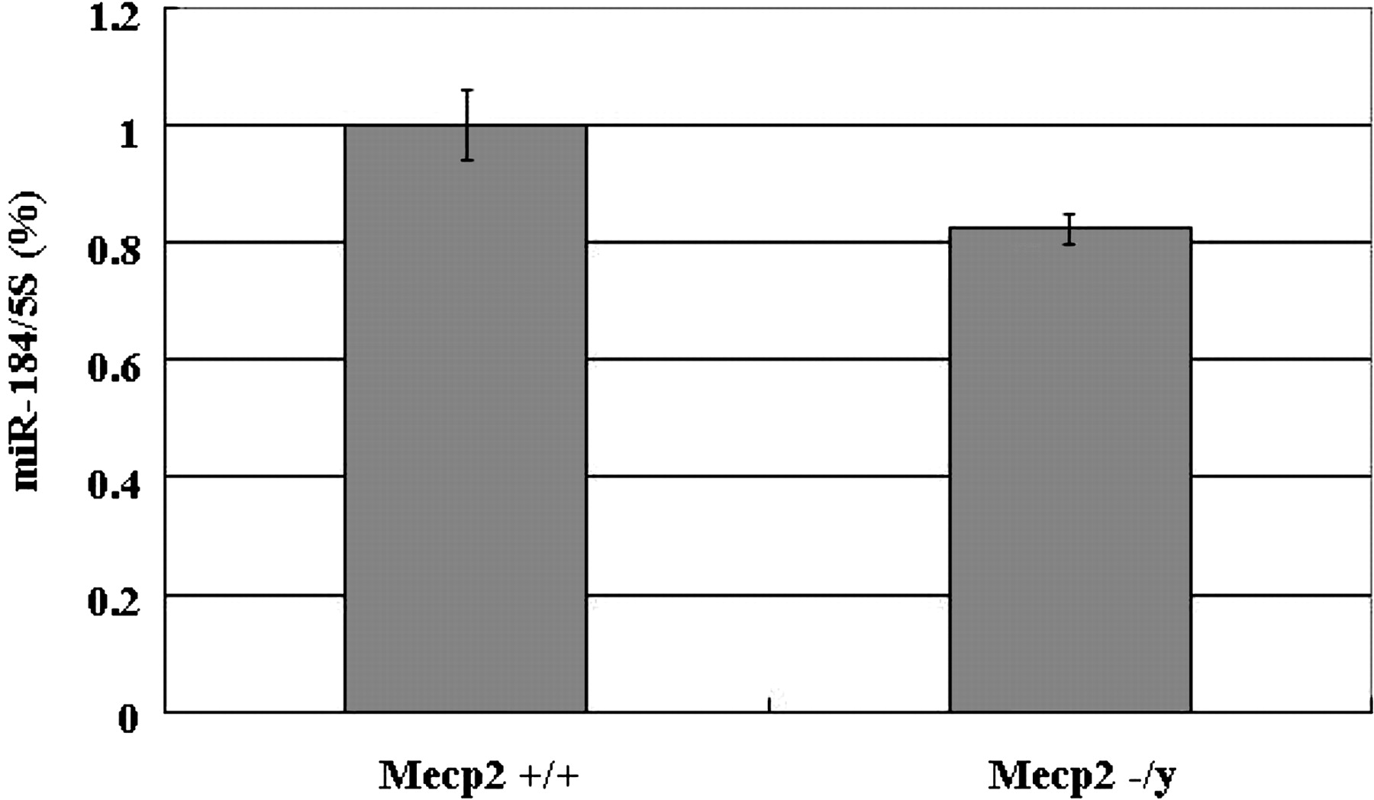
Figure 5. Expression of miR-184 in Mecp2-deficient mouse. TaqMan microRNA assays were performed on RNA samples obtained ...
Notes:
Figure 5. Expression of miR-184 in Mecp2-deficient mouse. TaqMan microRNA assays were performed on RNA samples obtained from 28-day-old Mecp2+/y and Mecp2−/y mice brains. Results shown are for the average of three experimental replicates of six Mecp2+/y and four Mecp2−/y mice. Expression is represented as fold changes relative to the expression in wild-type mice. Data are presented as mean ± SEM.
Unless provided in the caption above, the following copyright applies to the content of this slide: © The Author 2008. Published by Oxford University Press. All rights reserved. For Permissions, please email: journals.permissions@oxfordjournals.org

