Slide 1
Fig 1 Difficult Airway Society difficult intubation guidelines: overview. Difficult Airway Society, 2015, by ...
Notes:
Fig 1 Difficult Airway Society difficult intubation guidelines: overview. Difficult Airway Society, 2015, by permission of the Difficult Airway Society. This image is not covered by the terms of the Creative Commons Licence of this publication. For permission to re-use, please contact the Difficult Airway Society. CICO, can't intubate can't oxygenate; SAD, supraglottic airway device.
Unless provided in the caption above, the following copyright applies to the content of this slide: © The Author 2015. Published by Oxford University Press on behalf of the British Journal of Anaesthesia.This is an Open Access article distributed under the terms of the Creative Commons Attribution Non-Commercial License (http://creativecommons.org/licenses/by-nc/4.0/), which permits non-commercial re-use, distribution, and reproduction in any medium, provided the original work is properly cited. For commercial re-use, please contact journals.permissions@oup.com

Slide 2
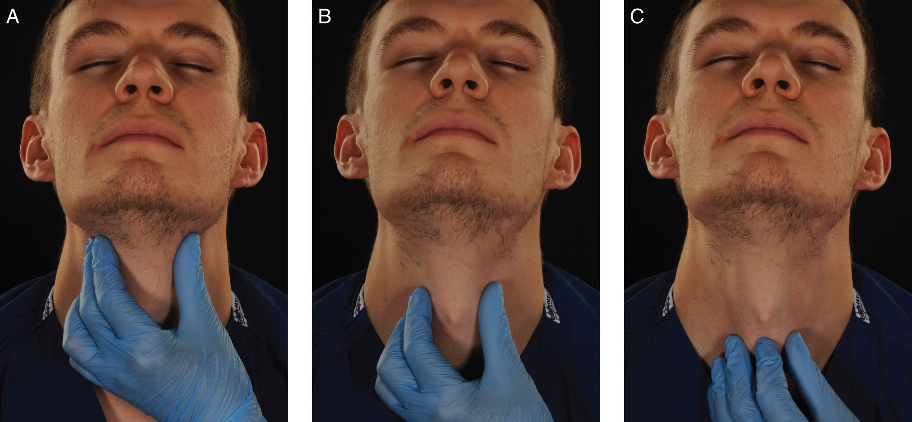
Fig 3 The laryngeal handshake. (a) The index finger and thumb grasp the top of the larynx (the greater cornu of the ...
Notes:
Fig 3 The laryngeal handshake. (a) The index finger and thumb grasp the top of the larynx (the greater cornu of the hyoid bone) and roll it from side to side. The bony and cartilaginous cage of the larynx is a cone, which connects to the trachea. (b) The fingers and thumb slide down over the thyroid laminae. (c) Middle finger and thumb rest on the cricoid cartilage, with the index finger palpating the cricothyroid membrane.
Unless provided in the caption above, the following copyright applies to the content of this slide: © The Author 2015. Published by Oxford University Press on behalf of the British Journal of Anaesthesia.This is an Open Access article distributed under the terms of the Creative Commons Attribution Non-Commercial License (http://creativecommons.org/licenses/by-nc/4.0/), which permits non-commercial re-use, distribution, and reproduction in any medium, provided the original work is properly cited. For commercial re-use, please contact journals.permissions@oup.com

Slide 3
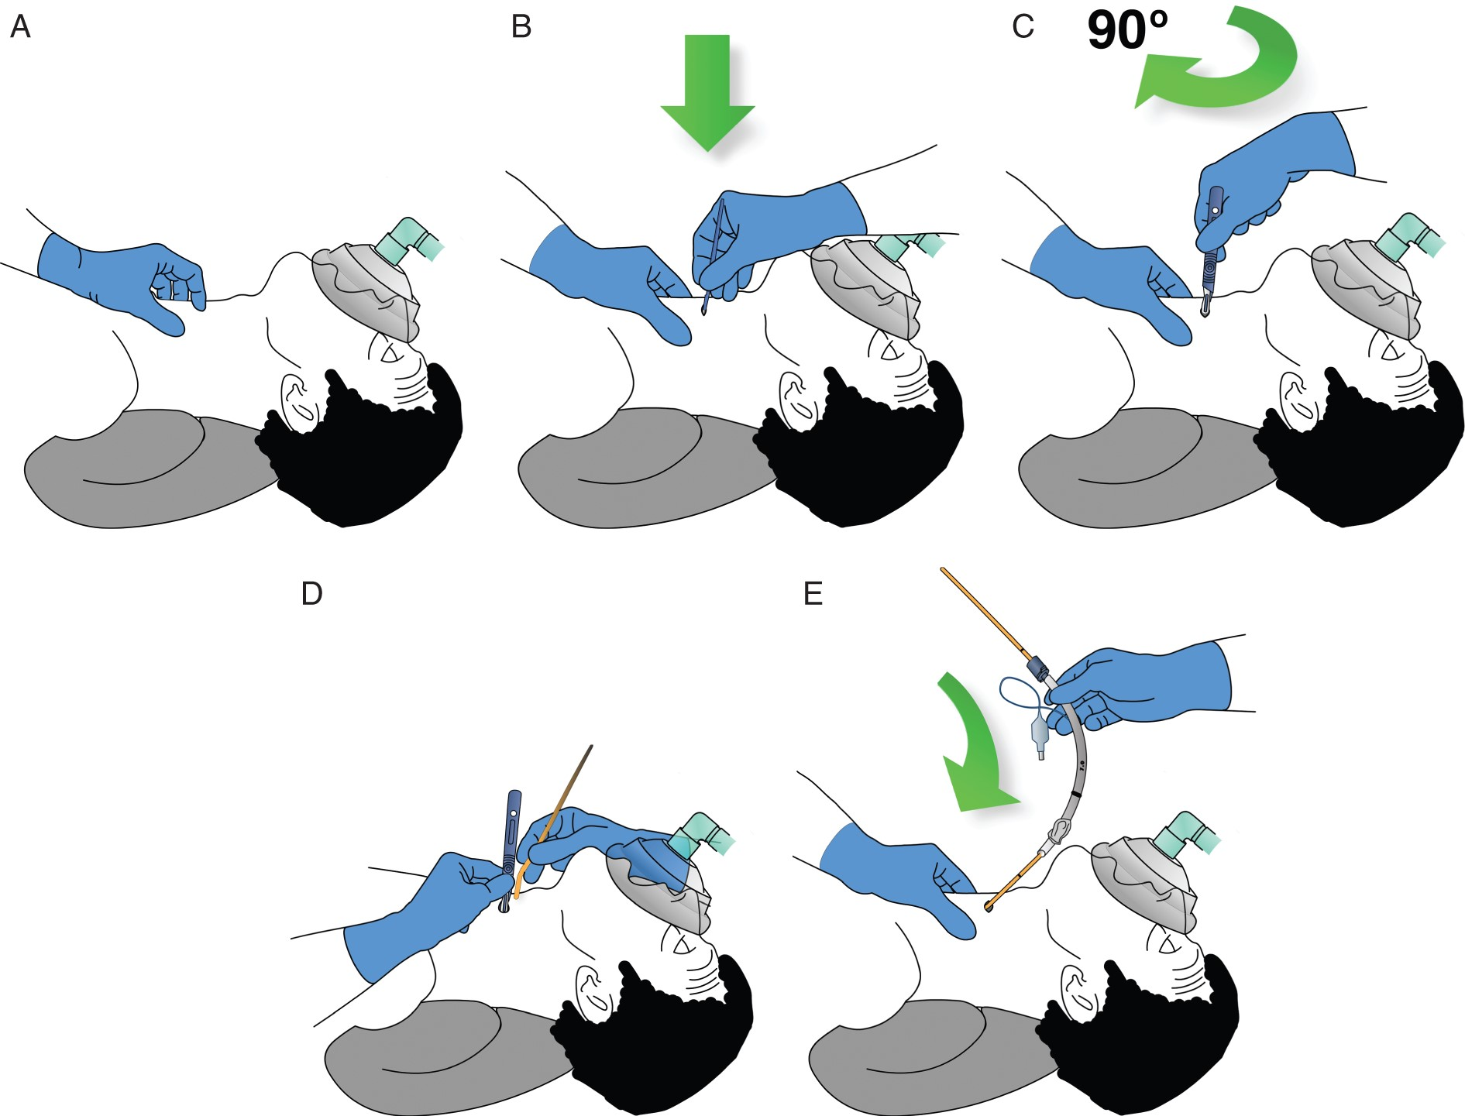
Fig 4 Cricothyroidotomy technique. Cricothyroid membrane palpable: scalpel technique; ‘stab, twist, bougie, tube’. ...
Notes:
Fig 4 Cricothyroidotomy technique. Cricothyroid membrane palpable: scalpel technique; ‘stab, twist, bougie, tube’. (a) Identify cricothyroid membrane. (b) Make transverse stab incision through cricothyroid membrane. (c) Rotate scalpel so that sharp edge points caudally. (d) Pulling scalpel towards you to open up the incision, slide coude tip of bougie down scalpel blade into trachea. (e) Railroad tube into trachea.
Unless provided in the caption above, the following copyright applies to the content of this slide: © The Author 2015. Published by Oxford University Press on behalf of the British Journal of Anaesthesia.This is an Open Access article distributed under the terms of the Creative Commons Attribution Non-Commercial License (http://creativecommons.org/licenses/by-nc/4.0/), which permits non-commercial re-use, distribution, and reproduction in any medium, provided the original work is properly cited. For commercial re-use, please contact journals.permissions@oup.com

Slide 4
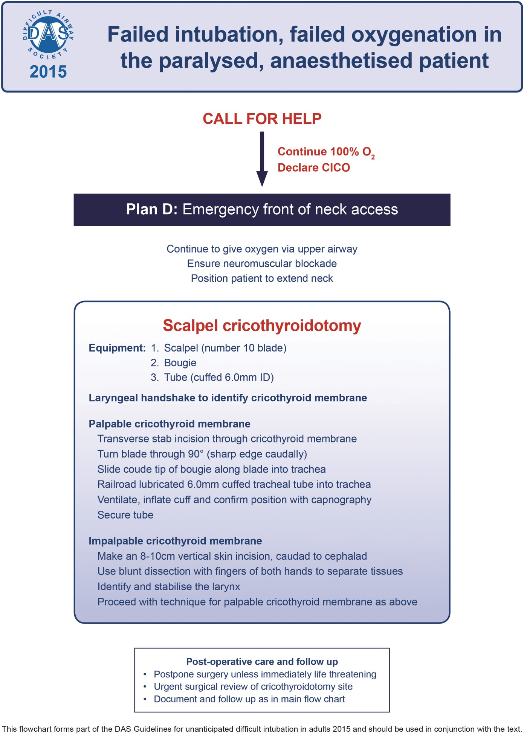
Fig 5 Failed intubation, failed oxygenation in the paralysed, anaesthetized patient. Technique for scalpel ...
Notes:
Fig 5 Failed intubation, failed oxygenation in the paralysed, anaesthetized patient. Technique for scalpel cricothyroidotomy. Difficult Airway Society, 2015, by permission of the Difficult Airway Society. This image is not covered by the terms of the Creative Commons Licence of this publication. For permission to re-use, please contact the Difficult Airway Society.
Unless provided in the caption above, the following copyright applies to the content of this slide: © The Author 2015. Published by Oxford University Press on behalf of the British Journal of Anaesthesia.This is an Open Access article distributed under the terms of the Creative Commons Attribution Non-Commercial License (http://creativecommons.org/licenses/by-nc/4.0/), which permits non-commercial re-use, distribution, and reproduction in any medium, provided the original work is properly cited. For commercial re-use, please contact journals.permissions@oup.com

