Slide 1
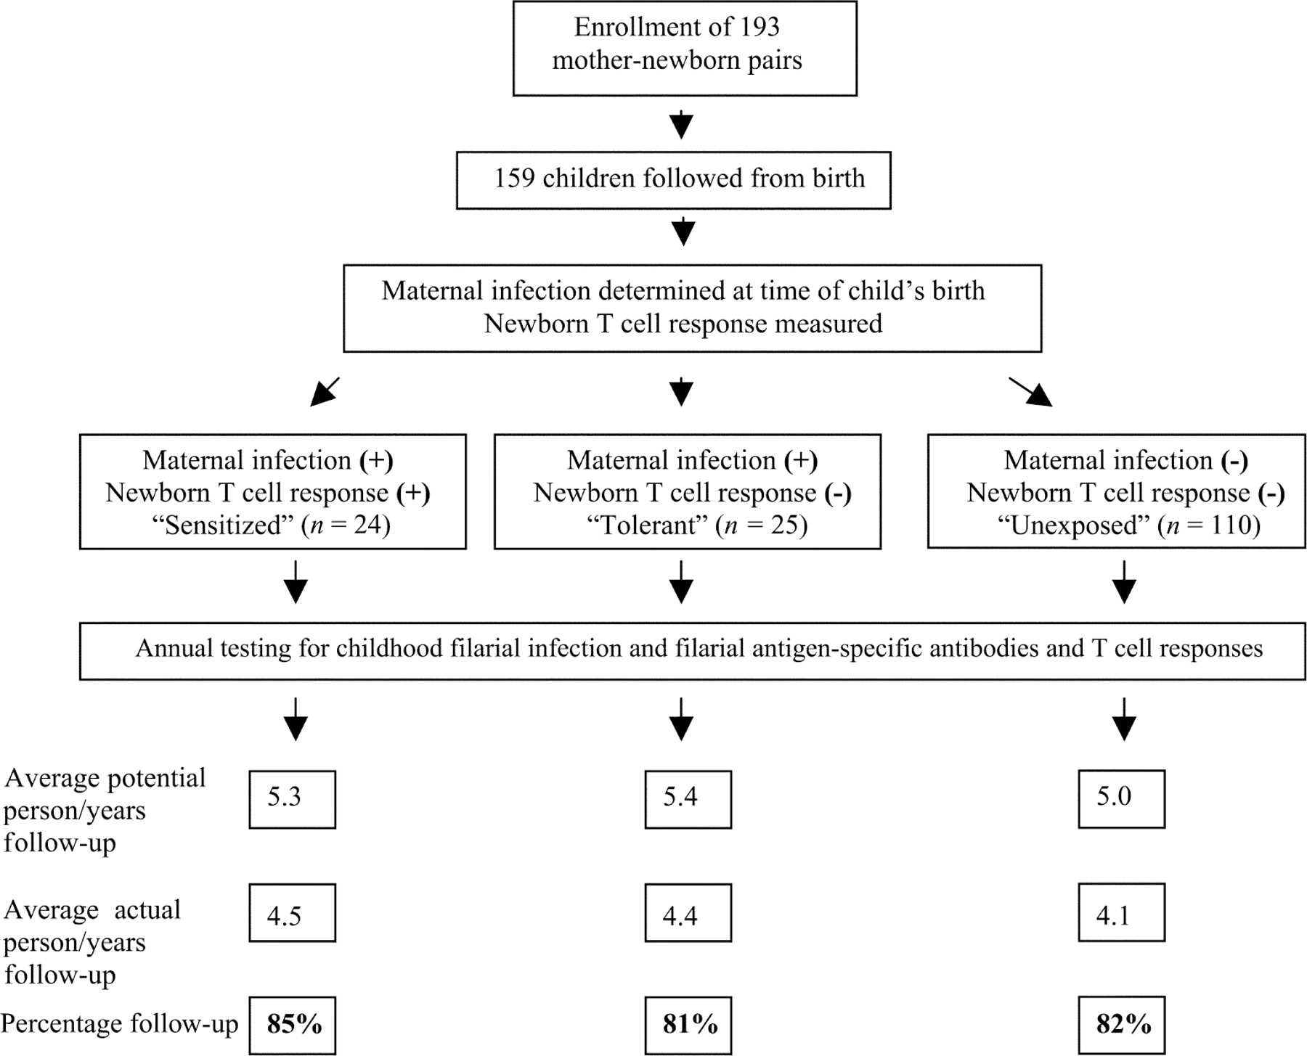
Figure 1 Study design of newborn cohort followed for time to filarial infection
Notes:
Figure 1 Study design of newborn cohort followed for time to filarial infection
Unless provided in the caption above, the following copyright applies to the content of this slide: © 2006 by the Infectious Diseases Society of America

Slide 2
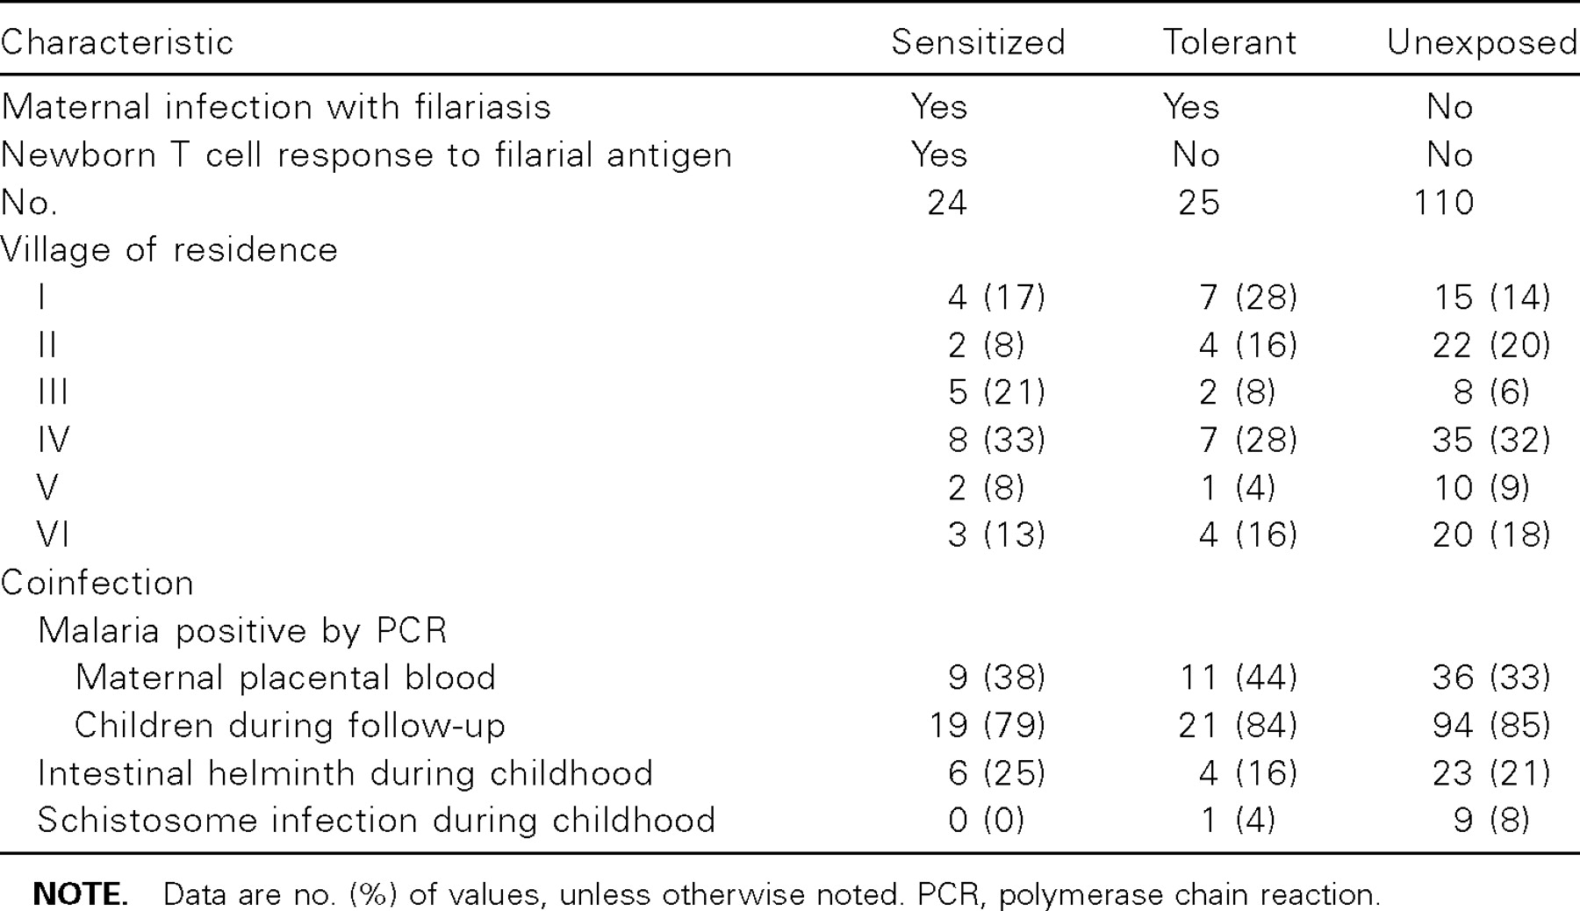
Table 1 Characteristics of the newborn cohort, grouped according to maternal infection status and cord blood T cell ...
Notes:
Table 1 Characteristics of the newborn cohort, grouped according to maternal infection status and cord blood T cell cytokine response to filarial antigen
Unless provided in the caption above, the following copyright applies to the content of this slide: © 2006 by the Infectious Diseases Society of America

Slide 3
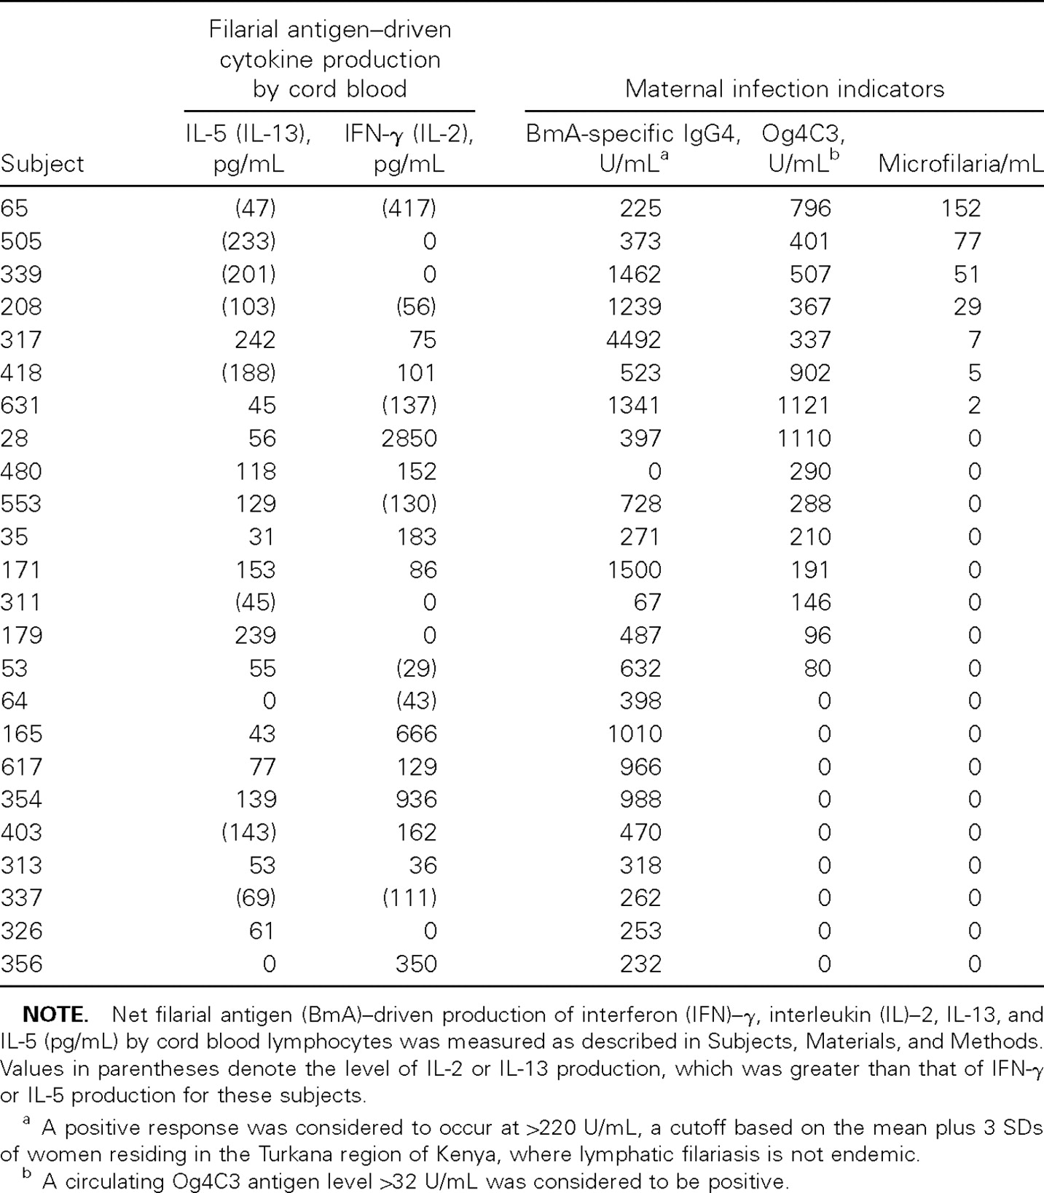
Table 2 Filarial antigen–driven cytokine production by T cells of newborns with evidence of in utero sensitization to ...
Notes:
Table 2 Filarial antigen–driven cytokine production by T cells of newborns with evidence of in utero sensitization to Wuchereria bancrofti
Unless provided in the caption above, the following copyright applies to the content of this slide: © 2006 by the Infectious Diseases Society of America

Slide 4
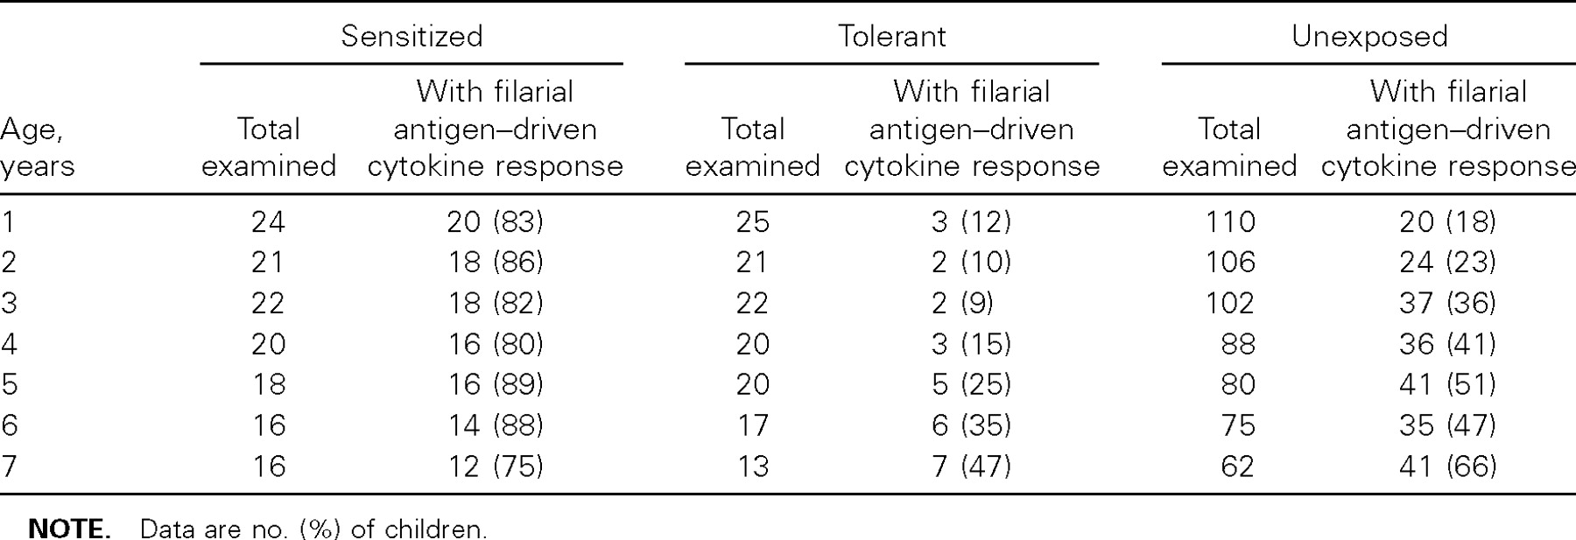
Table 3 Filarial antigen–driven cytokine responses at ages 1 year to 7 years, in children classified at birth as ...
Notes:
Table 3 Filarial antigen–driven cytokine responses at ages 1 year to 7 years, in children classified at birth as sensitized, tolerant, or unexposed (no active maternal filarial infection during gestation)
Unless provided in the caption above, the following copyright applies to the content of this slide: © 2006 by the Infectious Diseases Society of America

Slide 5
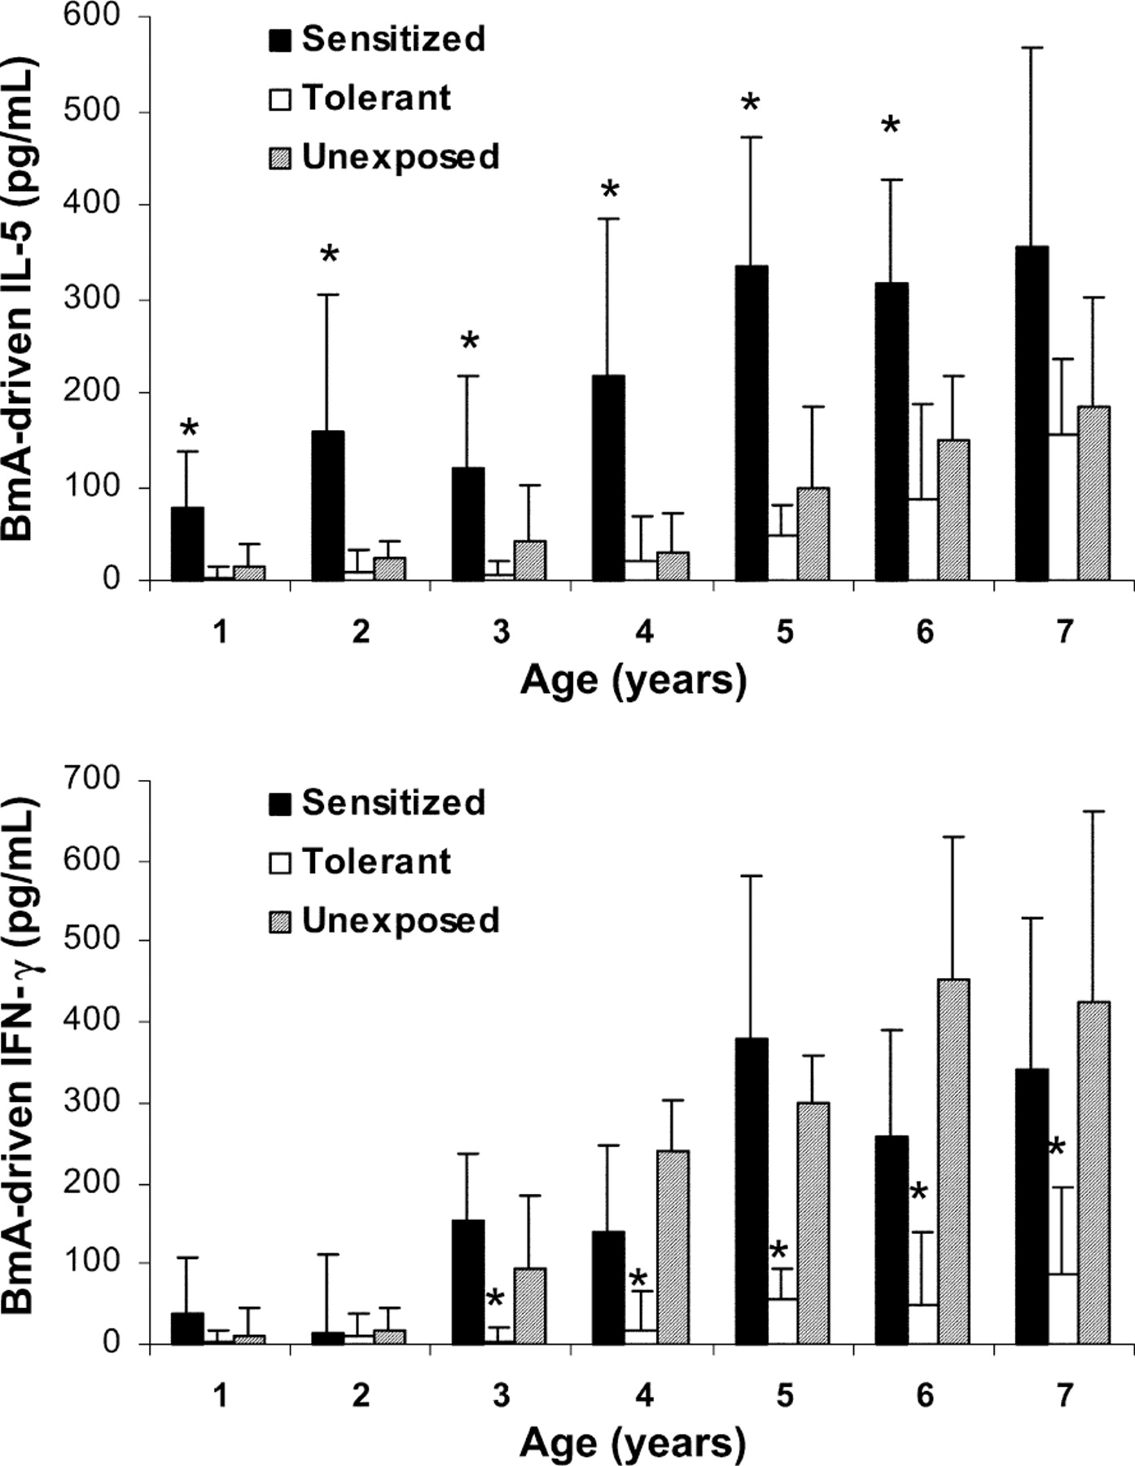
Figure 2 Age-related filarial antigen–driven interleukin (IL)–5 and interferon (IFN)–γ production by peripheral blood ...
Notes:
Figure 2 Age-related filarial antigen–driven interleukin (IL)–5 and interferon (IFN)–γ production by peripheral blood mononuclear cells from children with evidence of in utero sensitization, tolerance, or neither (unexposed). Peak levels of IL-5 (upper panel) and IFN-γ (lower panel) are shown for 2×106 cells cultured with filarial antigen (BmA) at 48 or 96 h. Bars represent net geometric mean cytokine production (cell cultures with antigen minus media alone) ± SE. Asterisks indicate significant differences (P<.05, Mann-Whitney U test) between the sensitized group and either the tolerant group or the unexposed group (upper panel) and between the tolerant group and either the sensitized group or the unexposed group (lower panel)
Unless provided in the caption above, the following copyright applies to the content of this slide: © 2006 by the Infectious Diseases Society of America

Slide 6
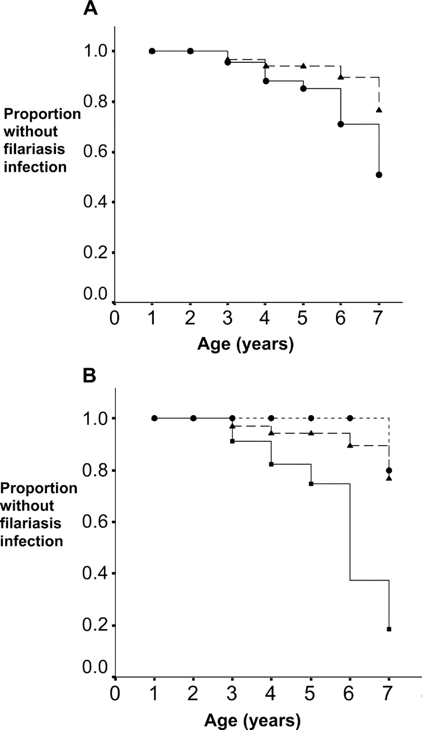
Figure 3 Kaplan-Meier time-to-infection survival curves for children of filarial-infected mothers (solid line) vs. ...
Notes:
Figure 3 Kaplan-Meier time-to-infection survival curves for children of filarial-infected mothers (solid line) vs. children of uninfected mothers (dashed line) (A) and children with evidence of in utero sensitization (dotted line) in utero tolerance (solid line) or neither (unexposed; dashed line) (B). Time to infection for the 2 groups in panel A did not differ (χ2=2.55 [1 df]; hazard ratio, 0.941 [95% confidence interval, 0.495–1.813]). The difference in time to infection among the 3 groups in panel B was significant (P<.0001), as was the comparison between children with evidence of in utero sensitization and those with in utero tolerance (P<.001) and between children with in utero tolerance and those who were unexposed (P.10)
Unless provided in the caption above, the following copyright applies to the content of this slide: © 2006 by the Infectious Diseases Society of America

