Slide 1
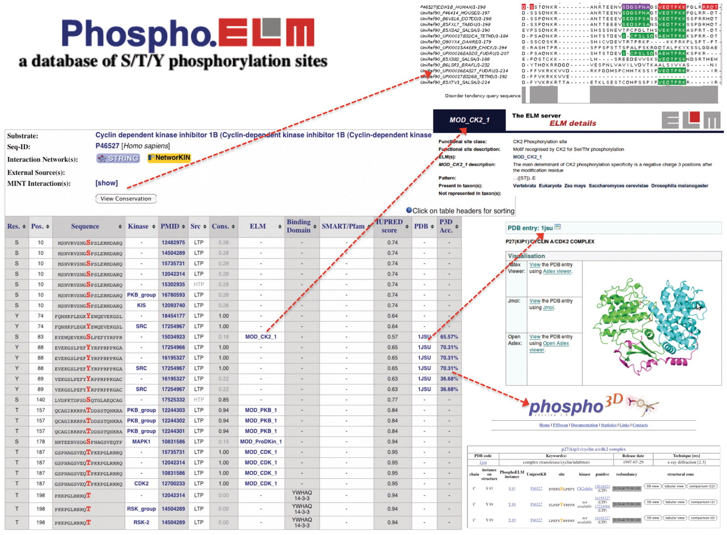
Figure 1. Output example of a Phospho.ELM search using the Cyclin dependent kinase inhibitor 1B (UniProt P46527) as ...
Notes:
Figure 1. Output example of a Phospho.ELM search using the Cyclin dependent kinase inhibitor 1B (UniProt P46527) as query. The results table contains: the phosphorylated residue and its position; surrounding sequence; kinase responsible for the phosphorylation; literature reference; type of source (HTP/LTP); conservation score; link to ELM database; annotation of domain which binds to the phosphorylated residue; protein domain identified by SMART or Pfam; a disorder score calculated by IUPRED; link to PDB structure; and accessibility score calculated by Phospho3D. The conservation of the instance and the multiple sequence alignment that was used to calculate the CS can be inspected using the JALVIEW plugin (top right). Furthermore links to Phospho3D and the respective ELM entry are shown at the bottom right.
Unless provided in the caption above, the following copyright applies to the content of this slide: © The Author(s) 2010. Published by Oxford University Press.This is an Open Access article distributed under the terms of the Creative Commons Attribution Non-Commercial License (http://creativecommons.org/licenses/by-nc/2.5), which permits unrestricted non-commercial use, distribution, and reproduction in any medium, provided the original work is properly cited.

Slide 2
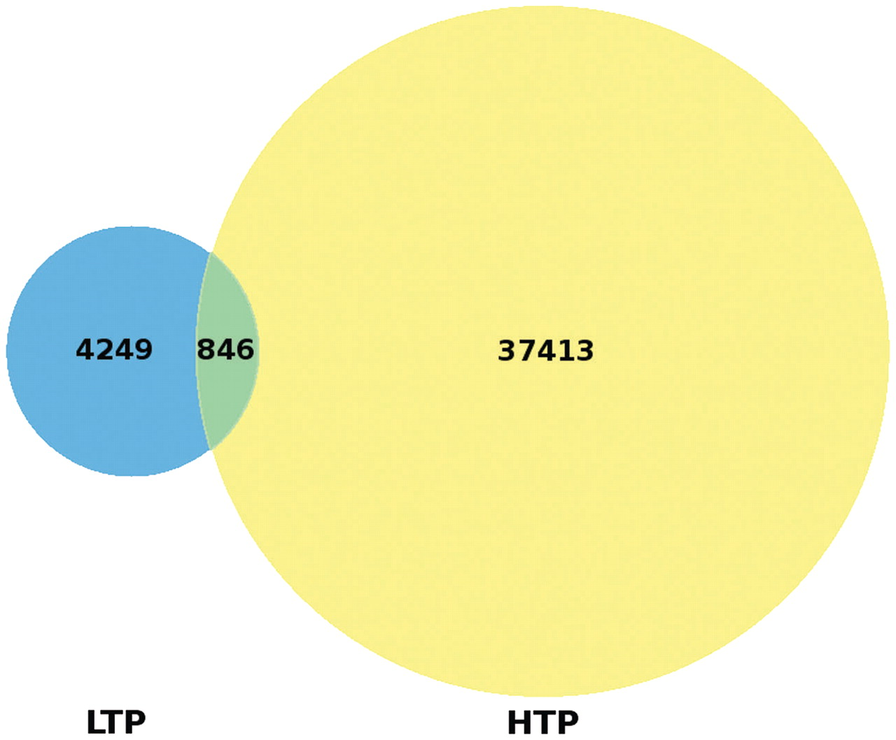
Figure 2. Venn diagram comparing the sources of Phospho.ELM instances. A total of 4249 instances have been obtained ...
Notes:
Figure 2. Venn diagram comparing the sources of Phospho.ELM instances. A total of 4249 instances have been obtained exclusively by LTP experiments and 37 413 instances solely by HTP assays while 846 instances were confirmed by both HTP and LTP analyses.
Unless provided in the caption above, the following copyright applies to the content of this slide: © The Author(s) 2010. Published by Oxford University Press.This is an Open Access article distributed under the terms of the Creative Commons Attribution Non-Commercial License (http://creativecommons.org/licenses/by-nc/2.5), which permits unrestricted non-commercial use, distribution, and reproduction in any medium, provided the original work is properly cited.

Slide 3
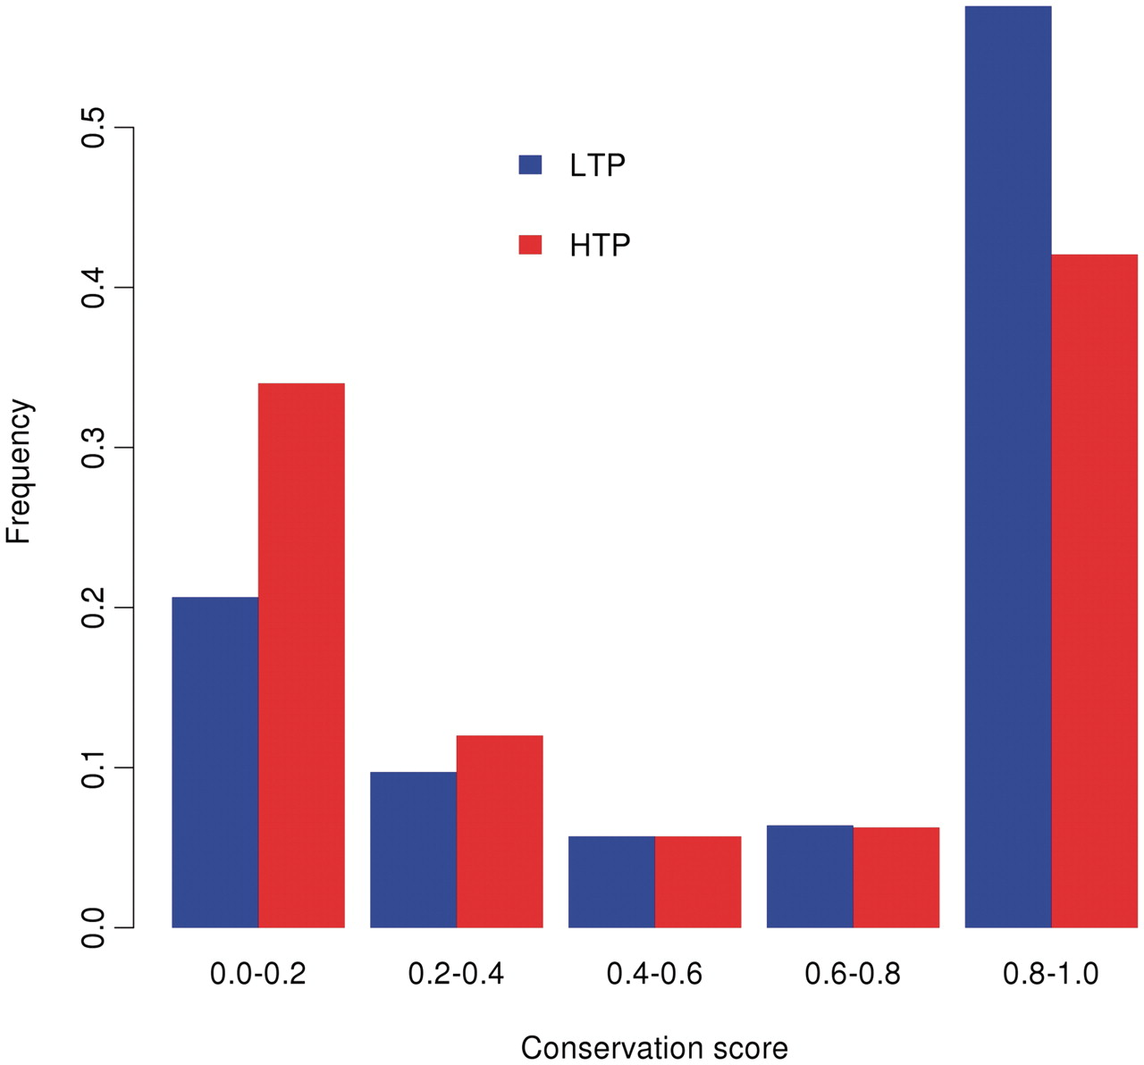
Figure 3. Distribution of the conservation scores for LTP and HTP instances in the Phospho.ELM database. The CS varies ...
Notes:
Figure 3. Distribution of the conservation scores for LTP and HTP instances in the Phospho.ELM database. The CS varies between 0 and 1, where 1 represents the highest conservation. The two distributions differ according to the Kolmogorov-Smirnov test with P -value <2.2e-16, with the LTP sites being more conserved.
Unless provided in the caption above, the following copyright applies to the content of this slide: © The Author(s) 2010. Published by Oxford University Press.This is an Open Access article distributed under the terms of the Creative Commons Attribution Non-Commercial License (http://creativecommons.org/licenses/by-nc/2.5), which permits unrestricted non-commercial use, distribution, and reproduction in any medium, provided the original work is properly cited.

Slide 4
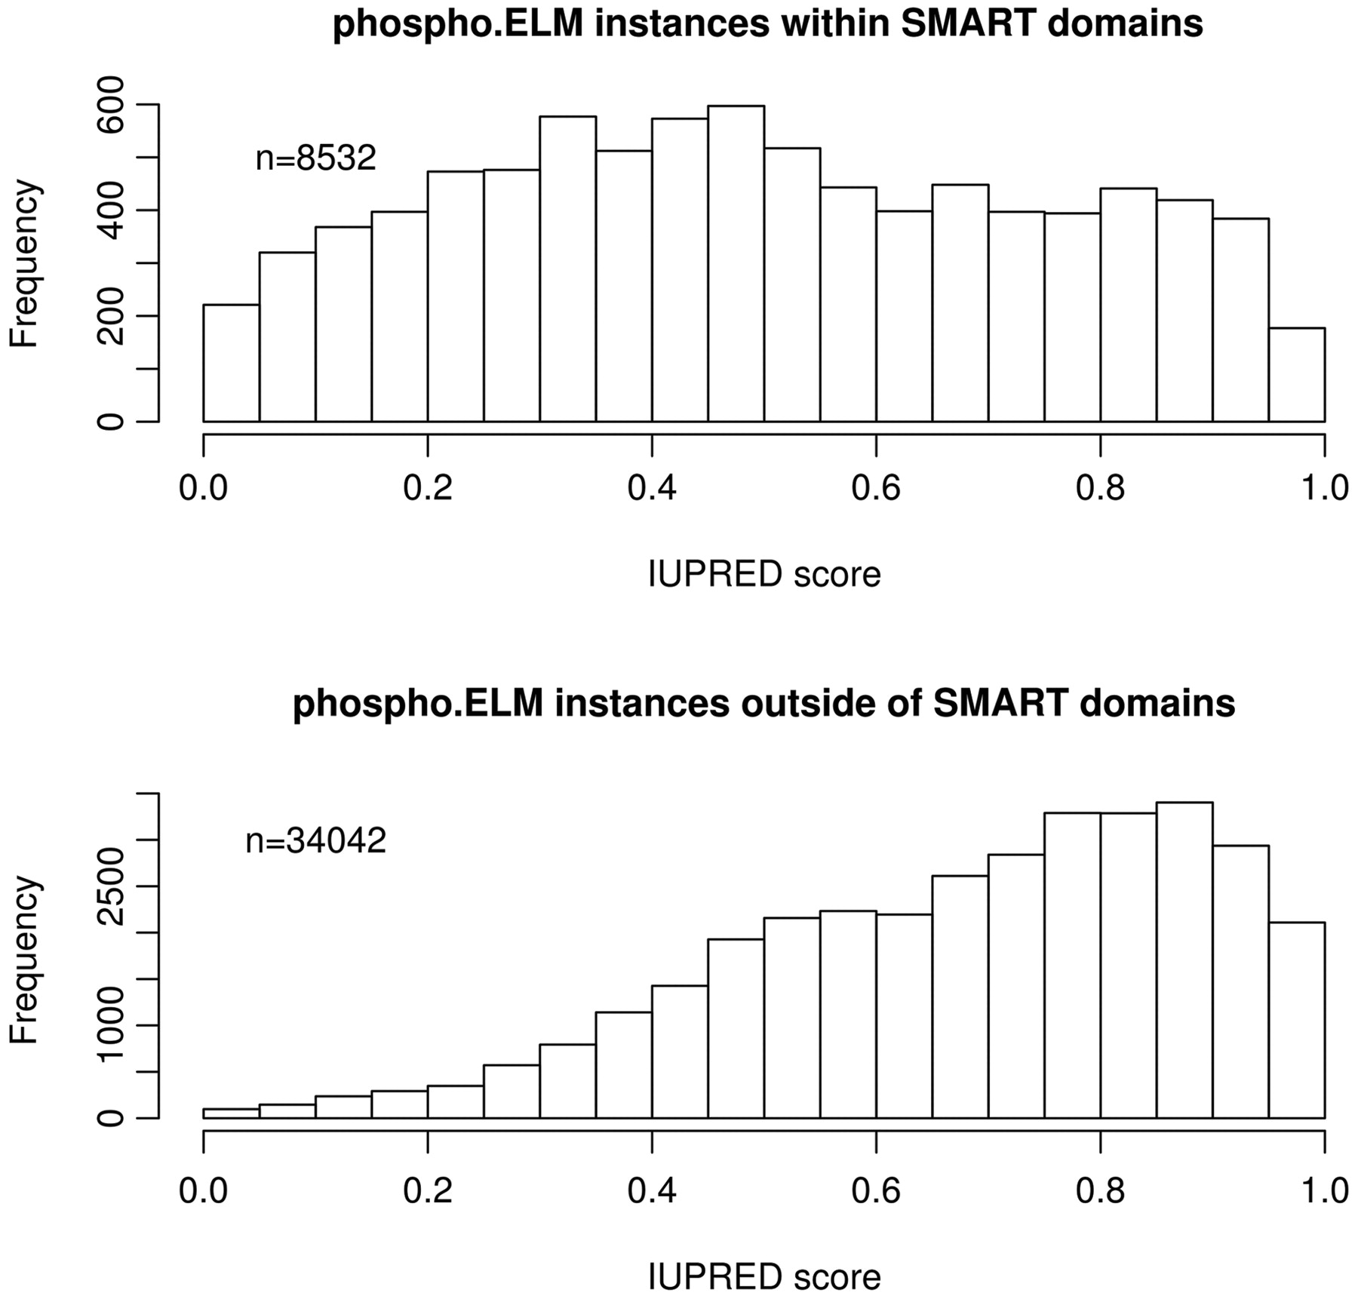
Figure 4. Histograms of IUPRED Score of Phospho.ELM instances within and outside of known domains. Instances with an ...
Notes:
Figure 4. Histograms of IUPRED Score of Phospho.ELM instances within and outside of known domains. Instances with an IUPRED score above 0.5 are predicted to be in a region of polypeptide sequence that is intrinsically disordered (i.e. cannot fold into a stable native structure). Instances that reside outside globular domains have a tendency towards higher IUPRED scores (disordered, lower panel) whereas the scores of instances within domains are more evenly distributed (upper panel). Note that sites mapping outside the known domains are predicted to be predominantly in natively disordered polypeptides.
Unless provided in the caption above, the following copyright applies to the content of this slide: © The Author(s) 2010. Published by Oxford University Press.This is an Open Access article distributed under the terms of the Creative Commons Attribution Non-Commercial License (http://creativecommons.org/licenses/by-nc/2.5), which permits unrestricted non-commercial use, distribution, and reproduction in any medium, provided the original work is properly cited.

