Slide 1
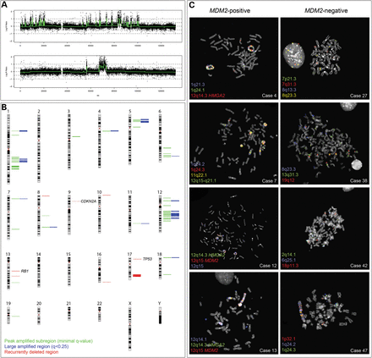
Figure 1. Ring chromosomes in sarcoma contain a wide array of amplified genomic regions. (A) Representative SNP array ...
Notes:
Figure 1. Ring chromosomes in sarcoma contain a wide array of amplified genomic regions. (A) Representative SNP array profiles from two different cases show high-level amplifications of multiple regions on chromosome 12. (B) The JISTIC algorithm identified 82 recurrently amplified regions. Fifty-eight of these were so-called peak-amplified subregions with a minimal q-value (green), which covered whole or parts of large aberrant regions (blue). For peak-amplified subregions that are identical in size to large aberrant regions, only the former are shown. Recurrently deleted regions are indicated in red. Recurrent homozygous deletions affected CDKN2A, RB1 and TP53. (C) By using FISH probes that mapped to amplified areas, two fundamentally different types of ring chromosomes were recognized by their MDM2 status. MDM2-positive tumors generally showed simple karyotypes with supernumerary ring chromosomes. In these tumors, 80% of amplicons mapped to ring chromosomes. In contrast, MDM2-negative tumors showed complex karyotypes with multiple aberrations in addition to the ring chromosomes. Less than 40% of their amplicons could be traced to rings; the remaining amplified signals were seen on marker chromosomes of varying size.
Unless provided in the caption above, the following copyright applies to the content of this slide: © The Author 2013. Published by Oxford University Press. All rights reserved. For Permissions, please email: journals.permissions@oup.com

Slide 2
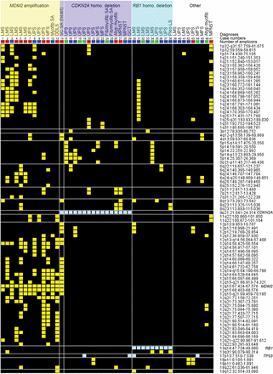
Figure 2. Amplification of MDM2 and homozygous deletion of either CDKN2A or RB1 characterize tumors with different ...
Notes:
Figure 2. Amplification of MDM2 and homozygous deletion of either CDKN2A or RB1 characterize tumors with different amplification profiles. Recurrent genomic aberrations detected in 47 sarcomas with ring chromosomes are displayed in a heat map. Cases are ordered in columns and aberrations in rows. Recurrently amplified regions identified by the JISTIC algorithm are displayed in yellow and recurrent homozygous deletions in light blue. Amplification of MDM2 and homozygous deletions of CDKN2A and RB1 were mutually exclusive in all but one case. In eight cases, neither MDM2 amplification nor homozygous CDKN2A or RB1 deletions were detected. Amplification of the region 12q14–12q21.1 was exclusively detected in tumors with MDM2 amplification. These tumors generally showed a complex genomic pattern with co-amplification of multiple regions on chromosomes 1, 6 and 12. Tumors without MDM2 amplification displayed less recurrent amplifications and generally fewer amplicons. The total number of amplicons per case is indicated by filled boxes; <20 (green), 20–49 (blue), ≥50 (red). Genomic positions are according to the UCSC hg18/NCBI Build 36 sequence assembly. LMS, leiomyosarcoma; UPS, undifferentiated pleomorphic sarcoma; MFS, myxofibrosarcoma; Myofib SA, low-grade myofibroblastic sarcoma; DDLS, dedifferentiated liposarcoma; SCSA, spindle cell sarcoma; Fib/myofib SA, fibroblastic/myofibroblastic sarcoma; Atyp myofib, atypical myofibroblastic tumor; MPNST, malignant peripheral nerve sheath tumor; GCT, giant cell tumor of soft tissue; Pleo LS, pleomorphic liposarcoma.
Unless provided in the caption above, the following copyright applies to the content of this slide: © The Author 2013. Published by Oxford University Press. All rights reserved. For Permissions, please email: journals.permissions@oup.com

Slide 3
Figure 3. Gene expression levels of MDM2, CDKN2A, RB1 and DDR2. Tumors are grouped and labeled based on their status of ...
Notes:
Figure 3. Gene expression levels of MDM2, CDKN2A, RB1 and DDR2. Tumors are grouped and labeled based on their status of MDM2, CDKN2A and RB1 (Fig. 2). Tumors with amplification of MDM2 are labeled in yellow, tumors with either homozygous loss of CDKN2A or RB1 are labeled in purple and cyan, respectively, and tumors without such aberrations are denoted ‘Other’ and labeled in white. (A) Tumors with amplification of MDM2 also show high expression levels of this gene. (B) Tumors with homozygous loss of CDKN2A show corresponding low expression levels. Case 14 was exceptional by showing both amplification of MDM2 and homozygous loss of CDKN2A. Also cases 7 and 9, without homozygous loss of the gene, show relatively low expression of CDKN2A. (C) The expression of RB1 varied significantly, also in the group with homozygous loss of the gene. The relatively high expression detected in cases 31 and 37 are most likely explained by normal cell contamination. The low expression in cases 19, 29 and 44 could be associated with loss of TP53; all four cases with homozygous loss of this gene showed low expression also of RB1. (D) Four of the cases with MDM2 amplification displayed amplification and overexpression of the gene encoding the receptor tyrosine kinase DDR2. The horizontal lines indicate arbitrary thresholds between high and low expression levels.
Unless provided in the caption above, the following copyright applies to the content of this slide: © The Author 2013. Published by Oxford University Press. All rights reserved. For Permissions, please email: journals.permissions@oup.com

Slide 4
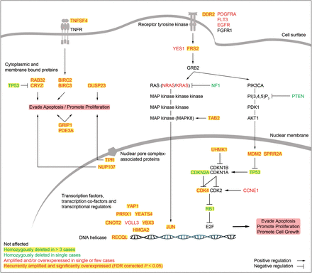
Figure 4. Genes that are affected in sarcomas with ring chromosomes are involved in pathways that promote proliferation ...
Notes:
Figure 4. Genes that are affected in sarcomas with ring chromosomes are involved in pathways that promote proliferation and/or inhibit apoptosis. Out of 123 genes that were found to be recurrently amplified and overexpressed, at least 25 have been reported to positively regulate proliferation, promote cell growth and/or prevent apoptosis. When including genes that were altered in single or few cases, the number of affected genes known to be associated with tumorigenesis is even higher. The affected genes encode, e.g. growth receptors, signal transduction proteins involved in the RAS-MAPK and PIK3CA pathways, cell cycle regulators and transcription factors.
Unless provided in the caption above, the following copyright applies to the content of this slide: © The Author 2013. Published by Oxford University Press. All rights reserved. For Permissions, please email: journals.permissions@oup.com

