Slide 1
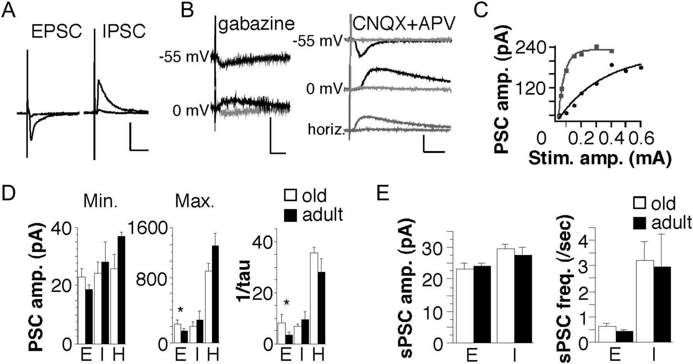
Figure 1. Amplitudes of thalamocortical and spontaneous PSCs in adult and old S1. (A) Examples of minimal and maximal ...
Notes:
Figure 1. Amplitudes of thalamocortical and spontaneous PSCs in adult and old S1. (A) Examples of minimal and maximal amplitude thalamocortical EPSCs (left) and thalamocortical IPSCs (right) from the same cell of an adult. Scale bar: 200 pA, 50 ms. (B) Pharmacological characterization of PSCs. Bath application of 5 μM gabazine (left traces) was used to block IPSCs and 10 μM CNQX plus 100 μM DL-APV (right traces) was used to block EPSCs. Black traces are before block and gray traces are in the presence of the indicated blocker(s). All traces are the average of 3 individual records; all traces were evoked by thalamocortical stimulation, except for the bottom right traces (‘horiz’), which were evoked by horizontal stimulation close to the cell (∼200 μm distant). Scale bars: 20 pA, 20 ms. (C) Input/output curves for EPSCs (black circles) and IPSCs (gray squares) from a single neuron. The lines are the best exponential fit to each. (D) Mean amplitudes of minimal-amplitude PSCs (left), mean amplitudes of maximal-amplitude PSCs (middle), and mean 1/tau of the exponential fit to the I/O curve (right) for thalamocortical EPSCs (E), thalamocortical IPSCs (I) and horizontal IPSCs (H) in old (white bars) and adult (black bars) rats. N = 11 cells for old and 10 cells for adult for thalamocortical and n = 8 cells for old and 8 cells for adult for horizontal PSCs. Asterisks represent significant difference between old and adult means (Student's t-test, P < 0.05). (E) Mean amplitudes (left) and frequencies (right) of spontaneous EPSCs (E) and IPSCs (I) from old (white bars) and adult (black bars) rats. N = 14 cells for old and 14 cells for old animals.
Unless provided in the caption above, the following copyright applies to the content of this slide: © The Author 2012. Published by Oxford University Press. All rights reserved. For Permissions, please e-mail: journals.permissions@oup.com

Slide 2
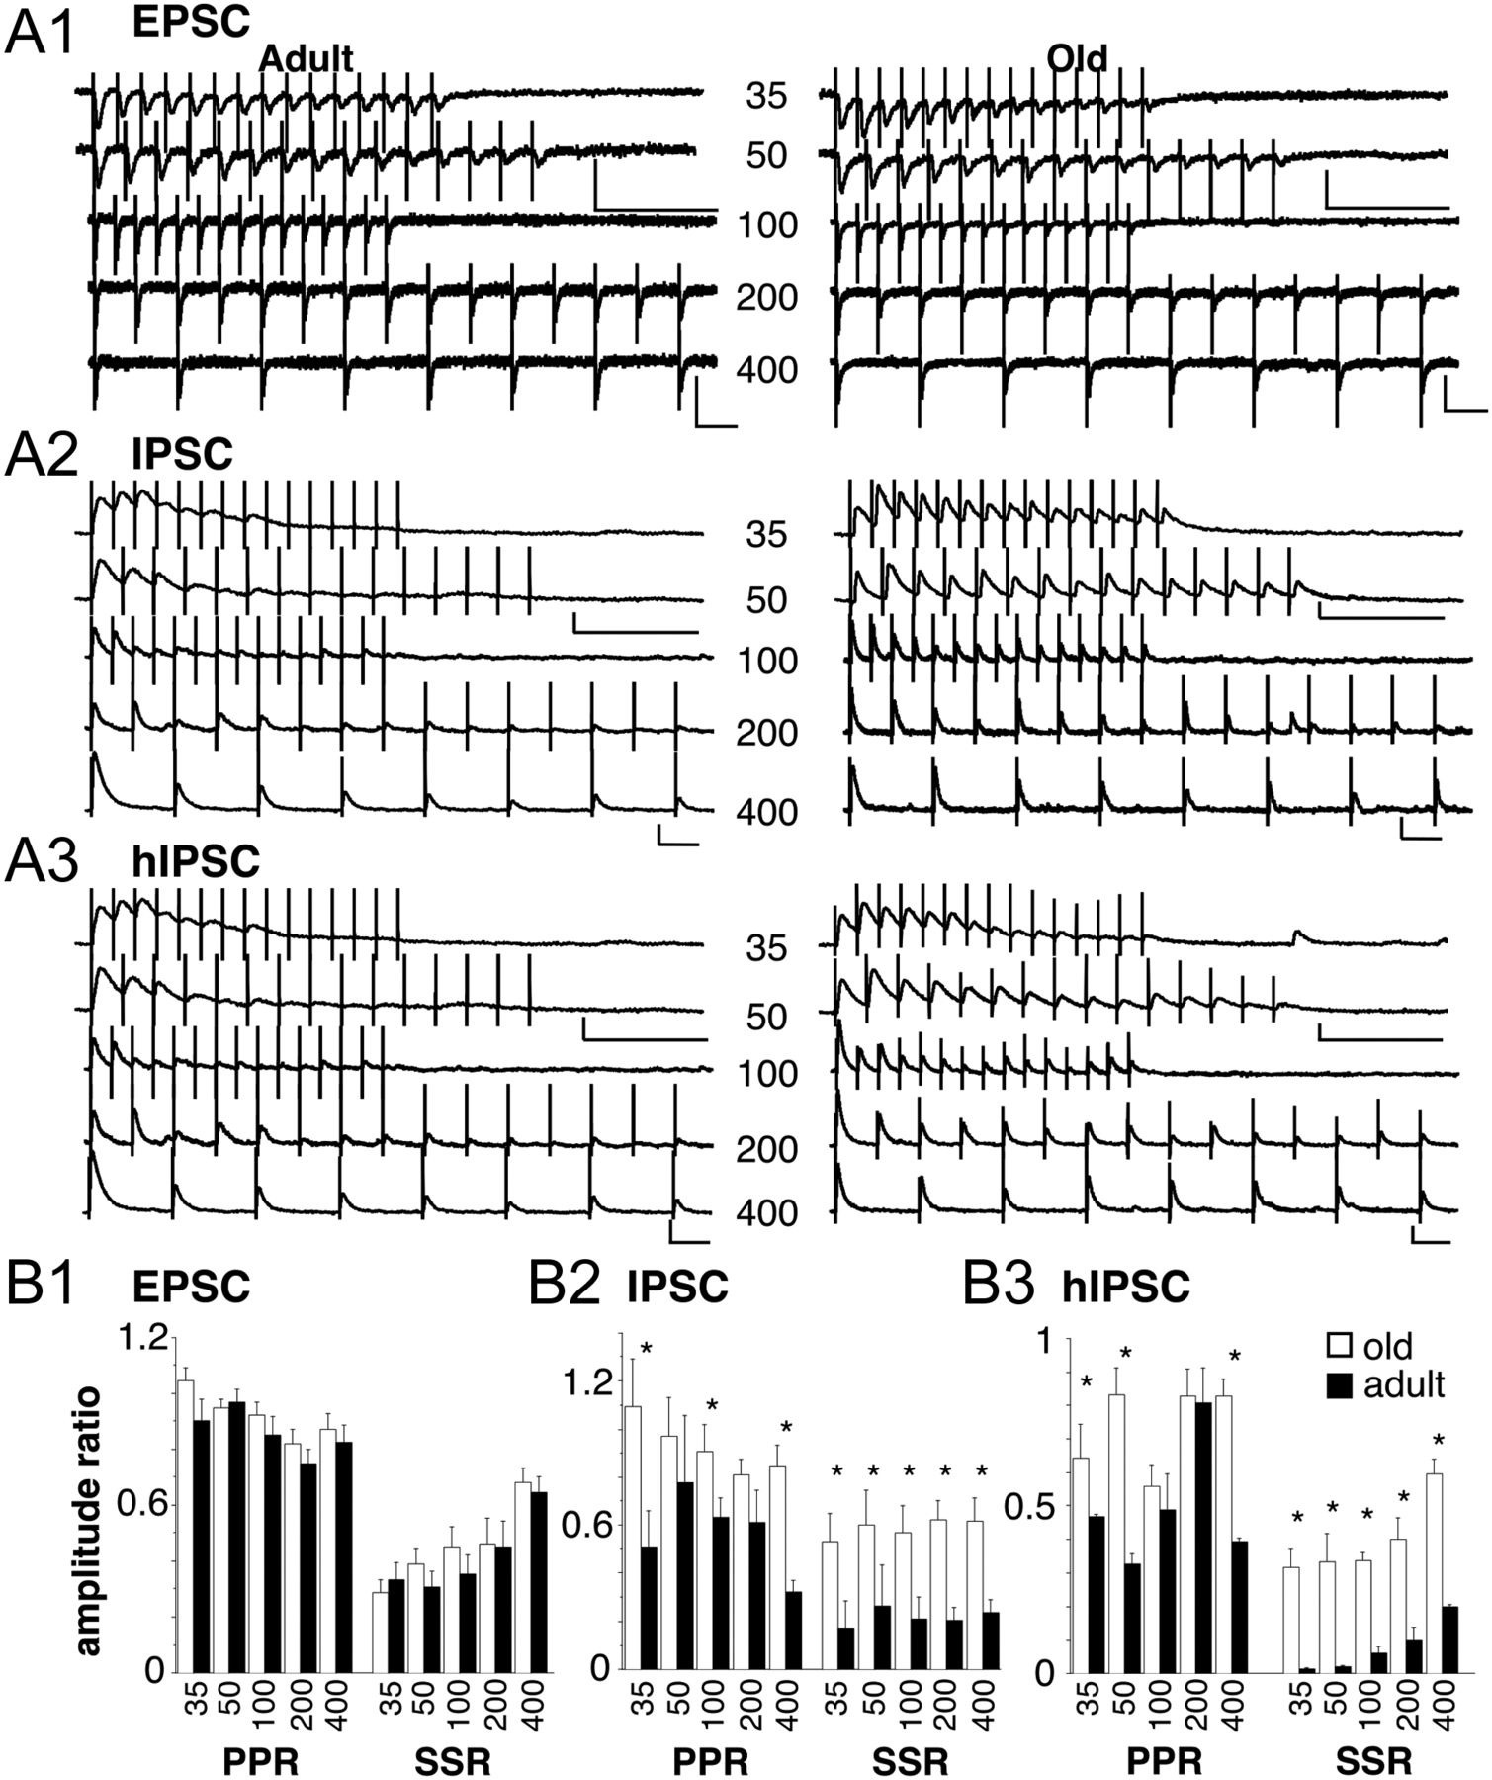
Figure 2. PSCs evoked by trains of stimuli at various IPIs. For A1-A3 traces on the left are from adult animals and on ...
Notes:
Figure 2. PSCs evoked by trains of stimuli at various IPIs. For A1-A3 traces on the left are from adult animals and on the right from old animals. IPIs are in msec as indicated. The scale bars represent 100 pA and 100 ms. Note the change in scale between the top 2 traces (35 and 50 ms IPI) and the bottom three (100, 200, and 400 ms IPI, A1) Examples of EPSCs evoked by stimulation of thalamocortical afferents, A2) Examples of IPSCs evoked by stimulation of thalamocortical afferents. These IPSCs were recorded in the same cell as the EPSCs in A1, A3, examples of IPSCs evoked by stimulation of horizontal afferents. B1–B3: Effects of repetitive stimulation on mean PPR and SSR for PSCs from adult (black bars) and old (white bars) animals for the indicated IPIs. Asterisks represent mean values that differ significantly between corresponding old and adult values (Student's t-test, P < 0.05). B1: Mean PPR and SSR values for thalamocortical EPSCs. N = 12 cells for old and 13 cells for adult. B2: Mean PPR and SSR values for thalamocortical IPSCs. N = 11 cells for old and 11 cells for adult. B3: Mean PPR and SSR values for horizontal IPSCs. N = 9 cells for old and 9 cells for adult.
Unless provided in the caption above, the following copyright applies to the content of this slide: © The Author 2012. Published by Oxford University Press. All rights reserved. For Permissions, please e-mail: journals.permissions@oup.com

Slide 3
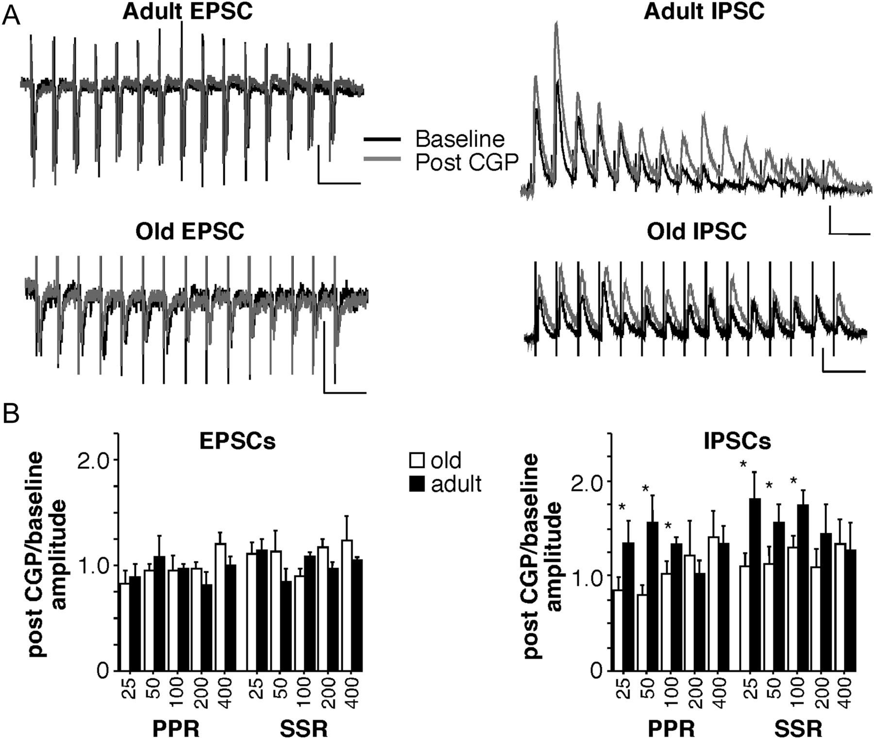
Figure 3. Effects of CGP 55845 on PSC trains. (A) Examples of trains of thalamocortical EPSCs (left) and IPSCs (right) ...
Notes:
Figure 3. Effects of CGP 55845 on PSC trains. (A) Examples of trains of thalamocortical EPSCs (left) and IPSCs (right) from adult (top) and old (bottom) rats before (black traces) and during (gray traces) bath application of 5 μM CGP 55845. Scale bars represent 100 pA and 100 ms. (B) Quantification of effects of CGP 55845 on PPR and SSR for EPSCs (left) and IPSCs (right) at various IPIs for old (white bars) and adult (black bars) animals. PPR and SSR values were determined for each IPI and the ratio of the value during and before CGP 55845 was determined. N = 9 cells for old and n = 10 cells for adult. Asterisks represent mean values that differ significantly between corresponding old and adult values (Student's t-test, P < 0.05).
Unless provided in the caption above, the following copyright applies to the content of this slide: © The Author 2012. Published by Oxford University Press. All rights reserved. For Permissions, please e-mail: journals.permissions@oup.com

Slide 4
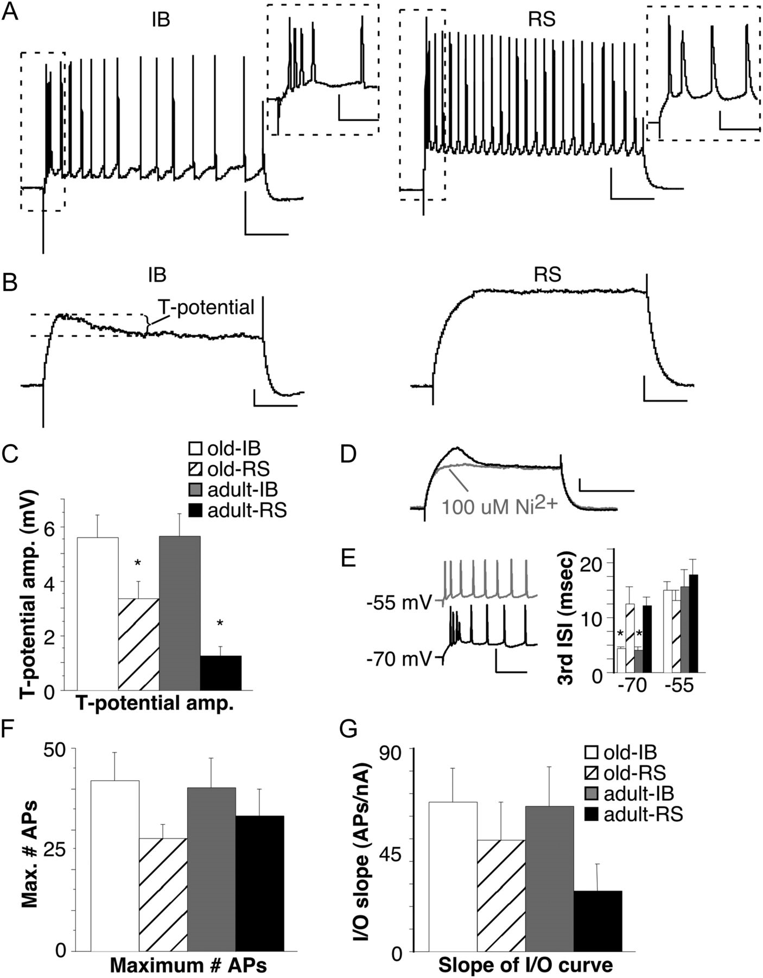
Figure 4. Differences in action potential trains in old and adult animals. N = 21 cells (11 IB and 10 RS) for old and ...
Notes:
Figure 4. Differences in action potential trains in old and adult animals. N = 21 cells (11 IB and 10 RS) for old and 20 cells (6 IB and 14 RS) for adult. (A) Examples of initially-bursting (IB) and regular-spiking (RS) neurons from an old (left) and adult (right) rat. Scale bars represent 20 mV and 100 ms. The inset shows the boxed area at expanded time base (scale bars represent 20 mV and 10 ms). (B) Examples of the T-potential in an IB (left) and RS cell (right). Scale bars represent 5 mV and 100 ms. (C) Mean T-potential amplitude for old versus adult and IB versus RS cells. Asterisks represent means that differ significantly from the other 3 means (1-way ANOVA, followed by Fisher's protected least-squares difference (PLSD), P < 0.05). (D) Example of the effects of bath-applied Ni2+ (100 μM) on the T-potential. Scale bars represent 5 mV and 200 msec. (E) Depolarization from −70 mV (black trace) to −55 mV (gray trace) converted neurons from IB to RS firing patterns. Scale bars represent 40 mV and 50 ms. The plot (right) shows the mean length of the third ISI for old versus adult and IB versus RS cells. Means for IB cells are significantly smaller than for RS cells (asterisks) only for hyperpolarized cells (−70) not for depolarized (−55; 1-way ANOVA, followed by Fisher's PLSD, P < 0.05). (F) Mean maximum number of spikes for old versus adult and IB versus RS cells. (G) Mean slope of the spike I/O curve for old versus adult and IB versus RS cells.
Unless provided in the caption above, the following copyright applies to the content of this slide: © The Author 2012. Published by Oxford University Press. All rights reserved. For Permissions, please e-mail: journals.permissions@oup.com

Slide 5
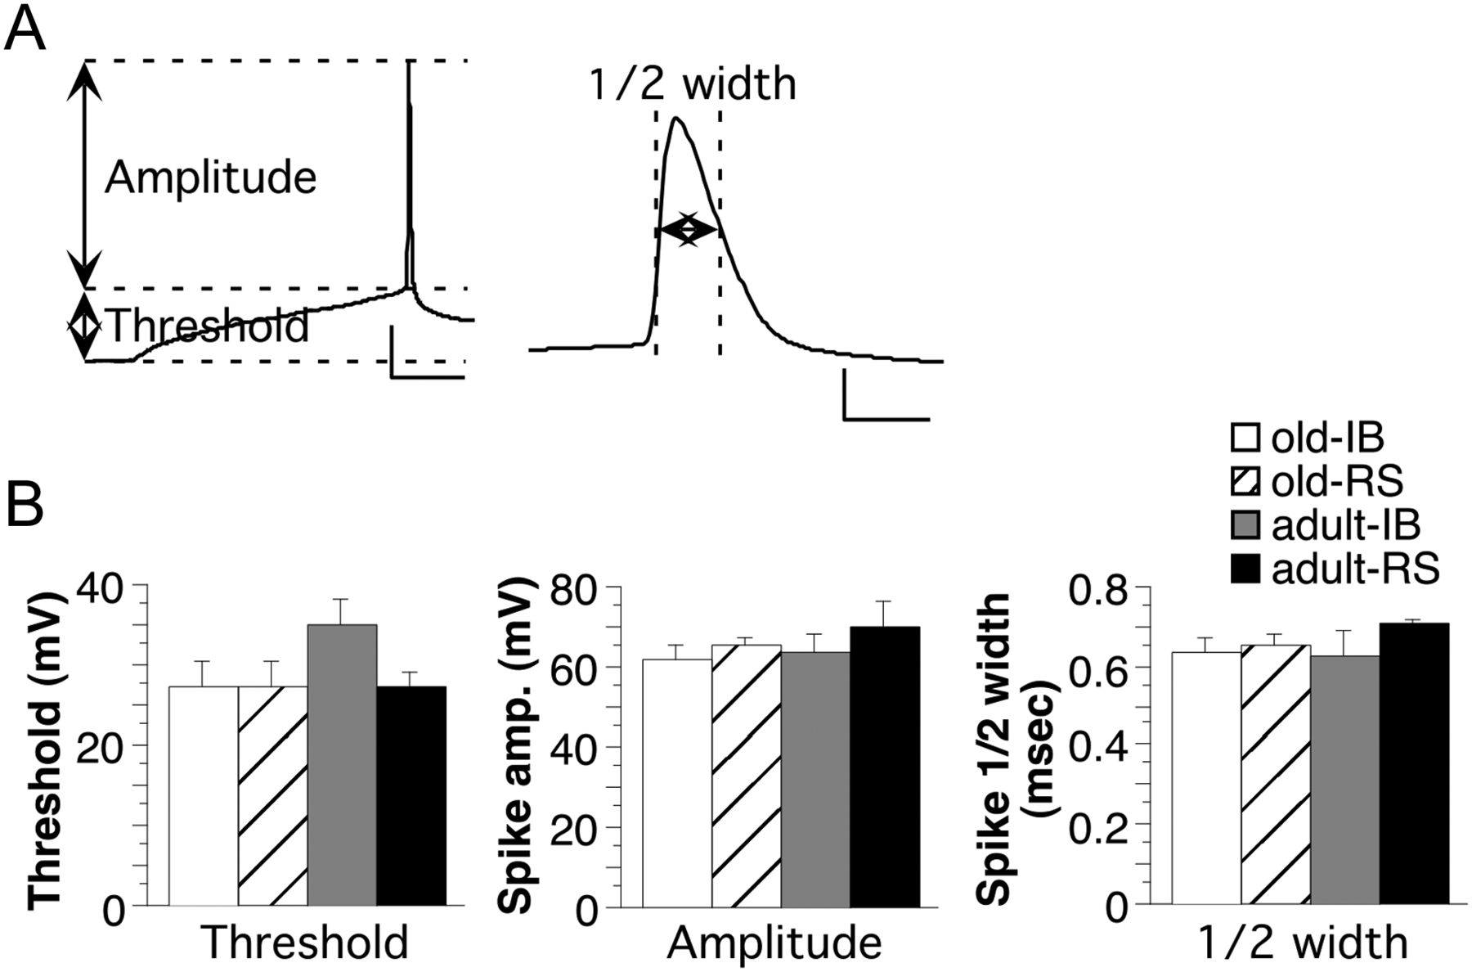
Figure 5. Characteristics of single action potentials. (A) Examples of single APs showing the measurement of threshold, ...
Notes:
Figure 5. Characteristics of single action potentials. (A) Examples of single APs showing the measurement of threshold, amplitude (left) and half-width (right). Scale bars represent 20 mV and 20 ms (left) and 20 mV and 1 ms (right). (B) Quantification of AP threshold, amplitude and half-width for old versus adult and IB versus RS cells. N = 21 cells (11 IB and 10 RS) for old and 20 cells (6 IB and 14 RS) for adult.
Unless provided in the caption above, the following copyright applies to the content of this slide: © The Author 2012. Published by Oxford University Press. All rights reserved. For Permissions, please e-mail: journals.permissions@oup.com

Slide 6
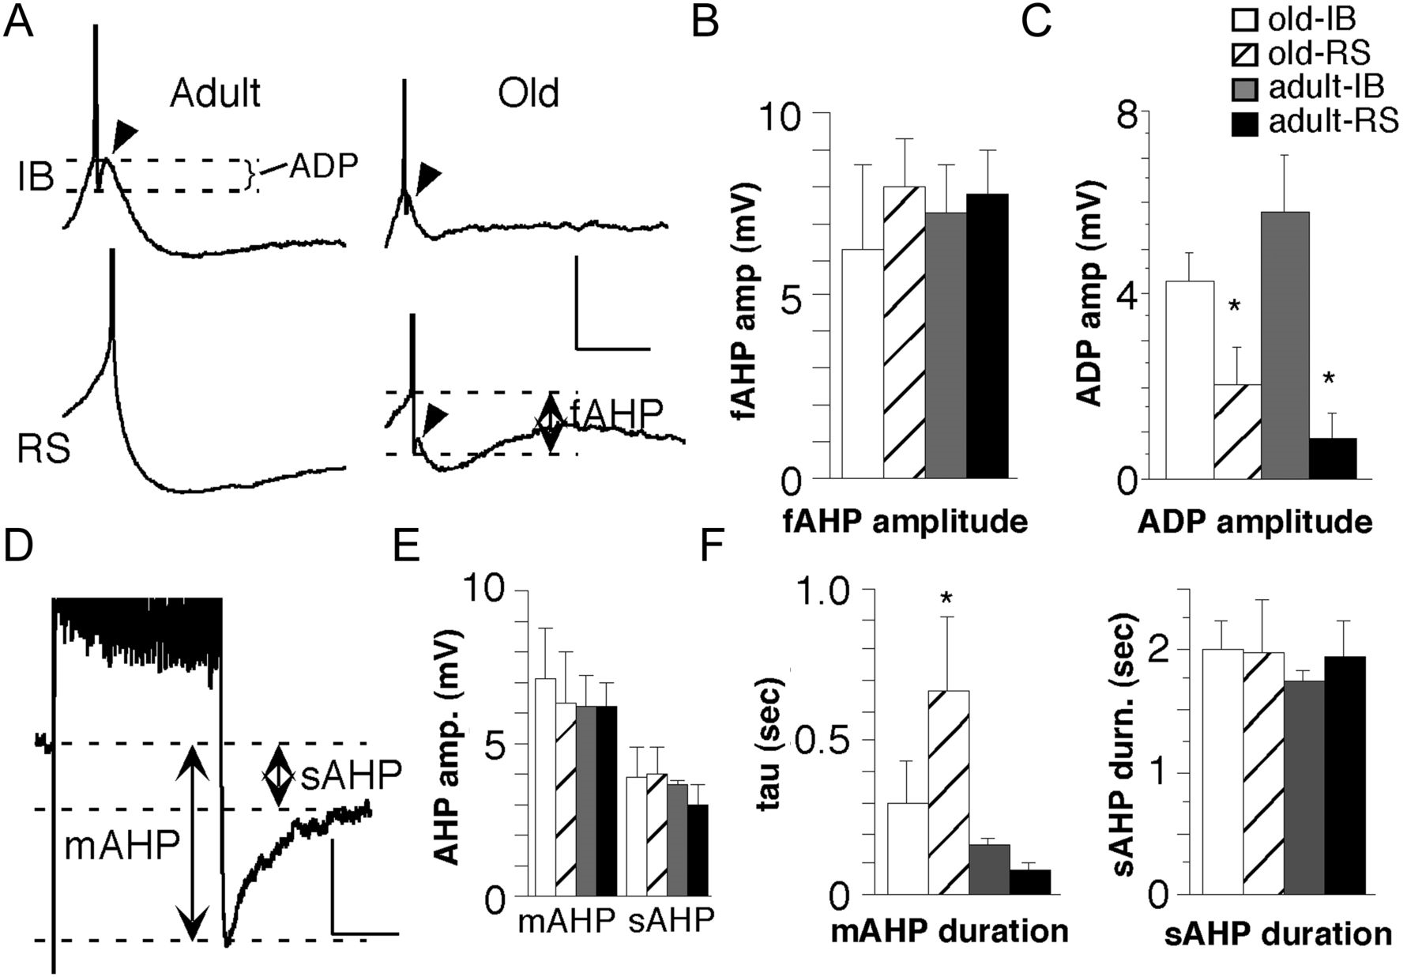
Figure 6. Characteristics of AHPs and ADPs. N = 21 cells (11 IB and 10 RS) for old and 20 cells (6 IB and 14 RS) for ...
Notes:
Figure 6. Characteristics of AHPs and ADPs. N = 21 cells (11 IB and 10 RS) for old and 20 cells (6 IB and 14 RS) for adult. (A) Examples of fAHPs and ADPs in adult (left traces) and old (right traces) animals for IB (top traces) and RS (bottom traces) cell types. The dotted lines show the measurement of ADPs (top left trace) and the fAHPs (bottom right trace). Arrowheads point to the ADP. Scale bars represent 10 mV and 50 ms. Note the APs are truncated. (B) Quantification of mean fAHP amplitude for old versus adult and IB versus RS cells. (C) Quantification of mean ADP amplitude for old versus adult and IB versus RS cells. Asterisks represent significant differences between the indicated mean and the other 3 means (1-way ANOVA, followed by Fisher's PLSD, P > 0.05). (D) Example of medium AHP (mAHP) and slow AHP (sAHP) after a train of APs and at −55 mV. The dotted lines show the measurement of the mAHP and sAHP. Scale bars represent 5 mV and 200 msec. Note APs are truncated. (E) Quantification of mean mAHP (left) and sAHP (right) amplitudes for old versus adult and IB versus RS cells. (F) Quantification of the mean durations of the mAHP (left) and sAHP (right). The asterisk represents significant difference between the indicated mean and the means of both categories of cells from adult rats (1-way ANOVA, followed by Fisher's PLSD, P > 0.05).
Unless provided in the caption above, the following copyright applies to the content of this slide: © The Author 2012. Published by Oxford University Press. All rights reserved. For Permissions, please e-mail: journals.permissions@oup.com

Slide 7
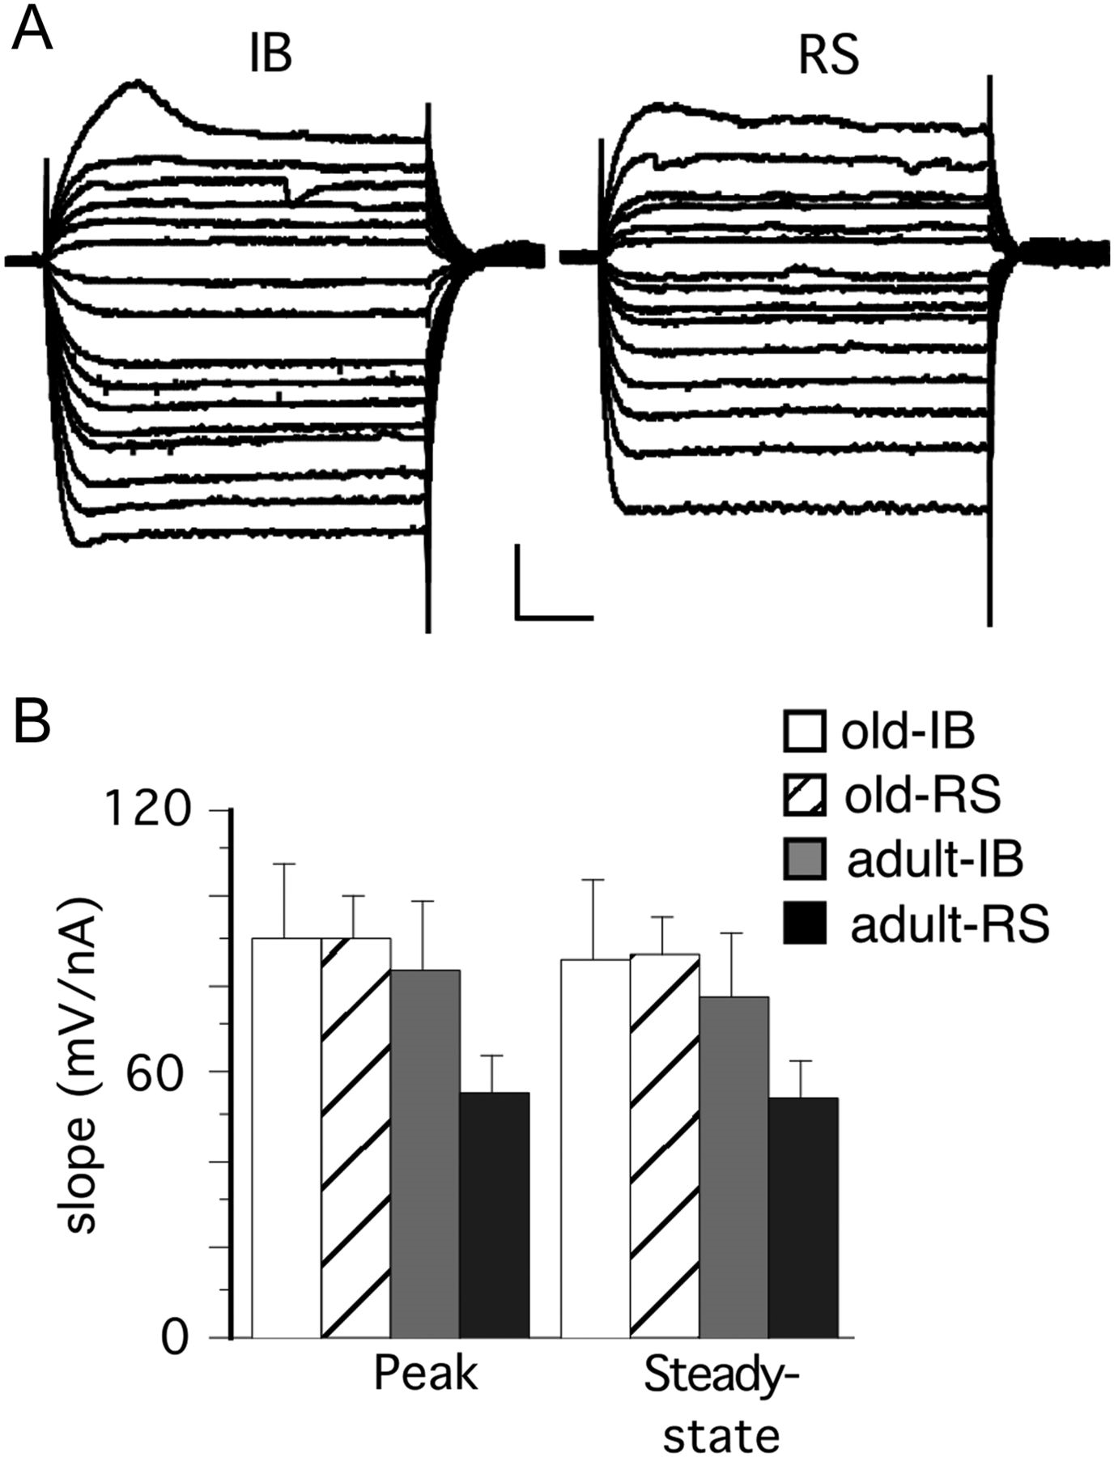
Figure 7. Properties of subthreshold responses. (A) Examples of subthreshold responses from an IB (left) and RS (right) ...
Notes:
Figure 7. Properties of subthreshold responses. (A) Examples of subthreshold responses from an IB (left) and RS (right) cell to both hyperpolarizing and depolarizing current steps. Scale bars represent 10 mV and 100 ms. (B) Quantification of the mean slope of the I/O curve for the peak subthreshold response (left) and the steady-state measured at 400 ms after onset (right) for old versus adult and IB versus RS cells. n = 21 cells (11 IB and 10 RS) for old and 20 cells (6 IB and 14 RS) for adult.
Unless provided in the caption above, the following copyright applies to the content of this slide: © The Author 2012. Published by Oxford University Press. All rights reserved. For Permissions, please e-mail: journals.permissions@oup.com

Slide 8
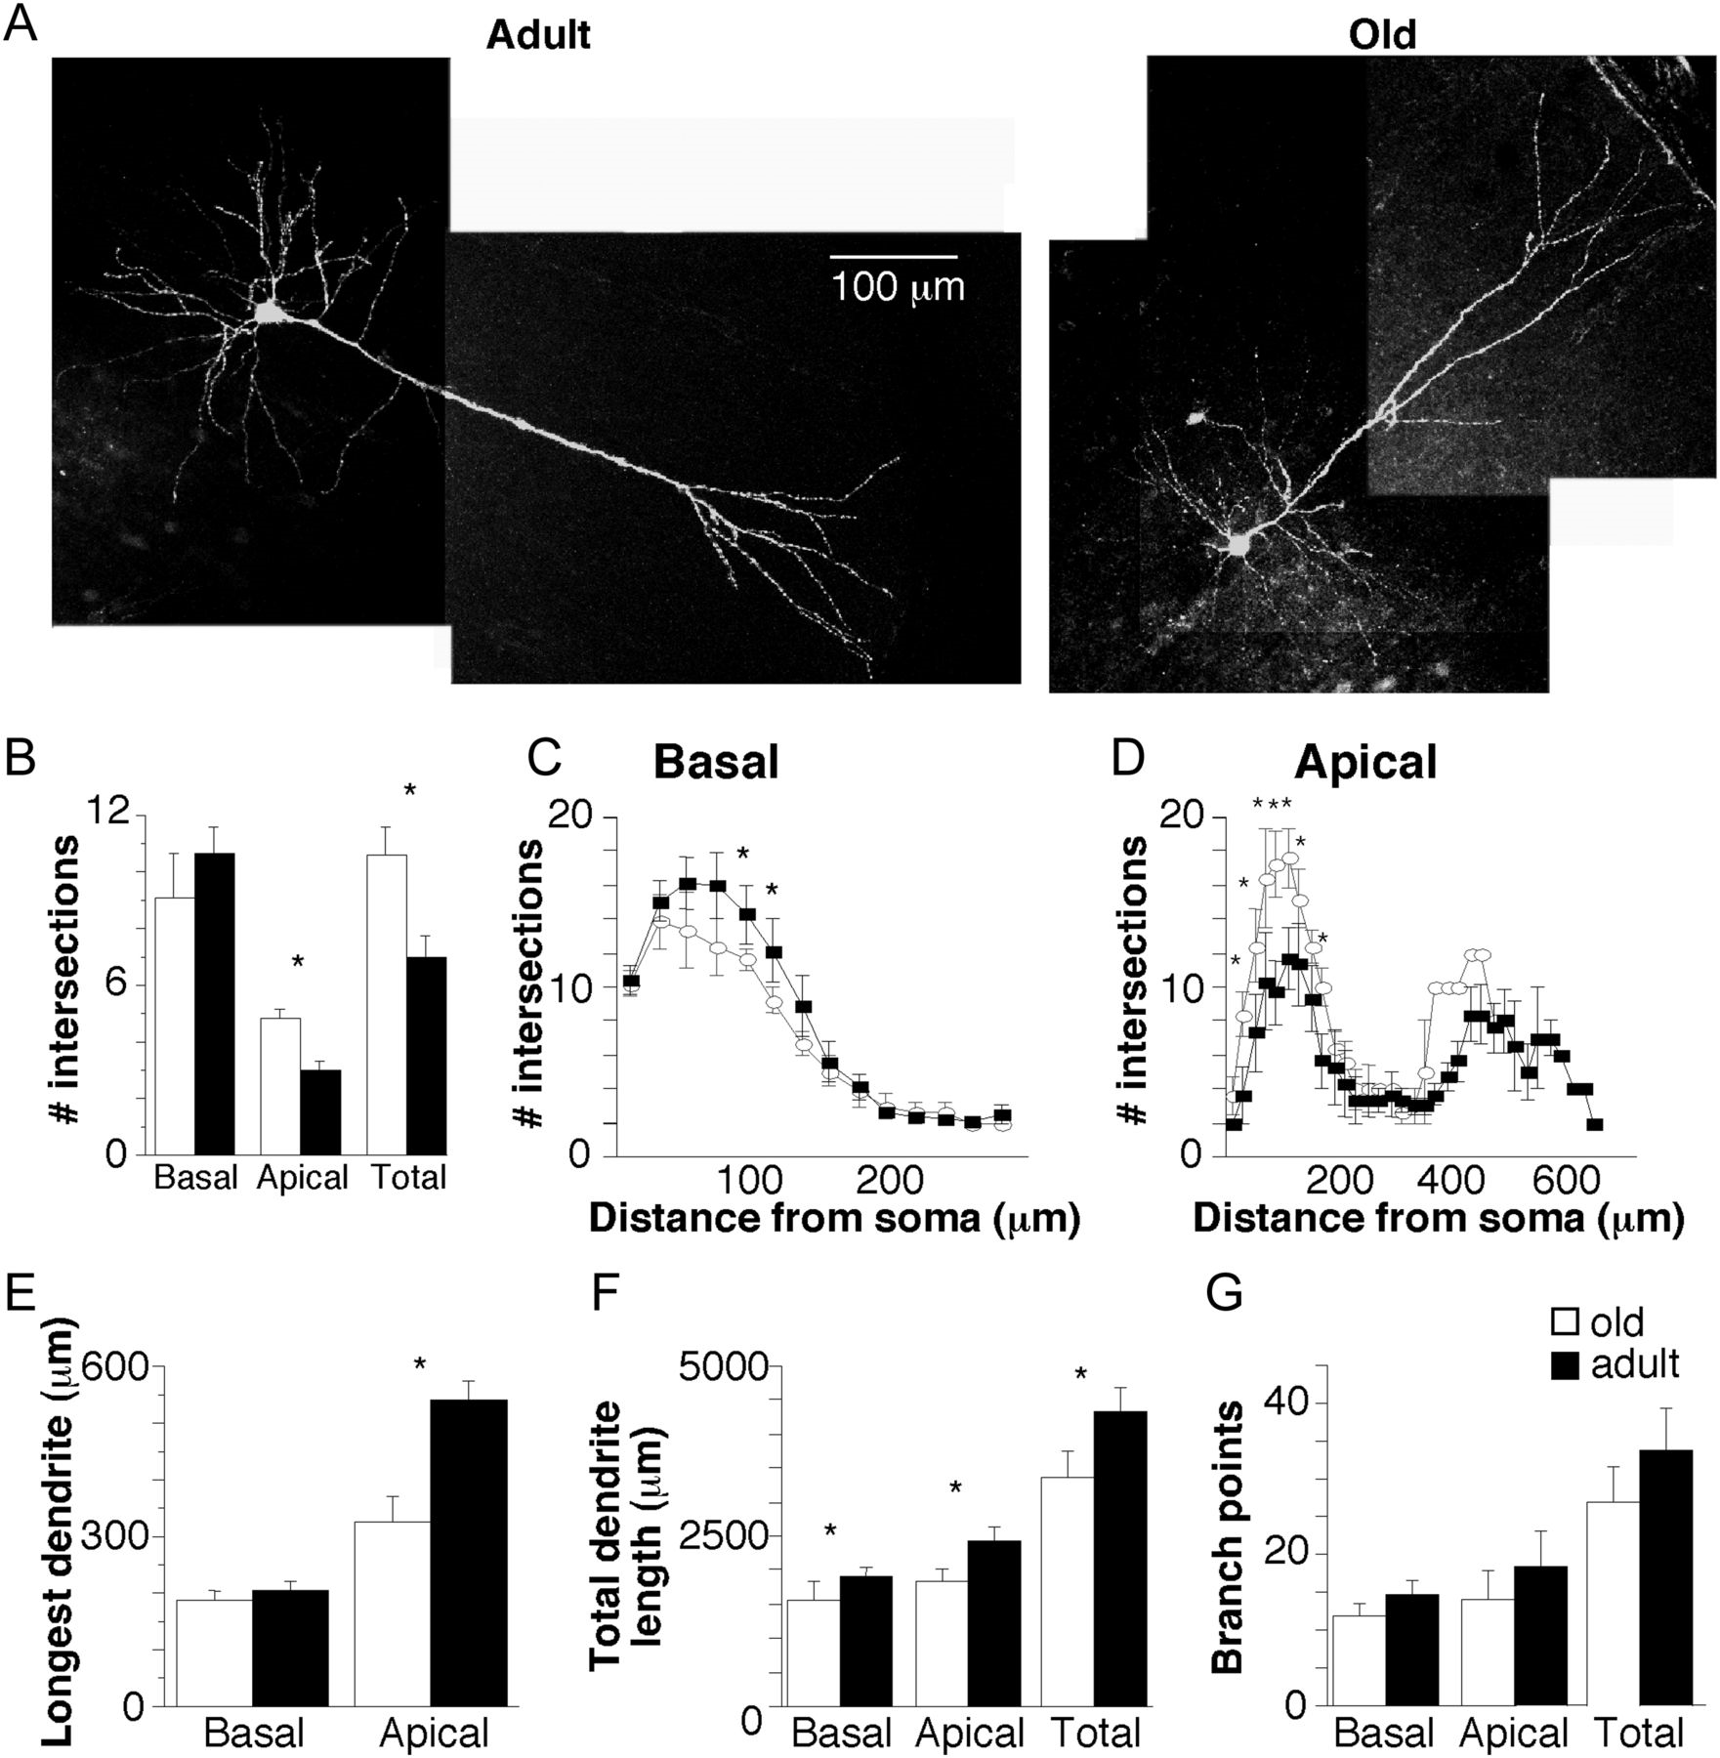
Figure 8. Characteristics of dendrites in old and adult animals. Note for each plot (B–G) the black bars represent data ...
Notes:
Figure 8. Characteristics of dendrites in old and adult animals. Note for each plot (B–G) the black bars represent data from adult animals and the white bars represent data from old animals; n = 10 cells for old and 11 cells for adult. Asterisks indicate significant differences (P < 0.05, unpaired t-test) between adult and old mean values. (A) Examples of deep layer 3 pyramidal neurons filled with biocytin during whole-cell recording in adult (left) and old (right) rat S1. (B) The mean total number of intersections with the concentric circles of the Scholl analysis (see Methods) is shown for basal (left), apical (middle), and total (right) dendrites. (C, D) The mean number of Scholl intersections is shown for each individual concentric circle (20 μm spacing) for basal dendrites (C) and apical dendrites (D) from adult (black squares) and old (white circles) rats. (E) The mean length of the longest dendrite is shown for basal (left) and apical (right) dendrites. (F) The total length of all dendrites is shown for basal (left), apical (middle), and total (right) dendrites. (G) The mean number of dendritic branch points is shown for basal (left), apical (middle), and total (right) dendrites.
Unless provided in the caption above, the following copyright applies to the content of this slide: © The Author 2012. Published by Oxford University Press. All rights reserved. For Permissions, please e-mail: journals.permissions@oup.com

Slide 9
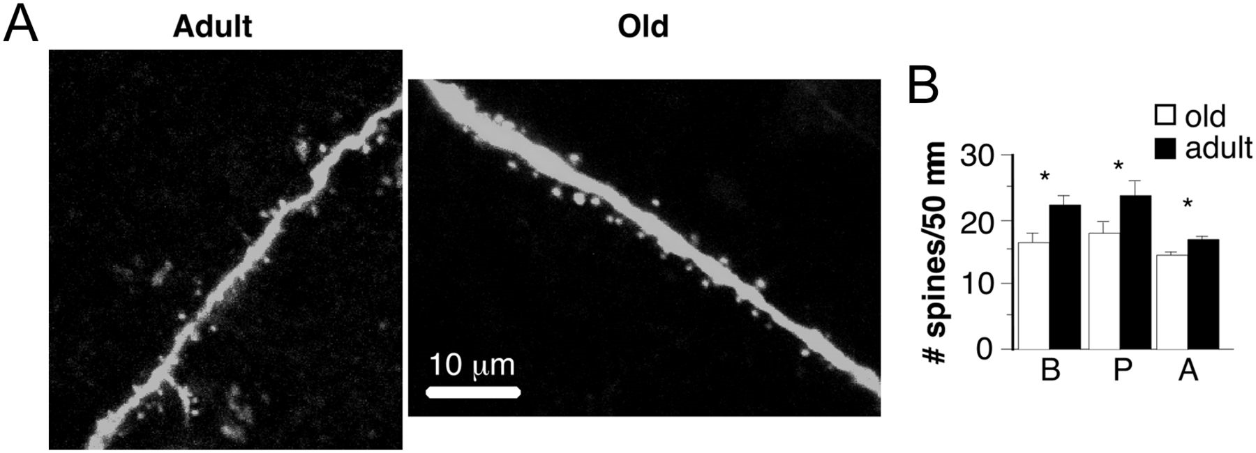
Figure 9. Dendritic spine densities in adult and old animals. (A) Examples of dendritic spines from the proximal apical ...
Notes:
Figure 9. Dendritic spine densities in adult and old animals. (A) Examples of dendritic spines from the proximal apical dendrite from adult (left panel) and old (right panel) animals. (B) The mean density of dendritic spines (number of spines per 50 μm length of dendrite) is shown for basal (‘B’, left), proximal apical (‘P’, middle) and apical tuft (‘A’, right) dendrites from adult (black bars) and old (white bars) animals. N = 10 cells for old and 11 cells for adult. Asterisks indicate significant differences (P < 0.05, unpaired t-test) between adult and old mean values.
Unless provided in the caption above, the following copyright applies to the content of this slide: © The Author 2012. Published by Oxford University Press. All rights reserved. For Permissions, please e-mail: journals.permissions@oup.com

