Slide 1
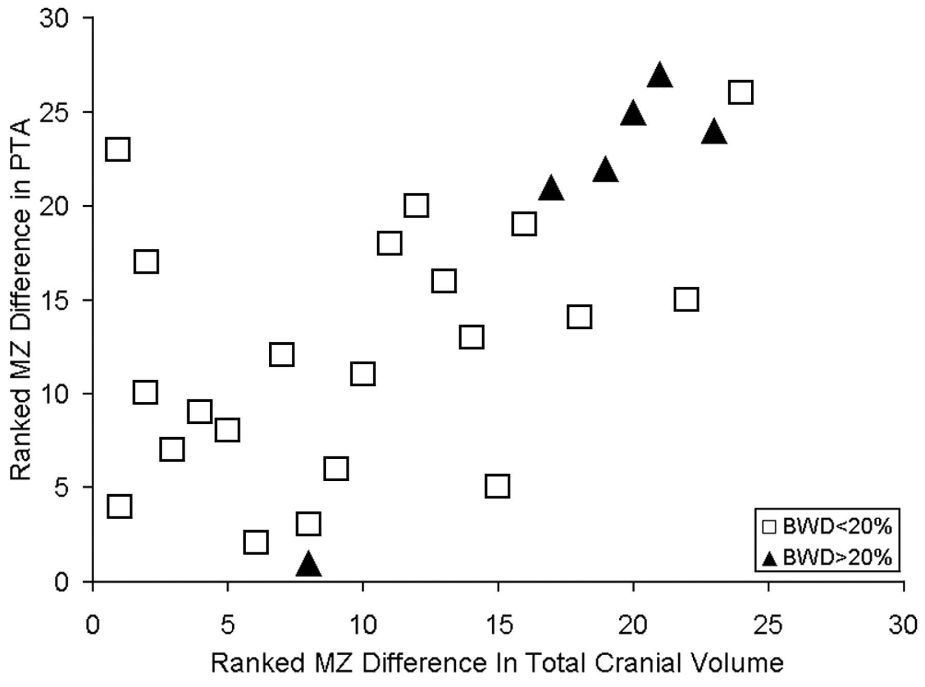
Figure 4. MZ twins exhibiting the largest PT asymmetry differences also exhibit the largest total cerebral volume ...
Notes:
Figure 4. MZ twins exhibiting the largest PT asymmetry differences also exhibit the largest total cerebral volume differences in the group.
Unless provided in the caption above, the following copyright applies to the content of this slide: © Oxford University Press

Slide 2
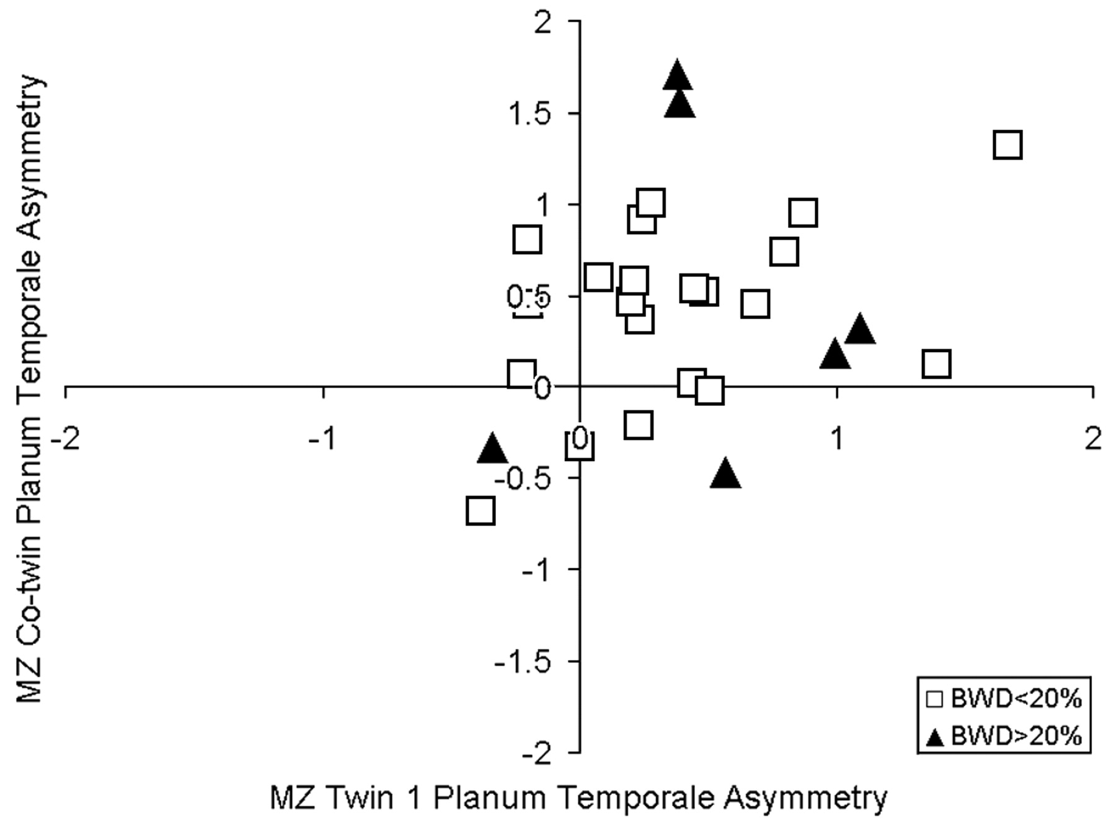
Figure 3. PTA relation between MZ twins by writing birth weight differences greater than 20% (BWD > 20%).
Notes:
Figure 3. PTA relation between MZ twins by writing birth weight differences greater than 20% (BWD > 20%).
Unless provided in the caption above, the following copyright applies to the content of this slide: © Oxford University Press

Slide 3
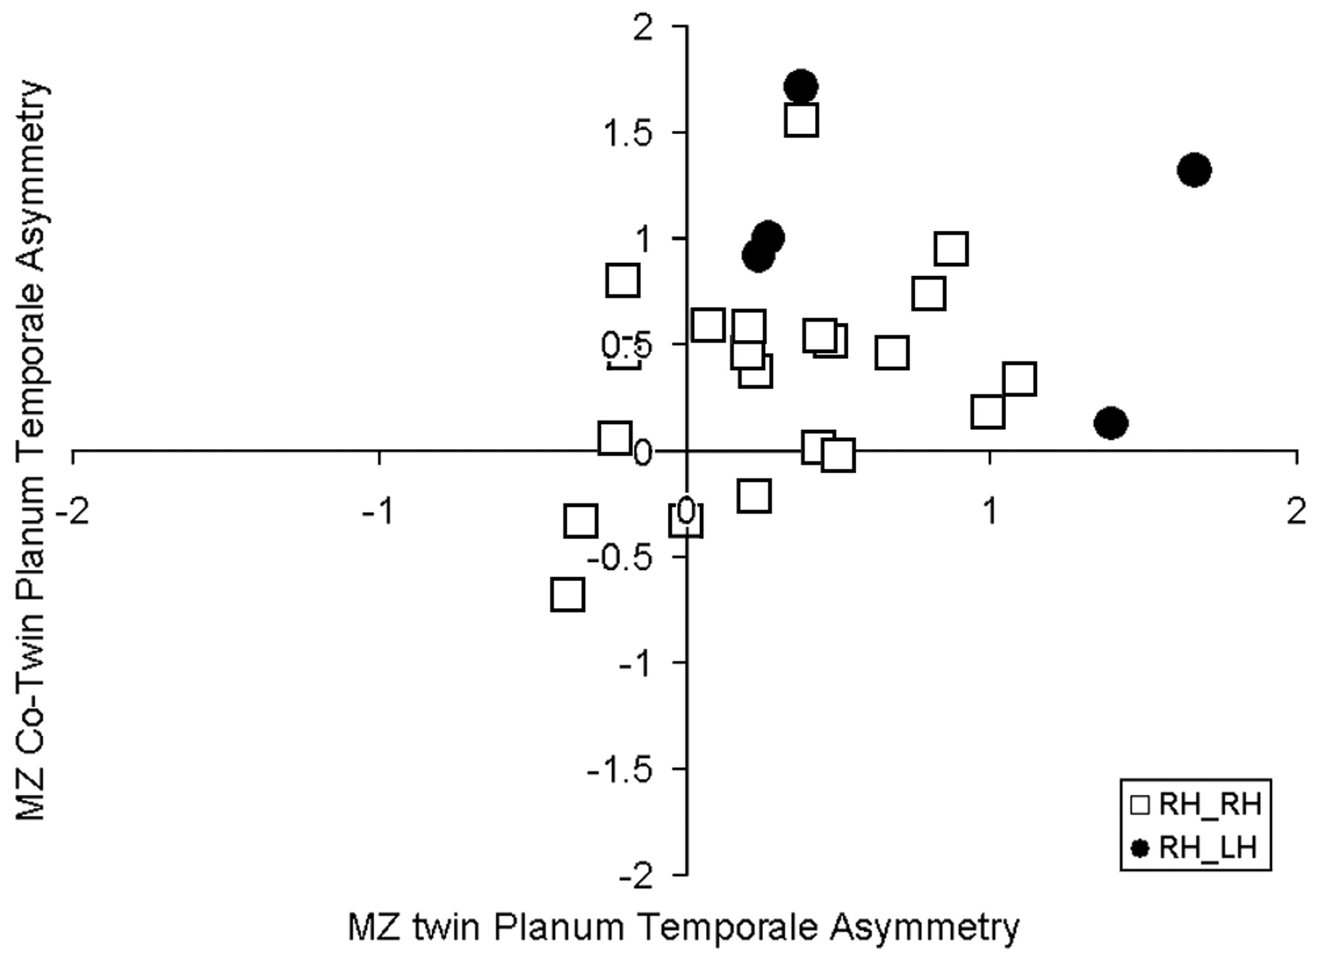
Figure 2. PT asymmetry relation between MZ twins by writing hand concordance (RH_RH = right-handed twin 1 and ...
Notes:
Figure 2. PT asymmetry relation between MZ twins by writing hand concordance (RH_RH = right-handed twin 1 and right-handed twin 2; RH_LH = right-handed twin 1 and left-handed twin 2).
Unless provided in the caption above, the following copyright applies to the content of this slide: © Oxford University Press

Slide 4
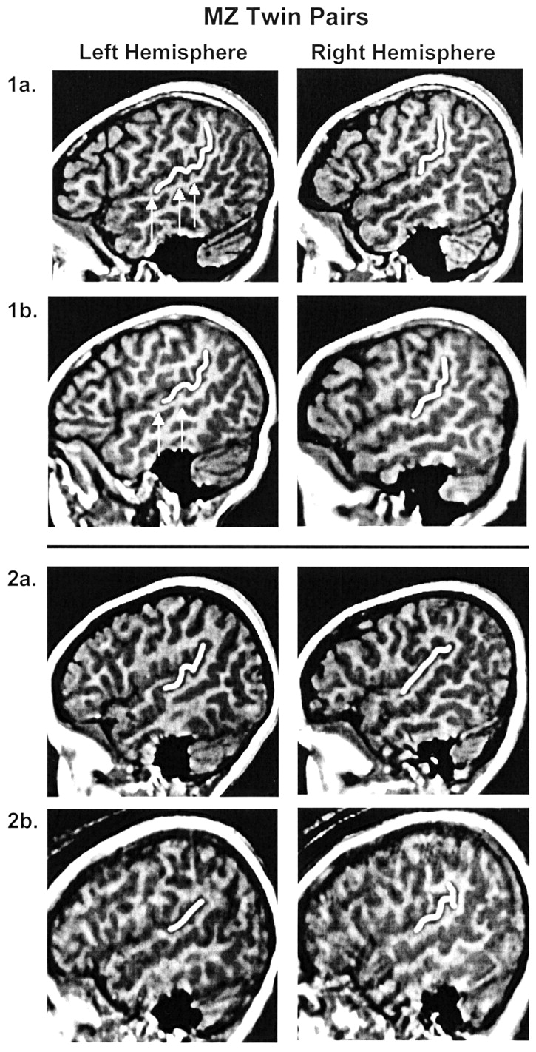
Figure 1. Sagittal images of MZ twin pairs. Twin pair 1a,b exhibit similar Sylvian fissure morphology. Also note the ...
Notes:
Figure 1. Sagittal images of MZ twin pairs. Twin pair 1a,b exhibit similar Sylvian fissure morphology. Also note the similarity in brain shape, but variation in minor gyri and sulci (arrows). Twin pair 2a,b exhibit hemispheric reversals in Witelson and Kigar Sylvian fissure classification, but they are not mirror image reversals. Images created at Talairach position 50 for the right hemisphere and 47 for the left hemisphere. The PT and PP are outlined in each image.
Unless provided in the caption above, the following copyright applies to the content of this slide: © Oxford University Press

