Slide 1
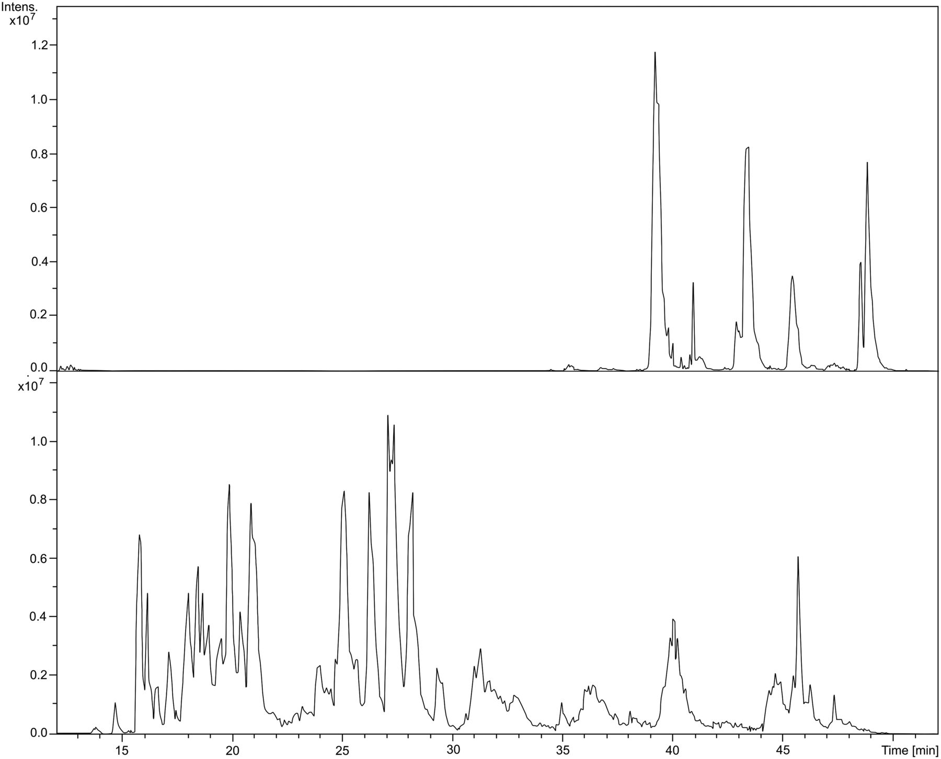
Figure 1. Separation of BSA digest using a C18 packed column (75 µm i.d. × 5 cm) at a flow rate of 300 nL/min with MS ...
Notes:
Figure 1. Separation of BSA digest using a C18 packed column (75 µm i.d. × 5 cm) at a flow rate of 300 nL/min with MS detection (range 400–1,400 m/z). The top frame shows the analysis with dead volume in the pre-column connections, whereas the bottom frame shows the same analysis repeated after the problem is solved. Reprinted from Journal of Separation Science, Vol 30, Author(s): Noga, M., Sucharski, F., Suder, P., Silberring, J., A practical guide to nano-LC troubleshooting, Pages 2179-2189, Copyright (2007) with permission from John Wiley and Sons.
Unless provided in the caption above, the following copyright applies to the content of this slide: © The Author [2013]. Published by Oxford University Press. All rights reserved. For Permissions, please email: journals.permissions@oup.com

Slide 2
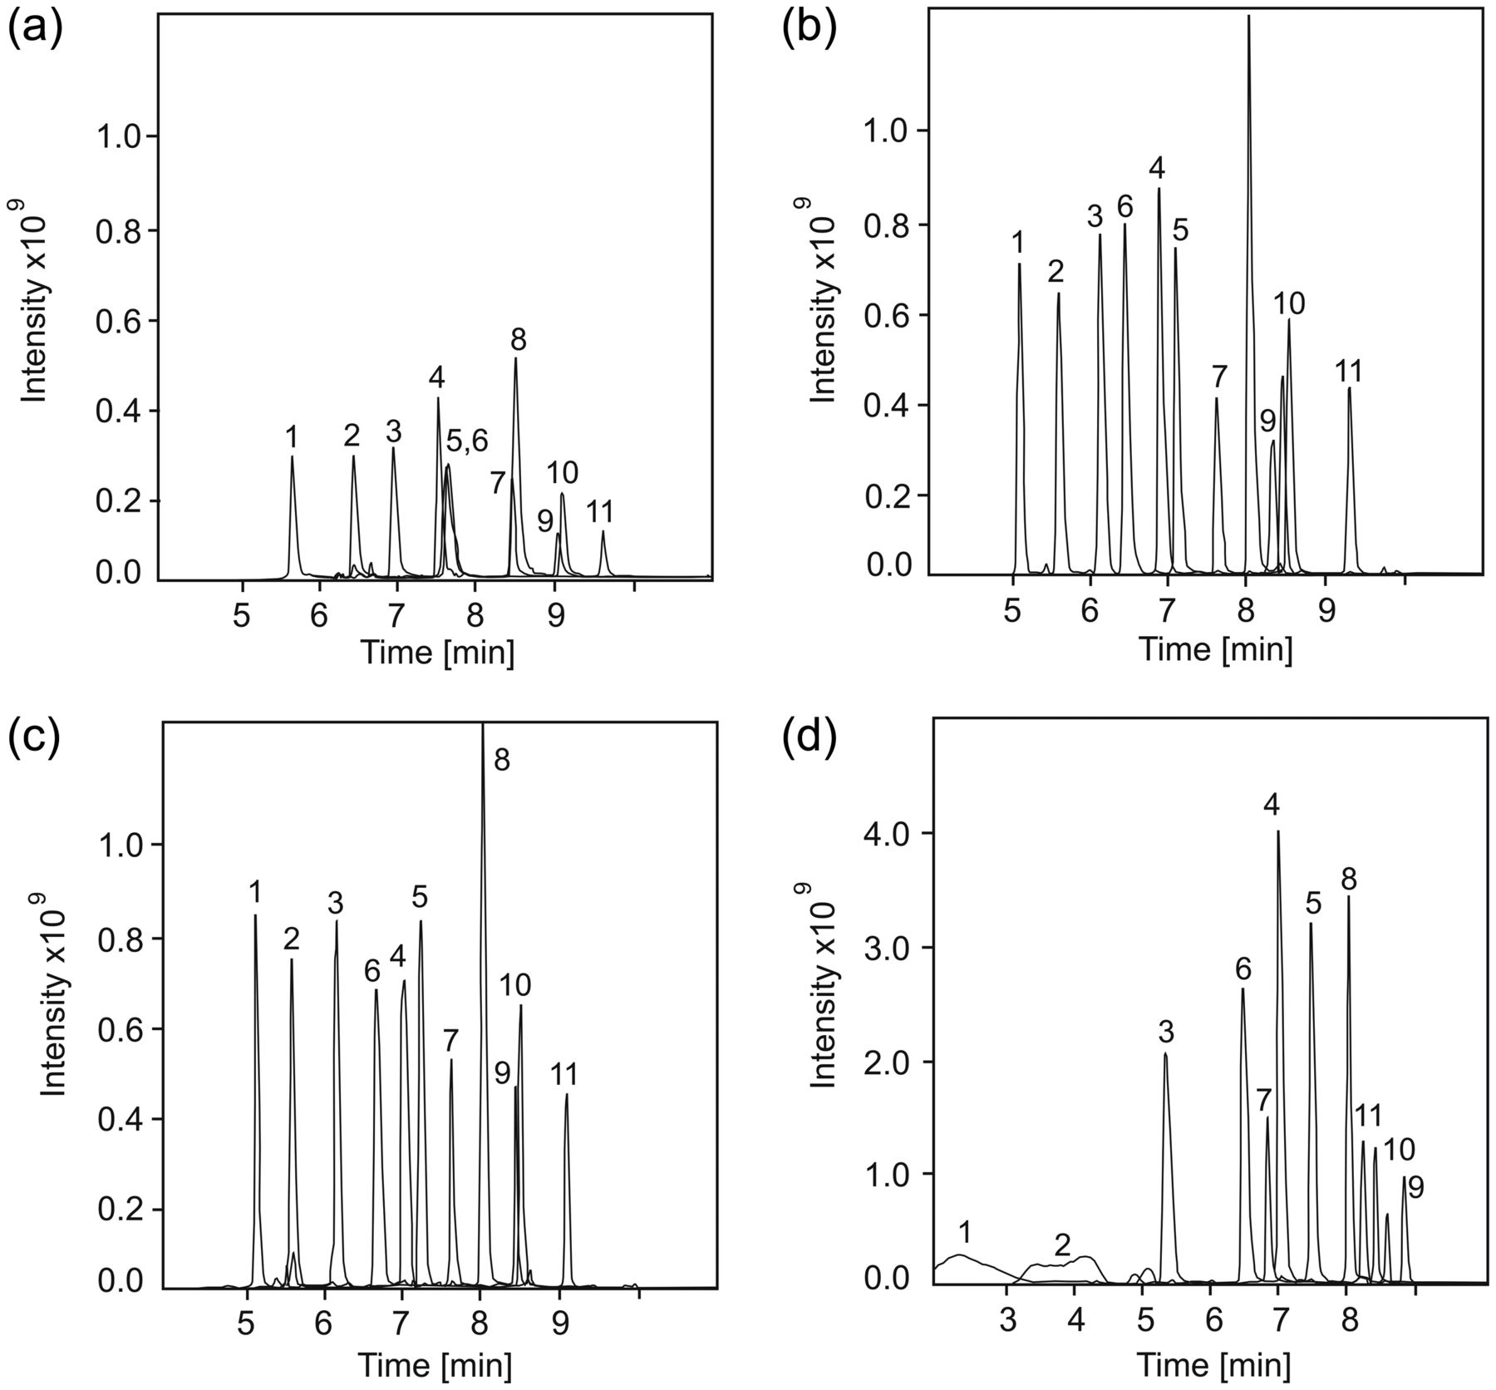
Figure 2. Extracted ion chromatograms of BSA digest analyzed on different capillary columns: 3 µm porous particles (a); ...
Notes:
Figure 2. Extracted ion chromatograms of BSA digest analyzed on different capillary columns: 3 µm porous particles (a); 2.7 µm fused-core particles (b); silica monolith (c); polymeric monolith (d). Separation conditions: flow rate of 1,000 nL/min, gradient time of 7.5 min. Injected amounts of sample: 500 fmol for silica-based columns and 200 fmol for the polymeric column MS detection. Reprinted from Journal of Chromatography B, Vol 912, Author(s): Dolman, S., Eeltink, S., Vaast, A., Pelzing, M., Investigation of carryover of peptides in nano-liquid chromatography/mass spectrometry using packed and monolithic capillary columns, Pages 56-63, Copyright (2012) with permission from Elsevier.
Unless provided in the caption above, the following copyright applies to the content of this slide: © The Author [2013]. Published by Oxford University Press. All rights reserved. For Permissions, please email: journals.permissions@oup.com

Slide 3
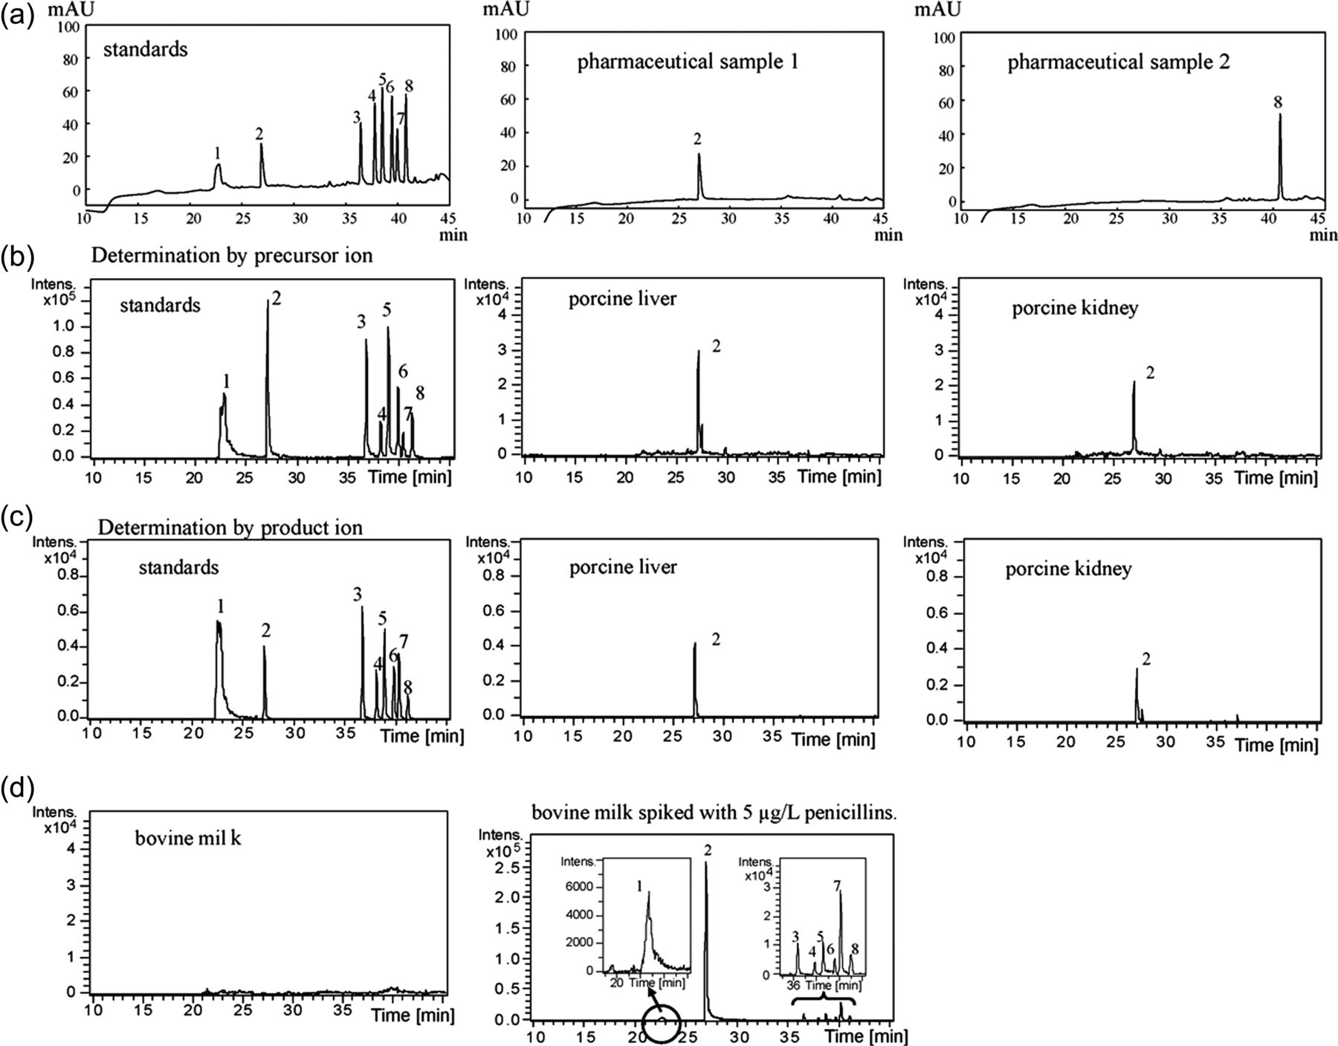
Figure 3. Chromatograms of penicillin standards or commercial products determined by nano-LC methods: penicillin ...
Notes:
Figure 3. Chromatograms of penicillin standards or commercial products determined by nano-LC methods: penicillin signals acquired by UV detection (λ = 200 nm) (a); penicillin signals acquired by MS detection, with mass signals determined by the precursor ions (b); penicillin signals acquired by MS detection, with mass signals determined by the product ions (c); penicillin signals acquired by MS detection, with mass signals determined by the precursor ions (d). Separation conditions: sample injection of 1,000 nL, C18 silica-based column (3 µm, 100 µm i.d. × 10 cm), acetonitrile (ACN) gradient elution at a flow rate of 200 nL/min. Peaks: amoxicillin (1), ampicillin (2), penicillin G (3), penicillin (4), oxacillin (5), cloxacillin (6), nafcillin (7) and dicloxacillin (8). Reprinted from Journal of Chromatography A, Vol 1216, Author(s): Hsieh, S.-H., Huang, H.-Y., Lee, S., Determination of eight penicillin antibiotics in pharmaceuticals, milk and porcine tissues by nano-liquid chromatography, Pages 7186-7194, Copyright (2009) with permission from Elsevier.
Unless provided in the caption above, the following copyright applies to the content of this slide: © The Author [2013]. Published by Oxford University Press. All rights reserved. For Permissions, please email: journals.permissions@oup.com

Slide 4
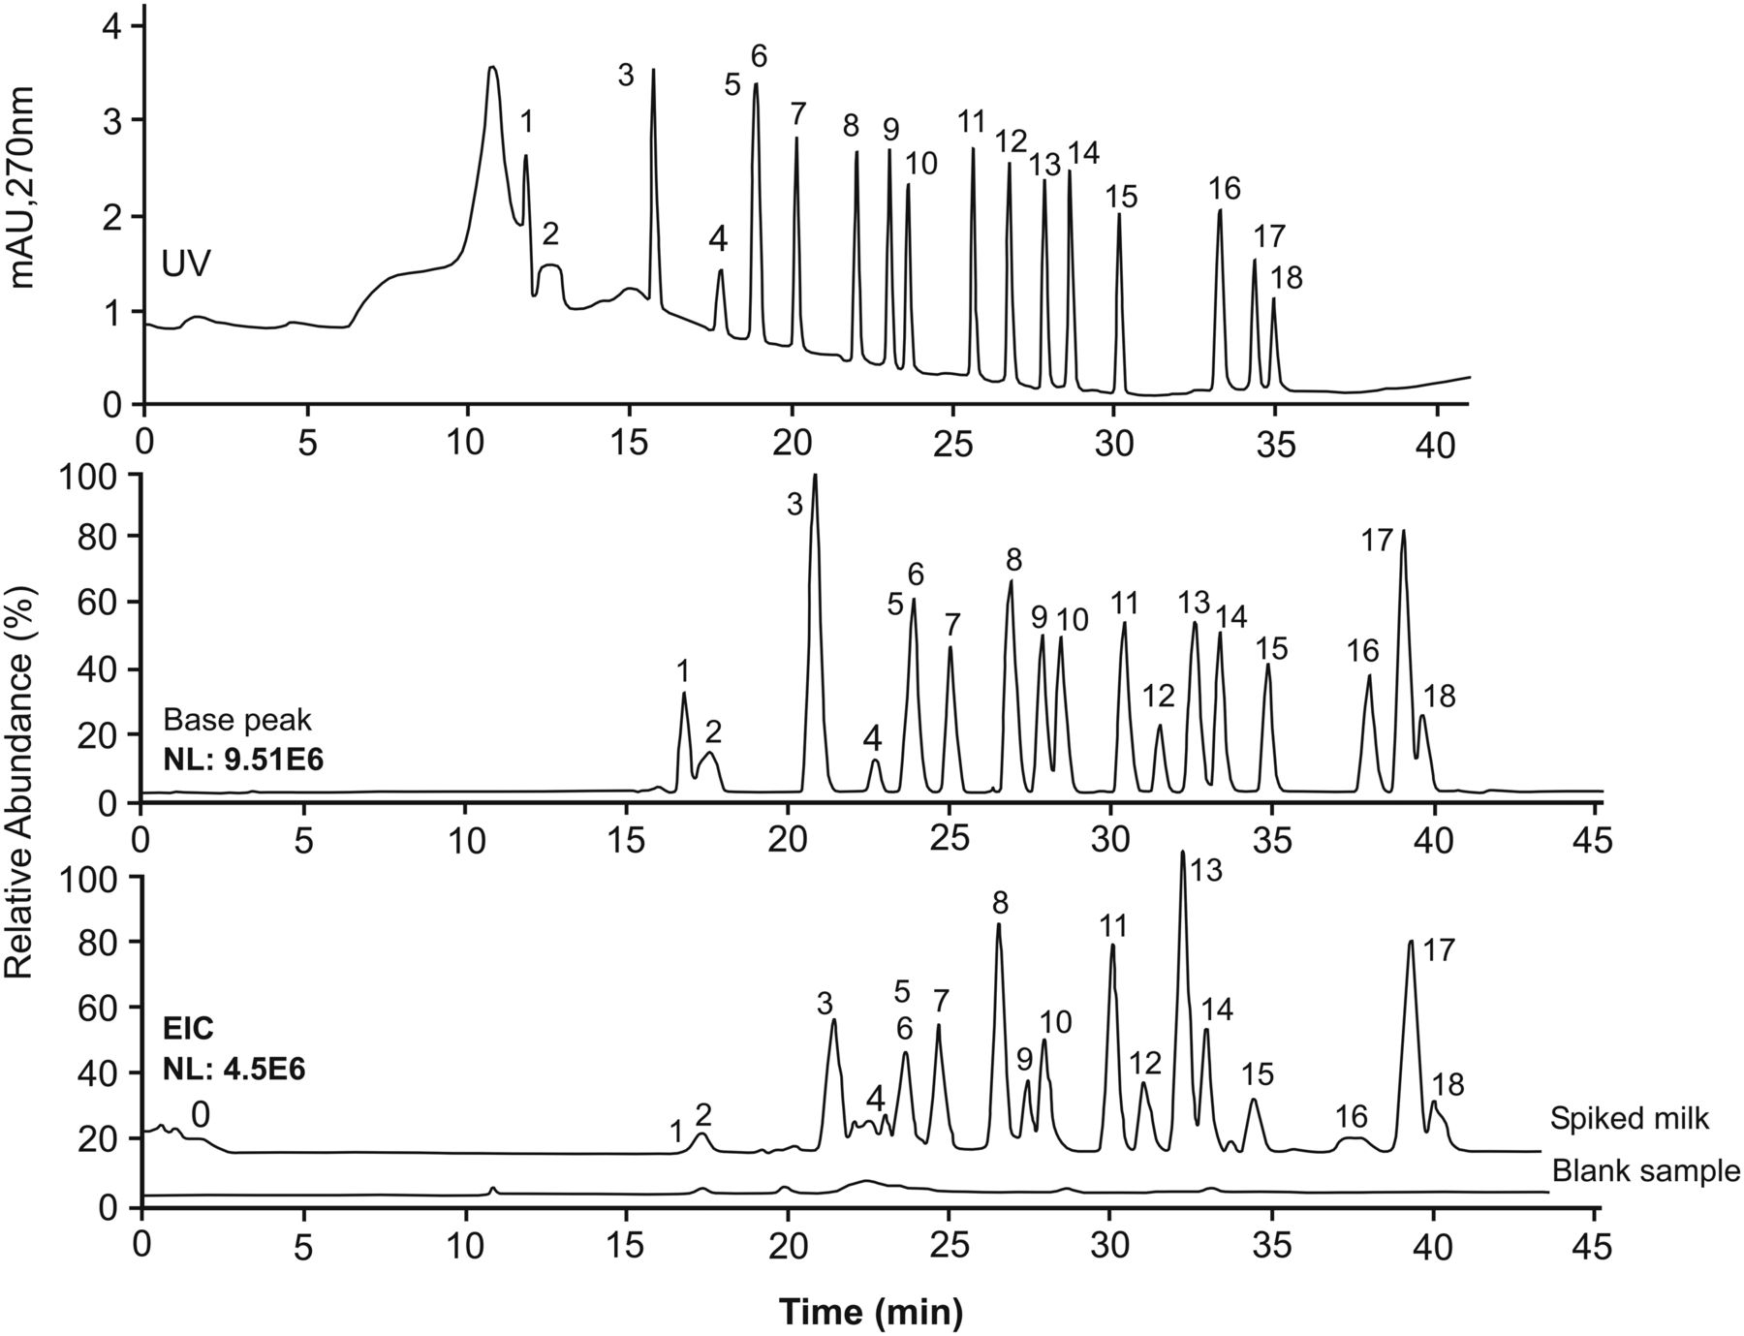
Figure 4. Comparison of nano-LC sulfonamide separations obtained while employing on-column focusing by using two ...
Notes:
Figure 4. Comparison of nano-LC sulfonamide separations obtained while employing on-column focusing by using two detection methods: UV detection (a); MS detection (b); MS detection (c). Milk spiked with 150 µg/kg of sulfa compounds. Separation conditions: 1,000 nL of injected sample, core-shell C18 column (3 µm, 100 µm i.d. × 25 cm of packed length), ACN gradient elution at a flow rate of 190 nL/min. Peak identifications: sulfaguanidine (1), sulfanilamide (2), sulfisomidine (3), sulfadiazine (4), sulfathiazole (5), sulfapyridine (6), sulfamerazine (7), sulfamethazine (8), sulfamethizole (9), sulfameter (10), sulfamonomethoxine (11), sulfachloropyridazine (12), sulfadoxin (13), sulfamethoxazole (14), sulfisoxazole (15), sulfabenzamide (16), sulfadimethoxine (17), sulfaquinoxaline (18). Reprinted from Journal of Chromatography A, Vol 1255, Author(s): D'Orazio, G., Rocchi, S., Fanali, S. Nano-liquid chromatography coupled with mass spectrometry: separation of sulfonamides employing non-porous core-shell particles, Pages 277-285, Copyright (2012) with permission from Elsevier.
Unless provided in the caption above, the following copyright applies to the content of this slide: © The Author [2013]. Published by Oxford University Press. All rights reserved. For Permissions, please email: journals.permissions@oup.com

