Slide 1
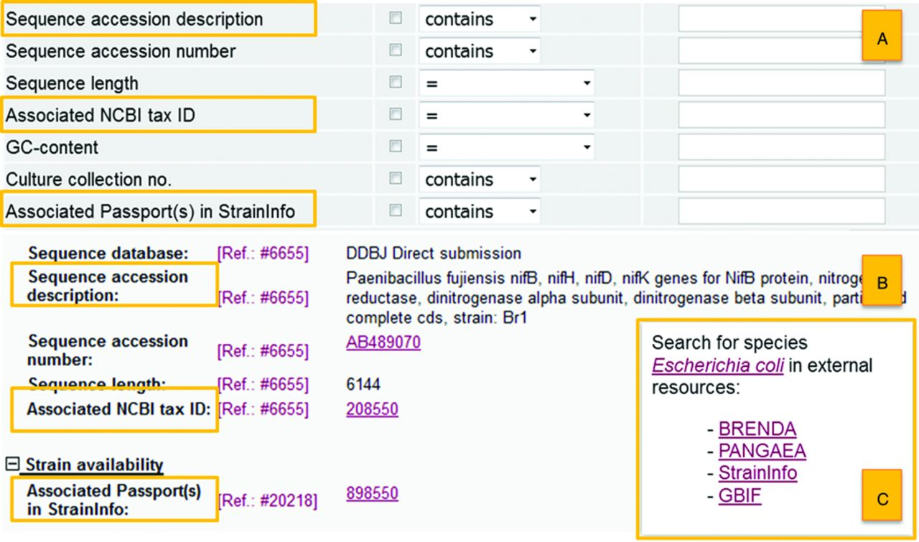
Figure 1. New features in the BacDive webportal: The advanced search (A) has been extended by additional search fields ...
Notes:
Figure 1. New features in the BacDive webportal: The advanced search (A) has been extended by additional search fields sequence accession description, associated NCBI tax ID, Associated Passport(s) in StrainInfo. These additional fields are also shown in the strain detail view (B). The new feature for facilitated searching in external web resources can also be found in the strain detail view (C).
Unless provided in the caption above, the following copyright applies to the content of this slide: © The Author(s) 2015. Published by Oxford University Press on behalf of Nucleic Acids Research.This is an Open Access article distributed under the terms of the Creative Commons Attribution License (http://creativecommons.org/licenses/by/4.0/), which permits unrestricted reuse, distribution, and reproduction in any medium, provided the original work is properly cited.

