Slide 1
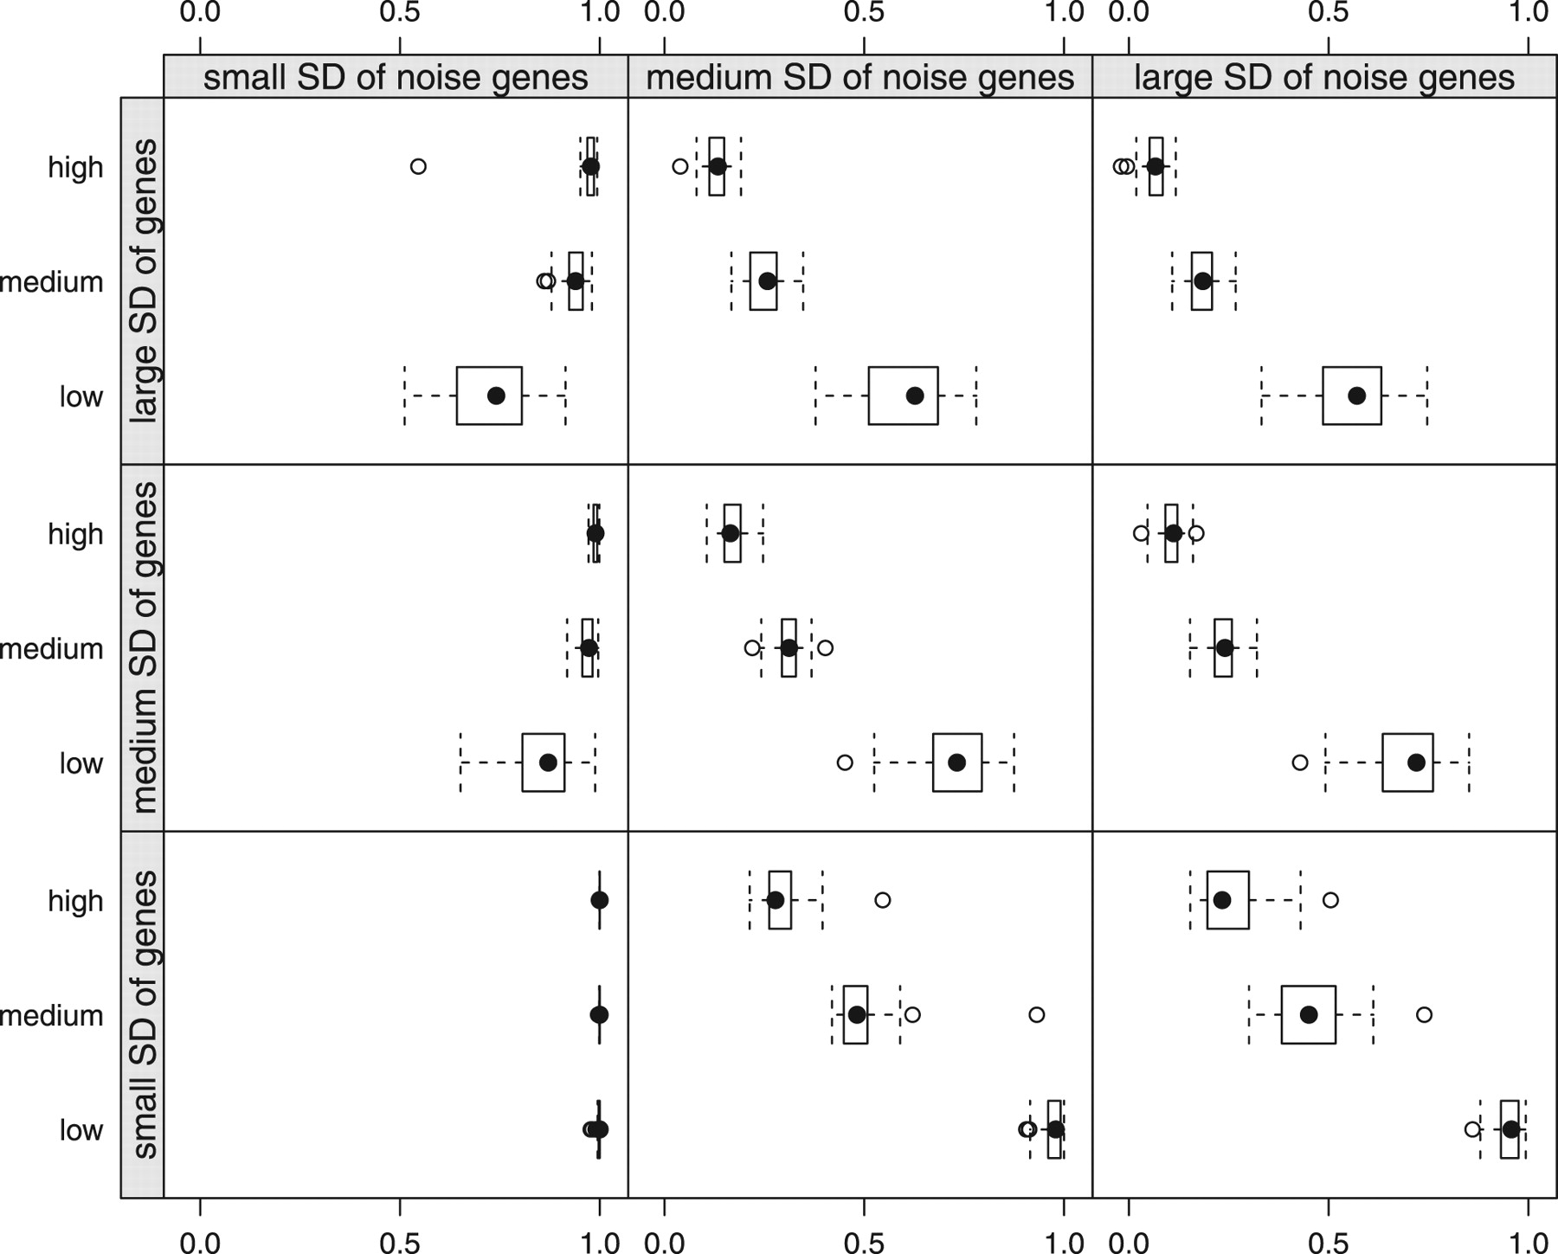
Fig. 1. Adjusted Rand index for initialization in the true classification for finite mixtures of LAMs with ...
Notes:
Fig. 1. Adjusted Rand index for initialization in the true classification for finite mixtures of LAMs with regularized estimation with the number of noise genes on the y-axis.
Unless provided in the caption above, the following copyright applies to the content of this slide: © The Author(s) 2011. Published by Oxford University Press.This is an Open Access article distributed under the terms of the Creative Commons Attribution Non-Commercial License (http://creativecommons.org/licenses/by-nc/3.0), which permits unrestricted non-commercial use, distribution, and reproduction in any medium, provided the original work is properly cited.

Slide 2
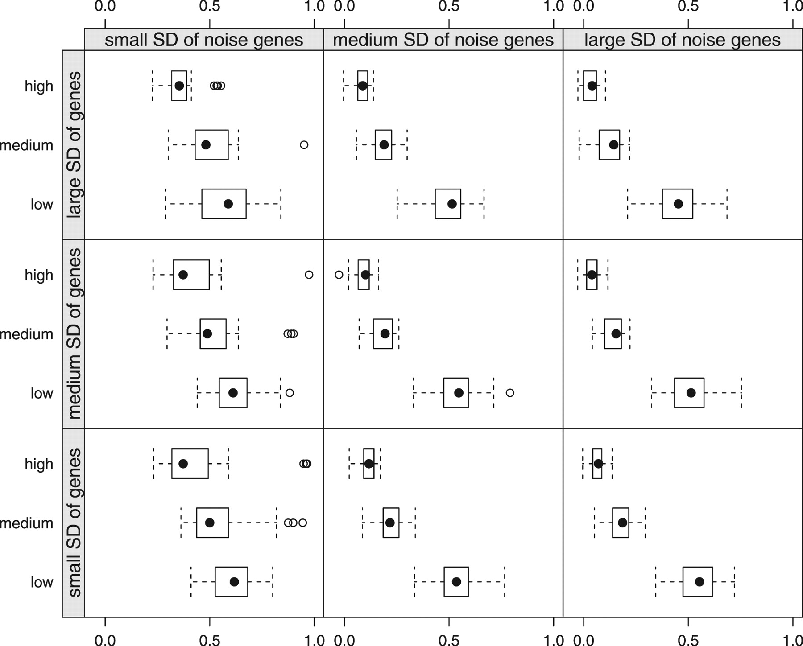
Fig. 2. Adjusted Rand index for the best models detected using short runs followed by a long run for finite mixtures ...
Notes:
Fig. 2. Adjusted Rand index for the best models detected using short runs followed by a long run for finite mixtures of LAMs with regularized estimation with the number of noise genes on the y-axis.
Unless provided in the caption above, the following copyright applies to the content of this slide: © The Author(s) 2011. Published by Oxford University Press.This is an Open Access article distributed under the terms of the Creative Commons Attribution Non-Commercial License (http://creativecommons.org/licenses/by-nc/3.0), which permits unrestricted non-commercial use, distribution, and reproduction in any medium, provided the original work is properly cited.

Slide 3
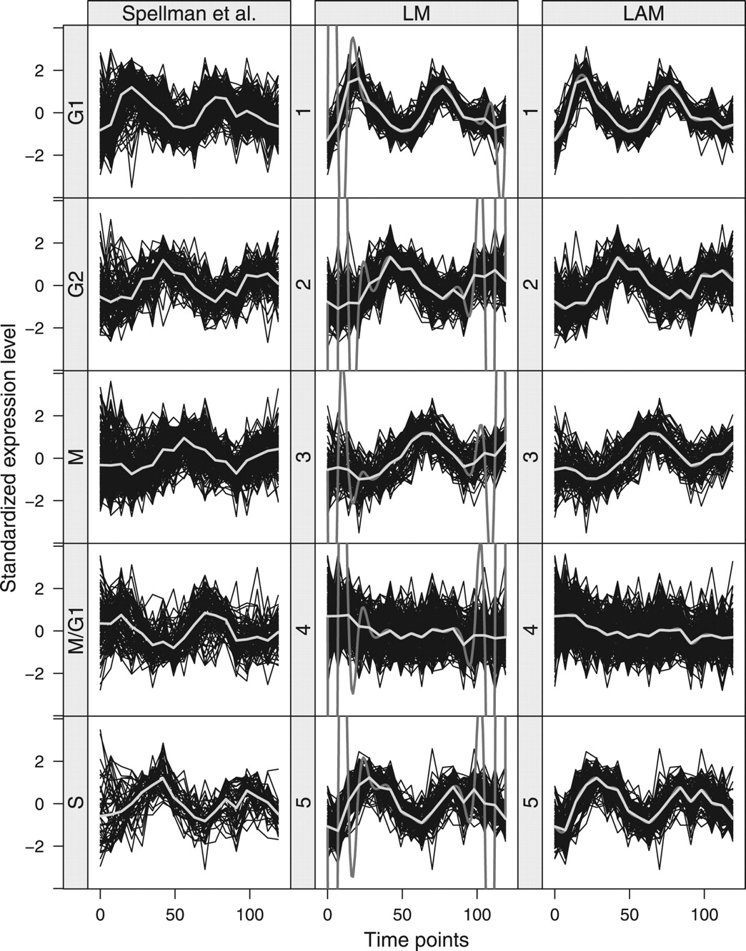
Fig. 3. Yeast cell cycle data using the Spellman et al. classification and the classification from fitted finite ...
Notes:
Fig. 3. Yeast cell cycle data using the Spellman et al. classification and the classification from fitted finite mixtures of LMs with unregularized estimation and LAMs with regularized estimation initialized in the Spellman et al. classification.
Unless provided in the caption above, the following copyright applies to the content of this slide: © The Author(s) 2011. Published by Oxford University Press.This is an Open Access article distributed under the terms of the Creative Commons Attribution Non-Commercial License (http://creativecommons.org/licenses/by-nc/3.0), which permits unrestricted non-commercial use, distribution, and reproduction in any medium, provided the original work is properly cited.

Slide 4
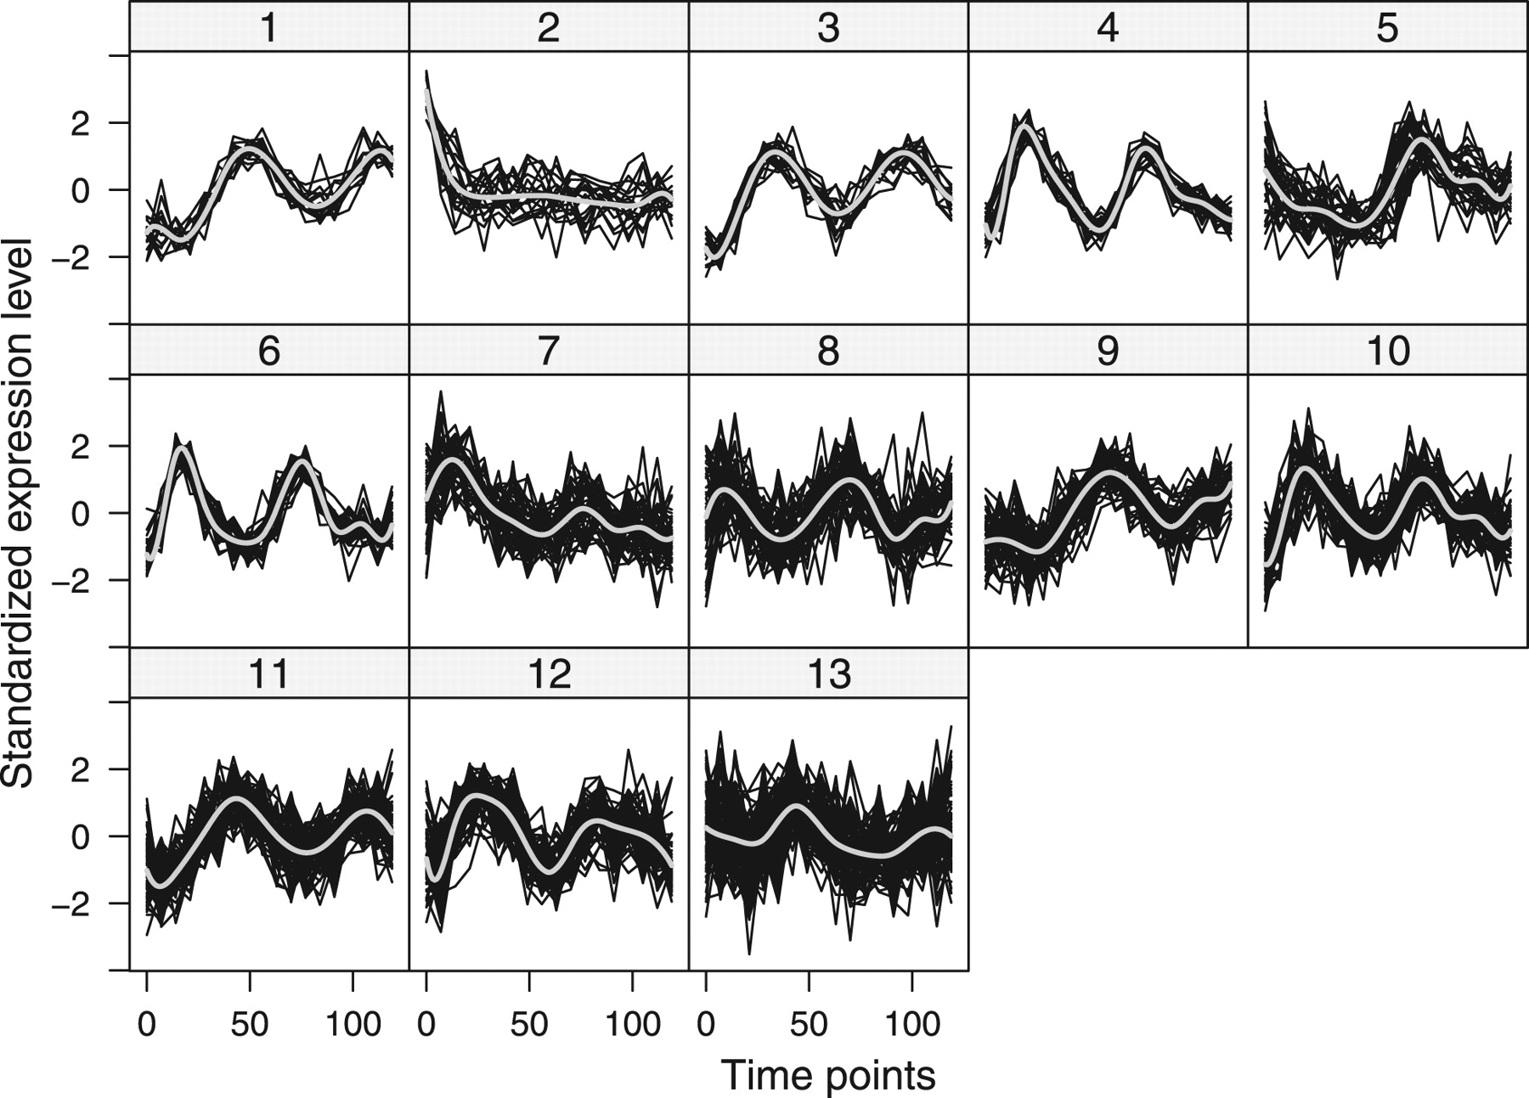
Fig. 4. Partition induced by the best finite mixture of LMs with unregularized estimation selected by the BIC ...
Notes:
Fig. 4. Partition induced by the best finite mixture of LMs with unregularized estimation selected by the BIC together with the fitted cluster curves.
Unless provided in the caption above, the following copyright applies to the content of this slide: © The Author(s) 2011. Published by Oxford University Press.This is an Open Access article distributed under the terms of the Creative Commons Attribution Non-Commercial License (http://creativecommons.org/licenses/by-nc/3.0), which permits unrestricted non-commercial use, distribution, and reproduction in any medium, provided the original work is properly cited.

Slide 5
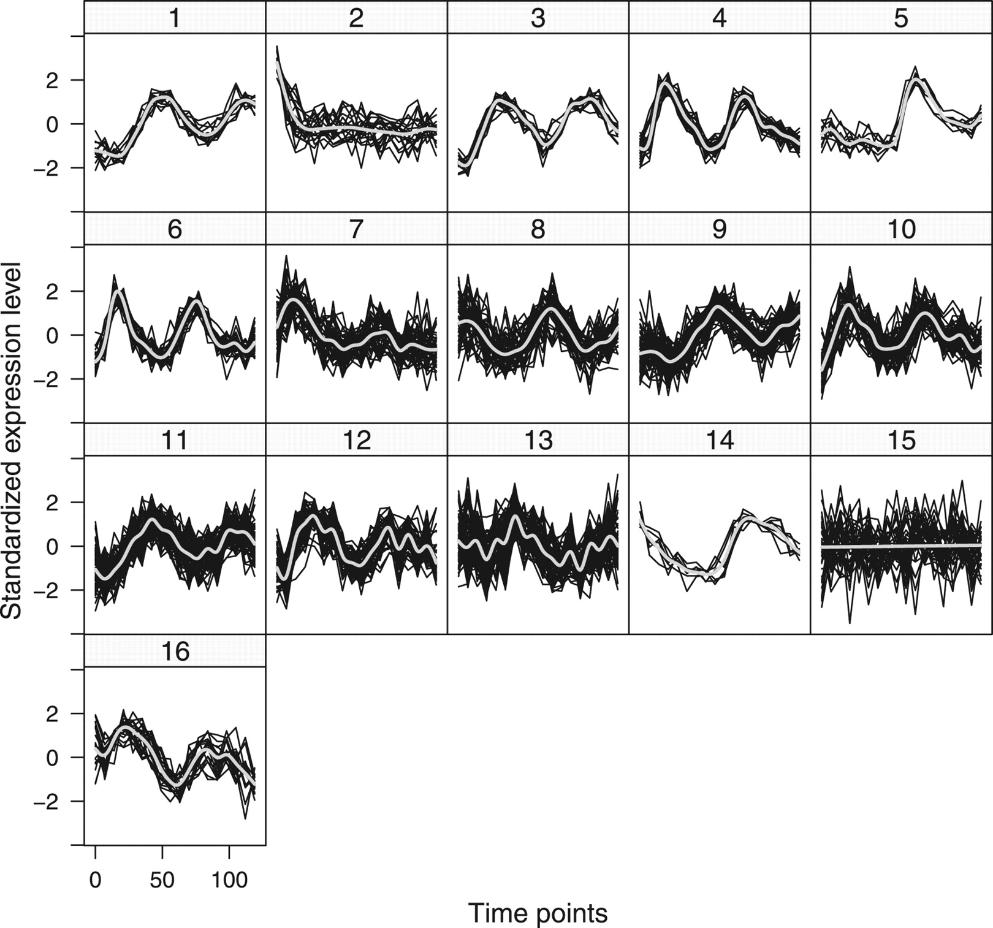
Fig. 5. Partition induced by the best finite mixture of LAMs with regularized estimation selected by the BIC together ...
Notes:
Fig. 5. Partition induced by the best finite mixture of LAMs with regularized estimation selected by the BIC together with the fitted cluster curves.
Unless provided in the caption above, the following copyright applies to the content of this slide: © The Author(s) 2011. Published by Oxford University Press.This is an Open Access article distributed under the terms of the Creative Commons Attribution Non-Commercial License (http://creativecommons.org/licenses/by-nc/3.0), which permits unrestricted non-commercial use, distribution, and reproduction in any medium, provided the original work is properly cited.

