Slide 1
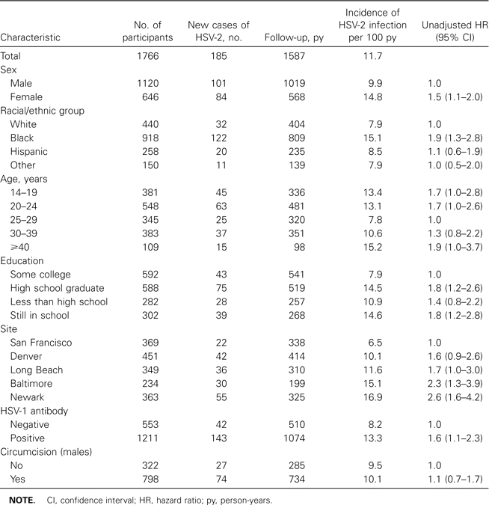
Table 1 Incidence of herpes simplex virus (HSV) type 2 infection, according to selected baseline characteristics.
Notes:
Table 1 Incidence of herpes simplex virus (HSV) type 2 infection, according to selected baseline characteristics.
Unless provided in the caption above, the following copyright applies to the content of this slide: © 2004 by the Infectious Diseases Society of America

Slide 2
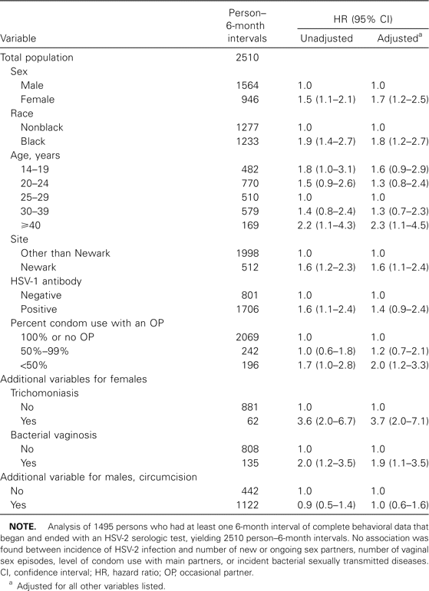
Table 2 Multivariate analysis of possible risk factors for incidence of herpes simplex virus (HSV) type 2 infection.
Notes:
Table 2 Multivariate analysis of possible risk factors for incidence of herpes simplex virus (HSV) type 2 infection.
Unless provided in the caption above, the following copyright applies to the content of this slide: © 2004 by the Infectious Diseases Society of America

Slide 3
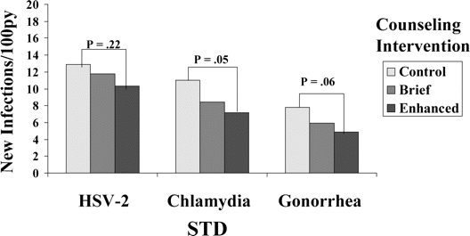
Figure 1 Incidence of herpes simplex virus type 2 (HSV-2) infection, and gonorrhea by counseling intervention arm. The ...
Notes:
Figure 1 Incidence of herpes simplex virus type 2 (HSV-2) infection, and gonorrhea by counseling intervention arm. The same pattern was seen for all 3 sexually transmitted diseases (STDs) with respect to counseling intervention arm with progressive decrease in incidence from control to brief counseling to enhanced counseling. However, the decrease in incidence by arm was greater for chlamydia and gonorrhea than it was for HSV-2 infection. py, person-years.
Unless provided in the caption above, the following copyright applies to the content of this slide: © 2004 by the Infectious Diseases Society of America

