Slide 1
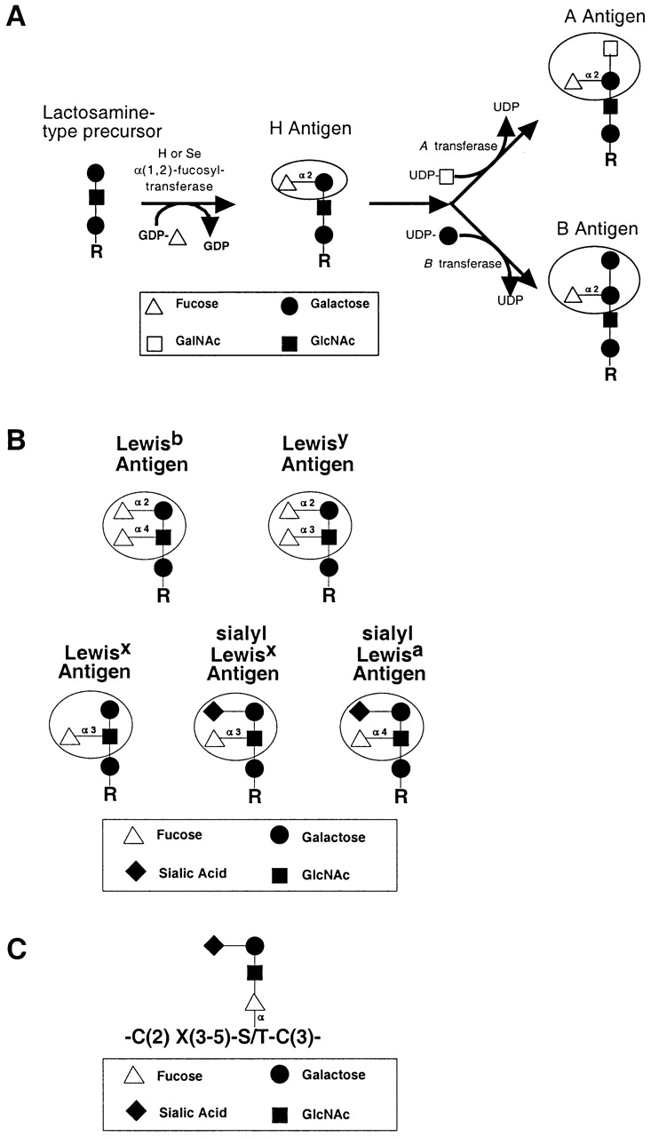
Fig. 1. Structures of common fucosylated glycans. (A) Synthesis of ABO blood group antigens. The H and Se ...
Notes:
Fig. 1. Structures of common fucosylated glycans. (A) Synthesis of ABO blood group antigens. The H and Se transferases are a pair of α(1,2)-fucosyltransferases that synthesize the H antigen in a variety of tissues. The ABO locus encodes a glycosyltransferase that further modifies the H antigen. The A allele at the ABO locus encodes an N-acteylgalactosaminyltransferase. The B allele encodes a galactosyltransferase that differs from the A transferase at four amino acid positions. The O allele at the ABO locus encodes a truncated, enzymatically inactive protein. (B) Lewis-related antigens. Circles indicate the immunodominant portion of each antigen. (C) A representative O-linked fucose glycan. Fucose modifies serines or threonine within the broad consensus site shown here, and in Table I. R indicates glycolipid and N- and O-linked glycoprotein precursors.
Unless provided in the caption above, the following copyright applies to the content of this slide: © Oxford University Press 2003; all rights reserved.

Slide 2
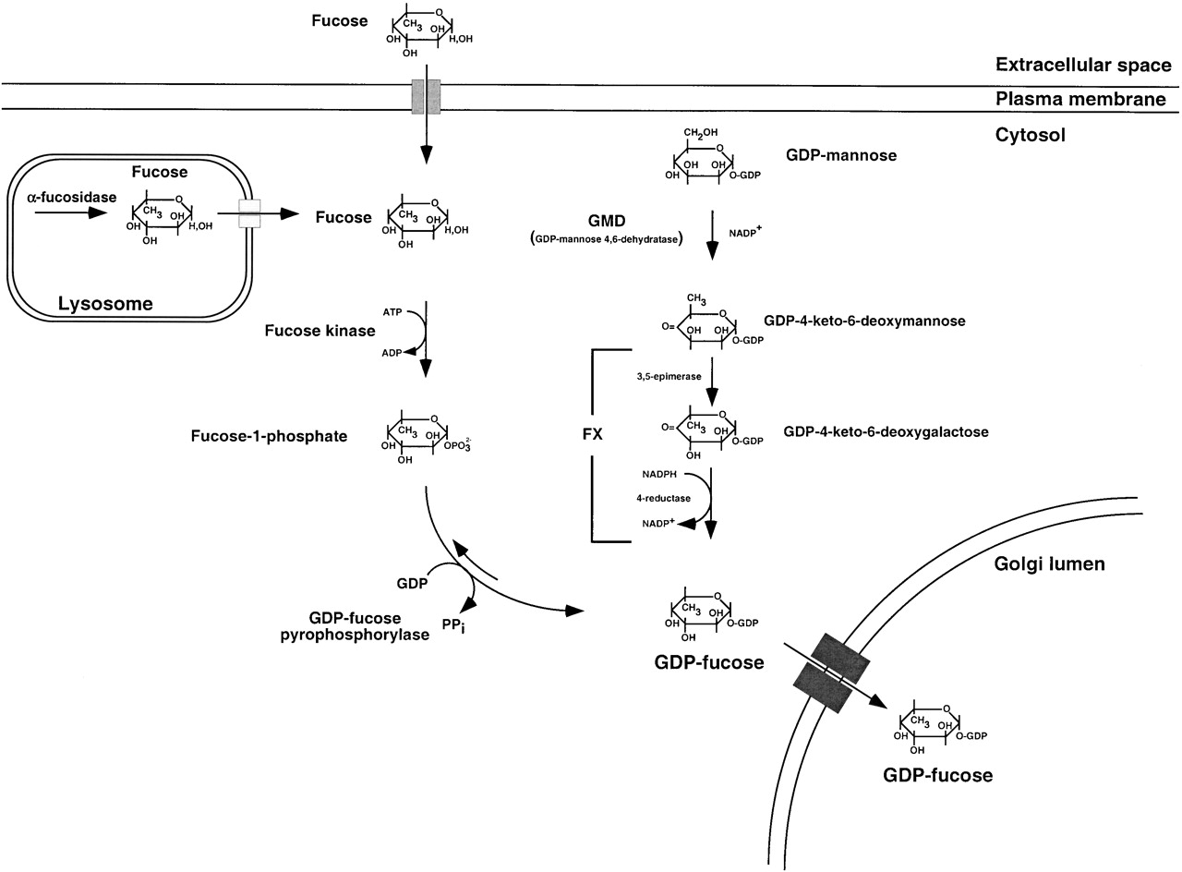
Fig. 2. Biosynthesis of GDP-fucose. In mammalian cells, GDP-fucose is synthesized by two distinct pathways. The de ...
Notes:
Fig. 2. Biosynthesis of GDP-fucose. In mammalian cells, GDP-fucose is synthesized by two distinct pathways. The de novo pathway is characterized by conversion of GDP-mannose to GDP-4-keto-6-deoxymannose by GMD. This keto intermediate is then converted to GDP-fucose by an epimerase/reductase known as the FX protein. An alternative salvage pathway can yield GDP-fucose derived directly from fucose. The salvage pathway utilizes fucose that is transported into the cytosol from an extracellular origin or fucose that is liberated from catabolism of fucosylated glycans in the lysosome and then transported into the cytosol. The salvage pathway is enabled by fucose kinase and GDP-fucose pyrophosphorylase, with fucose-1-phosphate is the metabolic intermediate. GDP-fucose synthesized by these pathways is then transported into the lumen of the Golgi apparatus where it becomes available to the catalytic domains of fucosyltransferases that also localize to this membrane-delimited compartment within the secretory pathway.
Unless provided in the caption above, the following copyright applies to the content of this slide: © Oxford University Press 2003; all rights reserved.

