Slide 1
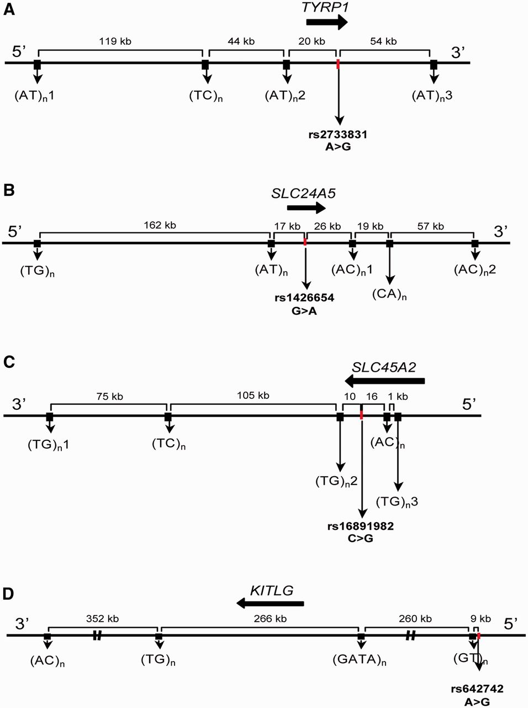
Fig. 1. Schematic representation of the genetic intervals including tag-SNPs and microsatellites used to characterize ...
Notes:
Fig. 1. Schematic representation of the genetic intervals including tag-SNPs and microsatellites used to characterize HD. The approximate locations of pigmentation genes are indicated by black arrows. The full characterization of each tag-SNP and microsatellite is reported in supplementary table S1, Supplementary Material online. (A) TYRP1; (B) SLC24A5; (C) SLC45A2; and (D) KITLG.
Unless provided in the caption above, the following copyright applies to the content of this slide: © The Author 2012. Published by Oxford University Press on behalf of the Society for Molecular Biology and Evolution. All rights reserved. For permissions, please e-mail: journals.permissions@oup.com

Slide 2
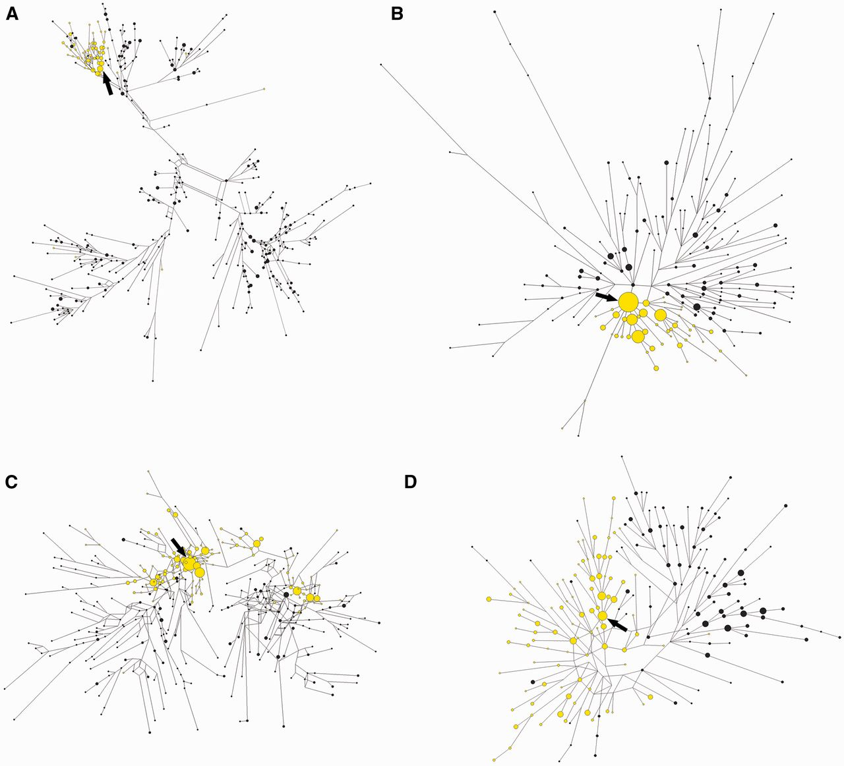
Fig. 2. Median-joining networks representing the relationships between compound SNP/microsatellite haplotypes ...
Notes:
Fig. 2. Median-joining networks representing the relationships between compound SNP/microsatellite haplotypes associated with different pigmentation genes. Ancestral (black) and derived (yellow) lineages from the pooled sample of European, East Asian, and African populations are shown. Each circle represents a different haplotype. The area of the circles is proportional to the frequency of the haplotype in the populations. The arrows point to the putative ancestral haplotype of each derived lineage. (A) TYRP1; (B) SLC24A5; (C) SLC45A2; and (D) KITLG.
Unless provided in the caption above, the following copyright applies to the content of this slide: © The Author 2012. Published by Oxford University Press on behalf of the Society for Molecular Biology and Evolution. All rights reserved. For permissions, please e-mail: journals.permissions@oup.com

Slide 3
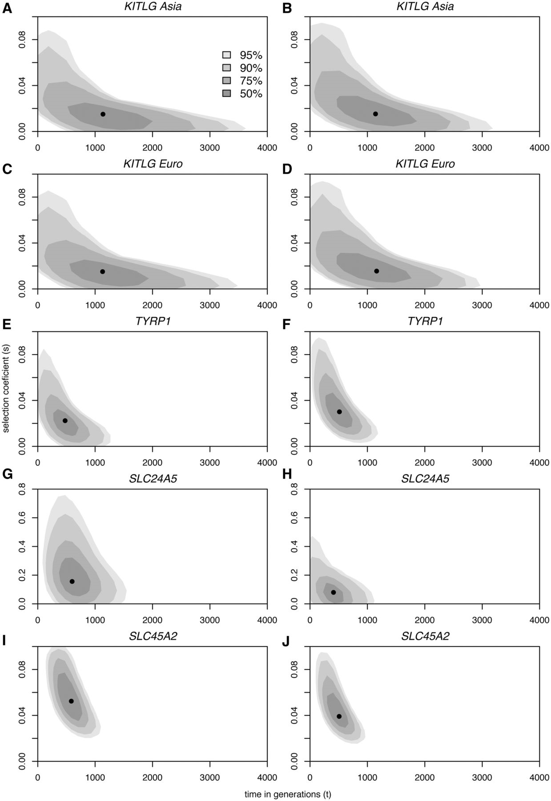
Fig. 3. Biplots of the posterior densities of the times of onset of selective sweeps in generations (x axes) and ...
Notes:
Fig. 3. Biplots of the posterior densities of the times of onset of selective sweeps in generations (x axes) and selection coefficients (y axes), at each of four tag SNPs at the KITLG (A–D), TYRP1 (E,F), SLC24A5 (G,H), and SLC45A2 (I,J) loci, assuming dominant (A, C, E, G, I) and additive (B, D, F, H, J) models of selection. The mode is marked by a black dot. Shades of gray with decreasing intensity indicate 50, 75, 90, and 95% HDR.
Unless provided in the caption above, the following copyright applies to the content of this slide: © The Author 2012. Published by Oxford University Press on behalf of the Society for Molecular Biology and Evolution. All rights reserved. For permissions, please e-mail: journals.permissions@oup.com

