Slide 1
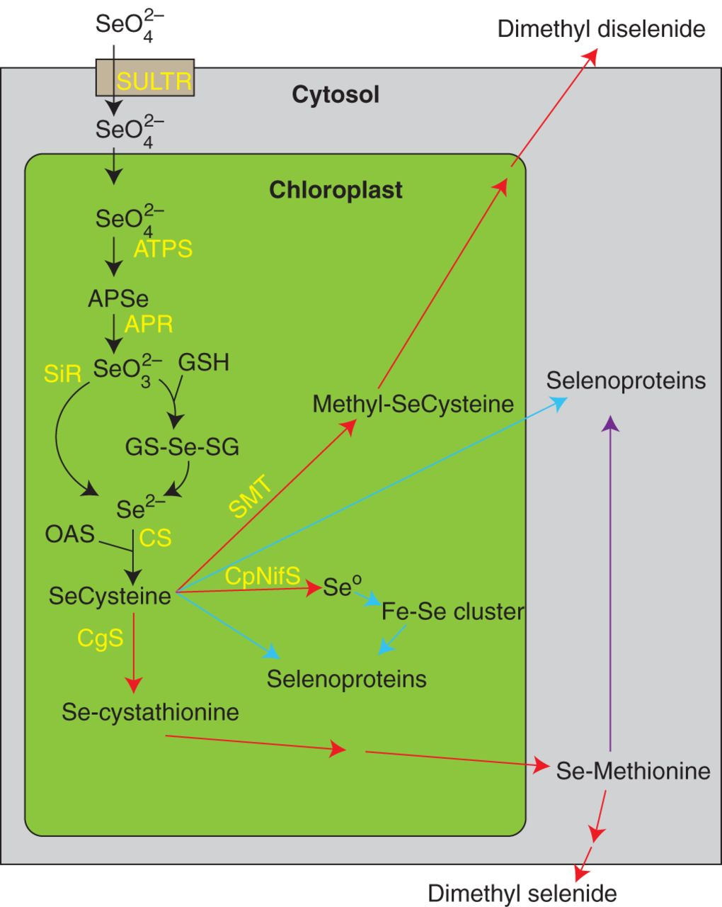
Fig. 1. Schematic diagram of Se metabolism in plants. Selenium metabolites are depicted in black, and proteins ...
Notes:
Fig. 1. Schematic diagram of Se metabolism in plants. Selenium metabolites are depicted in black, and proteins involved in Se transport and metabolism are in yellow. Arrows in blue and red are considered, respectively, to promote and to alleviate Se toxicity associated with the assimilation of selenocysteine. The purple arrow is not considered toxic. SULTR, sulphur transporter; ATPS, ATP sulphurylase; APR, adenosine 5-phosphosulfate reductase; SiR, sulphite reductase; CS, cysteine synthase; SMT, selenocysteine methyltransferase; CgS, cysthathionine gamme synthase; APSe, adenosine phosphoselenate; GSH, glutathione; GS-Se-SG, selenodiglutathione; OAS, o-acetylserine.
Unless provided in the caption above, the following copyright applies to the content of this slide: © The Author 2013. Published by Oxford University Press on behalf of the Annals of Botany Company. All rights reserved. For Permissions, please email: journals.permissions@oup.com

Slide 2
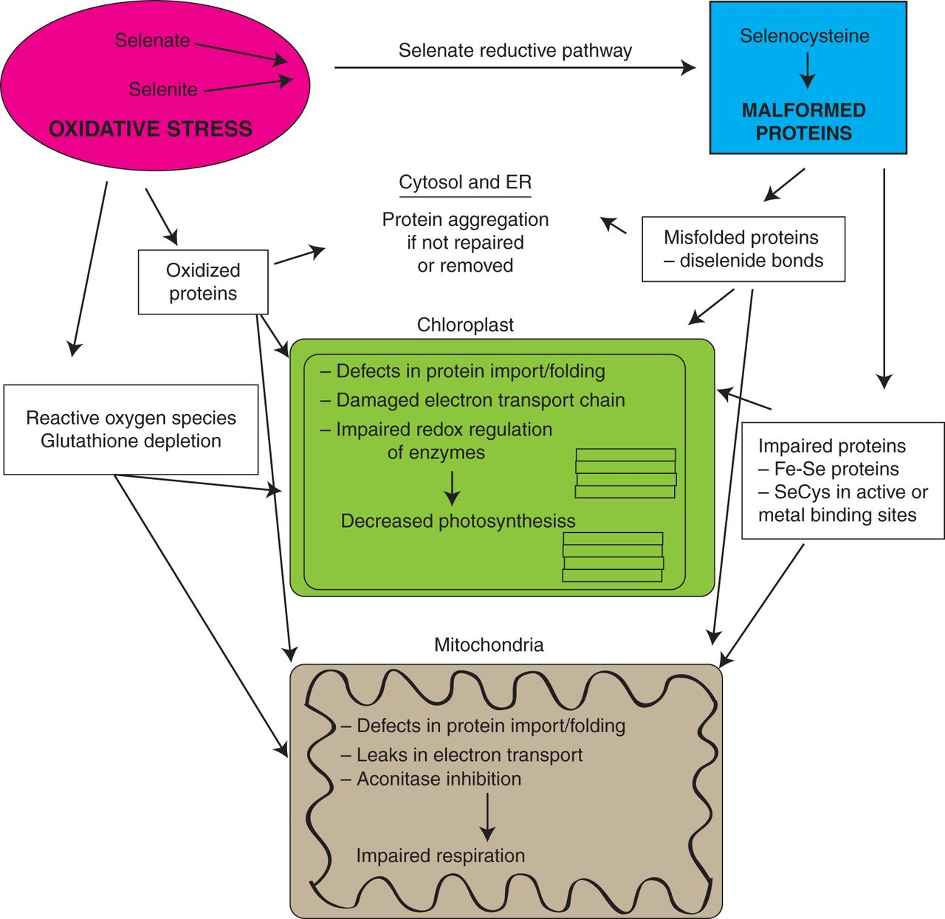
Fig. 2. A proposed model describing how the two distinct types of Se toxicity might affect plant physiology. ...
Notes:
Fig. 2. A proposed model describing how the two distinct types of Se toxicity might affect plant physiology. Inorganic Se contributes to oxidative stress, while its reduction to selenocysteine can inadvertently replace cysteine to create malformed selenoproteins. The possible targets and ramifications of Se-induced oxidative stress and non-specific selenoproteins are proposed, and illustrate the challenges of deciphering if Se stress is more attributable to just one mode of toxicity.
Unless provided in the caption above, the following copyright applies to the content of this slide: © The Author 2013. Published by Oxford University Press on behalf of the Annals of Botany Company. All rights reserved. For Permissions, please email: journals.permissions@oup.com

