Slide 1
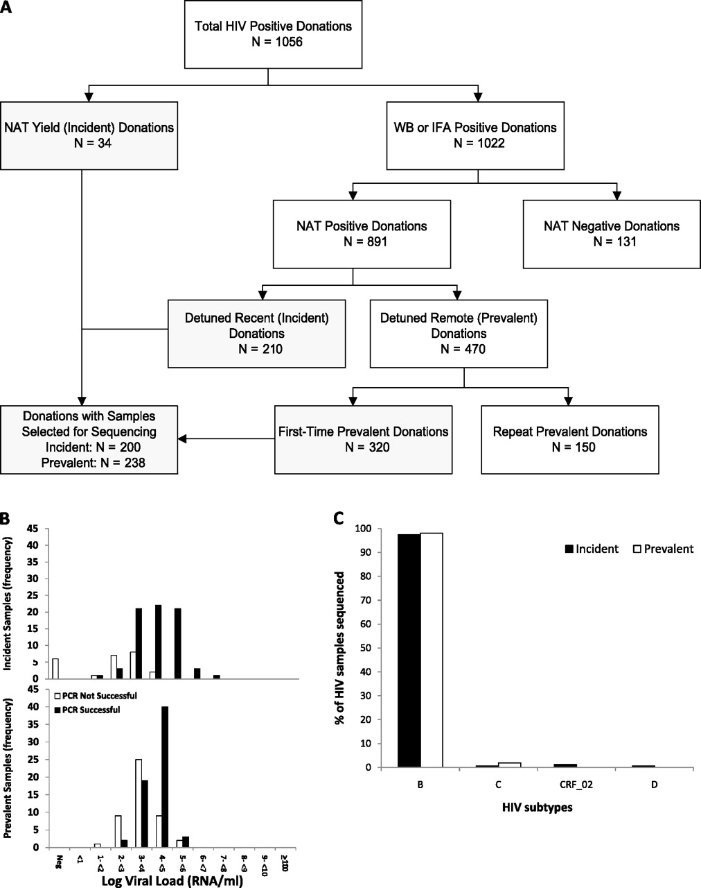
Figure 1. A, Algorithm for classification of human immunodeficiency virus (HIV)–positive donations as incident or ...
Notes:
Figure 1. A, Algorithm for classification of human immunodeficiency virus (HIV)–positive donations as incident or prevalent infections for selection of cases for sequencing. Boxes in gray indicate the donations from which samples were selected for sequencing for this study. B, Histograms showing success of polymerase chain reaction (PCR) relative to viral loads; frequencies of donations from incident and prevalent cases are shown separately. C, HIV subtypes of sequenced samples by incident and prevalent case status. Abbreviations: IFA, immunofluorescence assay; NAT, nucleic acid testing; WB, Western blot.
Unless provided in the caption above, the following copyright applies to the content of this slide: © The Author 2012. Published by Oxford University Press on behalf of the Infectious Diseases Society of America. All rights reserved. For Permissions, please e-mail: journals.permissions@oup.com

Slide 2
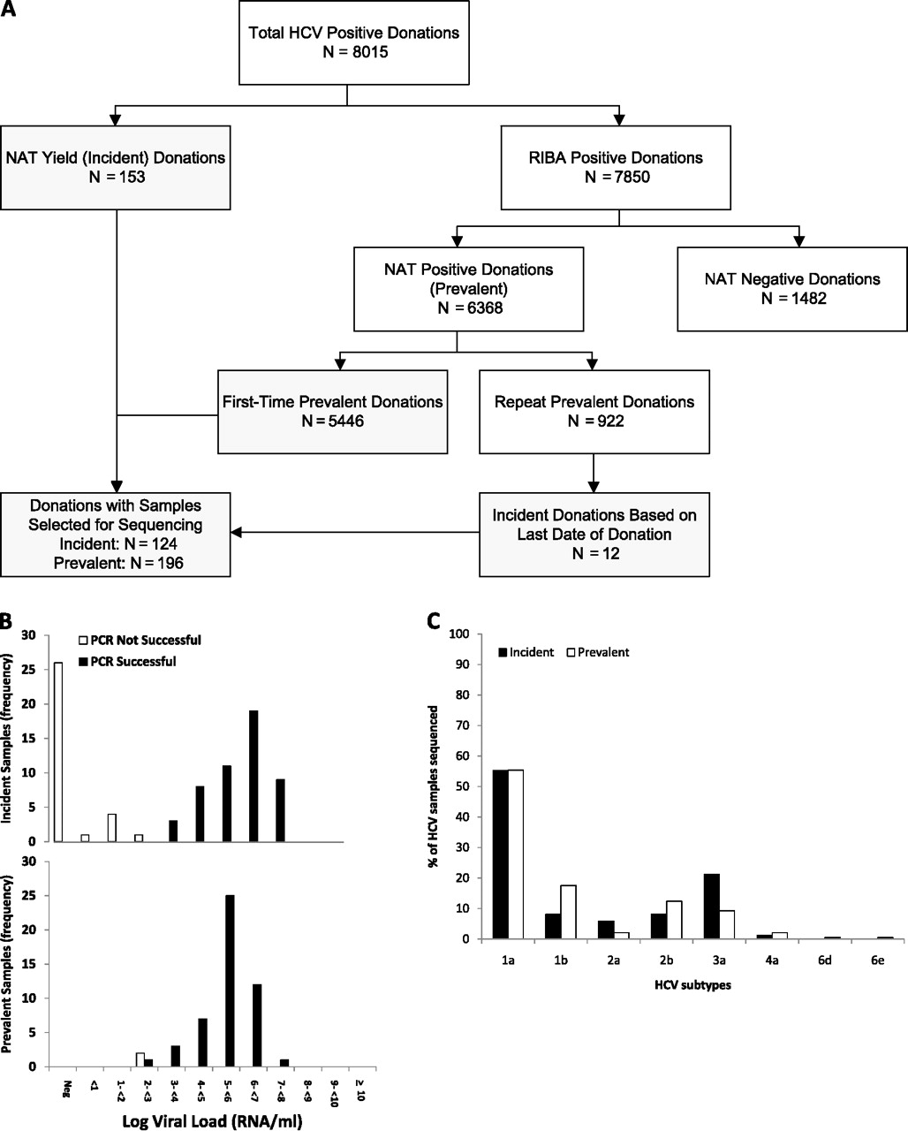
Figure 2. A, Algorithm for classification of hepatitis C virus (HCV)–positive donations as incident or prevalent ...
Notes:
Figure 2. A, Algorithm for classification of hepatitis C virus (HCV)–positive donations as incident or prevalent infections for selection of cases for sequencing. Boxes in gray indicate the donations from which samples were selected for sequencing for this study. B, Histograms showing success of polymerase chain reaction (PCR) relative to viral loads; frequencies of donations from incident and prevalent cases are shown separately. C, HCV subtypes of sequenced samples by incident and prevalent case status. Abbreviations: NAT, nucleic acid testing; RIBA, recombinant immunoblot assay.
Unless provided in the caption above, the following copyright applies to the content of this slide: © The Author 2012. Published by Oxford University Press on behalf of the Infectious Diseases Society of America. All rights reserved. For Permissions, please e-mail: journals.permissions@oup.com

Slide 3
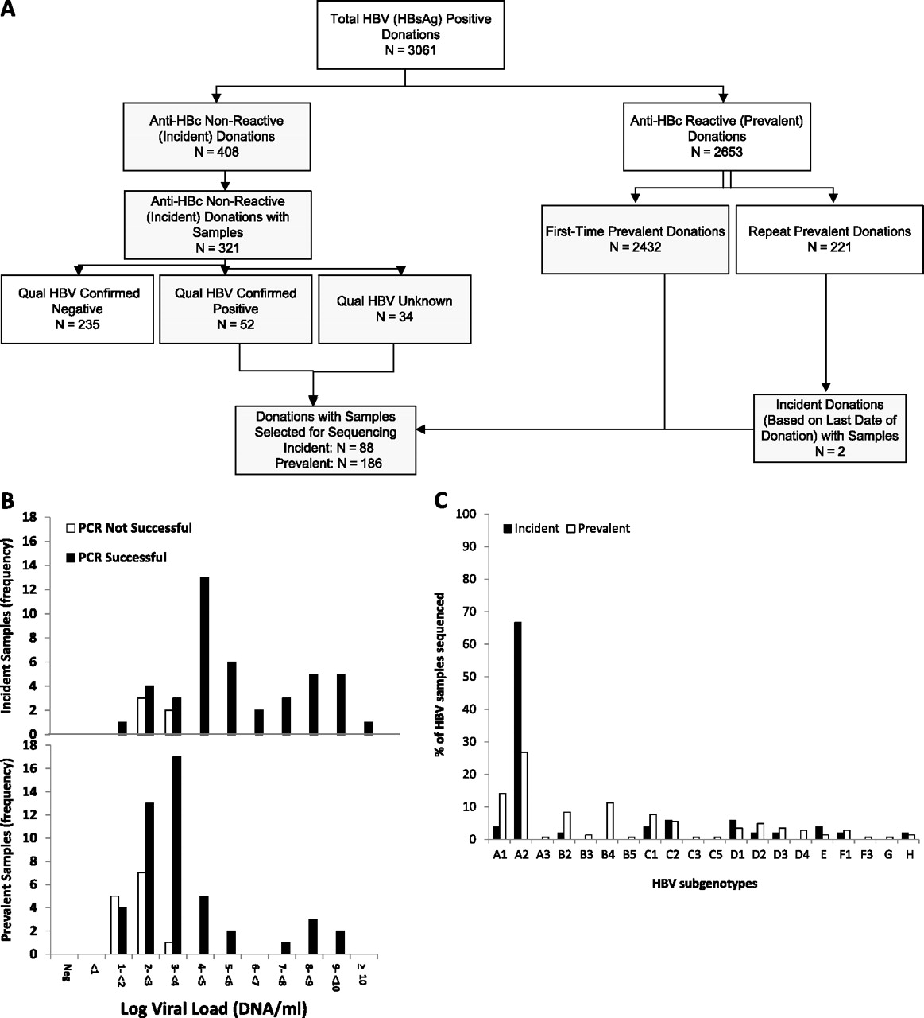
Figure 3. A, Algorithm for classification of hepatitis B virus (HBV)–positive donations as incident or prevalent ...
Notes:
Figure 3. A, Algorithm for classification of hepatitis B virus (HBV)–positive donations as incident or prevalent infections for selection of cases for sequencing. Boxes in gray indicate the donations from which samples were selected for sequencing for this study. B, Histograms showing success of polymerase chain reaction (PCR) relative to viral loads; frequencies of donations from incident and prevalent cases are shown separately. C, HBV subgenotypes of sequenced samples by incident and prevalent case status. Abbreviations: HBc, anti-HBV core antibody; HBsAg, HBV surface antigen.
Unless provided in the caption above, the following copyright applies to the content of this slide: © The Author 2012. Published by Oxford University Press on behalf of the Infectious Diseases Society of America. All rights reserved. For Permissions, please e-mail: journals.permissions@oup.com

