Slide 1
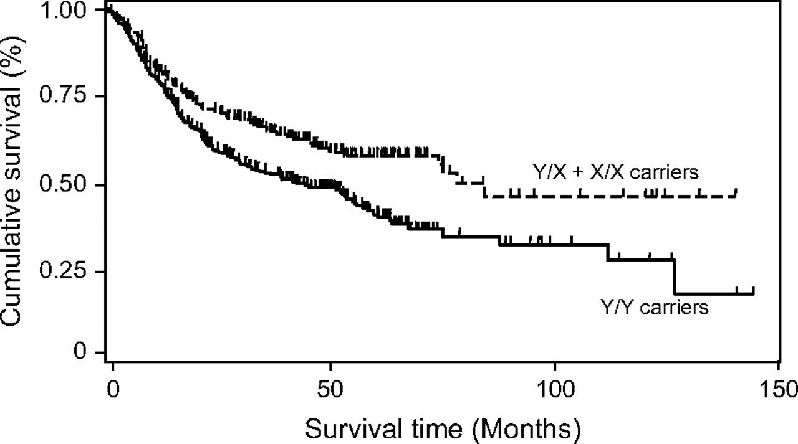
Fig. 1 MBL2 Y/X promoter single-nucleotide polymorphism (SNP) genotype in relation to lung cancer survival among ...
Notes:
Fig. 1 MBL2 Y/X promoter single-nucleotide polymorphism (SNP) genotype in relation to lung cancer survival among white patients: Kaplan–Meier survival analysis. Cumulative disease-specific survival of white patients with lung cancer is presented by MBL2 Y/X SNP status (patients at risk at time zero = 533). Survival of patients who carried the variant X allele (patients at risk at time zero = 204) was statistically significantly better than that of patients with the common Y/Y genotype (patients at risk at time zero = 329; two-sided log-rank test: P<.001). The 5-year cumulative survival rate was 41.5% (95% CI = 35.0% to 47.9%) for patients with the Y/Y genotype (patients at risk at 5 years = 53) and 58.2% (CI = 50.0% to 65.4%) for patients with at least one X allele (patients at risk at 5 years = 43). At the end of the follow-up period (12 years), the cumulative survival rate was 18.9% (95% CI = 5.8% to 37.7%) for patients with the Y/Y genotype and 46.6% (CI = 32.2% to 58.0%) for patients with at least one X allele.
Unless provided in the caption above, the following copyright applies to the content of this slide: Published by Oxford University Press 2007.

