Slide 1
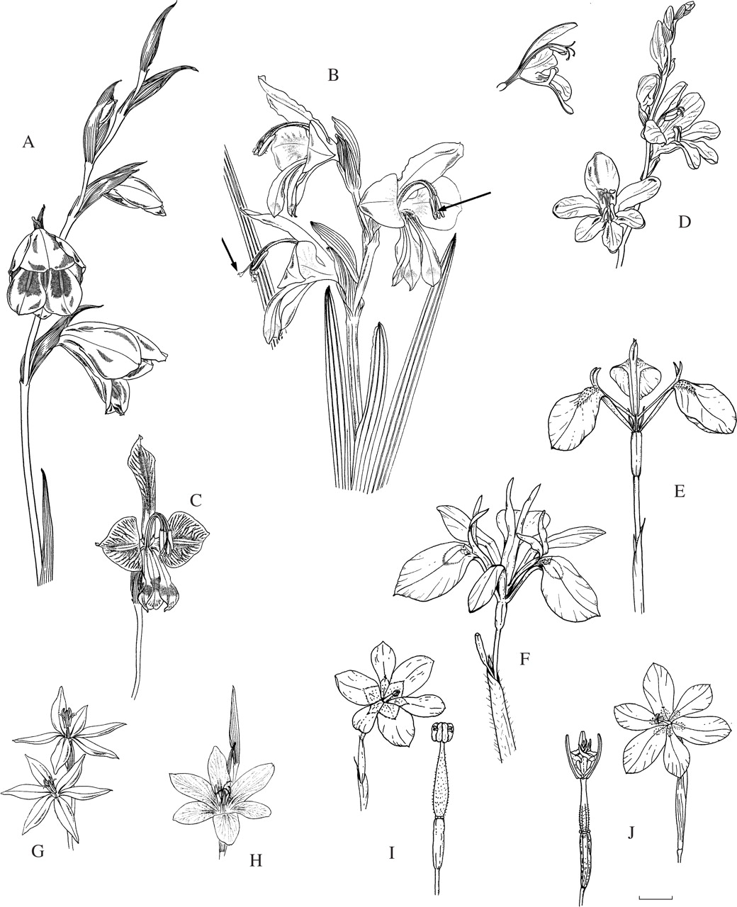
Fig. 1. Flowers pollinated by bees, using either the large anthophorine system (A–F) or the pollen-collecting female ...
Notes:
Fig. 1. Flowers pollinated by bees, using either the large anthophorine system (A–F) or the pollen-collecting female bee system (G–J). (A) Gladiolus papilio, with arched dorsal tepal concealing the stamens and style branches. (B) G. alatus, arrows indicate flowers in male phase (style branches folded together and style not extended) or female phase (style extended, style branches unfolded and stigmatic tips expanded). (C) G. uysiae. (D) Tritonia watermeyeri, with tooth-like ridges on lower three tepals. (E) Moraea tripetala. (F) M. papilionacea. (G) Gladiolus stellatus. (H) G. quadrangulus. (I) Moraea bifida. (J) M. marlothii. I and J with the staminal column enlarged to show anthers in close proximity to stigmatic surfaces. Scale bar = 10 mm.
Unless provided in the caption above, the following copyright applies to the content of this slide: © The Author 2005. Published by Oxford University Press on behalf of the Annals of Botany Company. All rights reserved. For Permissions, please email: journals.permissions@oxfordjournals.org

Slide 2
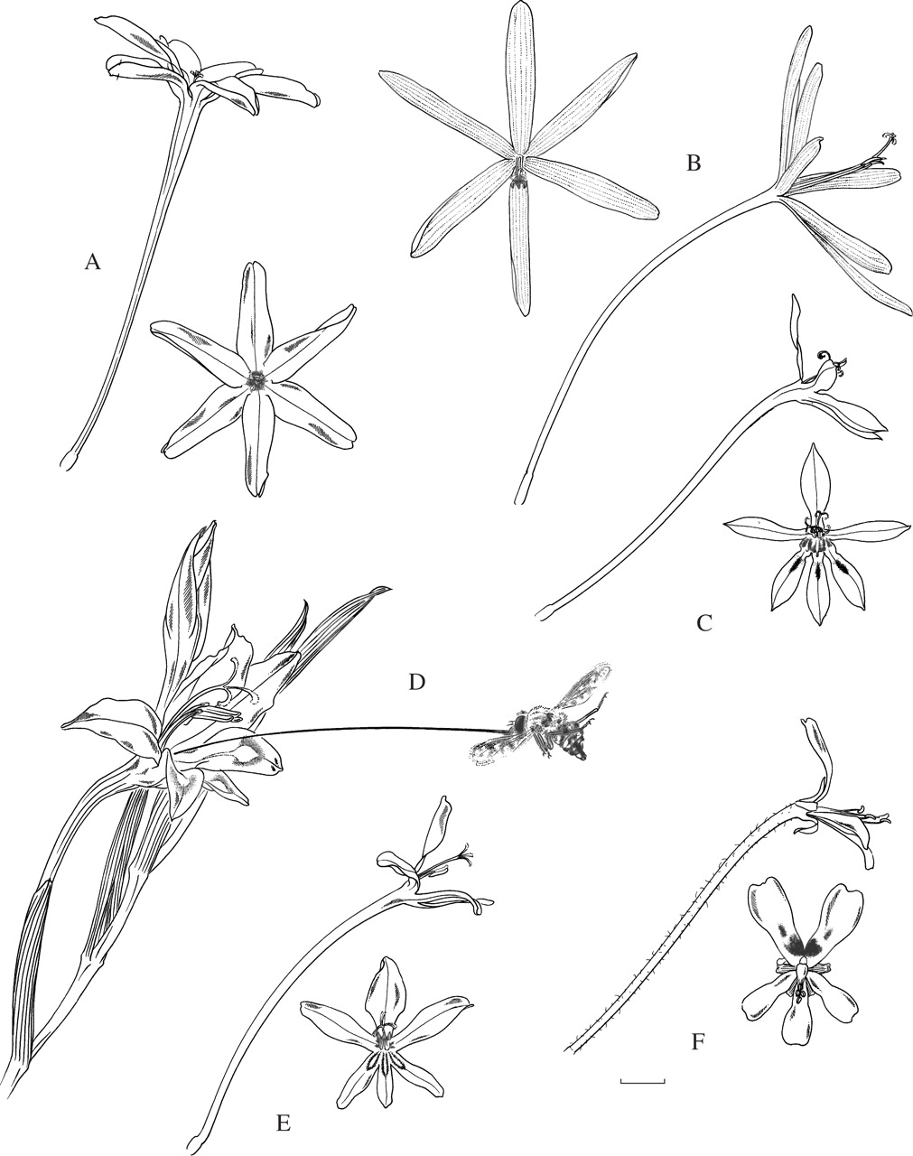
Fig. 2. Lateral and frontal views of flowers pollinated by long-proboscid flies and the fly Moegistorhynchus ...
Notes:
Fig. 2. Lateral and frontal views of flowers pollinated by long-proboscid flies and the fly Moegistorhynchus longirostris. (A) Ixia paniculata. (B) Geissorhiza exscapa. (C) Lapeirousia anceps. (D) Gladiolus angustus. (E) Tritonia crispa. (F) Pelargonium moniliforme (Geraniaeae), to show similarity of flower form in another family belonging to this guild. Scale bar = 10 mm.
Unless provided in the caption above, the following copyright applies to the content of this slide: © The Author 2005. Published by Oxford University Press on behalf of the Annals of Botany Company. All rights reserved. For Permissions, please email: journals.permissions@oxfordjournals.org

Slide 3
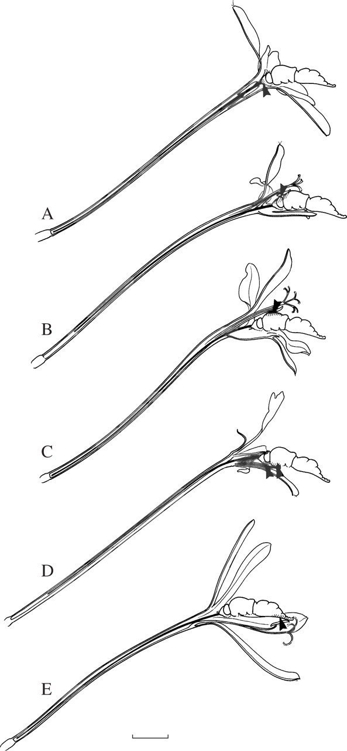
Fig. 3. Differential pollen placement indicated by arrows and hatching on fly's body by different plant species of ...
Notes:
Fig. 3. Differential pollen placement indicated by arrows and hatching on fly's body by different plant species of the Moegistorhynchus longirostris pollination guild. (A) Ixia paniculata (frons and base of proboscis). (B) Tritonia crispa (dorsal part of head). (C) Lapeirousia anceps (dorsal part of thorax). (D) Pelargonium appendiculatum (ventral part of head and thorax). (E) Geissorhiza exscapa (ventral part of abdomen). Scale bar = 1 cm.
Unless provided in the caption above, the following copyright applies to the content of this slide: © The Author 2005. Published by Oxford University Press on behalf of the Annals of Botany Company. All rights reserved. For Permissions, please email: journals.permissions@oxfordjournals.org

Slide 4
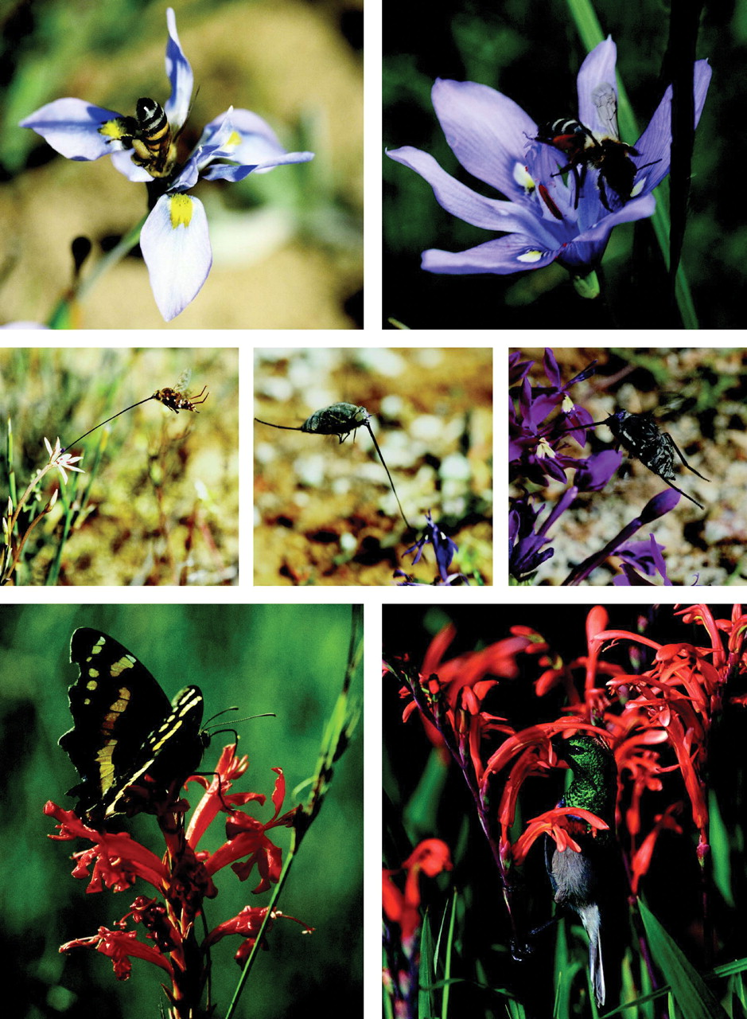
Fig. 4. Pollination systems in Iridaceae I. Bee pollination. Apis mellifera (Apidae) on Moraea ciliata (top row, ...
Notes:
Fig. 4. Pollination systems in Iridaceae I. Bee pollination. Apis mellifera (Apidae) on Moraea ciliata (top row, left); Rediviva sp. (Melittidae) on Moraea inclinata (top row, right). Long-proboscid fly pollination. Moegistorhynchus longirostris (Nemestrinidae) visiting Lapeirouisa anceps (middle row, left); Prosoeca sp. (Nemestrinidae) visiting Lapeirousia oreogena (middle row, centre); Prosoeca peringueyi (Nemestrinidae) visiting Lapeirousia pyramidalis subsp. regalis (middle row, right). Butterfly pollination. Aeropetes tulbaghia (Satyridae) on Tritoniopsis burchellii (bottom row, left). Bird pollination. Lesser double-collared sunbird, Nectarinia chalybea on Chasmanthe aethiopica (bottom row, right) (photographer: Colin Paterson-Jones).
Unless provided in the caption above, the following copyright applies to the content of this slide: © The Author 2005. Published by Oxford University Press on behalf of the Annals of Botany Company. All rights reserved. For Permissions, please email: journals.permissions@oxfordjournals.org

Slide 5
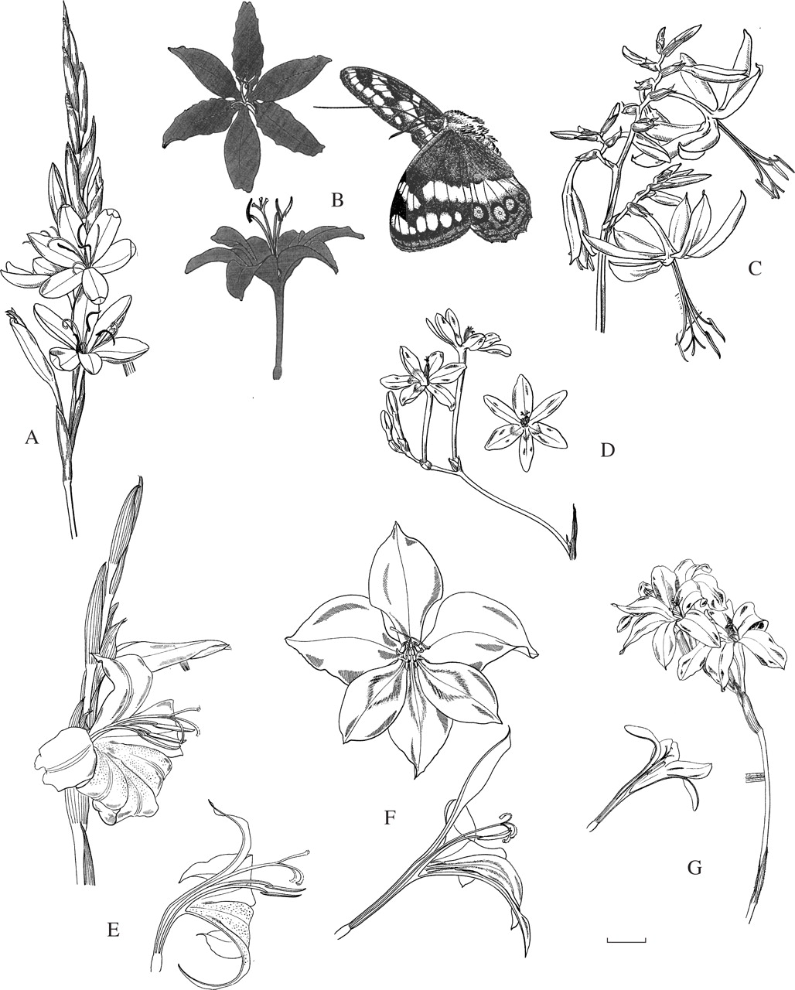
Fig. 5. Flowers pollinated by large butterflies, with vertical sections of some flowers, and the satyrid butterfly ...
Notes:
Fig. 5. Flowers pollinated by large butterflies, with vertical sections of some flowers, and the satyrid butterfly Aeropetes tulbaghia at same scale. (A) Hesperantha coccinea. (B) Tritoniopsis lesliei, lateral and dorsal views. (C) Crocosmia aurea. (D) Freesia laxa. (E) Gladiolus saundersii. (F) G. stefaniae. (G) G. nerineoides; a brush flower in contrast to the previous two flag flowers of the same genus. Scale bar = 10 mm.
Unless provided in the caption above, the following copyright applies to the content of this slide: © The Author 2005. Published by Oxford University Press on behalf of the Annals of Botany Company. All rights reserved. For Permissions, please email: journals.permissions@oxfordjournals.org

Slide 6
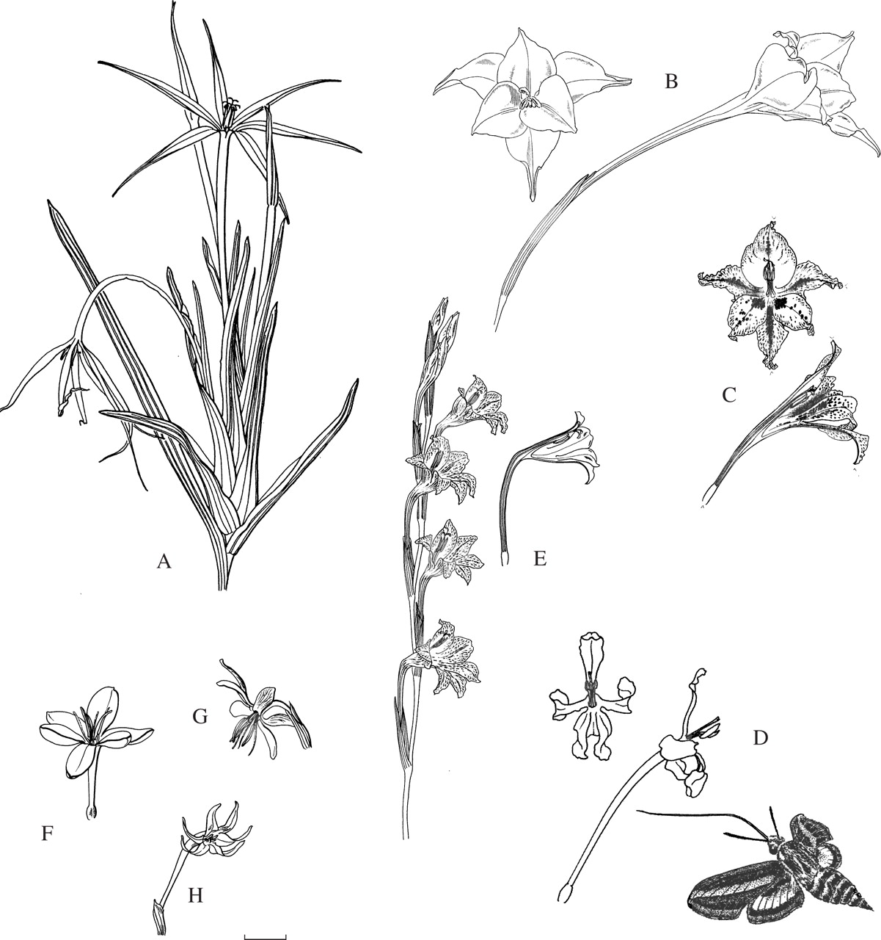
Fig. 6. Flowers pollinated by moths: (A–D), sphinxmoth flowers; (E–H) settling moth flowers. (A) Lapeirousia ...
Notes:
Fig. 6. Flowers pollinated by moths: (A–D), sphinxmoth flowers; (E–H) settling moth flowers. (A) Lapeirousia odoratissima. (B) Gladiolus longicollis subsp. praelongitubus. (C) Gladiolus hyalinus. (D) Tritoniopsis nervosa with the moth Hyles lineata. (E) Gladiolus emiliae. (F) Hesperantha falcata. (G) Hesperantha radiata. (H) Freesia viridis. Scale bar = 10 mm.
Unless provided in the caption above, the following copyright applies to the content of this slide: © The Author 2005. Published by Oxford University Press on behalf of the Annals of Botany Company. All rights reserved. For Permissions, please email: journals.permissions@oxfordjournals.org

Slide 7
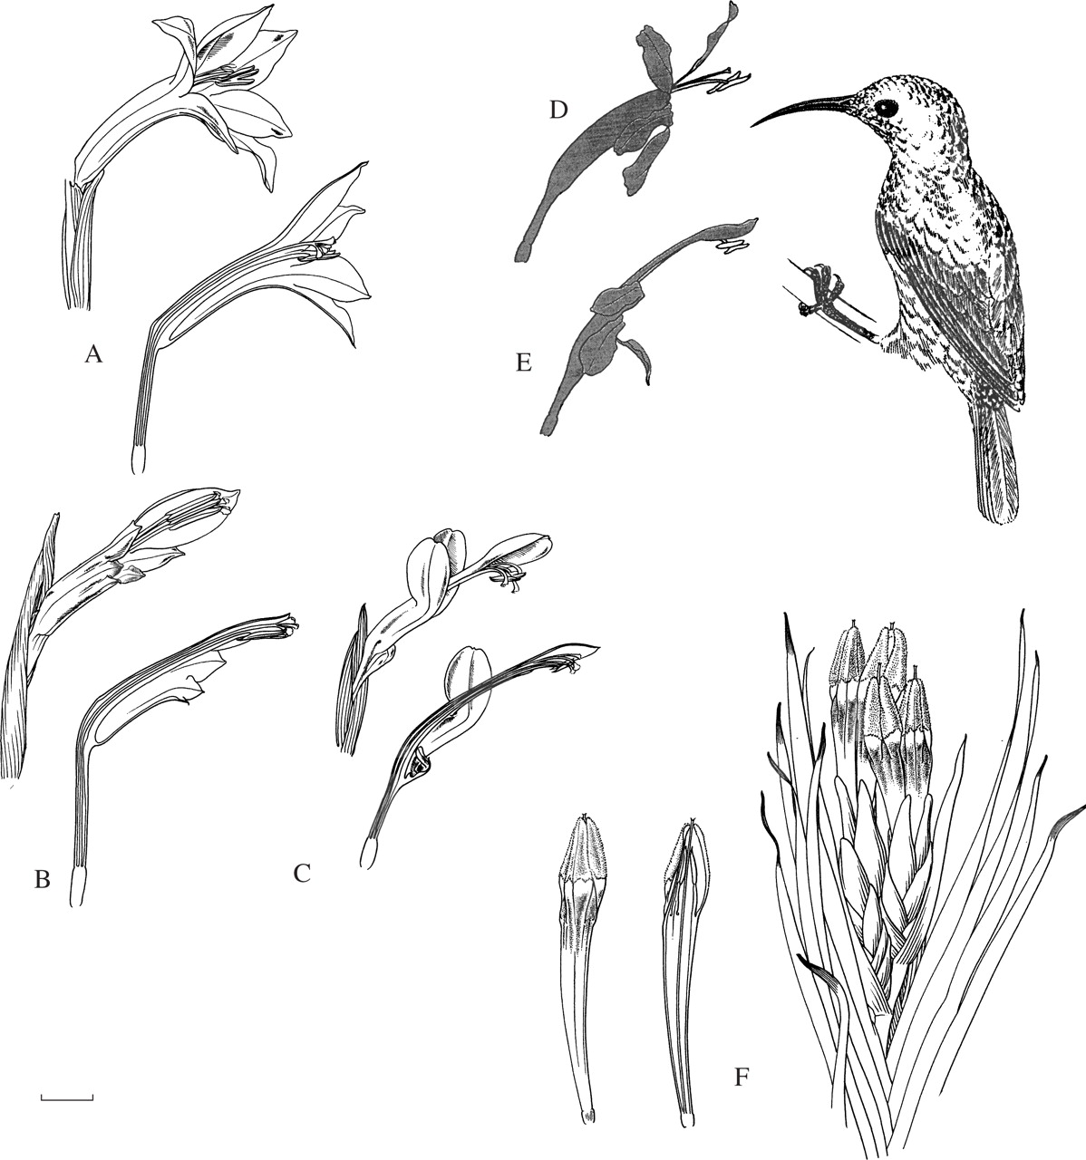
Fig. 7. Lateral views of flowers pollinated by sunbirds, with vertical sections of some flowers, and the sunbird ...
Notes:
Fig. 7. Lateral views of flowers pollinated by sunbirds, with vertical sections of some flowers, and the sunbird Nectarinia famosa at the same scale. (A) Gladiolus watsonius (section Homoglossum). (B) G. abyssinicus (section Ophiolyza). (C) G. cunonius (section Hebea). (D) Tritoniopsis caffra. (E) T. burchellii. (F) Witsenia maura (radially symmetric flower). Note the different floral form in the different species of Gladiolus. Scale bar = 10 mm.
Unless provided in the caption above, the following copyright applies to the content of this slide: © The Author 2005. Published by Oxford University Press on behalf of the Annals of Botany Company. All rights reserved. For Permissions, please email: journals.permissions@oxfordjournals.org

Slide 8
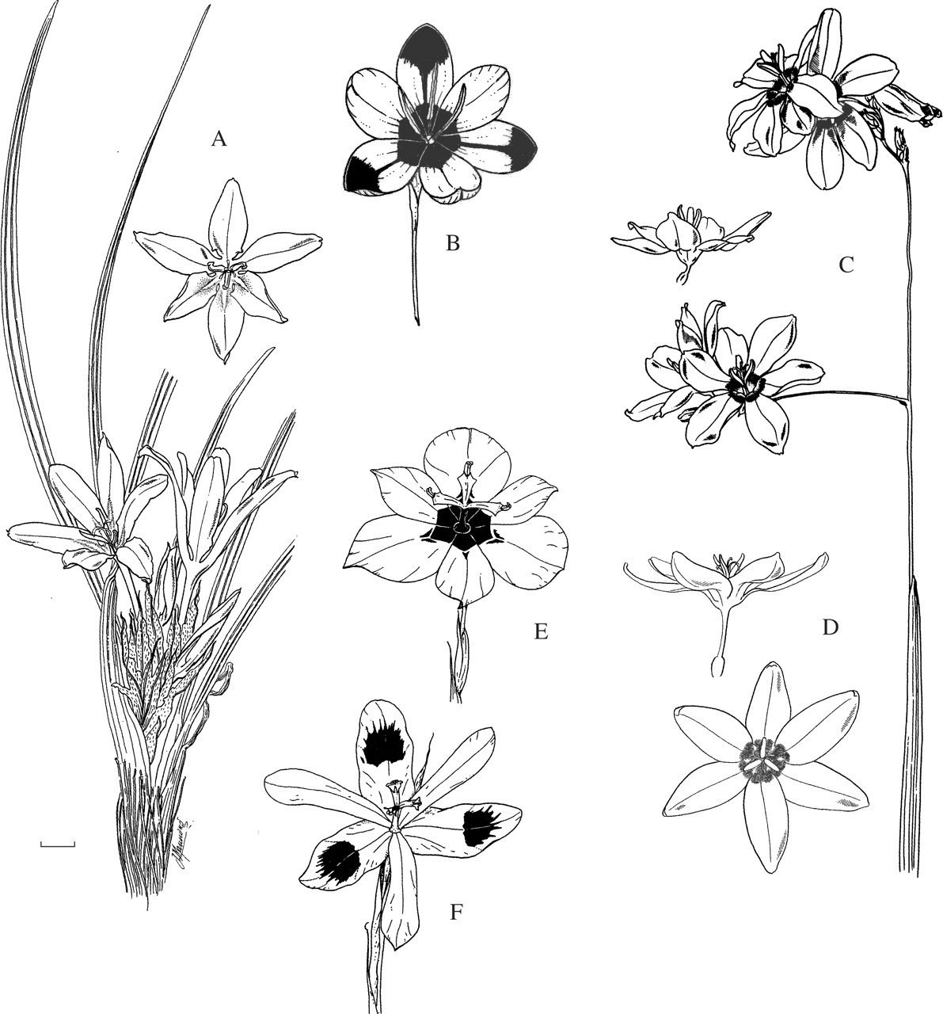
Fig. 8. Flowers pollinated by hopliine beetles. (A) Babiana papyracea; whole plant and single flower—note the narrow ...
Notes:
Fig. 8. Flowers pollinated by hopliine beetles. (A) Babiana papyracea; whole plant and single flower—note the narrow perianth tube that serves only to raise the flower above the ground. (B) Hesperantha vaginata, with prominent ‘beetle marks’ in centre of flower and at tips of outer tepals. (C) Ixia superba; flowering branch and lateral view of single flower. (D) Ixia maculata; dorsal and lateral views. (E) Moraea insolens. (F) Moraea elegans. Scale bar = 10 mm.
Unless provided in the caption above, the following copyright applies to the content of this slide: © The Author 2005. Published by Oxford University Press on behalf of the Annals of Botany Company. All rights reserved. For Permissions, please email: journals.permissions@oxfordjournals.org

Slide 9
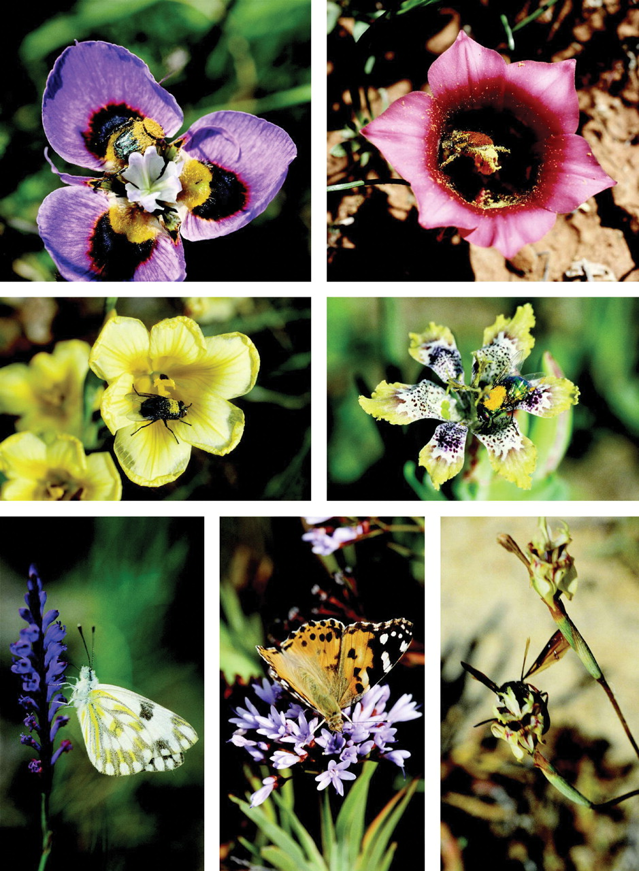
Fig. 9. Pollination systems in Iridaceae. Beetle pollination. Anisonyx ursus on Moraea villosa (top row, left); ...
Notes:
Fig. 9. Pollination systems in Iridaceae. Beetle pollination. Anisonyx ursus on Moraea villosa (top row, left); Clania macgregorii on Romulea monadelpha (top row, right). Short-proboscid fly pollination. Muscid fly on Moraea ochroleuca (middle row, left); Muscid fly on Ferraria densepunctulata (middle row, right). Generalist pollination. Belenois aurata (Pieridae) on Micranthus junceus (bottom row, left); Cynthia cardui (Nymphalidae) on Nivenia parviflora (bottom row, centre). Polistes sp. (Vespidae) on Moraea inconspicua (bottom row, right).
Unless provided in the caption above, the following copyright applies to the content of this slide: © The Author 2005. Published by Oxford University Press on behalf of the Annals of Botany Company. All rights reserved. For Permissions, please email: journals.permissions@oxfordjournals.org

Slide 10
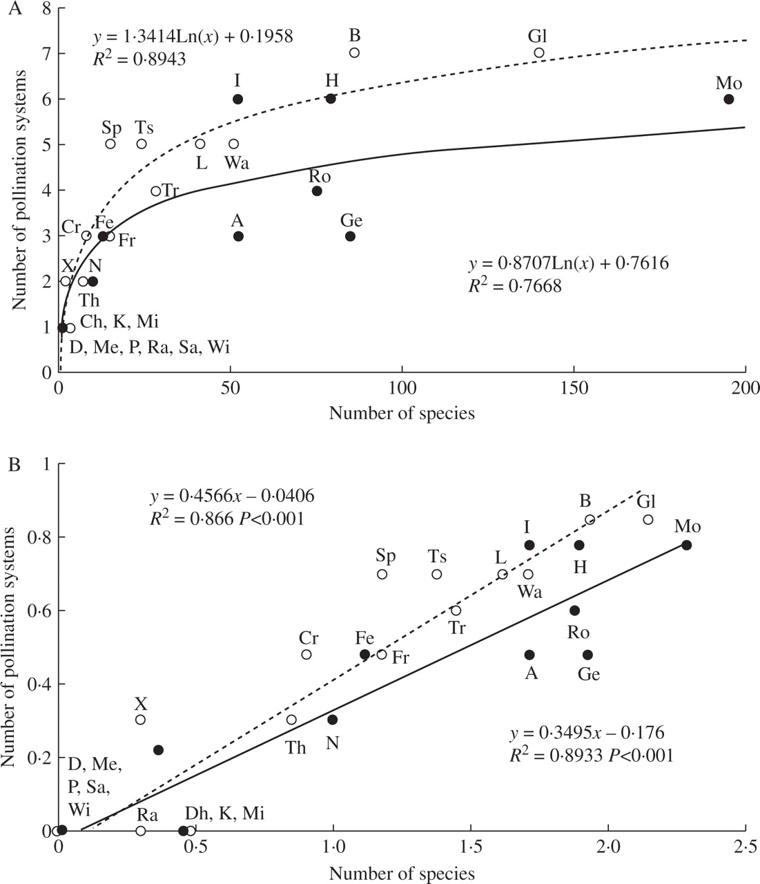
Fig. 10. Relationship between number of species and number of pollination systems per genus in ancestrally ...
Notes:
Fig. 10. Relationship between number of species and number of pollination systems per genus in ancestrally actinomorphic (open circles, broken curve) and ancestrally zygomorphic (closed circles, solid curve) genera of African Iridaceae. (A) Untransformed data; (B) logarithmically transformed data, with the two curves tested for between-group effects using the general linear model (F = 92·135, P < 0·001). A, Aristea; B, Babiana; Ch, Chasmanthe; Cr, Crocosmia; D, Duthiastrum; Fe, Ferraria; Fr, Freesia; Ge, Geissorhiza; Gl, Gladiolus; H, Hesperantha; I, Ixia; K, Klattia; L, Lapeirousia; Me, Melaspherula; Mi, Micranthus; Mo, Moraea; N, Nivenia; P, Pillansia; Ra, Radinosiphon; Ro, Romulea; Sa, Savannosiphon; Sp, Sparaxis; Th, Thereianthus; Tr, Tritonia; Ts, Tritoniopsis; Wa, Watsonia; Wi, Witsenia; X, Xenoscapa.
Unless provided in the caption above, the following copyright applies to the content of this slide: © The Author 2005. Published by Oxford University Press on behalf of the Annals of Botany Company. All rights reserved. For Permissions, please email: journals.permissions@oxfordjournals.org

