Slide 1
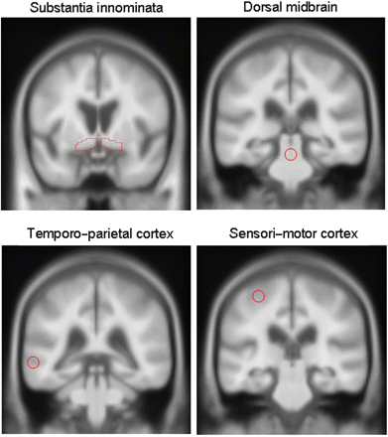
Fig. 1 Coronal slices of the unsmoothed customized template image showing the location of the four ROI used in the ...
Notes:
Fig. 1 Coronal slices of the unsmoothed customized template image showing the location of the four ROI used in the VBM-based ROI analysis.
Unless provided in the caption above, the following copyright applies to the content of this slide: © 2007 The Author(s)This is an Open Access article distributed under the terms of the Creative Commons Attribution Non-Commercial use License (http://creativecommons.org/lisences/by-nc/2.0/uk/) which permits unrestricted non-commercial use, distributed, and reproduction in medium, provided the original work is properly cited.

Slide 2
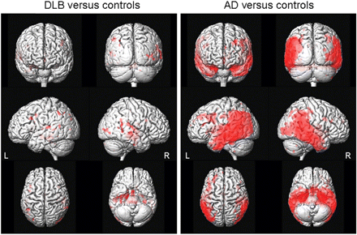
Fig. 2 Three-dimensional surface renders showing the patterns of cortical GM loss in the DLB, and Alzheimer's ...
Notes:
Fig. 2 Three-dimensional surface renders showing the patterns of cortical GM loss in the DLB, and Alzheimer's disease groups, compared with controls (corrected for multiple comparisons, P < 0.05). The Alzheimer's disease group shows widespread cortical loss particularly involving the temporo-parietal cortices. In contrast, the DLB group shows very little cortical involvement.
Unless provided in the caption above, the following copyright applies to the content of this slide: © 2007 The Author(s)This is an Open Access article distributed under the terms of the Creative Commons Attribution Non-Commercial use License (http://creativecommons.org/lisences/by-nc/2.0/uk/) which permits unrestricted non-commercial use, distributed, and reproduction in medium, provided the original work is properly cited.

Slide 3
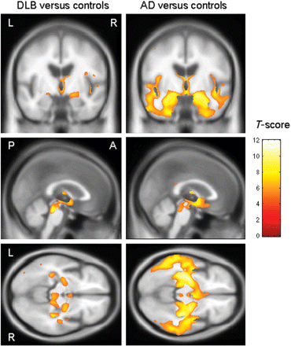
Fig. 3 Patterns of GM loss in the DLB and Alzheimer's disease groups compared with controls (corrected for multiple ...
Notes:
Fig. 3 Patterns of GM loss in the DLB and Alzheimer's disease groups compared with controls (corrected for multiple comparisons, P < 0.05), overlaid on the unsmoothed customized template. This shows that the GM loss in DLB is focused on the SI, dorsal midbrain and the hypothalamus.
Unless provided in the caption above, the following copyright applies to the content of this slide: © 2007 The Author(s)This is an Open Access article distributed under the terms of the Creative Commons Attribution Non-Commercial use License (http://creativecommons.org/lisences/by-nc/2.0/uk/) which permits unrestricted non-commercial use, distributed, and reproduction in medium, provided the original work is properly cited.

Slide 4
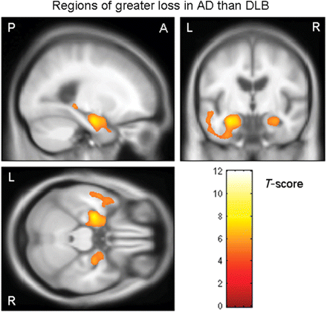
Fig. 4 Regions showing significantly greater GM loss in the Alzheimer's disease group than the DLB group (corrected ...
Notes:
Fig. 4 Regions showing significantly greater GM loss in the Alzheimer's disease group than the DLB group (corrected for multiple comparisons, P < 0.05), overlaid on the unsmoothed customized template.
Unless provided in the caption above, the following copyright applies to the content of this slide: © 2007 The Author(s)This is an Open Access article distributed under the terms of the Creative Commons Attribution Non-Commercial use License (http://creativecommons.org/lisences/by-nc/2.0/uk/) which permits unrestricted non-commercial use, distributed, and reproduction in medium, provided the original work is properly cited.

Slide 5
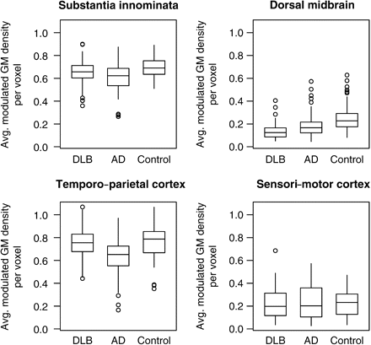
Fig. 5 Box-plots of each patient's average VBM-based modulated GM density per voxel for four ROI. The horizontal ...
Notes:
Fig. 5 Box-plots of each patient's average VBM-based modulated GM density per voxel for four ROI. The horizontal lines of the boxes represent the 25th, 50th (median) and 75th percentiles of the distributions. The vertical lines extending from the boxes stop at the most extreme data point within 1.5 interquartile ranges of the box. Points beyond this are individually identified. GM, grey matter.
Unless provided in the caption above, the following copyright applies to the content of this slide: © 2007 The Author(s)This is an Open Access article distributed under the terms of the Creative Commons Attribution Non-Commercial use License (http://creativecommons.org/lisences/by-nc/2.0/uk/) which permits unrestricted non-commercial use, distributed, and reproduction in medium, provided the original work is properly cited.

Slide 6
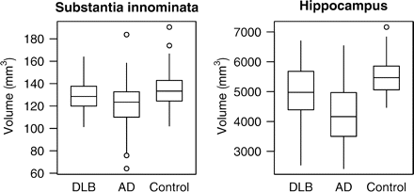
Fig. 6 Box-plots showing the hippocampal and SI volumes measured from the volumetric MRI for each subject. The ...
Notes:
Fig. 6 Box-plots showing the hippocampal and SI volumes measured from the volumetric MRI for each subject. The horizontal lines of the boxes represent the 25th, 50th (median) and 75th percentiles of the distributions. The vertical lines extending from the boxes stop at the most extreme data point within 1.5 inter-quartile ranges of the box. Points beyond this are individually identified.
Unless provided in the caption above, the following copyright applies to the content of this slide: © 2007 The Author(s)This is an Open Access article distributed under the terms of the Creative Commons Attribution Non-Commercial use License (http://creativecommons.org/lisences/by-nc/2.0/uk/) which permits unrestricted non-commercial use, distributed, and reproduction in medium, provided the original work is properly cited.

Slide 7
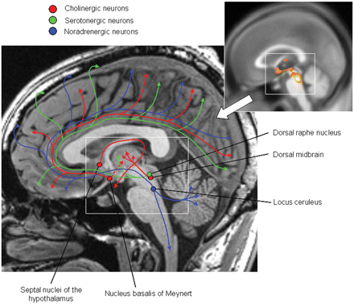
Fig. 7 Schematic diagram showing the location of cholinergic, serotonergic and noradrenergic neurons in the ...
Notes:
Fig. 7 Schematic diagram showing the location of cholinergic, serotonergic and noradrenergic neurons in the brainstem and basal forebrain. The inset shows the patterns of GM loss identified in the DLB group (see Fig. 3), and illustrates how the locations of the neurotransmitter nuclei correspond with the regions of loss in DLB. The cholinergic neurons in the nucleus basalis of Meynert project widely through the cingulum to the medial cerebral cortex with some lesser connections to the thalamus; neurons in the septal nuclei of the hypothalamus connect to the fornix and hippocampus (structure not shown); and neurons in the dorsal midbrain project to the thalamus. The serotonergic neurons in the dorsal raphe nucleus project to the basal ganglia and the basal forebrain, from which they distribute widely to the cerebral cortex. The noradrenergic neurons in the locus coeruleus innervate the brainstem and cerebellum, and also project to the basal forebrain, hypothalamus, temporal lobe (structure not shown) and the entire coerebral cortex (Mesulam et al., 1983; Mesulam and Geula, 1988; Woolsey et al., 2003; Benarroch, 2006).
Unless provided in the caption above, the following copyright applies to the content of this slide: © 2007 The Author(s)This is an Open Access article distributed under the terms of the Creative Commons Attribution Non-Commercial use License (http://creativecommons.org/lisences/by-nc/2.0/uk/) which permits unrestricted non-commercial use, distributed, and reproduction in medium, provided the original work is properly cited.

