Slide 1
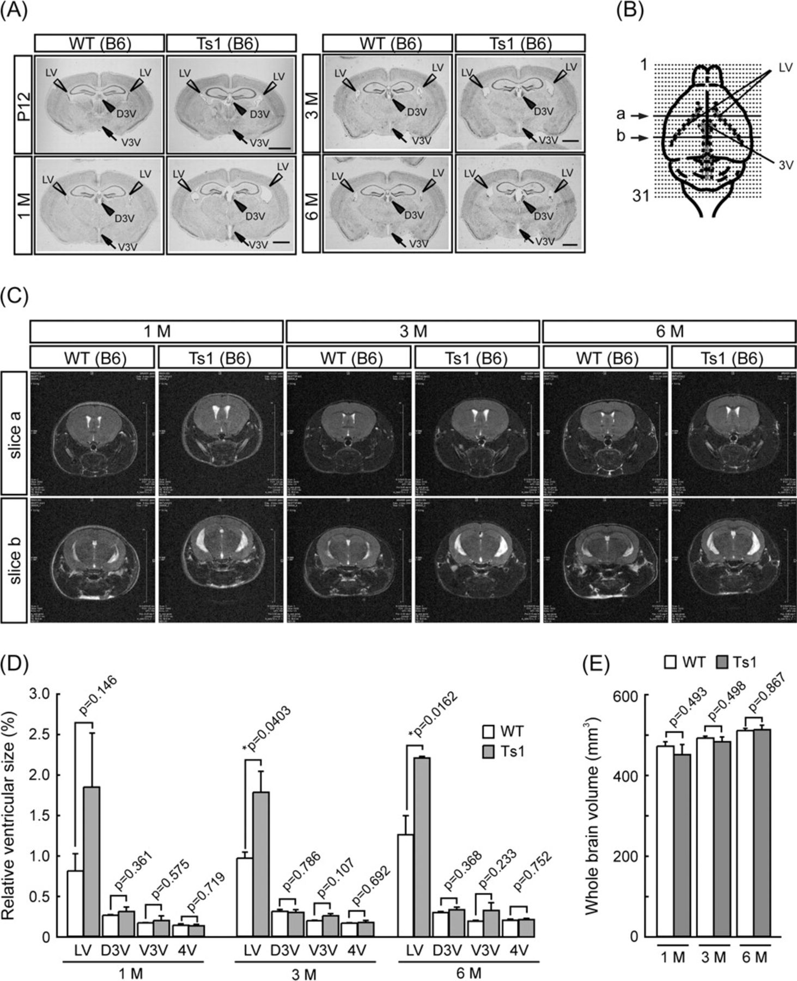
Figure 2. Enlarged brain ventricles in Ts1Cje. (A) Nissl staining of coronal brain sections (at bregma −1.2 mm for P12, ...
Notes:
Figure 2. Enlarged brain ventricles in Ts1Cje. (A) Nissl staining of coronal brain sections (at bregma −1.2 mm for P12, -1.4 mm for 1 M, −1.5 mm for 3 and 6 M) from Ts1Cje (Ts1) and wild-type (WT) littermates on B6 background at 12 days and 1, 3, and 6 months of age. Prominent enlargements of ventricles are observed in Ts1Cje. Scale bar: 1 mm. (B) Schematic representation of coronal sectioning on brain MRI. Thirty-one cortical images were acquired with the 0.5-mm gap between the images. The 12th and 17th images from the most anterior part of nose indicated by arrows were used as slices a and b in C. (C) Typical T2-weighted MRI images (slices a and b) from WT littermates (upper panels) and Ts1 (lower panels) on B6 background at 1, 3, and 6 months of age. Note that the LVs were enlarged in Ts1 mice (white areas). (D) Volume of each brain ventricle was calculated by summing-up the area of each section multiplied by slice thickness. The value is the ratio of each ventricle volume to whole brain volume (mean ± standard error of the mean; n = 3 in each group and each age). LV is volumetrically increased in Ts1 at all examined ages. (E) The volumes of whole brain parenchyma excluding brain stem and brain ventricles. No significant change in whole brain volume is detected between 2 genotypes at all examined ages. Statistical significance was determined with the Student's t-test. *P < 0.05, significantly different from WT. D3V, dorsal third ventricle; V3V, ventral third ventricle; and 4V, fourth ventricle.
Unless provided in the caption above, the following copyright applies to the content of this slide: © The Author 2009. Published by Oxford University Press. All rights reserved. For permissions, please e-mail: journals.permissions@oxfordjournals.org

Slide 2
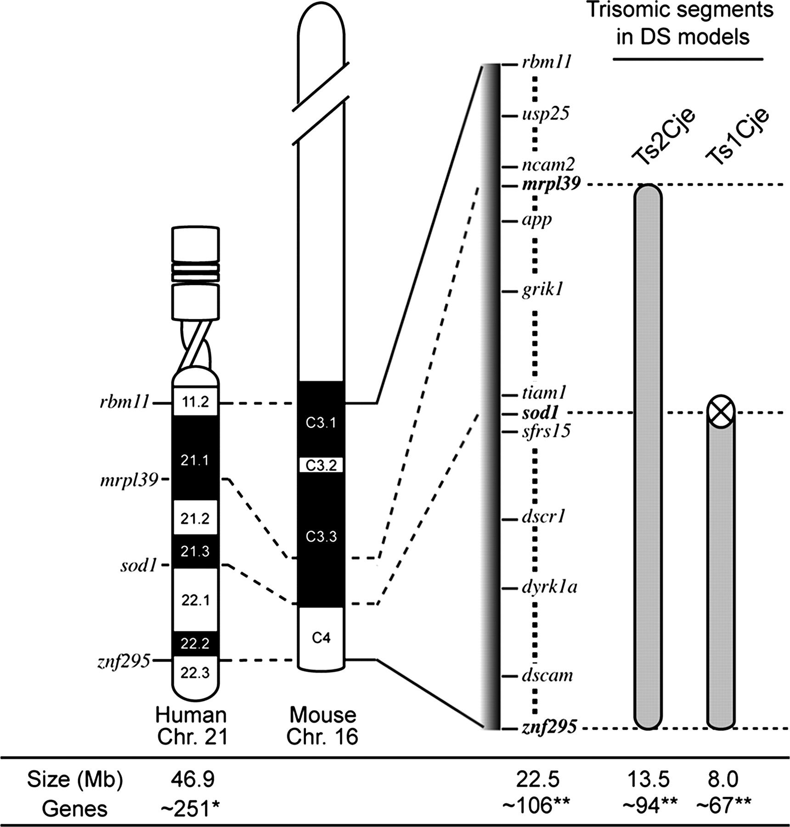
Figure 1. Trisomic segments in Ts1Cje and Ts2Cje DS model mice. Most part of the long arm of human chromosome 21 is ...
Notes:
Figure 1. Trisomic segments in Ts1Cje and Ts2Cje DS model mice. Most part of the long arm of human chromosome 21 is orthologous to distal end of mouse chromosome 16. Information including genomic size and number of genes in the trisomic mouse chromosome 16 partial segments and human chromosome 21 is based on NCBI databases, mouse build 37.1 (http://www.ncbi.nlm.nih.gov/genome/guide/mouse/) and build 36.3 of human genome (http://www.ncbi.nlm.nih.gov/mapview/). Note that the sod1 gene in the trisomic segment of Ts1Cje is inactivated by insertion of NEO cassette (Sago et al. 1998). *, number of protein-coding genes on human chromosome 21; **, number of protein-coding genes conserved between human chromosome 21 and mouse chromosome 16.
Unless provided in the caption above, the following copyright applies to the content of this slide: © The Author 2009. Published by Oxford University Press. All rights reserved. For permissions, please e-mail: journals.permissions@oxfordjournals.org

Slide 3
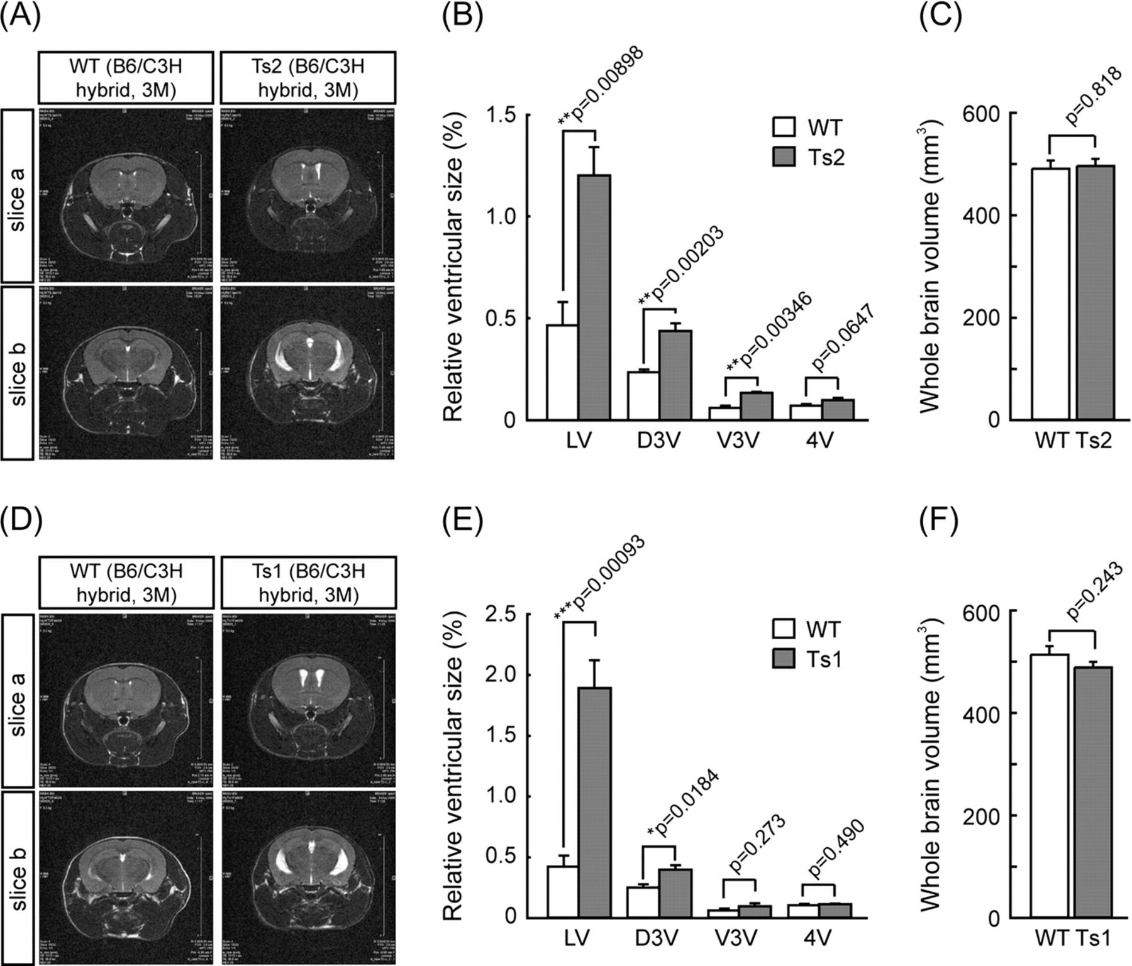
Figure 3. Enlarged brain ventricles in Ts2Cje. MRI analyses was performed on the brains from Ts2Cje (Ts2) (A–C) and ...
Notes:
Figure 3. Enlarged brain ventricles in Ts2Cje. MRI analyses was performed on the brains from Ts2Cje (Ts2) (A–C) and Ts1Cje mice (Ts1) (D–F) on B6/C3H hybrid background at 3 months of age. (A, D) Coronal T2-weighted MRI images (slices a and b) of the brain from Ts2 (A), Ts1 (D), and respective wild-type (WT) littermates. Expanded LV and third ventricle (3V) were observed in both Ts1 and Ts2 mice. (B, E) The ratios of each ventricular volume to whole brain volume indicate expansion of ventricles in both DS models (mean ± standard error of the mean; n = 3 in each group and each age). (C, F) No significant change in whole brain volumes is detected in both mice Ts1 and Ts2 compared with respective wild-type littermates. Statistical significance was determined with the Student's t-test. ***P < 0.001, **P < 0.01, *P < 0.05, significantly different from WT.
Unless provided in the caption above, the following copyright applies to the content of this slide: © The Author 2009. Published by Oxford University Press. All rights reserved. For permissions, please e-mail: journals.permissions@oxfordjournals.org

Slide 4
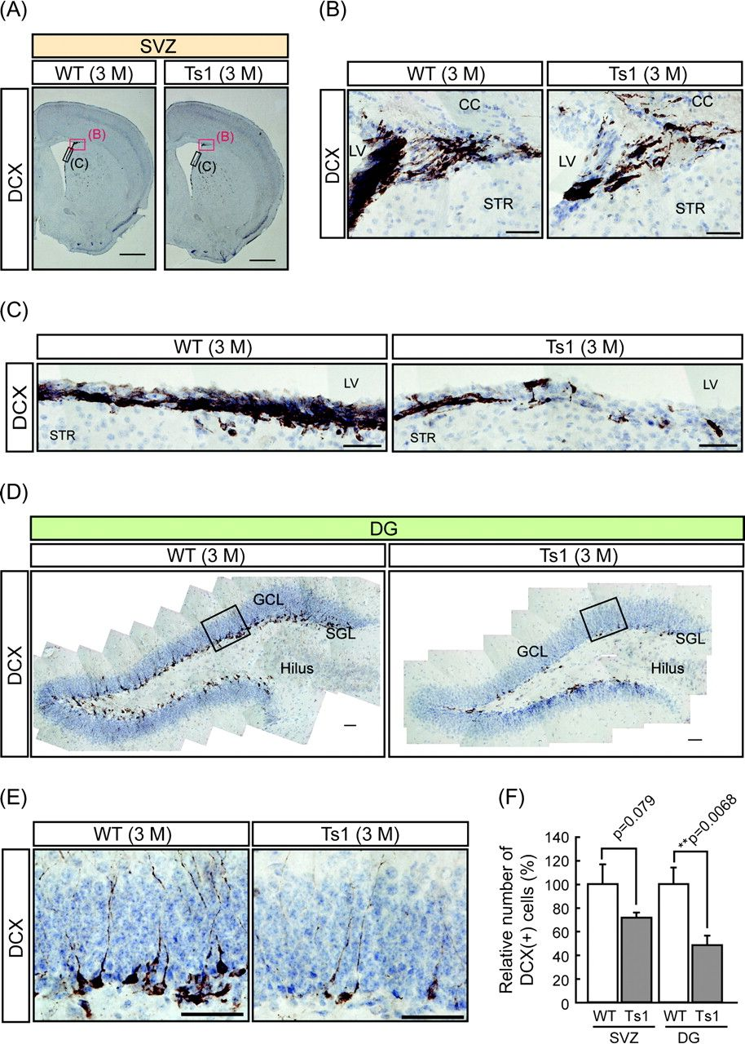
Figure 4. Decreased DCX-positive neuroblasts in the SVZ and DG of Ts1Cje. Immunohistochemistry using anti- DCX antibody ...
Notes:
Figure 4. Decreased DCX-positive neuroblasts in the SVZ and DG of Ts1Cje. Immunohistochemistry using anti- DCX antibody was performed on the brain sections from Ts1Cje (Ts1) mice on the B6/C3H hybrid background at 3 months of age. Nuclear was stained with Hematoxylin. (A) Coronal forebrain sections from wild-type (WT) and Ts1 mice. Scale bars: 1 mm. (B, C) Magnified images of the boxed areas in A. Scale bars: 50 μm. CC, corpus callosum; STR, striatum. (D) Coronal sections of hippocampal DG from WT and Ts1 mice. Scale bar: 50 μm. (E) Magnified images of the boxed areas in D. Scale bars: 50 μm. GCL, granule cell layer; SGL, subgranular layer (2–3 cells widths along the border of the GCL and hilus). (F) Quantification of DCX-positive cells in the SVZ and DG (GSL and SGL) by counting in a blinded manner shows that the number of DCX-positive neuroblasts is reduced in the SVZ and DG of Ts1 compared with WT littermates. The average number of DCX-positive cells in WT mice was set equal to 100. Each bar corresponds to the total number of DCX-positive cells per a LV wall or a DG (mean ± standard error of the mean, n = 3 in each genotype). Statistical significance was determined with the Student's t-test. **P < 0.01 significantly different from WT littermate.
Unless provided in the caption above, the following copyright applies to the content of this slide: © The Author 2009. Published by Oxford University Press. All rights reserved. For permissions, please e-mail: journals.permissions@oxfordjournals.org

Slide 5
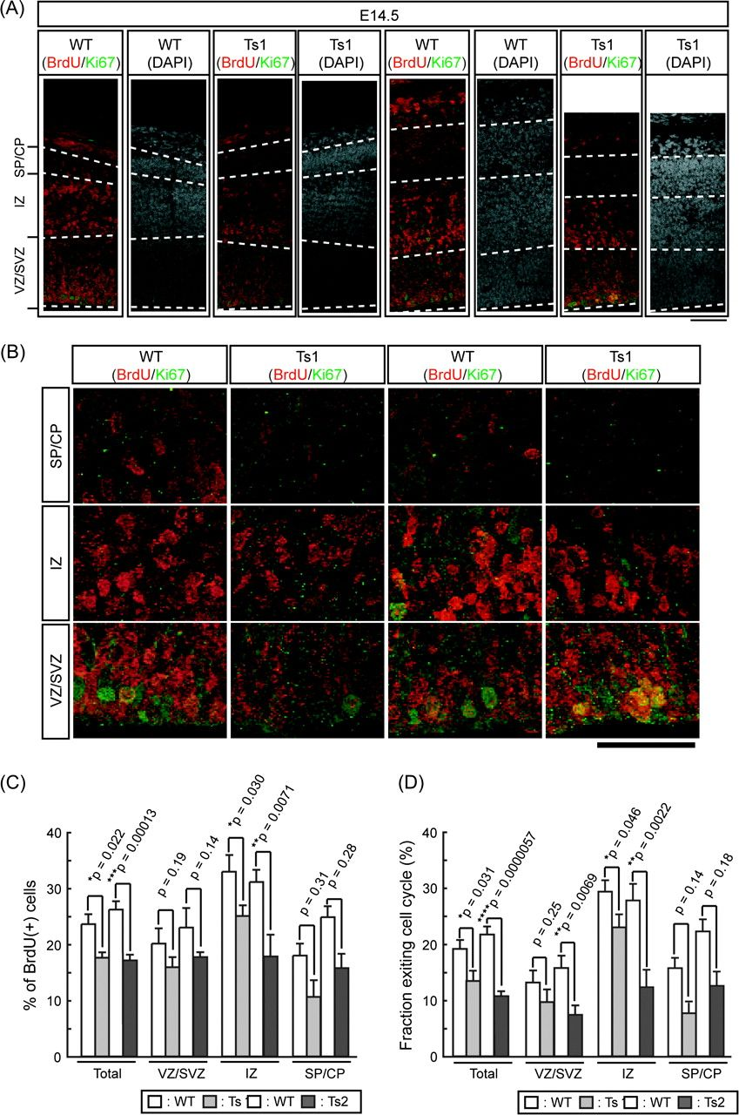
Figure 9. Decreased BrdU-positive cells exiting the cell cycle in Ts1Cje and Ts2Cje embryonic neocortices. Pregnant ...
Notes:
Figure 9. Decreased BrdU-positive cells exiting the cell cycle in Ts1Cje and Ts2Cje embryonic neocortices. Pregnant Ts1Cje (Ts1) and Ts2Cje (Ts2) females on the B6/C3H hybrid background at gestational day 13 (E13.5 for embryos) were administrated with one pulse of 50 mg/kg BrdU, and BrdU- and Ki67-positive cells were detected at 24 h after injection on immunofluorescence. (A) Double-staining images of the cortical wall for Ki67 (green) and BrdU (red) taken at the midpoint between the medial and lateral angles of the LV show that fewer BrdU-positive and Ki67-negative, BrdU-positive cells (exiting the cell cycle) were detected in both DS models. Nuclear was stained with DAPI. Scale bar: 75 μm. (B) Higher magnification images of each layer. Scale bar: 50 μm. (C, D) Percentages of the number of BrdU-positive (C) and Ki67-negative/BrdU-positive cells (D) against total cell numbers (on the DAPI staining) in each layer (VZ/SVZ, IZ, and SP/CP) of the cortex were calculated by cell counting with stereological method. Number of cells with proliferating (C) and exiting cell cycle (D) were reduced in embryonic cortices of both Ts1 and Ts2. Values in C and D indicate the ratios of BrdU(+) cell number/total cell number and BrdU(+), Ki67(−) cell number/total cell number, respectively (n = 2 pairs, mean ± standard error of the mean). Statistical significance was determined with the Student's t-test. *P < 0.05, **P < 0.01, ***P < 0.001, ****P < 0.0001 significantly different from WT littermate.
Unless provided in the caption above, the following copyright applies to the content of this slide: © The Author 2009. Published by Oxford University Press. All rights reserved. For permissions, please e-mail: journals.permissions@oxfordjournals.org

Slide 6
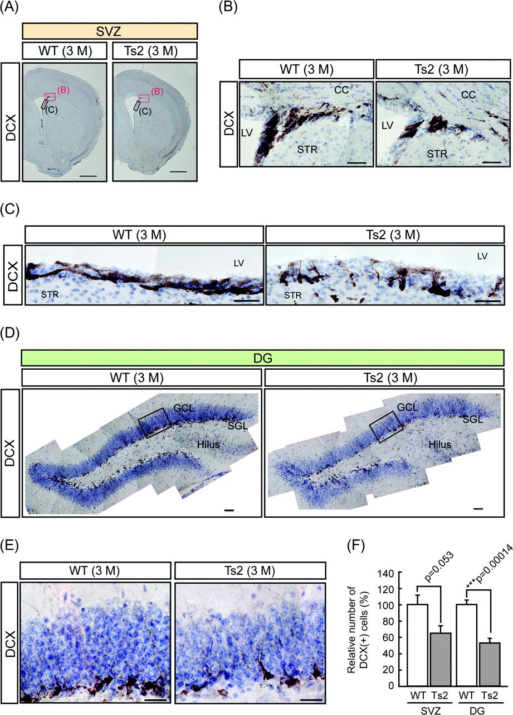
Figure 5. Decreased DCX-positive neuroblasts in the SVZ and DG of Ts2Cje. DCX-positive cells were detected in SVZ (A–C) ...
Notes:
Figure 5. Decreased DCX-positive neuroblasts in the SVZ and DG of Ts2Cje. DCX-positive cells were detected in SVZ (A–C) and DG (D, E) of Ts2Cje (Ts2) mice on the B6/C3H hybrid background at 3 months of age. (A) Coronal forebrain sections from Ts2 and their wild-type (WT) littermate. Scale bars: 1 mm. (B, C) Magnified images of the boxed areas in A. Scale bars: 50 μm. (D) Coronal sections of DG from WT and Ts2. Scale bar: 50 μm. (E) Magnified images of the boxed areas in D. Scale bar: 50 μm. (F) Quantification of DCX-positive cells in SVZ and DG by counting in a blinded manner shows that the number of DCX-positive neuroblasts are reduced in Ts2 similarly to that in Ts1Cje. Each value corresponds to relative number of DCX-positive cells against the average number of WT (mean ± standard error of the mean). Statistical significance was determined with the Student's t-test (n = 3 in each genotype). ***P < 0.001 significantly different from WT littermate.
Unless provided in the caption above, the following copyright applies to the content of this slide: © The Author 2009. Published by Oxford University Press. All rights reserved. For permissions, please e-mail: journals.permissions@oxfordjournals.org

Slide 7
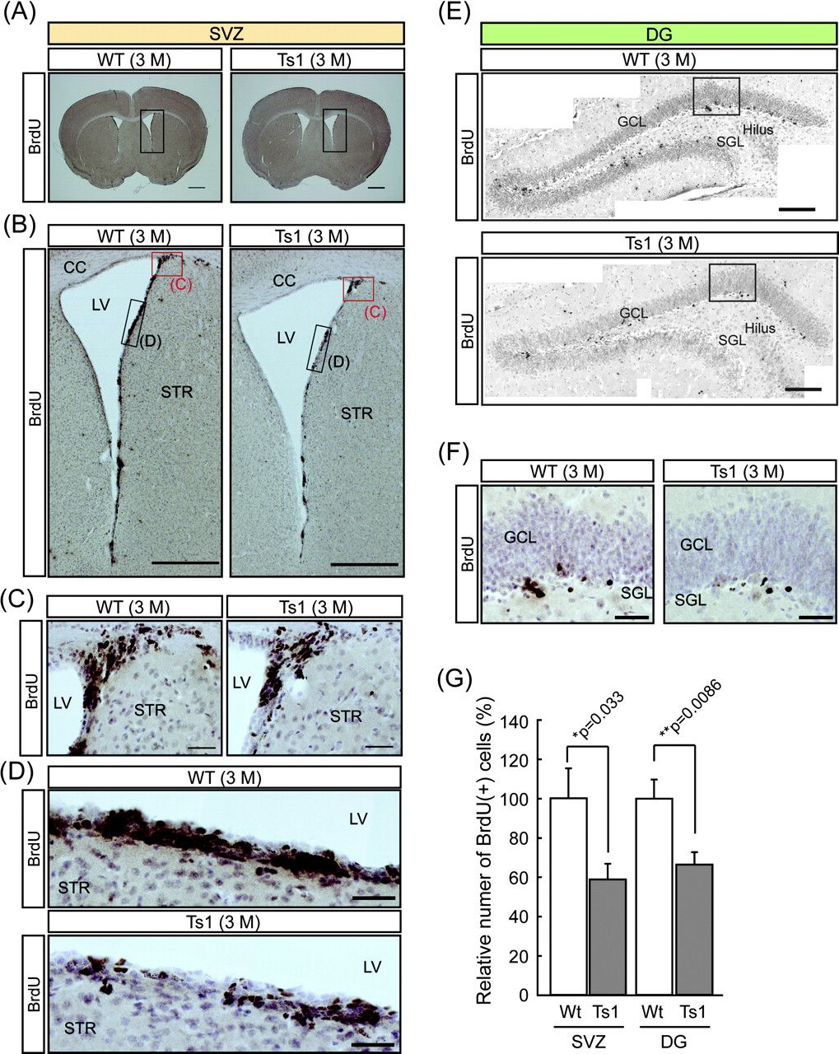
Figure 6. Decreased BrdU-positive proliferating cells in SVZ and DG of Ts1Cje. Wild-type (WT) and Ts1Cje mice (Ts1) on ...
Notes:
Figure 6. Decreased BrdU-positive proliferating cells in SVZ and DG of Ts1Cje. Wild-type (WT) and Ts1Cje mice (Ts1) on the B6/C3H hybrid background at 3 months of age were labeled with BrdU (see Materials and Methods). The BrdU-positive cells in SVZ (A–D) and DG (E, F) were detected by immunohistochemistry at 24 h after last BrdU injection. Nuclear was stained with Hematoxylin. (A) Coronal forebrain sections from WT and Ts1. Scale bars: 1 mm. (B) Magnified images of the boxed area in A. Scale bars: 1 mm. (C, D) Magnified images of the boxed area in B. The boxed areas surrounded by red and black line in B correspond to C and D, respectively. Scale bars: 50 μm. (E) Coronal sections of DG from WT and Ts1. Scale bar: 100 μm. (F) Magnified images of the boxed area in E. Scale bar: 25 μm. (G) Quantification of BrdU-positive cells by counting in a blinded manner shows that the number of BrdU-labeled proliferating cells is decreased in SVZ and DG (granular cell layer [GSL] and subgranular cell layer [SGL]) of Ts1 compared with that of WT littermates. The averaged number of BrdU-positive cells in the WT littermates was set equal to 100. Each bar corresponds to the total number of BrdU-positive nuclei per LV wall or DG (mean ± standard error of the mean, n = 3 in each genotype). Statistical significance was determined with the Student's t-test. *P < 0.05, **P < 0.01 significantly different from WT littermate.
Unless provided in the caption above, the following copyright applies to the content of this slide: © The Author 2009. Published by Oxford University Press. All rights reserved. For permissions, please e-mail: journals.permissions@oxfordjournals.org

Slide 8
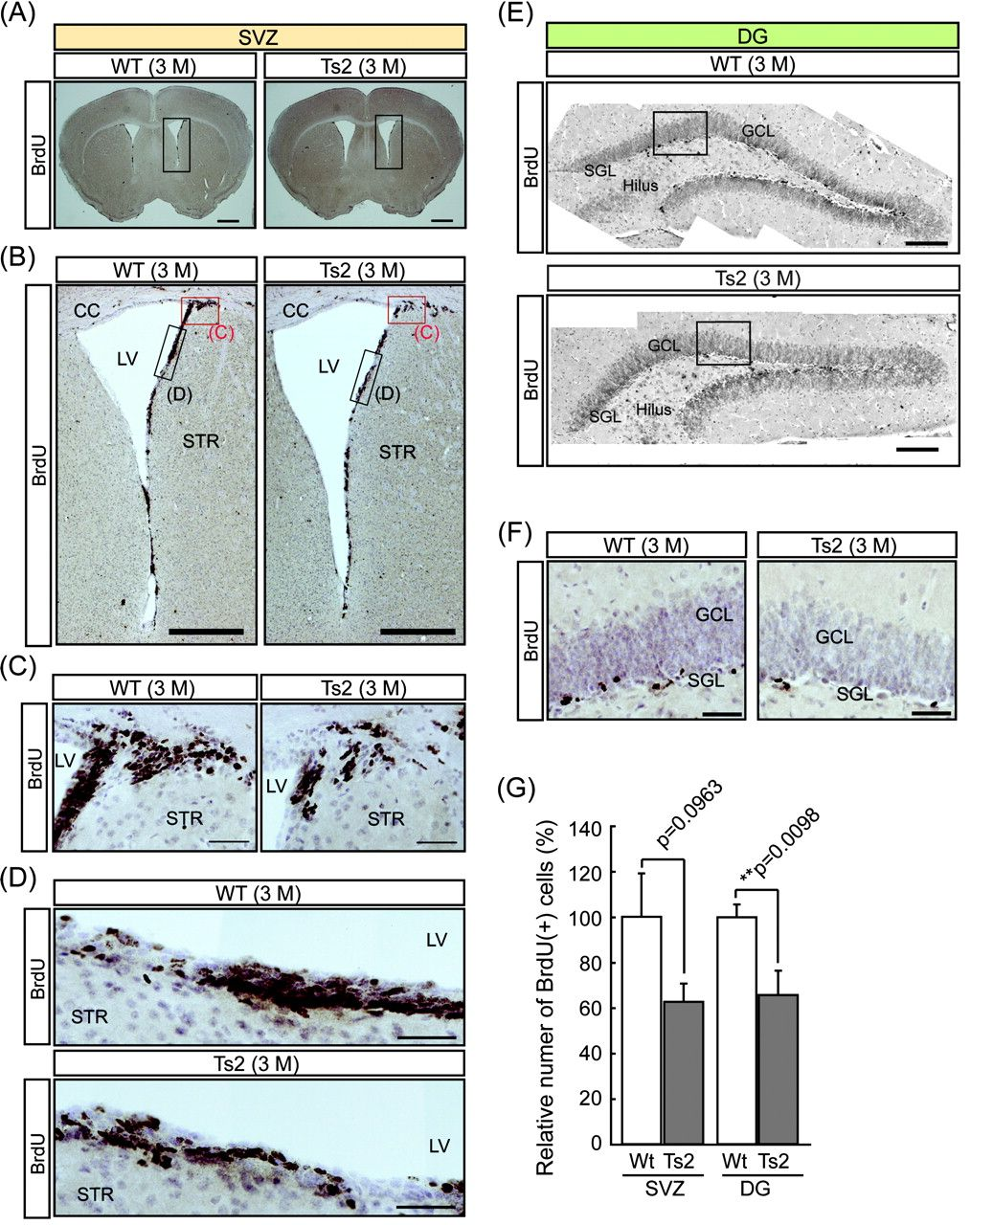
Figure 7. Decreased BrdU-positive proliferating cells in SVZ and DG of Ts2Cje. BrdU-positive cells were detected in ...
Notes:
Figure 7. Decreased BrdU-positive proliferating cells in SVZ and DG of Ts2Cje. BrdU-positive cells were detected in wild-type (WT) and Ts2Cje mice (Ts2) on the B6/C3H hybrid background at 3 months of age. (A) Coronal forebrain sections from Ts2 and their WT littermates. Scale bars: 1 mm. (B) Magnified images of the boxed area in A. Scale bars: 1 mm. (C, D) Magnified images of the boxed area in B. The boxed areas surrounded by red and black line in B correspond to C and D, respectively. Scale bars: 50 μm. (E) Coronal sections of DG from WT and Ts2. Scale bar: 100 μm. (F) Magnified images of the boxed area in E. Scale bar: 25 μm. (G) Quantification of BrdU-positive cells by counting in a blinded manner shows that the number of BrdU-labeled proliferating cells is decreased in SVZ and DG (granular cell layer [GSL] and subgranular cell layer [SGL]) of Ts2 compared with that of WT littermates. The averaged number of BrdU-positive cells in the WT littermates was set equal to 100. Each bar corresponds to the total number of BrdU-positive nuclei per a LV wall or a DG (mean ± standard error of the mean, n = 3 in each genotype). Statistical significance was determined with the Student's t-test (n = 3 in each genotype). **P < 0.01 significantly different from WT littermate.
Unless provided in the caption above, the following copyright applies to the content of this slide: © The Author 2009. Published by Oxford University Press. All rights reserved. For permissions, please e-mail: journals.permissions@oxfordjournals.org

Slide 9
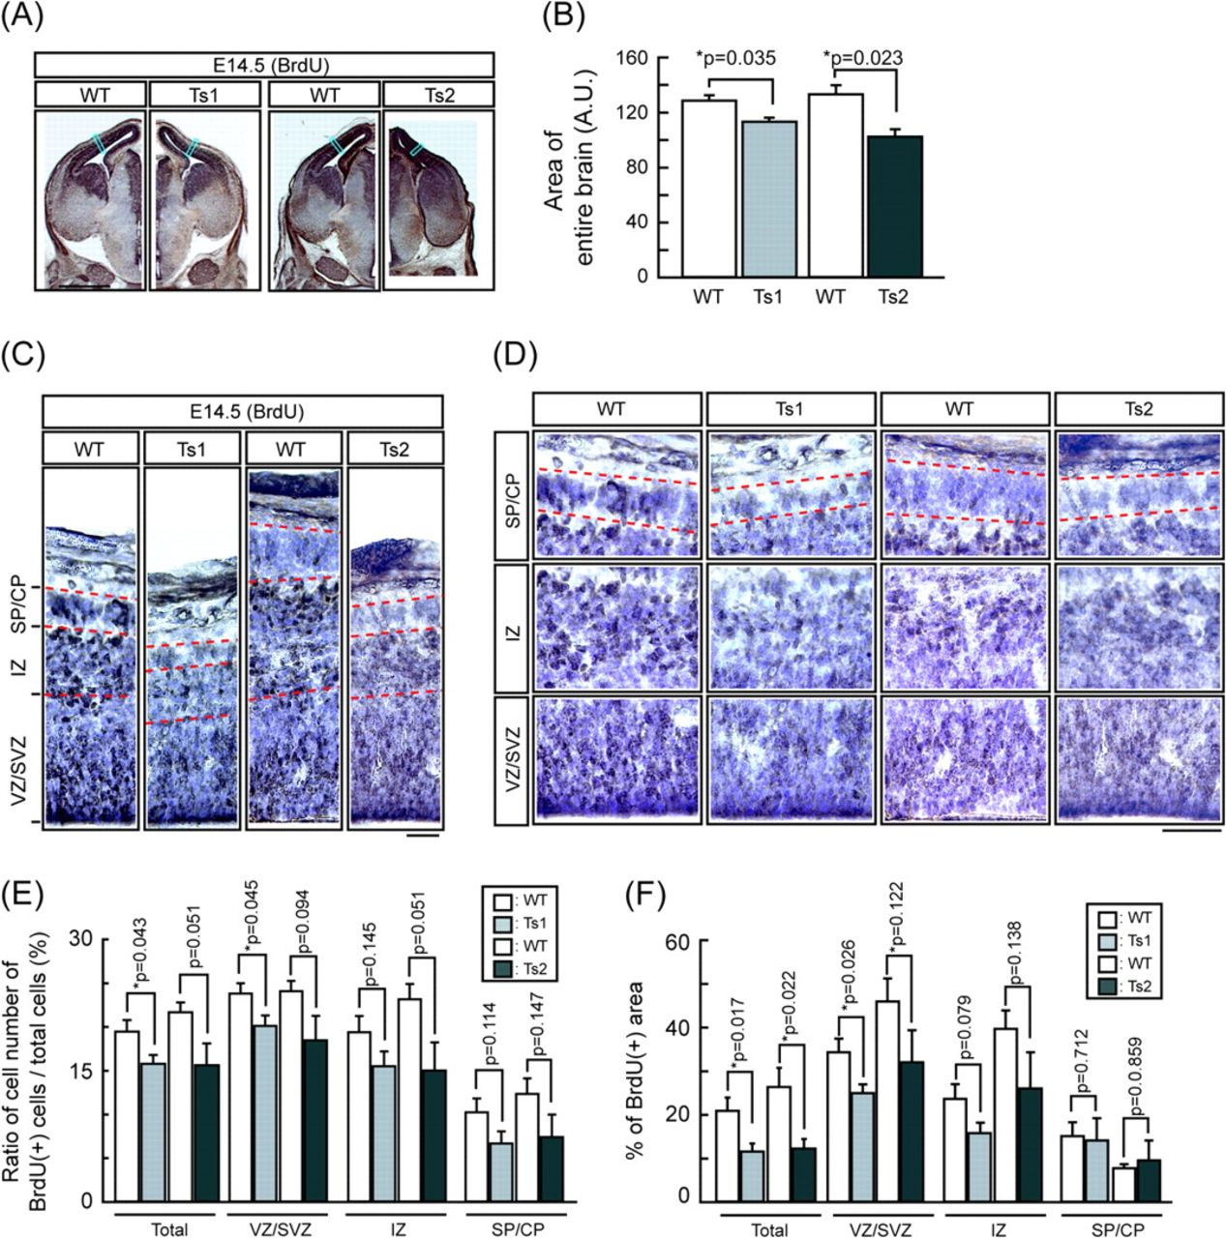
Figure 8. Decreased proliferating cells in Ts1Cje and Ts2Cje embryonic neocortices. Pregnant Ts1Cje (Ts1) and Ts2Cje ...
Notes:
Figure 8. Decreased proliferating cells in Ts1Cje and Ts2Cje embryonic neocortices. Pregnant Ts1Cje (Ts1) and Ts2Cje (Ts2) females on the B6/C3H hybrid background at gestational day 13 (E13.5 for embryos) were administrated with one pulse of 50 mg/kg BrdU and BrdU-positive cells were detected at 24 h after injection on immunohistochemistry. (A) BrdU immunostaining of coronal sections from Ts1 (left) and Ts2 (right) taken from matched sections according to the morphology of somatosensory cortex. Scale bar: 1 mm. (B) Areas of entire brains from Ts1, Ts2, and respective wild-type (WT) littermates (n = 4 for pairs of Ts1 and n = 3 for pairs of Ts2) were measured by NIH ImageJ software. Each value indicates area of the entire brain in arbitrary unit (mean ± standard error of the mean). Note that the brains of Ts1 and Ts2 were significantly smaller than those of respective WT littermates. (C) Higher magnification images of the cortical wall taken at the midpoint between the medial and lateral angles of the LV (boxed areas in A) show that pallial thickness of DS models is thinner than that of respective WT littermate. In addition, fewer BrdU-positive cells (brown) were detected in both DS models. Nuclear was stained with Hematoxylin (blue). Scale bar: 50 μm. (D) Higher magnification images of each layer. Scale bar: 25 μm. (E, F) Quantifications of BrdU-positive and -negative cell numbers (D) and their areas (E) in each layer (VZ/SVZ, IZ, and SP/CP) of the cortex by counting in a blinded manner using NIH ImageJ. Proliferating cells were reduced in embryonic cortices of both Ts1 and Ts2. Values in D and E indicate the ratios of the number of BrdU-positive cells/total cells and of the BrdU-positive area/total area, respectively (mean ± standard error of the mean). Statistical significance was determined with the Student's t-test. *P < 0.05, significantly different from WT littermate.
Unless provided in the caption above, the following copyright applies to the content of this slide: © The Author 2009. Published by Oxford University Press. All rights reserved. For permissions, please e-mail: journals.permissions@oxfordjournals.org

