Slide 1
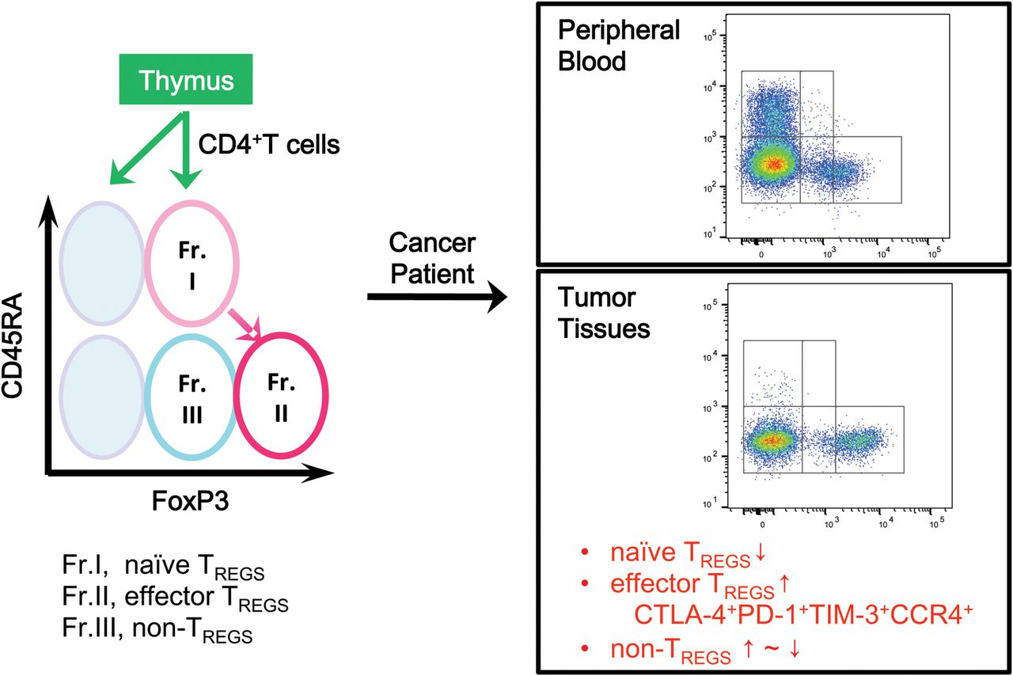
Fig. 1. Identification of human T _{regs} . Human T _{regs} are classified into naive and effector T ...
Notes:
Fig. 1. Identification of human T regs . Human T regs are classified into naive and effector T regs by the expression levels of a naive marker CD45RA and of FoxP3. In TMEs compared with blood, naive T reg (fraction I, Fr. I) numbers are reduced and highly suppressive effector T reg (fraction II) numbers are increased, expressing CTLA-4, PD-1, TIM-3 and CCR4. The frequency of FoxP3 + non-T reg cells (fraction III) is variable depending on cancer types.
Unless provided in the caption above, the following copyright applies to the content of this slide: © The Author(s) 2016. Published by Oxford University Press on behalf of The Japanese Society for Immunology. All rights reserved. For permissions, please e-mail: journals.permissions@oup.comThis article is published and distributed under the terms of the Oxford University Press, Standard Journals Publication Model (https://academic.oup.com/pages/standard-publication-reuse-rights)

Slide 2
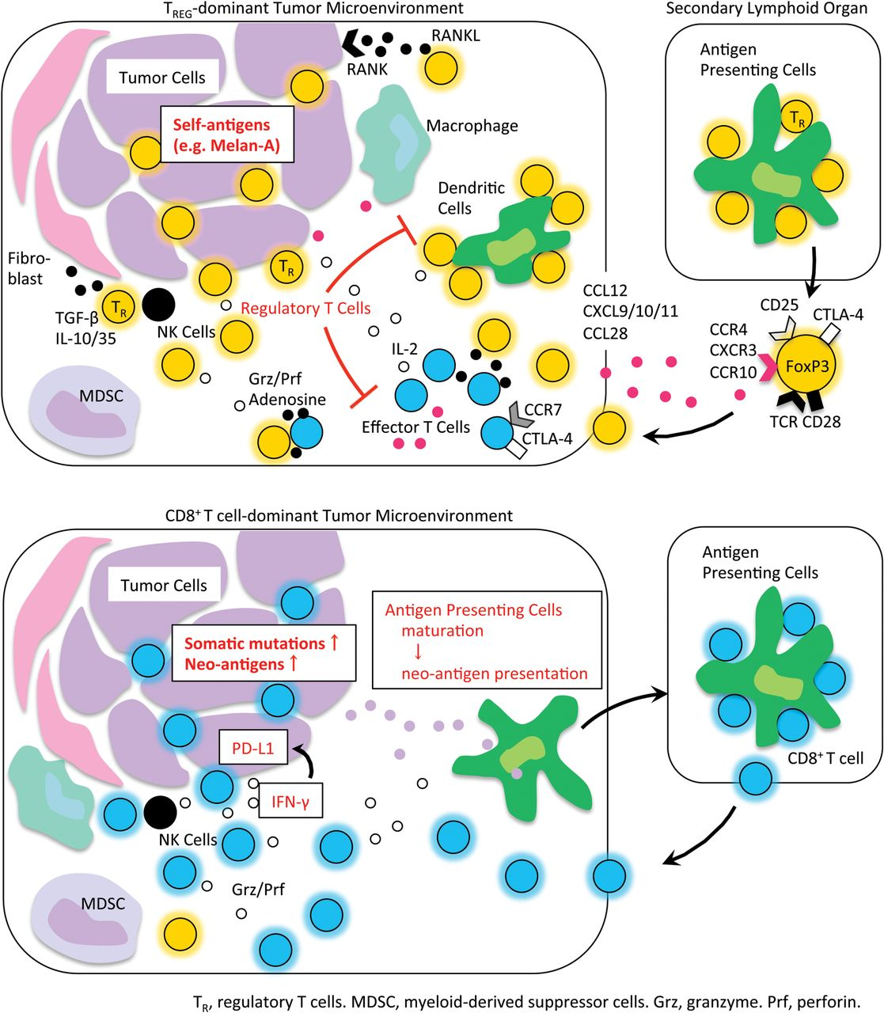
Fig. 2. T _{regs} in cancer immunity. In cancer patients with minimal neoantigens (top part of the figure), ...
Notes:
Fig. 2. T regs in cancer immunity. In cancer patients with minimal neoantigens (top part of the figure), T regs appear to be primed at the secondary lymphoid organs and traffic to the TME by chemotaxis. T regs suppress effective antitumor immunity and/or contribute to tumor progression and metastasis. In contrast, in cancer patients with abundant neoantigens (bottom part of the figure), effector cells including CD8 + T cells are primed and expanded; while they are suppressed in local tumor sites by the immune suppressive network and chronic exposure to cancer antigens in tumors, they are yet on stand-by for tumor killing upon re-stimulation with inhibition of the immune suppressive network, particularly PD-1 signaling. Grz, granzyme; MDSC, myeloid-derived suppressor cell; Prf, perforin; T R , regulatory T cell.
Unless provided in the caption above, the following copyright applies to the content of this slide: © The Author(s) 2016. Published by Oxford University Press on behalf of The Japanese Society for Immunology. All rights reserved. For permissions, please e-mail: journals.permissions@oup.comThis article is published and distributed under the terms of the Oxford University Press, Standard Journals Publication Model (https://academic.oup.com/pages/standard-publication-reuse-rights)

