Slide 1
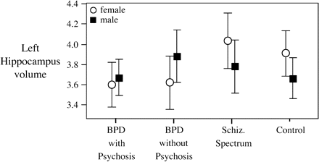
Fig. 1. Diagnostic and Sex Differences in the Left Hippocampus. All figures plot mean volumes ± 95% confidence ...
Notes:
Fig. 1. Diagnostic and Sex Differences in the Left Hippocampus. All figures plot mean volumes ± 95% confidence interval.
Unless provided in the caption above, the following copyright applies to the content of this slide: © The Author 2007. Published by Oxford University Press on behalf of the Maryland Psychiatric Research Center. All rights reserved. For permissions, please email: journals.permissions@oxfordjournals.org.

Slide 2
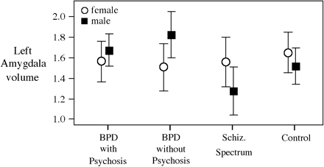
Fig. 2. Diagnostic and Sex Differences in the Left Amygdala.
Notes:
Fig. 2. Diagnostic and Sex Differences in the Left Amygdala.
Unless provided in the caption above, the following copyright applies to the content of this slide: © The Author 2007. Published by Oxford University Press on behalf of the Maryland Psychiatric Research Center. All rights reserved. For permissions, please email: journals.permissions@oxfordjournals.org.

Slide 3
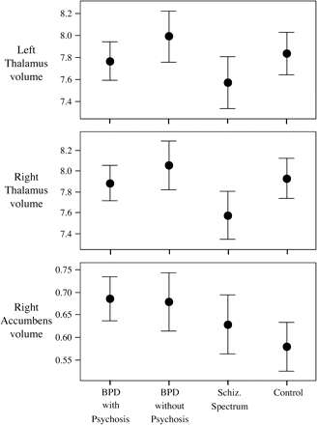
Fig. 3. Diagnostic Differences in the Thalamus and Right Nucleus Accumbens.
Notes:
Fig. 3. Diagnostic Differences in the Thalamus and Right Nucleus Accumbens.
Unless provided in the caption above, the following copyright applies to the content of this slide: © The Author 2007. Published by Oxford University Press on behalf of the Maryland Psychiatric Research Center. All rights reserved. For permissions, please email: journals.permissions@oxfordjournals.org.

