Slide 1
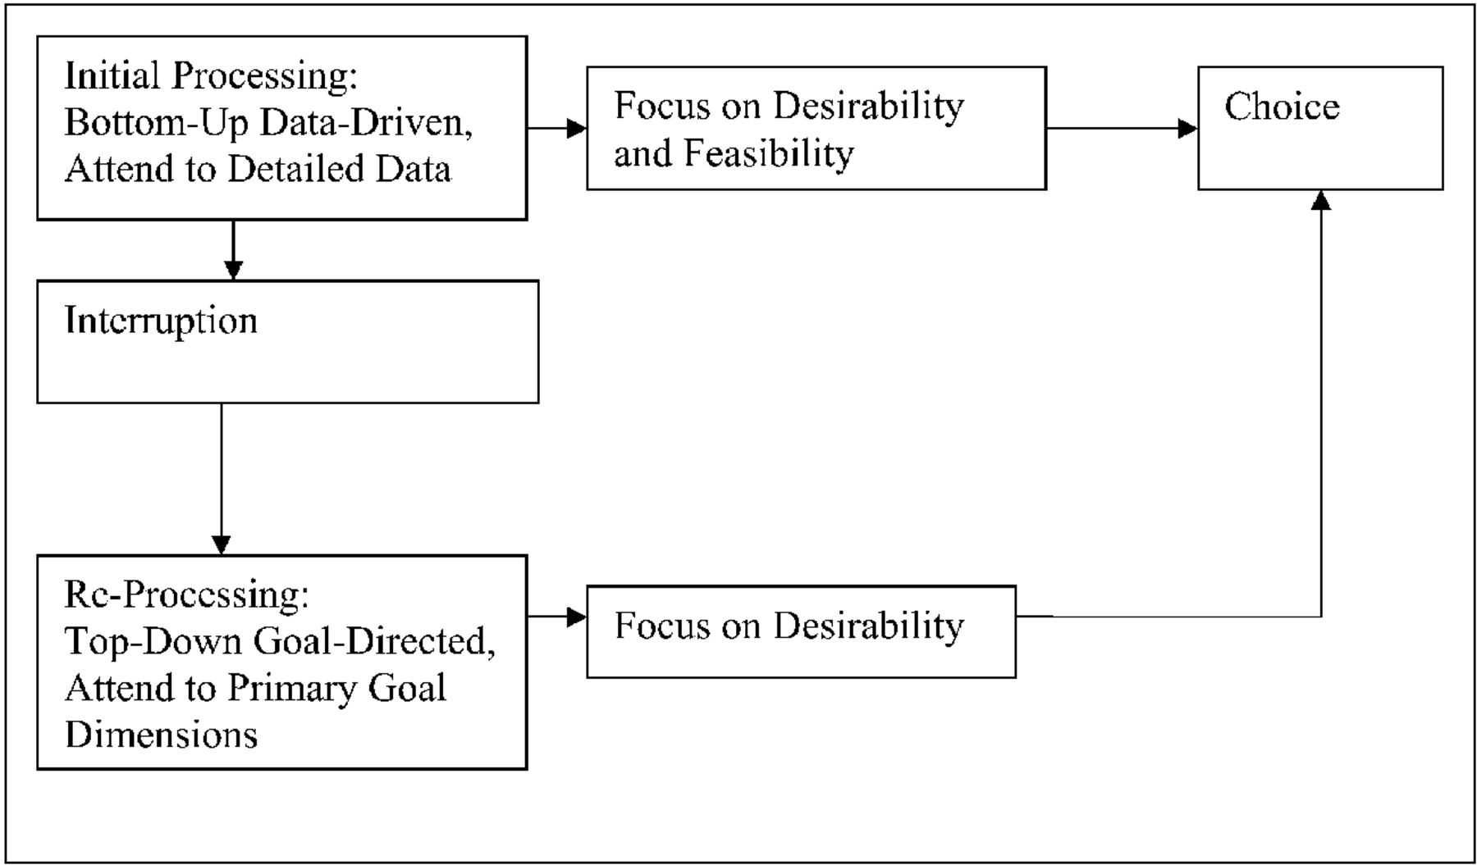
Figure 1 Theoretical model
Notes:
Figure 1 Theoretical model
Unless provided in the caption above, the following copyright applies to the content of this slide: © 2008 by JOURNAL OF CONSUMER RESEARCH, Inc.

Slide 2
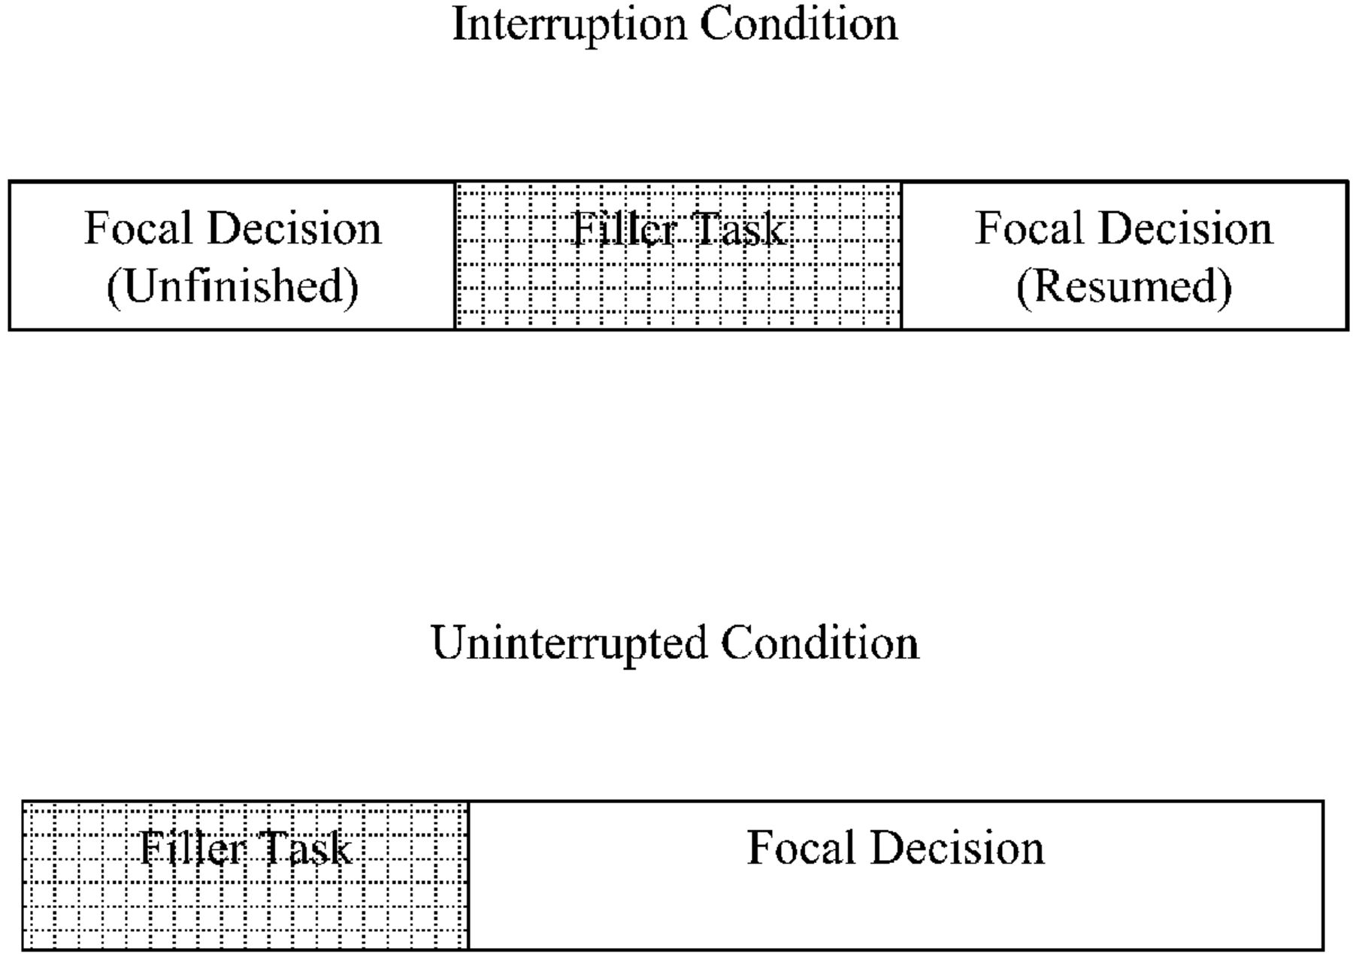
Figure 2 Illustration of the decision interruption procedure
Notes:
Figure 2 Illustration of the decision interruption procedure
Unless provided in the caption above, the following copyright applies to the content of this slide: © 2008 by JOURNAL OF CONSUMER RESEARCH, Inc.

Slide 3
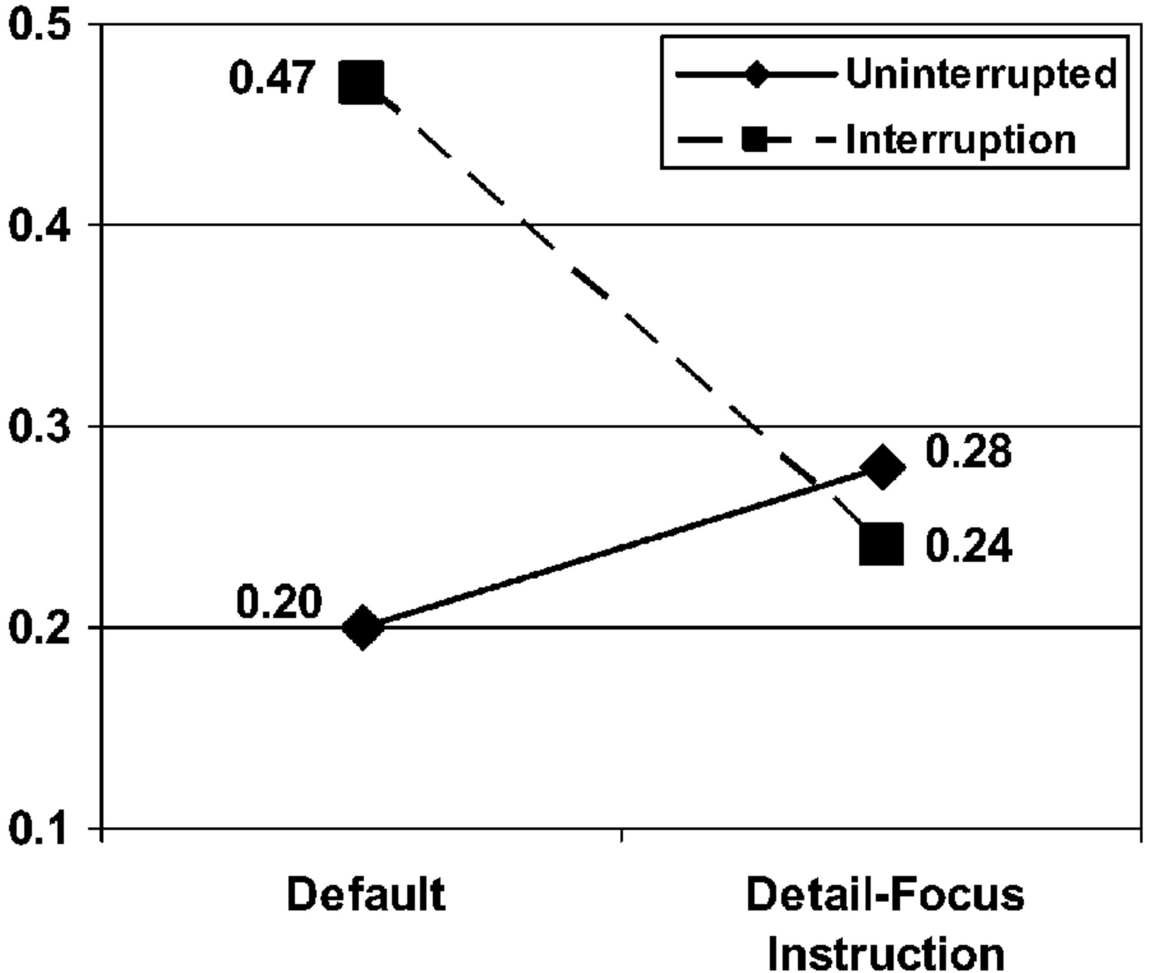
Figure 3 Study 3 results
Notes:
Figure 3 Study 3 results
Unless provided in the caption above, the following copyright applies to the content of this slide: © 2008 by JOURNAL OF CONSUMER RESEARCH, Inc.

Slide 4
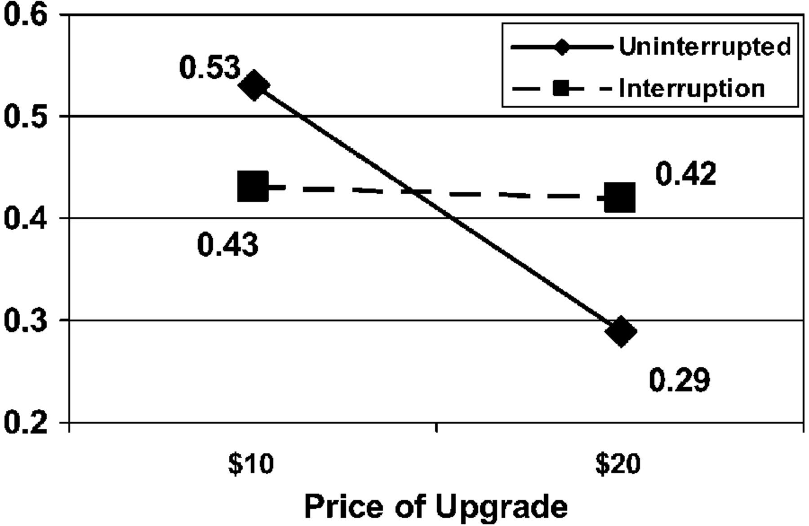
Figure 4 Study 4 results
Notes:
Figure 4 Study 4 results
Unless provided in the caption above, the following copyright applies to the content of this slide: © 2008 by JOURNAL OF CONSUMER RESEARCH, Inc.

