Slide 1
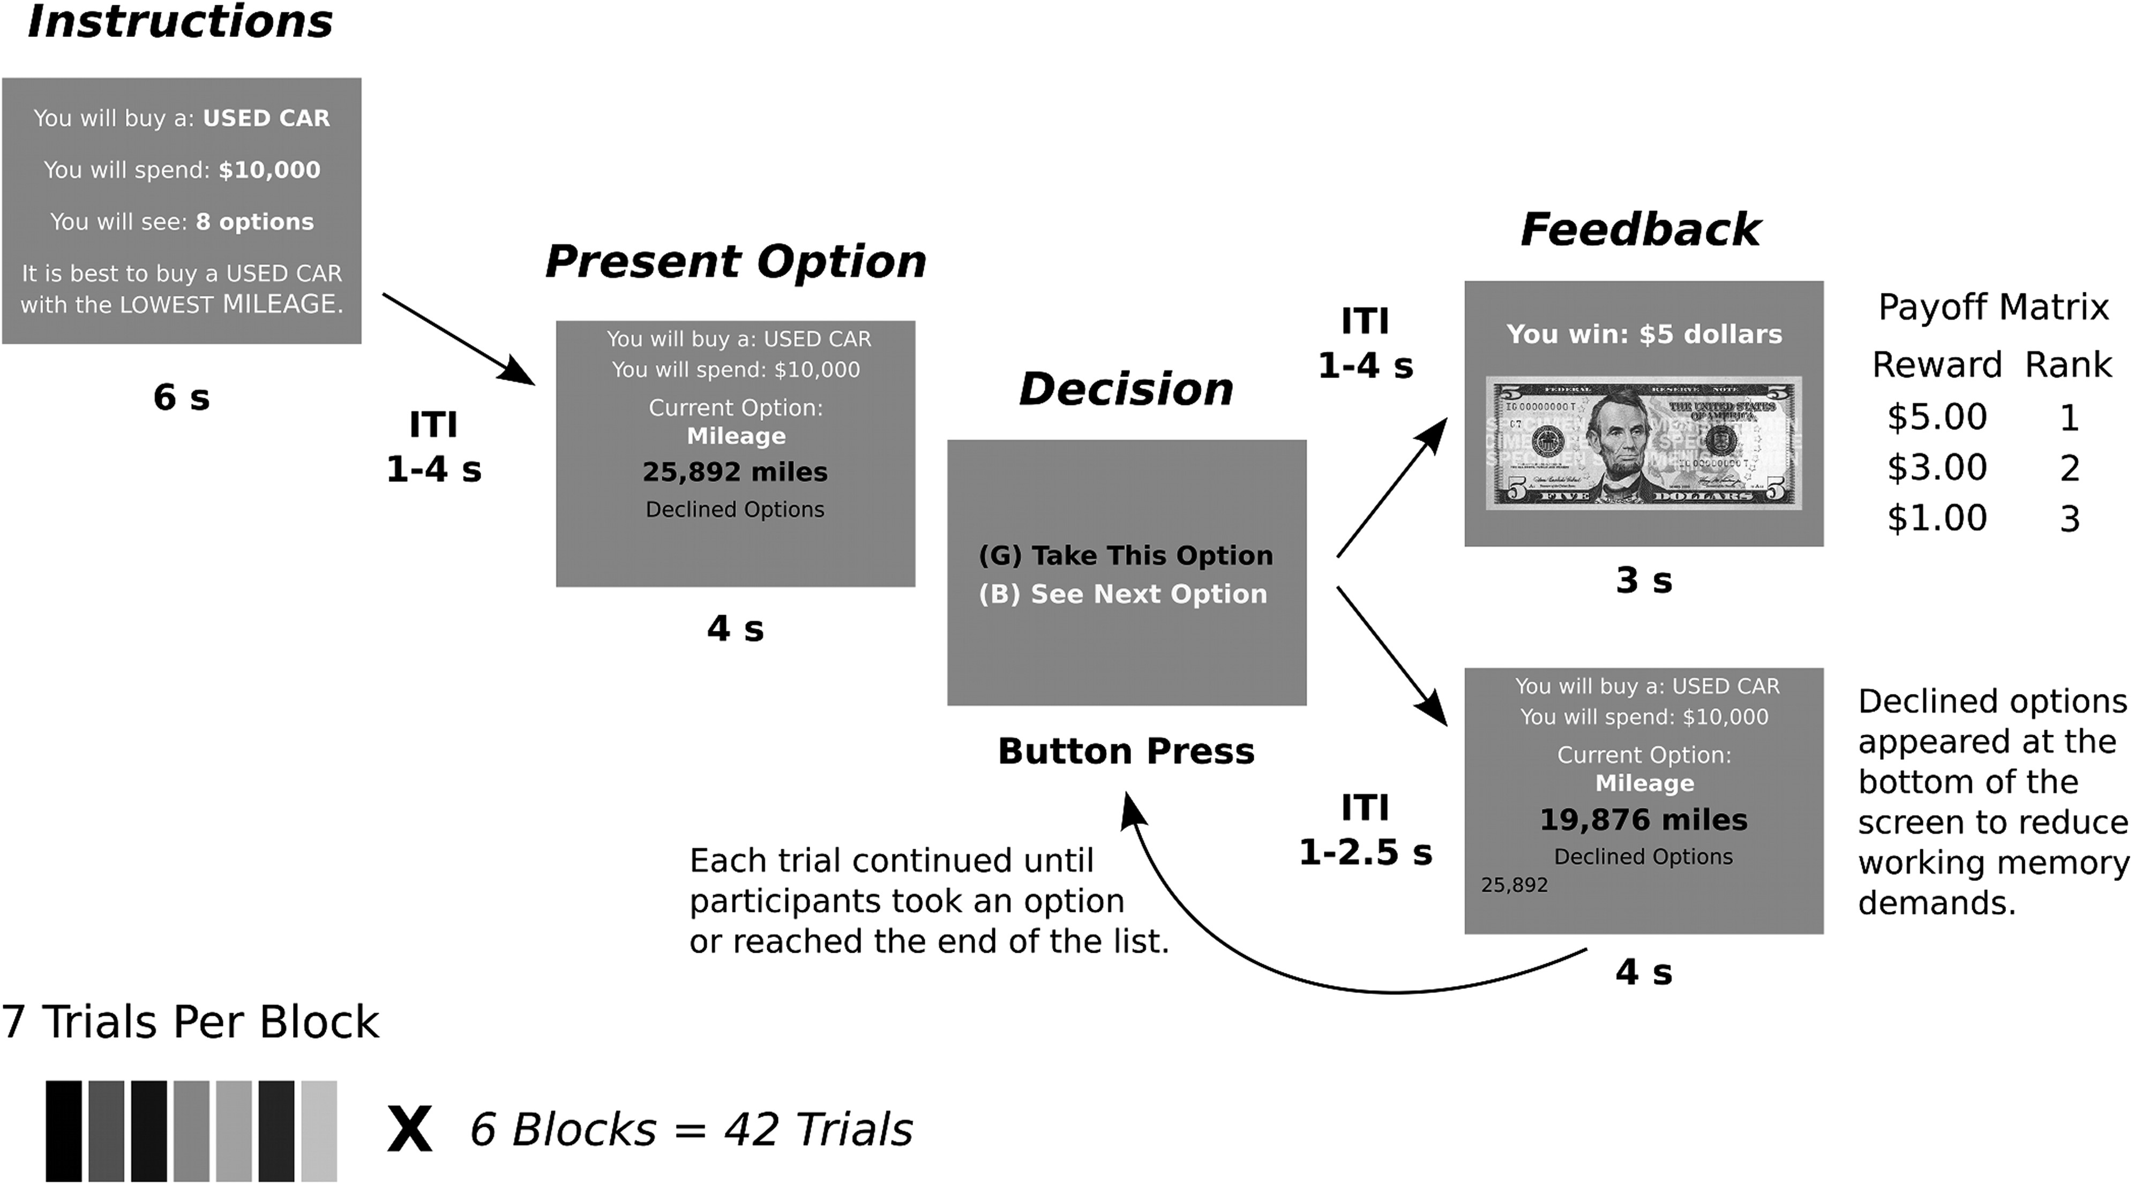
Figure 1. Task events. Participants were given an instruction screen at the beginning of each sequence of options that ...
Notes:
Figure 1. Task events. Participants were given an instruction screen at the beginning of each sequence of options that framed the problem. They were then shown a series of options one at a time. They did not know what the other options in the list were. After each option, they had to decide whether to take or decline the current option. Declined options were shown on the bottom of subsequent screens. If an option was chosen, the participant was given reward feedback.
Unless provided in the caption above, the following copyright applies to the content of this slide: Published by Oxford University Press 2013. This work is written by (a) US Government employee(s) and is in the public domain in the US

Slide 2
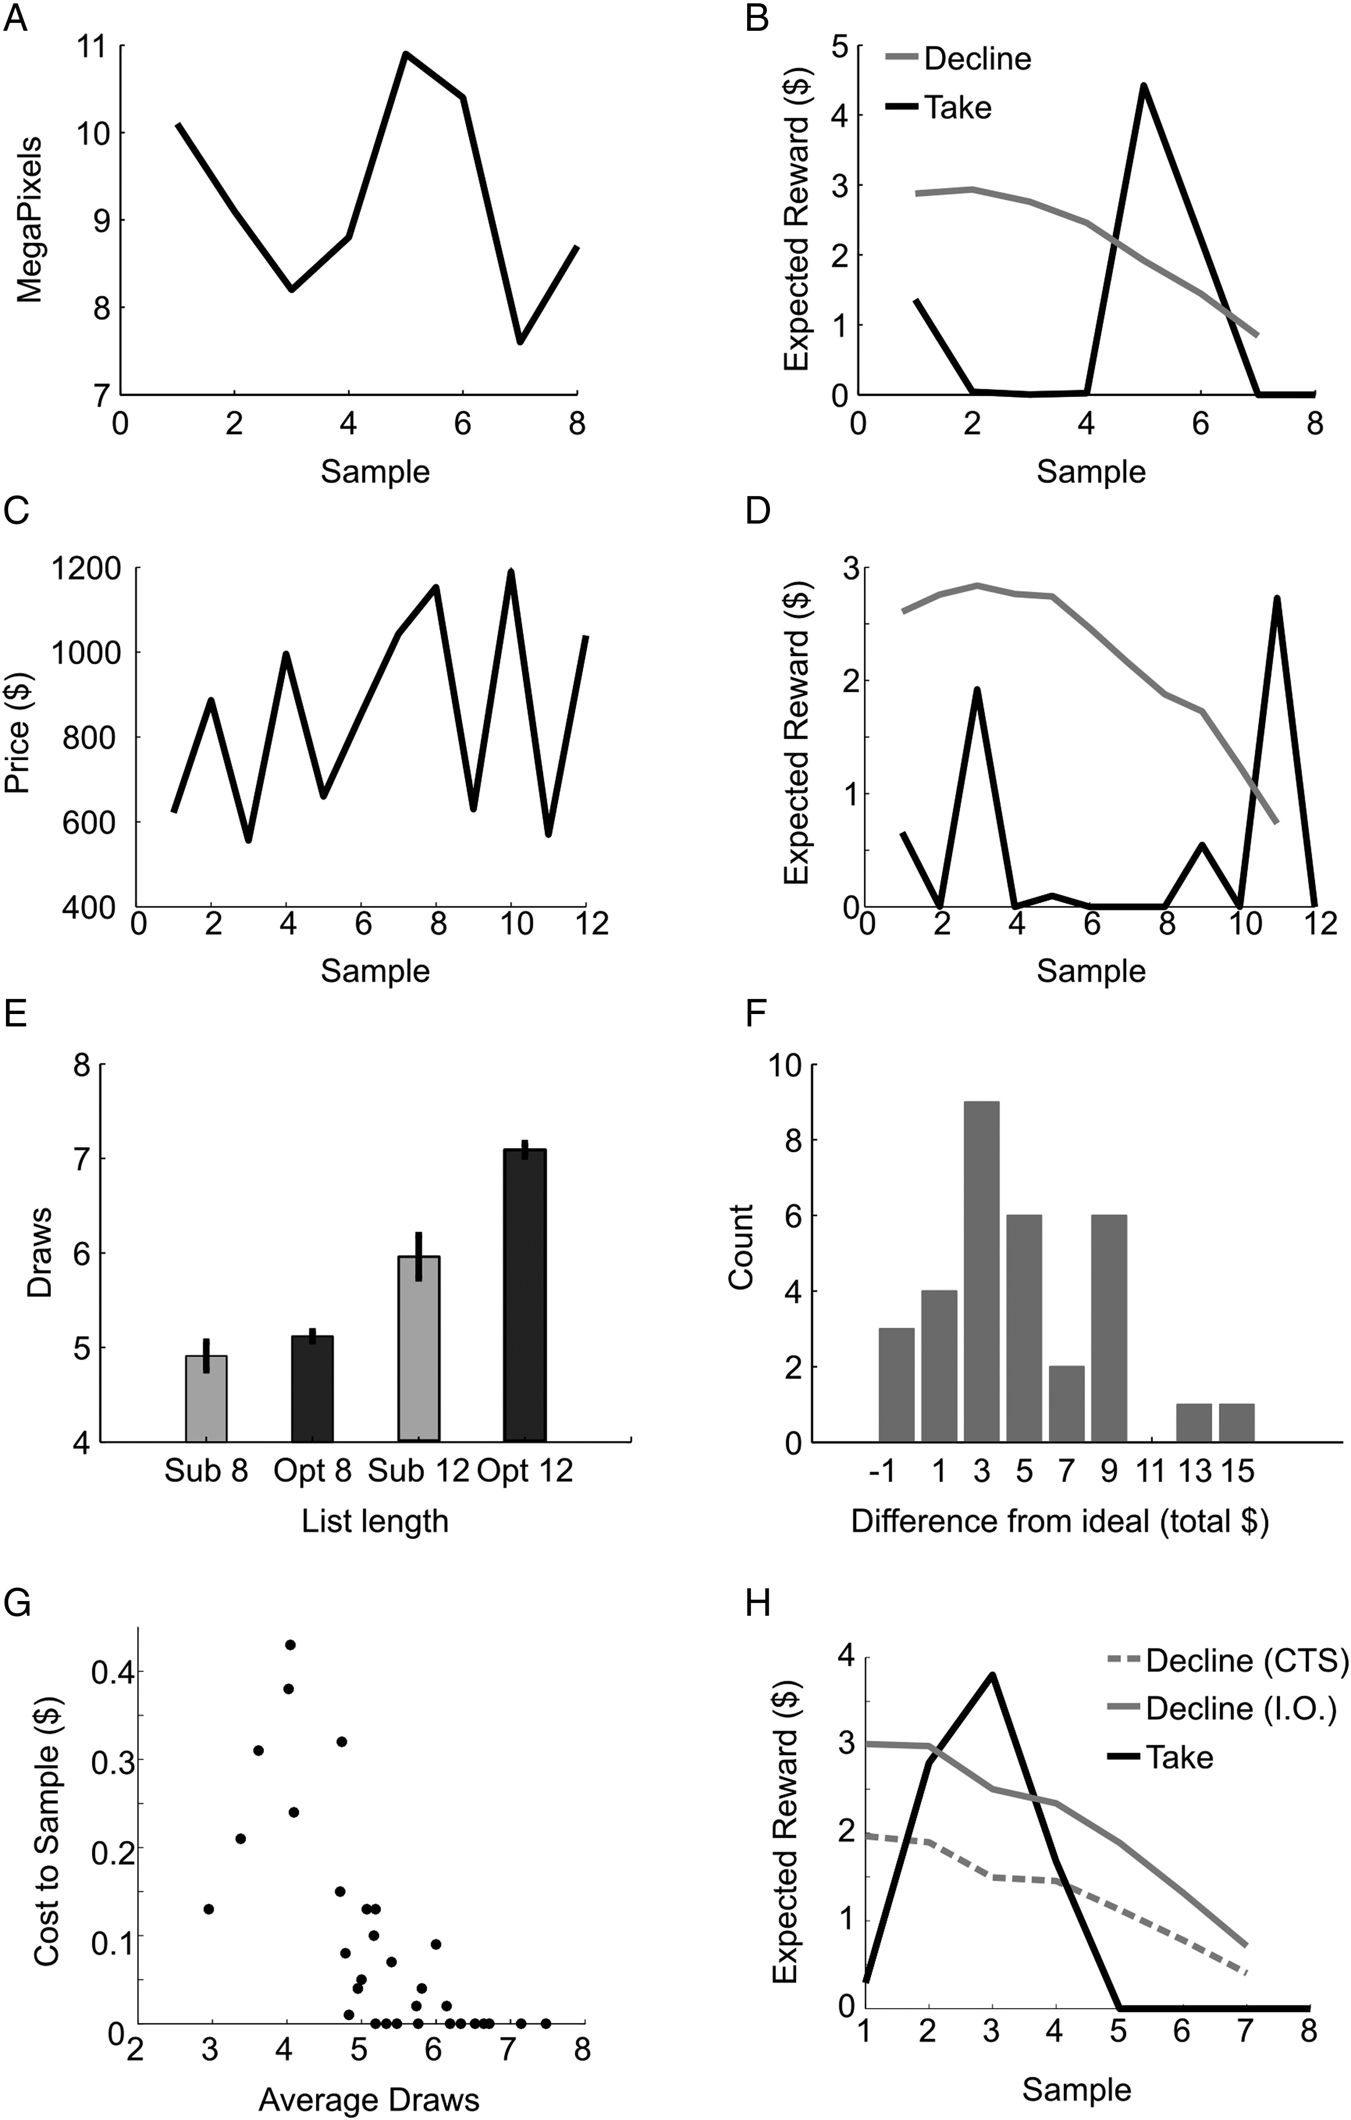
Figure 2. Model output and behavioral results. (A) Sequence of options that varied in mega-pixels for the scenario of ...
Notes:
Figure 2. Model output and behavioral results. (A) Sequence of options that varied in mega-pixels for the scenario of purchasing a camera. (B) Expected reward for either decline or take choices on the current option, for the camera scenario shown at left. (C) Sequence of options for the scenario of purchasing an airplane ticket. (D) Expected reward for decline and take choices, for the airplane tickets shown at left. (E) Participant number of draws (Sub) and optimal number of draws (Opt) at list lengths of 8 and 12. (F) Summed difference between actual rewards earned by the MDP algorithm, and rewards earned by individual participants. Negative values indicate subjects that slightly outperformed model. (G) Cost-to-sample and average number of draws, for each subject. (H) Example sequence for a subject whose cost-to-sample was $0.31. In this case, the ideal observer would not stop at the second sample, but the subject did. CTS, cost-to-sample model; IO, ideal observer model.
Unless provided in the caption above, the following copyright applies to the content of this slide: Published by Oxford University Press 2013. This work is written by (a) US Government employee(s) and is in the public domain in the US

Slide 3
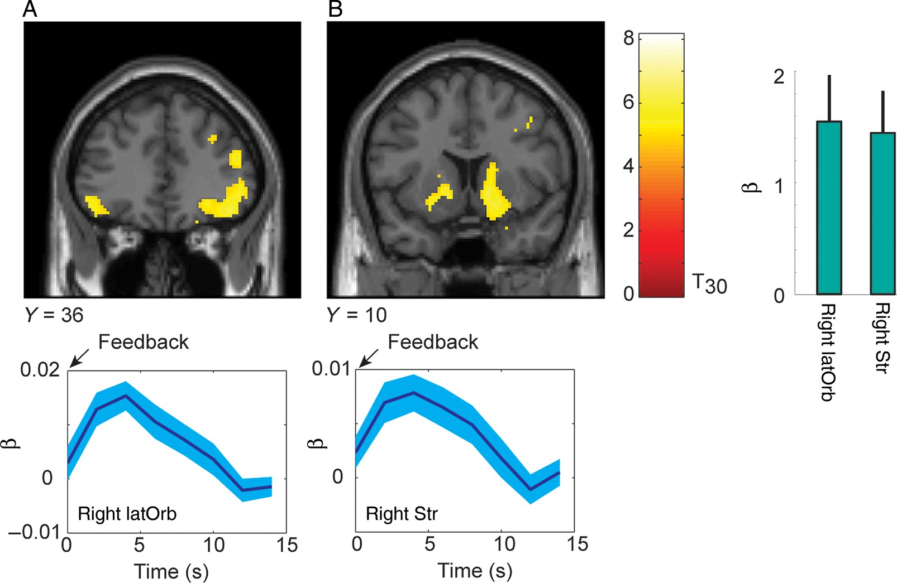
Figure 3. Parametric modulation for reward outcome. Activations plotted at P < 0.05 FWE. Time series below each coronal ...
Notes:
Figure 3. Parametric modulation for reward outcome. Activations plotted at P < 0.05 FWE. Time series below each coronal section show mean and standard error from analysis of finite impulse response (FIR), for comparison. The FIR analysis was not used for inference of active clusters. The time course of a parametric modulator, as plotted here, indicates the time-course of significant covariation between the value of the modulator, and the value of the bold signal, over and above the actual event-related response. Histogram shows β weights and 90% CI from the GLM analysis. (A) Activation in lateral-orbital cortex that correlated with the size of the outcome. (B) Activation in ventral striatum.
Unless provided in the caption above, the following copyright applies to the content of this slide: Published by Oxford University Press 2013. This work is written by (a) US Government employee(s) and is in the public domain in the US

Slide 4
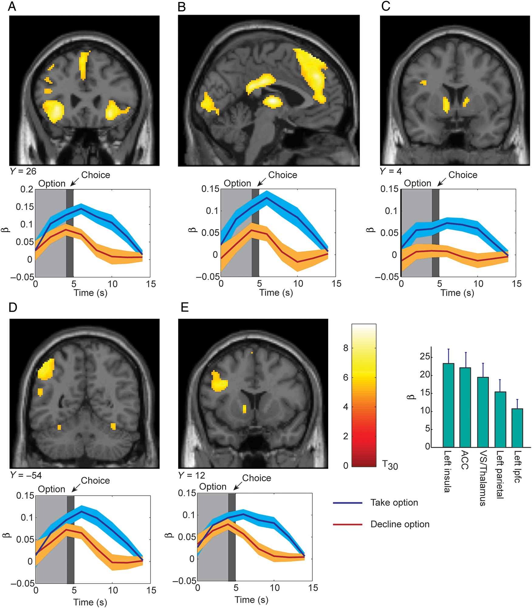
Figure 4. Significant clusters for contrast of Take option versus Decline option. Coronal (and one sagittal) sections ...
Notes:
Figure 4. Significant clusters for contrast of Take option versus Decline option. Coronal (and one sagittal) sections with significant voxels are shown on top. The time-course of activations from a FIR analysis is shown below each corresponding coronal section. Time zero is option onset, while choice indicates the time at which the subject entered their decision. Activations plotted at P < 0.05 FWE. Histogram shows β weights and 90% confidence interval from GLM analysis for each of the activations shown in (A–E). (A) Activation in left anterior insula. (B) Activation in anterior cingulate shown on a sagittal view. (C) Activation in ventral striatum. (D) Activation in dorsal parietal cortex. (E) Activation in lateral–prefrontal cortex.
Unless provided in the caption above, the following copyright applies to the content of this slide: Published by Oxford University Press 2013. This work is written by (a) US Government employee(s) and is in the public domain in the US

Slide 5
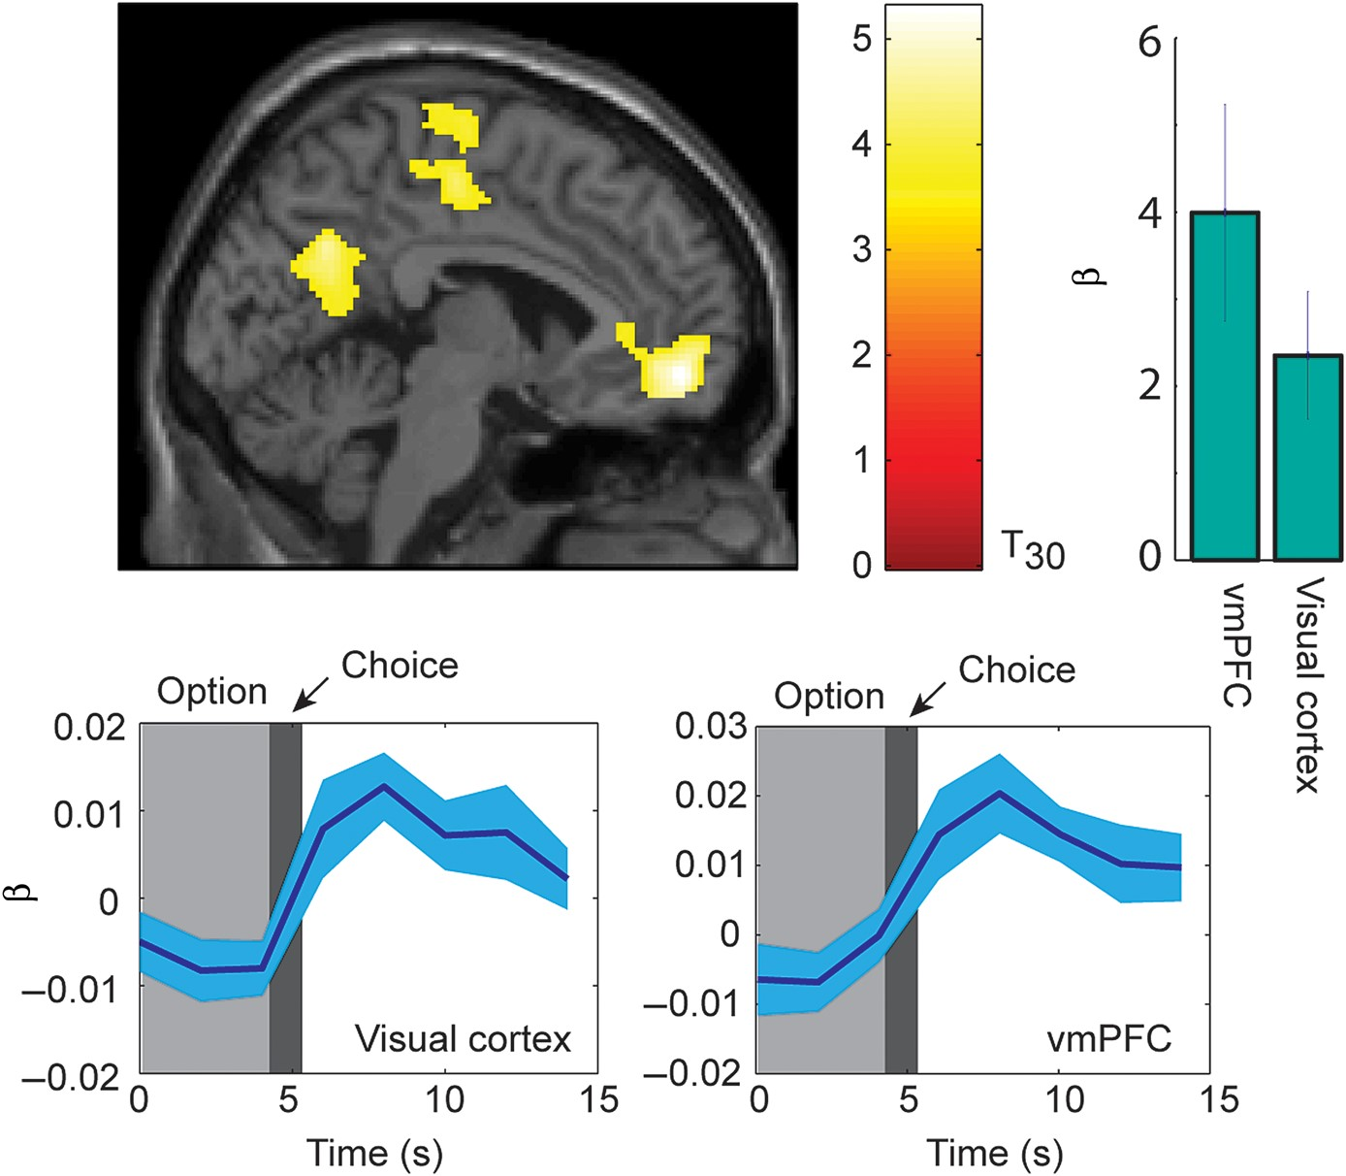
Figure 5. Significant effects of parametric modulator for declined choices. The time-course for a parametric modulator ...
Notes:
Figure 5. Significant effects of parametric modulator for declined choices. The time-course for a parametric modulator shows significant covariation between BOLD response and value of parametric modulator, over time. Activations plotted at P < 0.001 uncorrected. Histogram shows β weights from the GLM analysis that corresponds to activations. Significant activations can be seen in visual cortex and vmPFC. Lower panels show time series from FIR analysis in visual cortex and vmPFC, as indicated.
Unless provided in the caption above, the following copyright applies to the content of this slide: Published by Oxford University Press 2013. This work is written by (a) US Government employee(s) and is in the public domain in the US

Slide 6
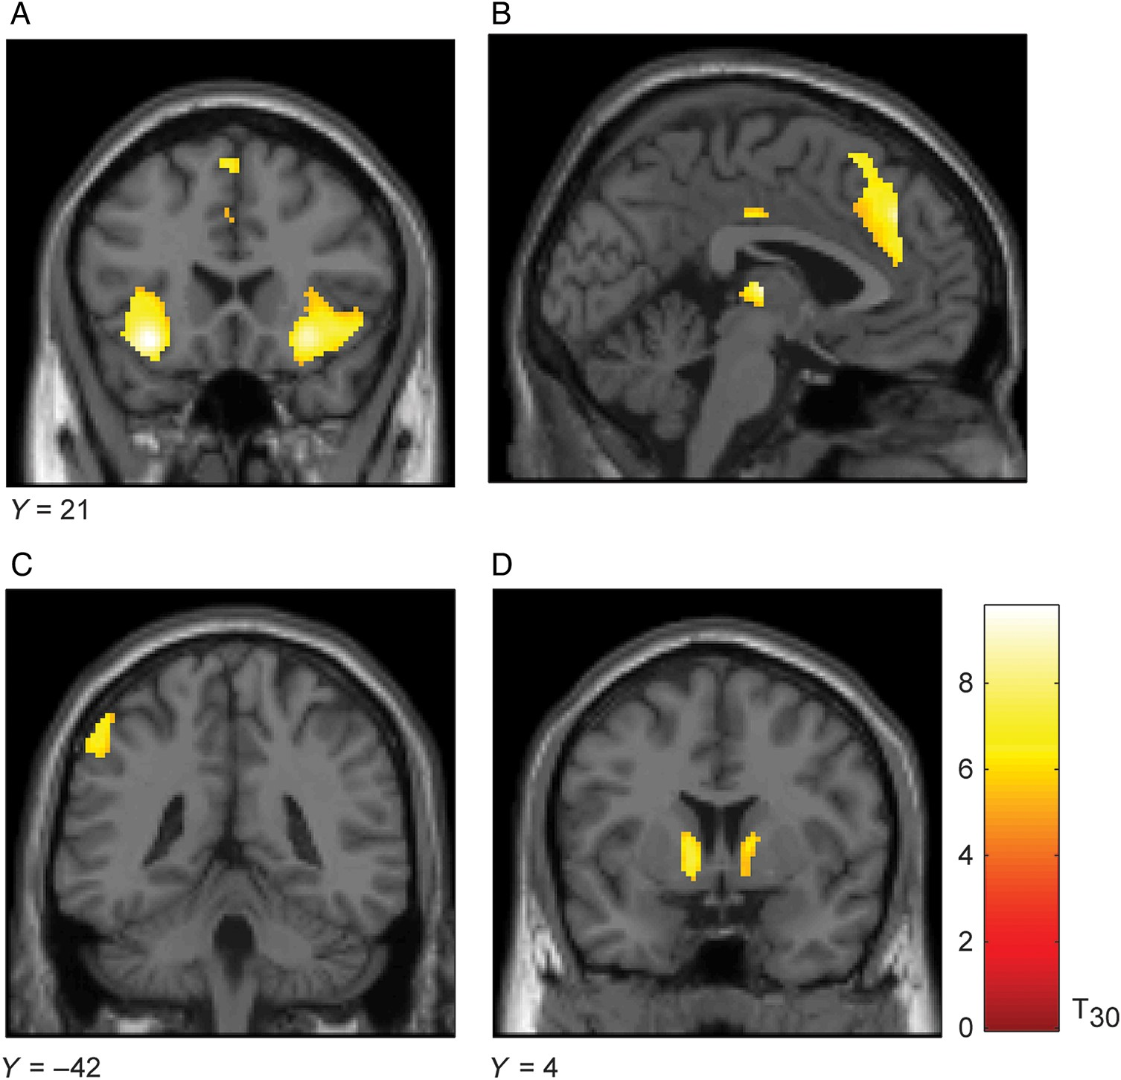
Figure 6. Take versus decline activation, masked by significant clusters (P < 0.05 FWE) from Furl and Averbeck (2011). ...
Notes:
Figure 6. Take versus decline activation, masked by significant clusters (P < 0.05 FWE) from Furl and Averbeck (2011). Compare with Figure 4 from this earlier paper in which information sampling was assessed in the beads task. (A) Anterior insula activation; (B) ACC activation; (C) dorsal parietal activation; (D) ventral striatal activation.
Unless provided in the caption above, the following copyright applies to the content of this slide: Published by Oxford University Press 2013. This work is written by (a) US Government employee(s) and is in the public domain in the US

