Slide 1
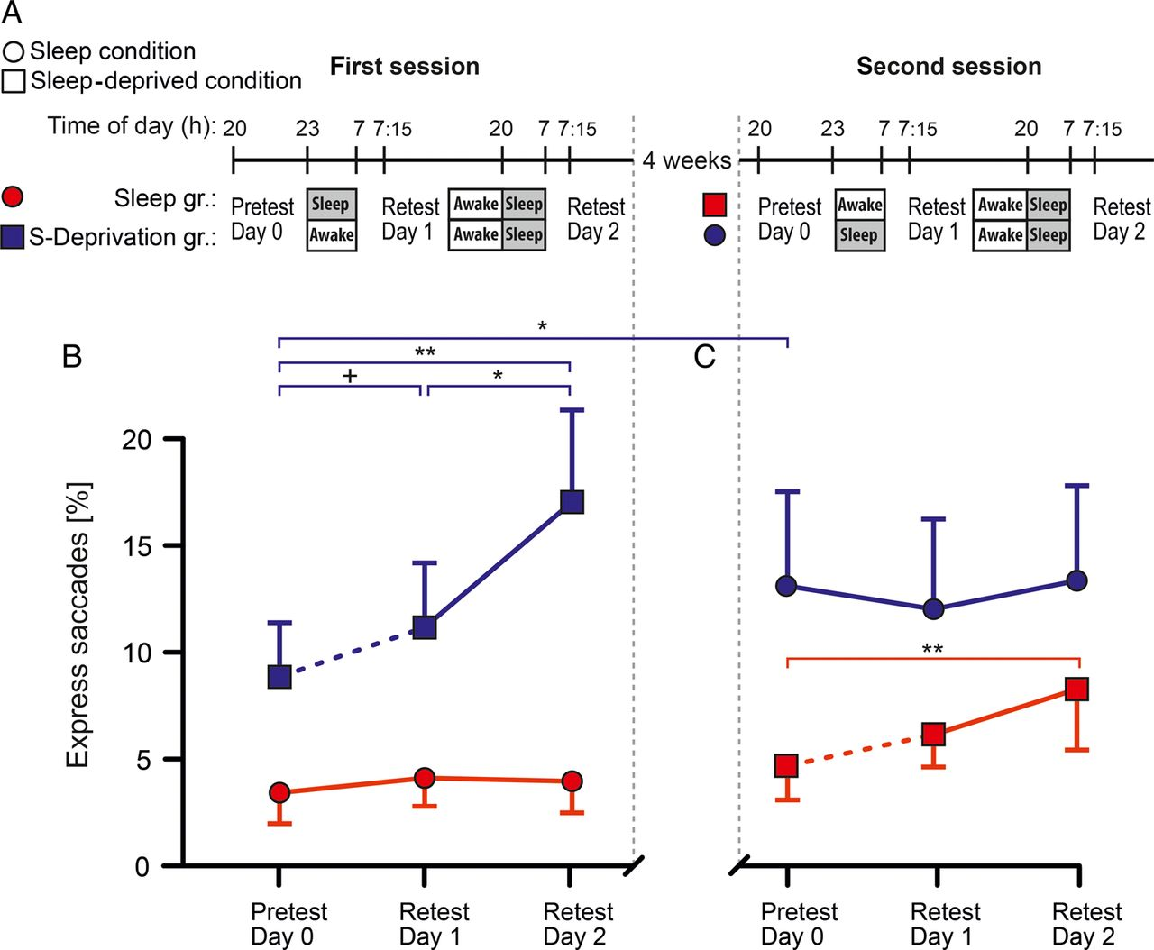
Figure 1. (A) Procedures for the Sleep and S-Deprivation groups for the original first session (left) and for the ...
Notes:
Figure 1. (A) Procedures for the Sleep and S-Deprivation groups for the original first session (left) and for the second session taking place 4 weeks later (right). Red lines—Sleep group, that is, subjects who had regular sleep on the original first session and were deprived of sleep on the second session; blue lines—S-Deprivation group, that is, subjects who were deprived of sleep on the original first session and had regular sleep on the second session. Shapes of data points indicate actual condition, that is, circles—regular sleep; squares—sleep deprivation. Times of pretest (on Day 0) and retests (on Day 1 and Day 2) are indicated. (B) Mean ± SEM express saccade rates at the pretest (on Day 0) and at retests (on Day 1 and Day 2) for the first and (C) second session. Sleep-deprived subjects were allowed to sleep already at 18:00 h but usually went to bed later than that, that is, around 20:00 h, as indicated. Dashed line indicates an intervening night of sleep deprivation. +P < 0.1, *P < 0.05, **P < 0.01 for paired tests between conditions.
Unless provided in the caption above, the following copyright applies to the content of this slide: © The Author 2015. Published by Oxford University PressThis is an Open Access article distributed under the terms of the Creative Commons Attribution Non-Commercial License (http://creativecommons.org/licenses/by-nc/4.0/), which permits non-commercial re-use, distribution, and reproduction in any medium, provided the original work is properly cited. For commercial re-use, please contact journals.permissions@oup.com

Slide 2
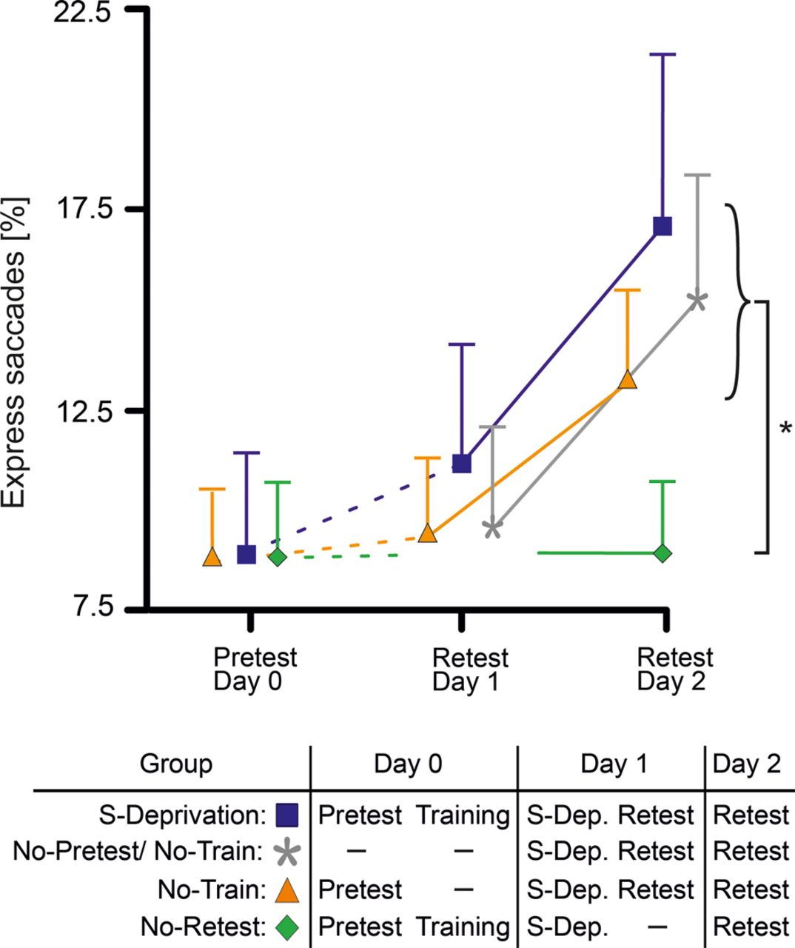
Figure 2. Mean ± SEM express saccade rates at the pretest (on Day 0) and retests (on Day 1 and Day 2) of the original ...
Notes:
Figure 2. Mean ± SEM express saccade rates at the pretest (on Day 0) and retests (on Day 1 and Day 2) of the original S-Deprivation group (squares filled blue), and 3 additional groups which, like the S-Deprivation group, were subjected to sleep deprivation between Day 0 and Day 1. Of these groups (see bottom panel), different from the original S-Deprivation group, the No-Pretest/No-train group (grey asterisks) did neither perform the Pretest nor saccade training on Day 0, the No-train group (triangles filled yellow) did not perform the training on Day 0, and the No-Retest group (diamonds filled green) did not perform the retest on Day 1. Dashed lines indicate intervening night of sleep deprivation. (At pretest on Day 0 express rates were quite similar for the respective groups, i.e., 8.94 ± 2.49% for the original S-Deprivation group, 8.69 ± 1.83% for the No-Train group, and 8.80 ± 1.86% for the No-Retest group; respective group differences are hardly distinguishable.) *P < 0.05, for the difference between performance of the No-Retest group and performance of each of the other 3 groups at the retest on Day 2.
Unless provided in the caption above, the following copyright applies to the content of this slide: © The Author 2015. Published by Oxford University PressThis is an Open Access article distributed under the terms of the Creative Commons Attribution Non-Commercial License (http://creativecommons.org/licenses/by-nc/4.0/), which permits non-commercial re-use, distribution, and reproduction in any medium, provided the original work is properly cited. For commercial re-use, please contact journals.permissions@oup.com

Slide 3
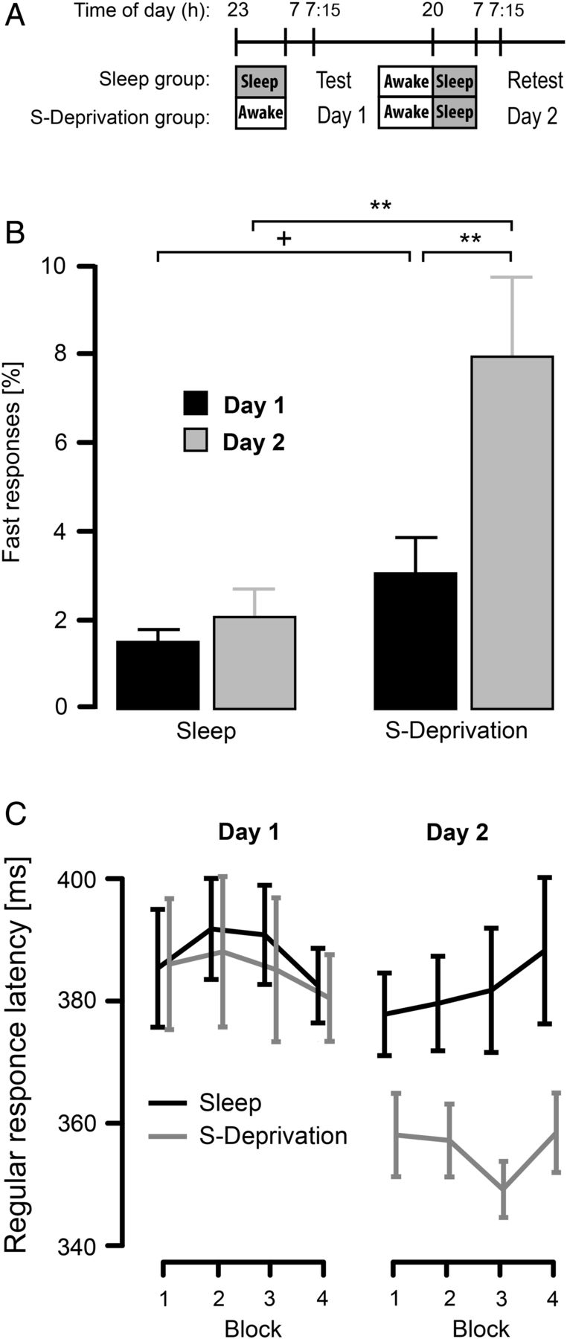
Figure 3. (A) Procedures for the Sleep and S-Deprivation groups of the supplementary study on finger motor responses. ...
Notes:
Figure 3. (A) Procedures for the Sleep and S-Deprivation groups of the supplementary study on finger motor responses. Times of the first test (on Day 1) and the retest (on Day 2) are indicated. (B) Mean ± SEM percentage of very fast responses (latencies 150–275 ms) at the test on Day 1 and at the retest on Day 2 between the groups. +P < 0.1, **P < 0.01, for t-test between groups and test conditions, respectively. (C) Reaction times (in ms) for regular responses (latencies ≥275 ms) for each of the 4 blocks during the test and the retest for the Sleep (black lines) and S-Deprivation groups (gray lines). Sleep-deprived subjects were allowed to sleep already at 18:00 h but usually went to bed later, that is, around 20:00 h, as indicated.
Unless provided in the caption above, the following copyright applies to the content of this slide: © The Author 2015. Published by Oxford University PressThis is an Open Access article distributed under the terms of the Creative Commons Attribution Non-Commercial License (http://creativecommons.org/licenses/by-nc/4.0/), which permits non-commercial re-use, distribution, and reproduction in any medium, provided the original work is properly cited. For commercial re-use, please contact journals.permissions@oup.com

