Slide 1
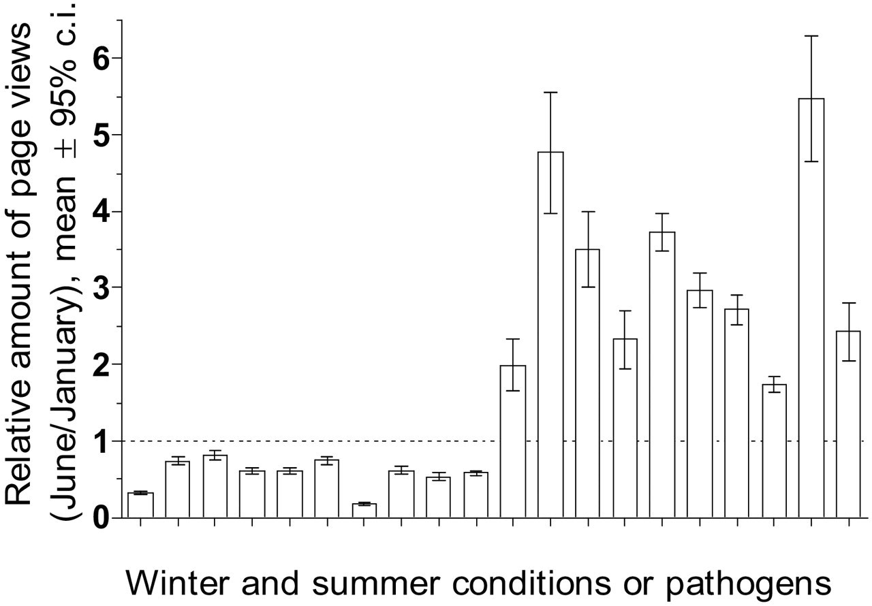
Figure 1 This graph shows the amount of page views during Jun relative to Jan 2008 for ten conditions or pathogens ...
Notes:
Figure 1 This graph shows the amount of page views during Jun relative to Jan 2008 for ten conditions or pathogens which are more common during winter (shown left: frostbite, hypothermia, carbon monoxide poisoning, common cold, pneumonia, bronchiolitis, norovirus, influenza, rhinovirus and seasonal affective disorder) or summer months (shown right: hyperthermia, sunburn, hay fever, insect bites and stings, bee sting, Lyme disease, Rocky Mountain spotted fever, hemolytic-uremic syndrome, harvest mite, West Nile virus), respectively. Results are expressed as a mean relative number of page views, and bars symbolize the 95% confidence interval around the mean.
Unless provided in the caption above, the following copyright applies to the content of this slide: American Medical Informatics Association

Slide 2
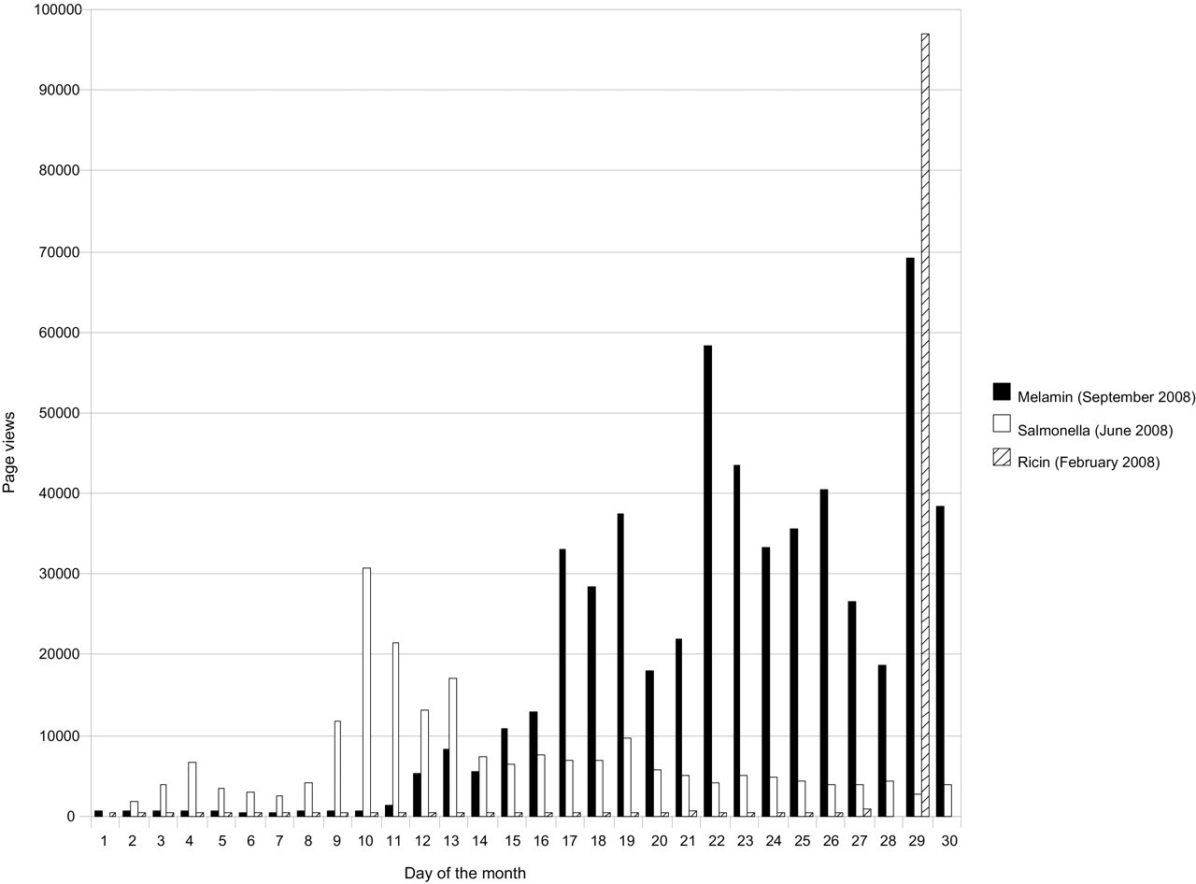
Figure 2 This graph shows the daily amount of page views during Sept 2008 for the article “Melamine” on the English ...
Notes:
Figure 2 This graph shows the daily amount of page views during Sept 2008 for the article “Melamine” on the English Wikipedia, the Jun 2008 daily page views for “Salmonella”, and the Feb 2008 daily page views for the article “Ricin”. On Sept 12, 2008, reports emerged of melamine-contaminated infant formula in China. Following the announcement of an outbreak of Salmonella Saint Paul and a possible link to tomatoes, several groceries and restaurants stopped offering tomatoes on Jun 9, 2008. On Feb 29, 2008, the Centers for Disease Control and Prevention announced an investigation following an intoxication with the protein toxin ricin.
Unless provided in the caption above, the following copyright applies to the content of this slide: American Medical Informatics Association

