Slide 1
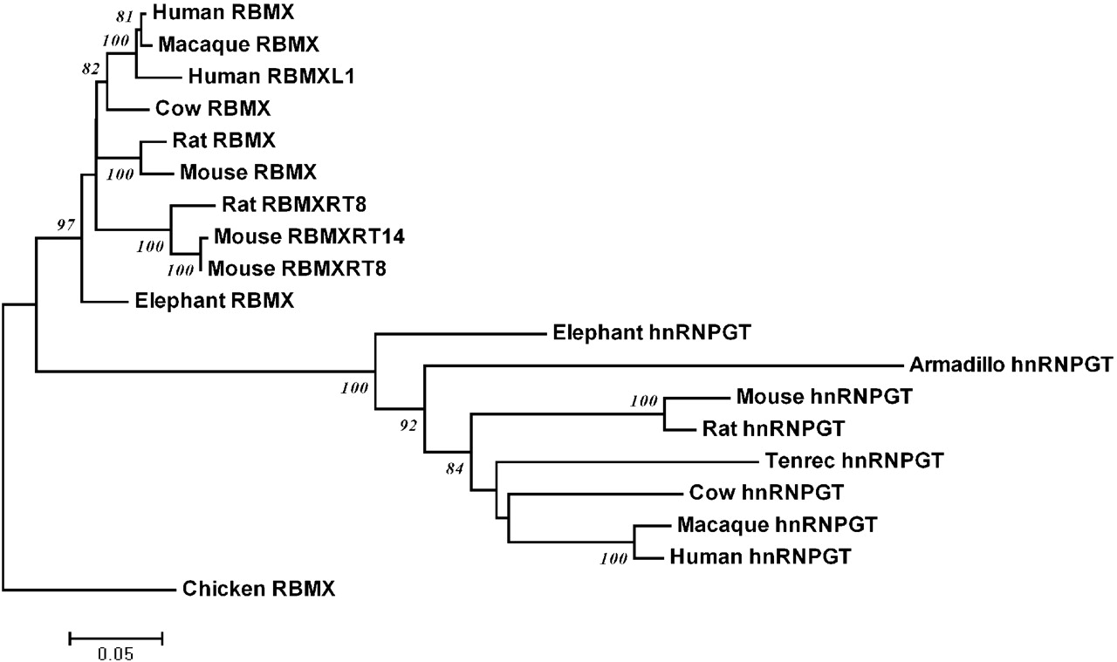
Figure 1. HNRNPGT originated from a single retrotransposition event before the radiation of all extant placental ...
Notes:
Figure 1. HNRNPGT originated from a single retrotransposition event before the radiation of all extant placental mammals. Neighbour joining phylogenetic tree of mammalian RBMX and HNRNPGT related sequences constructed using the maximum composite likelihood method (46). Bootstrap values over 70% are shown, based on 1000 replicates. For details, see Materials and Methods. Mouse Rbmxrt8 and Rbmxrt14 retrogenes also formed a clade with 100% bootstrap support, indicating that Rbmxrt14 is a retroposed copy of the Rbmxrt8 gene (rather than both being independently derived from Rbmx ; see Supplementary Material, Fig. S1 ).
Unless provided in the caption above, the following copyright applies to the content of this slide: © The Author 2008. Published by Oxford University Press. All rights reserved. For Permissions, please email: journals.permissions@oxfordjournals.org

Slide 2
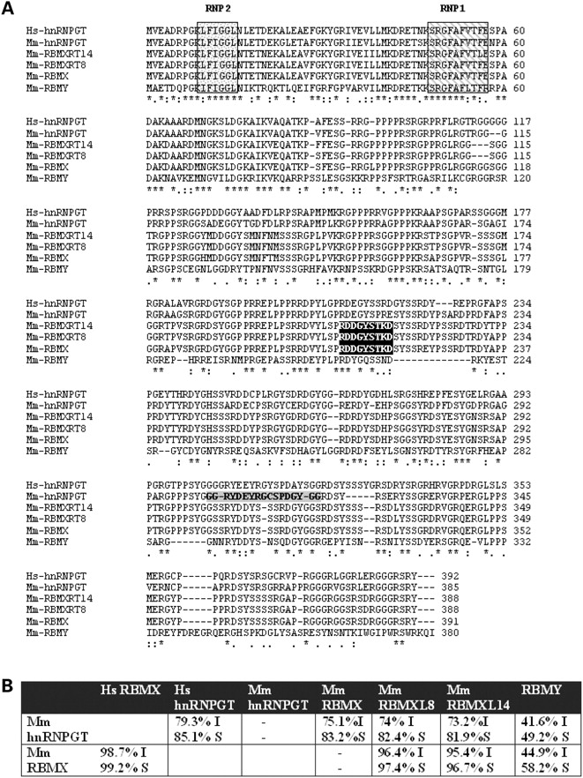
Figure 2. A family of RBMX proteins are encoded by the mouse genome. ( A ) The protein sequence of human (Hs) hnRNPG-T ...
Notes:
Figure 2. A family of RBMX proteins are encoded by the mouse genome. ( A ) The protein sequence of human (Hs) hnRNPG-T protein aligned with the conceptual protein sequences encoded by the open reading frames of mouse (abbreviated Mm) Hnrnpgt (encoded by chromosome 7), Rbmx (hnRNPG, encoded by the X chromosome), Rbmxrt8 (encoded by chromosome 8) and Rbmxrt 14 (encoded by chromosome 14). Conserved sequences within the N terminal RNA recognition motif which is found within each of these proteins are boxed and striped (RNP1), or stippled (RNP2). The 18 amino acid peptide which was used to generate and affinity purify the α-mouse HnRNP G-T specific polyclonal antibody is lightly shaded, and the actual peptide sequence is in bold. The peptide to which the antisera specific to RBMX, RBMXRT8 and RBMXRT14 proteins was raised is indicated by a black box. ( B ) Table showing percentage sequence identity (I) and similarity (S) between human and mouse hnRNPGT proteins, and between different members of the mouse RBM protein family measured using a pairwise alignment algorithm ( http://www.ebi.ac.uk/emboss/align/index.html ).
Unless provided in the caption above, the following copyright applies to the content of this slide: © The Author 2008. Published by Oxford University Press. All rights reserved. For Permissions, please email: journals.permissions@oxfordjournals.org

Slide 3
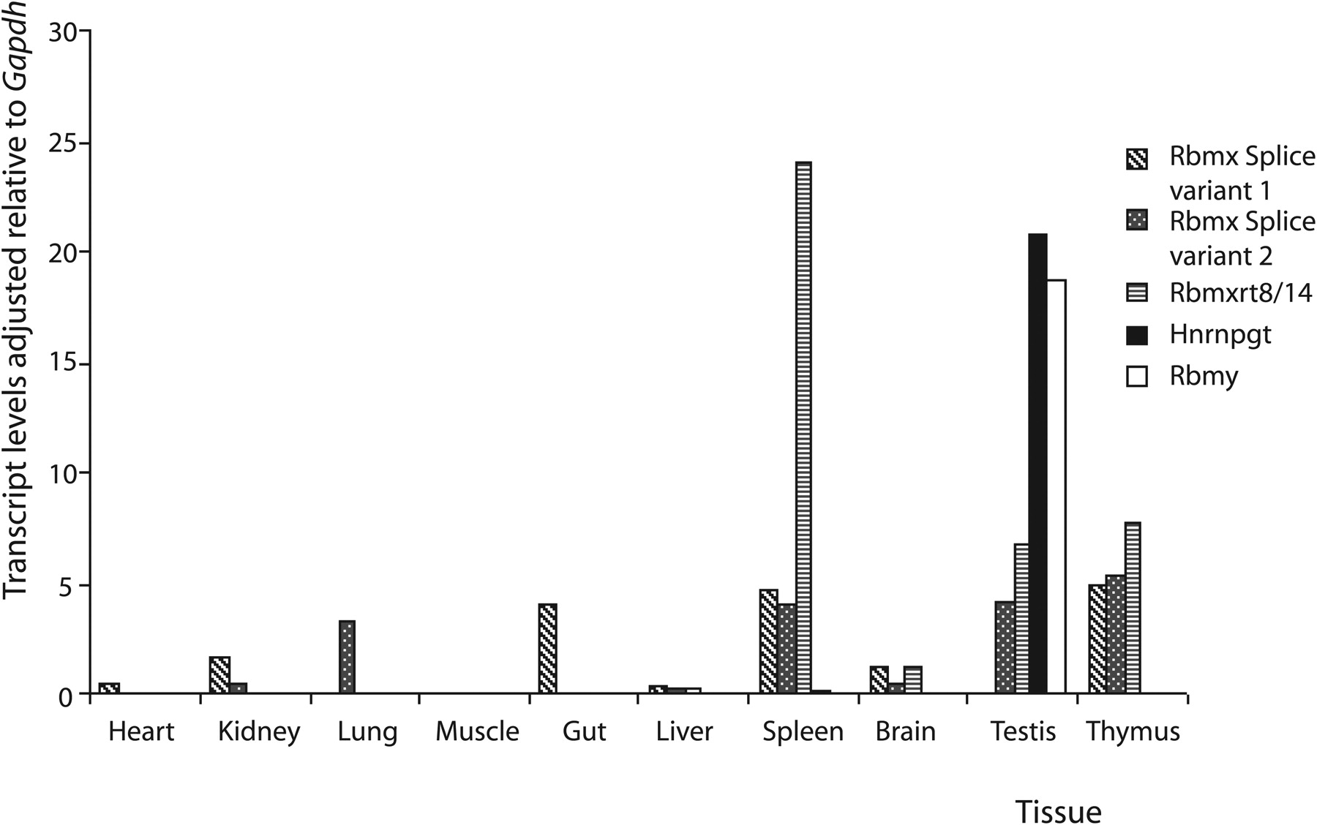
Figure 3. The Hnrnpgt , Rbmx and Rbmxrt8 genes are co-expressed in the testis. Bar chart showing expression of mouse ...
Notes:
Figure 3. The Hnrnpgt , Rbmx and Rbmxrt8 genes are co-expressed in the testis. Bar chart showing expression of mouse Rbmy , Rbmx splice variants 1 and 2, Hnrnpgt , and Rbmxrt8 genes quantitated by northern blotting and normalized to the expression of Gapdh in different mouse tissues.
Unless provided in the caption above, the following copyright applies to the content of this slide: © The Author 2008. Published by Oxford University Press. All rights reserved. For Permissions, please email: journals.permissions@oxfordjournals.org

Slide 4
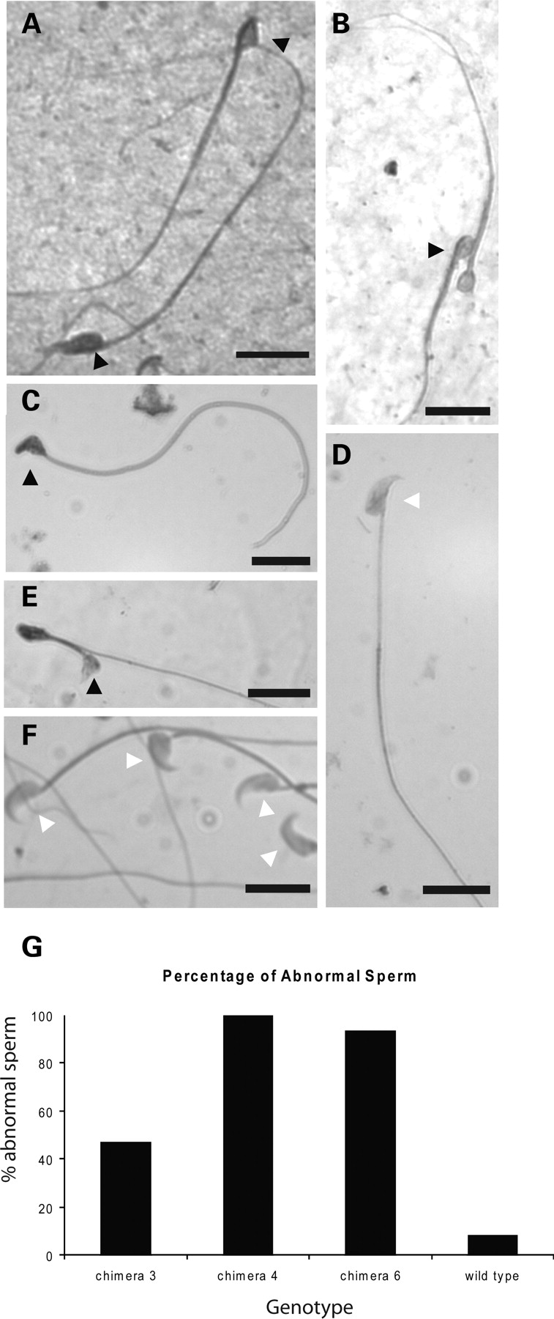
Figure 9. Sperm morphology of chimaeras and wild-type mice. Morphology of epididymal sperm from ( A and B ) chimaera ...
Notes:
Figure 9. Sperm morphology of chimaeras and wild-type mice. Morphology of epididymal sperm from ( A and B ) chimaera C4; ( C – E ) chimaera C6 and ( F ) wild-type mouse prepared under identical conditions as detailed in Materials and Methods. Abnormal sperm heads are shown as a black arrow head, and normal sperm heads as a white arrow head. In each case, the scale bar represents 10 µm. ( G ) Bar chart showing the percentage abnormal sperm seen in each of three infertile chimaeras and the wild-type.
Unless provided in the caption above, the following copyright applies to the content of this slide: © The Author 2008. Published by Oxford University Press. All rights reserved. For Permissions, please email: journals.permissions@oxfordjournals.org

Slide 5
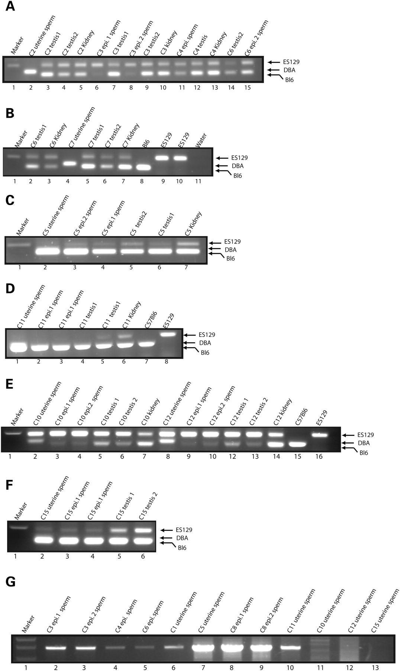
Figure 8. Genetic contribution of tissues and sperm from chimaeric mice made from ES cells containing the targeted ...
Notes:
Figure 8. Genetic contribution of tissues and sperm from chimaeric mice made from ES cells containing the targeted allele of Hnrnpgt . ( A – F ) Genomic DNA was isolated from tissue, epididymal sperm or uterine sperm from plugged DBA females, amplified by genomic PCR and analysed by agarose gel electrophoresis to distinguish the cellular contribution of each genotype in the starting sample. ( G ) Genomic DNA was analysed using PCR primers to detect the targeted locus.
Unless provided in the caption above, the following copyright applies to the content of this slide: © The Author 2008. Published by Oxford University Press. All rights reserved. For Permissions, please email: journals.permissions@oxfordjournals.org

Slide 6
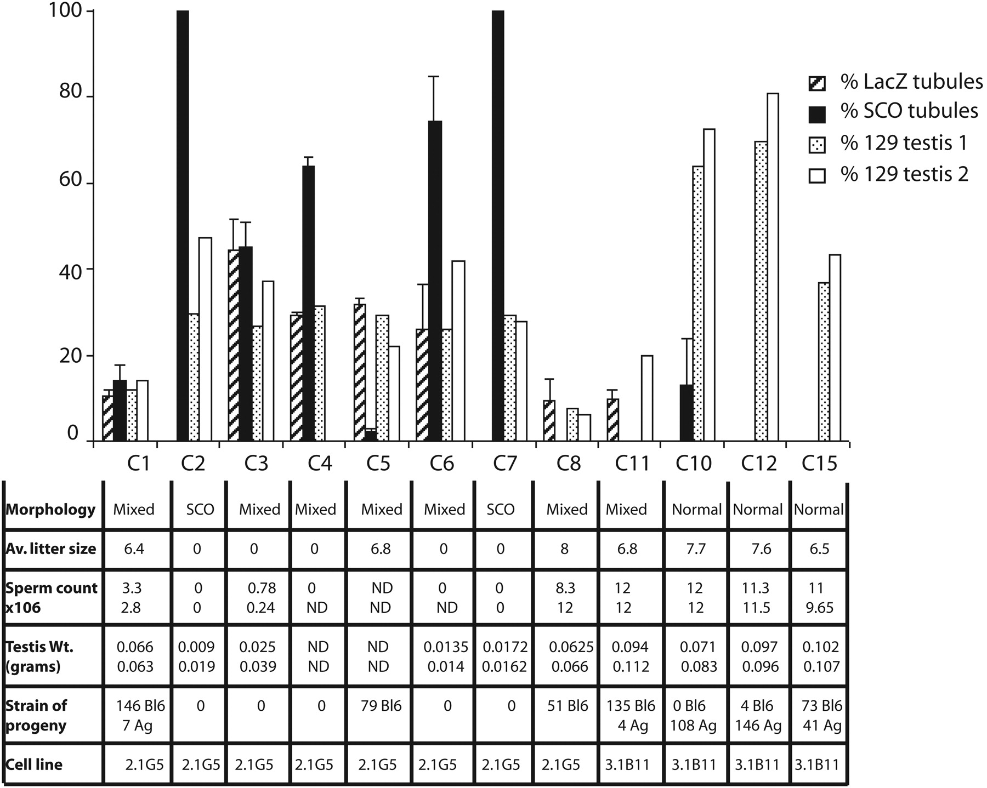
Figure 6. Summary of experimental data obtained from chimaeras. For genotyping, the intensity of the bands was measured ...
Notes:
Figure 6. Summary of experimental data obtained from chimaeras. For genotyping, the intensity of the bands was measured after strain-specific genomic PCR amplification and agarose gel electrophoresis and plotted as a percentage. The percentage of LacZ positive tubules and SCO tubules are the means of between two and seven separate sections from different parts of the testes.
Unless provided in the caption above, the following copyright applies to the content of this slide: © The Author 2008. Published by Oxford University Press. All rights reserved. For Permissions, please email: journals.permissions@oxfordjournals.org

Slide 7
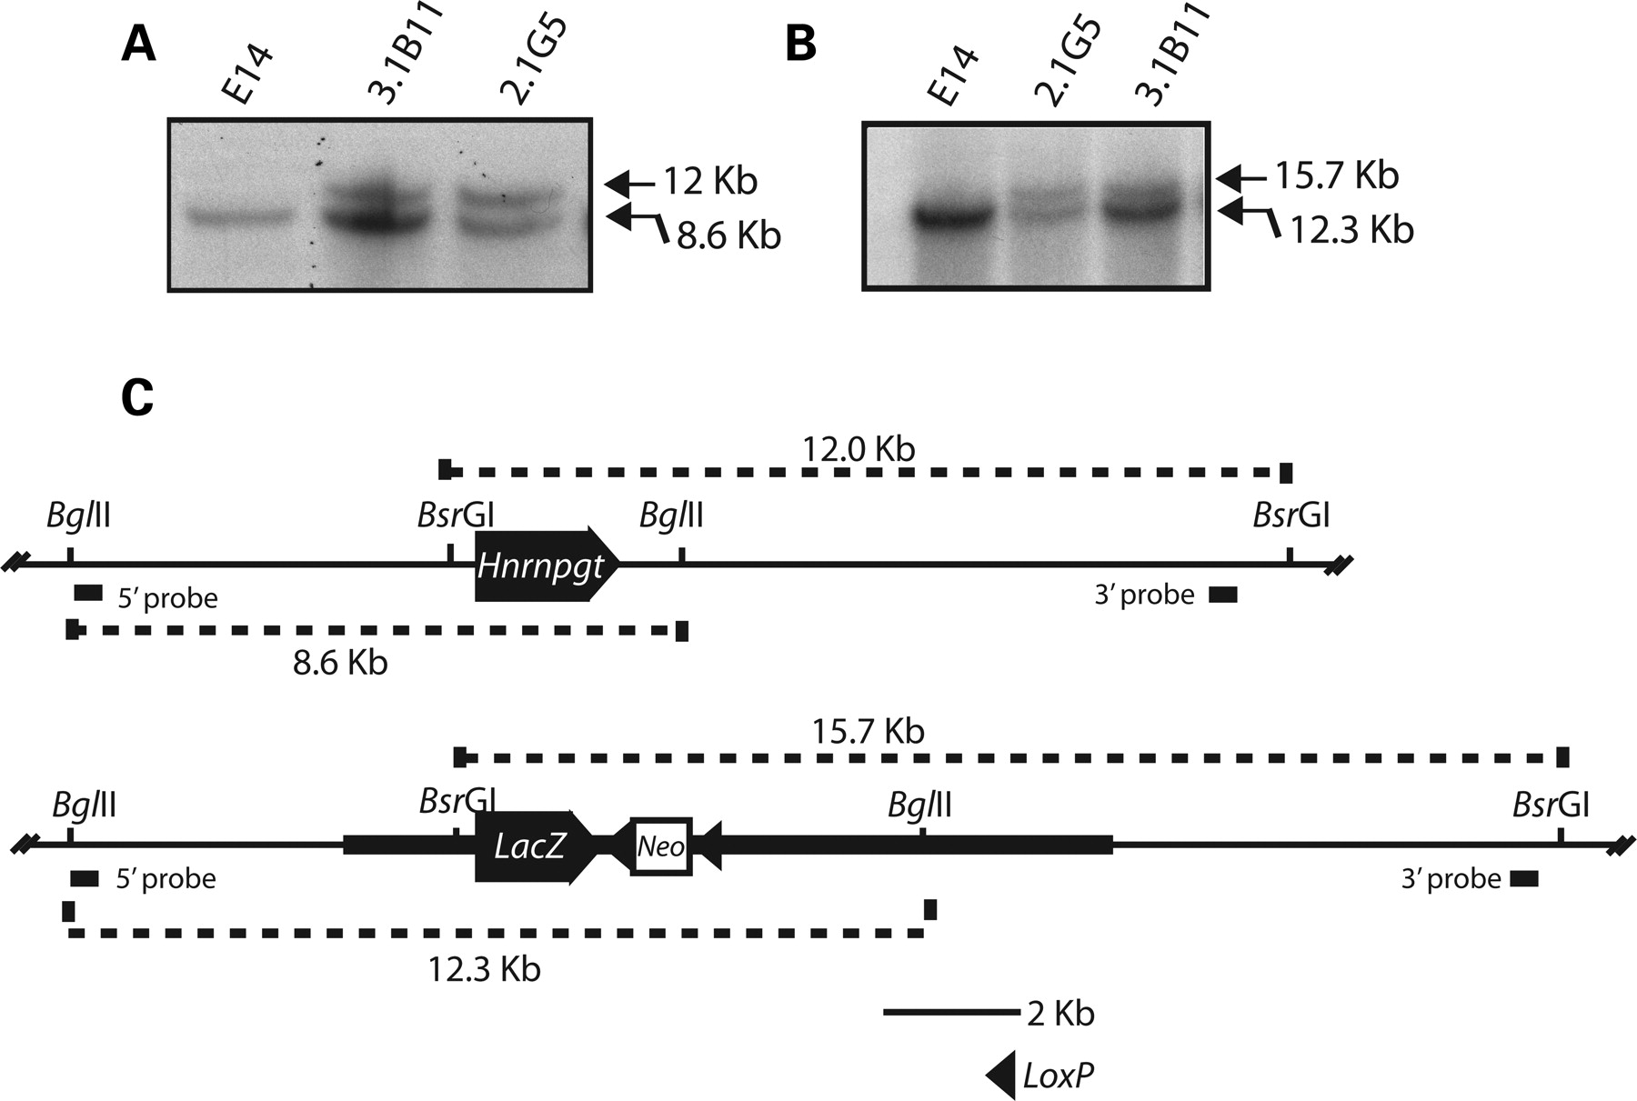
Figure 5. Targeting of the Hnrnpgt gene in ES cells by homologous recombination. ( A ) Southern blot of genomic DNA ...
Notes:
Figure 5. Targeting of the Hnrnpgt gene in ES cells by homologous recombination. ( A ) Southern blot of genomic DNA from E14 ES cells, and the 3.1B11 and 2.1G5 clones after digestion with Bgl II. The blot was probed with the 5′ probe and developed by autoradiography. ( B ) Southern blot of genomic DNA from E14 ES cells, and the 3.1B11 and 2.1G5 clones after digestion with Bsr GI. The blot was probed with the 3′ probe and developed by autoradiography. ( C ) Map of the wild-type Hnrnpgt genomic locus (above) and the targeted loci (below) showing the positions of the Hnrnpgt gene and LacZ transgene, restriction sites used in the analysis and location of the 5′ and 3′ probes. Above each restriction map are shown the fragments detected by the 3′ probe in the wild-type and targeted locus, and below the restriction map are shown the fragments detected by the 5′ probe. Southern blots of restriction digested genomic DNA from clone 3.1B11 confirmed the genomic structure of the wild-type and targeted alleles within the ES cells. However, these blotting experiments detected the restriction fragment corresponding to the wild-type allele slightly more strongly than that of the targeted allele. Since there is one targeted allele and one wild-type allele per ES cell, the theoretically expected ratio for a pure clone of heterozygote ES cells containing a targeted allele should be 50:50. Consistent with this, phosphorimager analysis confirmed that clone 2.1G5 gave a ratio of 50:50. Clone 3.1B11 gave a ratio of 70:30. This is very close to the expected ratio of 75:25 if clone 3.1B11 contained one wild-type (untargeted) ES cell for every targeted ES cell (in this case, there would be three wild-type alleles for every targeted allele). This indicated that clone 3.1B11 contains a mixture of targeted ES cells and untargeted ES cells at an approximate ratio of 1:1.
Unless provided in the caption above, the following copyright applies to the content of this slide: © The Author 2008. Published by Oxford University Press. All rights reserved. For Permissions, please email: journals.permissions@oxfordjournals.org

Slide 8
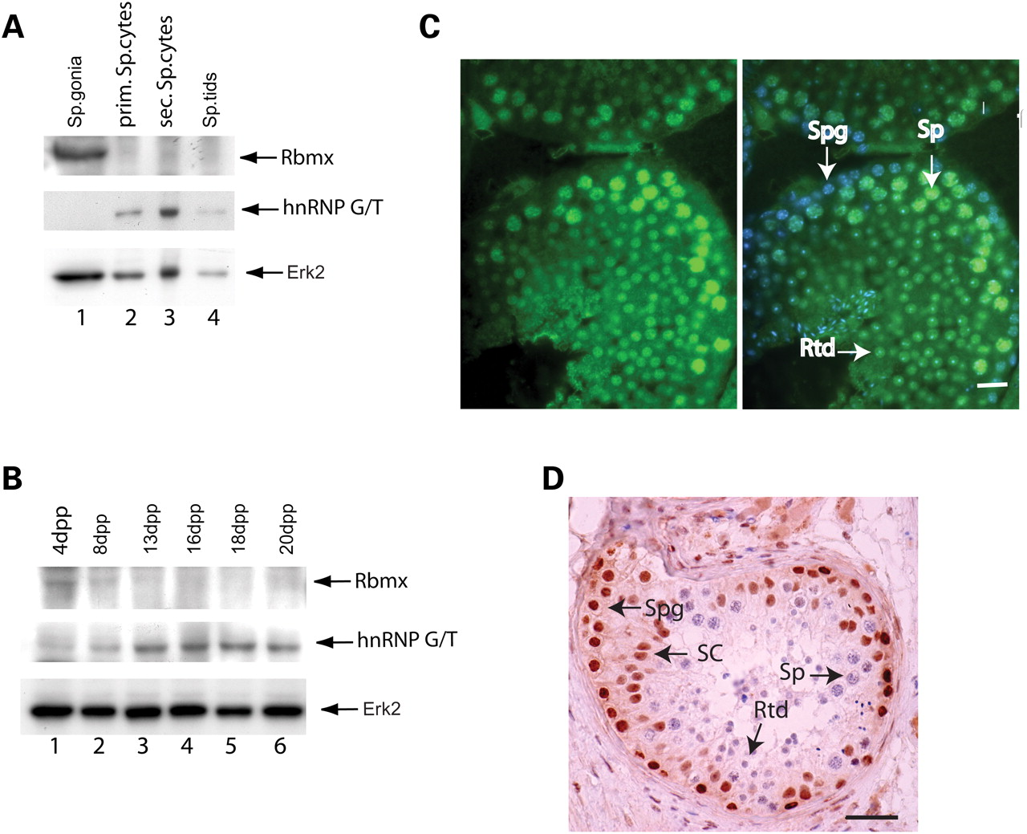
Figure 4. hnRNPGT provides exclusive RBMX family function during meiosis. ( A ) Mouse germ cells were purified by ...
Notes:
Figure 4. hnRNPGT provides exclusive RBMX family function during meiosis. ( A ) Mouse germ cells were purified by elutriation, proteins extracted and western blotted. Blots were probed with an antisera raised to a peptide sequence in RBMX/RBMXRT proteins (upper panel) or the affinity purified α-HnRNPG-T antisera (middle panel) and α-Erk2 (lower panel). We confirmed equal loading of protein in each lane using an antibody against Erk2 (lower panel). ( B ) Mouse testes from different developmental stages from 4 to 20 days postpartum were western blotted and probed with antisera as in part (A). ( C ) Mouse hnRNP G-T protein detected by the affinity purified α-HnRNPG-T antisera is highly expressed in the nuclei of primary spermatocytes. Left-hand panel: antibody staining was visualized using indirect immunofluorescence (pseudocoloured green). Right-hand panel shows the same picture including a DNA counterstain (DAPI, blue colour) which indicates that the cells on the periphery of the seminiferous tubules (Spermatogonia or Spg) are only stained for DAPI, while the meiotic spermatocytes (Sp) and post-meiotic round spermatids (Rtd) strongly express hnRNP G-T (pseudocoloured green). The scale bar represents 10 µm. ( D ) Human testis probed with an antisera raised to a peptide sequence in RBMX/RBMXRT proteins and detected using an HRP-conjugated secondary antibody. Brown staining indicates RBMX/RBMXRT protein detection, and blue staining is the haematoxylin counterstain.
Unless provided in the caption above, the following copyright applies to the content of this slide: © The Author 2008. Published by Oxford University Press. All rights reserved. For Permissions, please email: journals.permissions@oxfordjournals.org

Slide 9
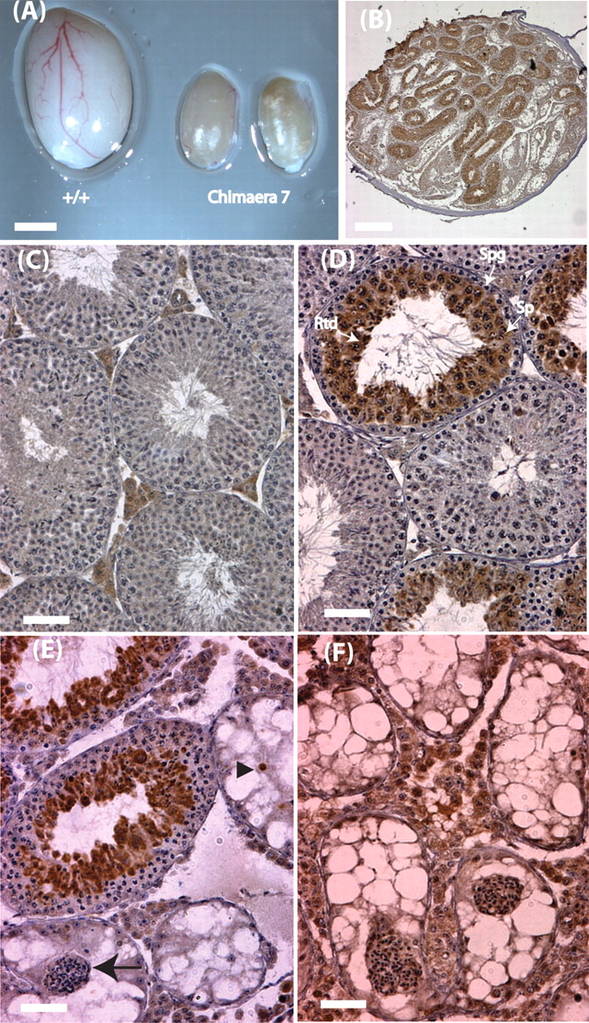
Figure 7. Testicular phenotype in chimaeric mice made from ES cell clone 2.1G5. ( A ) The two testes of chimaera 7 ...
Notes:
Figure 7. Testicular phenotype in chimaeric mice made from ES cell clone 2.1G5. ( A ) The two testes of chimaera 7 next to the testis of a C57Bl6 littermate (Scale bar = 2 mm). ( B ) A low resolution light micrograph of a section from chimaera C3 immunostained for LacZ (Scale bar = 20 µm). ( C ) High-resolution light micrograph of a testis section from a wild-type C57Bl6 littermate immunostained for LacZ. ( D ) High-resolution light micrograph of a testis section from chimaera C5 immunostained for LacZ. ( E ) High-resolution light micrograph of Chimaera C4 immunostained for LacZ. ( F ) High-resolution light micrograph of a testis section from Chimaera C7 immunostained for LacZ. Scale bars in (C)–(F) are equal to 50 µm.
Unless provided in the caption above, the following copyright applies to the content of this slide: © The Author 2008. Published by Oxford University Press. All rights reserved. For Permissions, please email: journals.permissions@oxfordjournals.org

