Slide 1
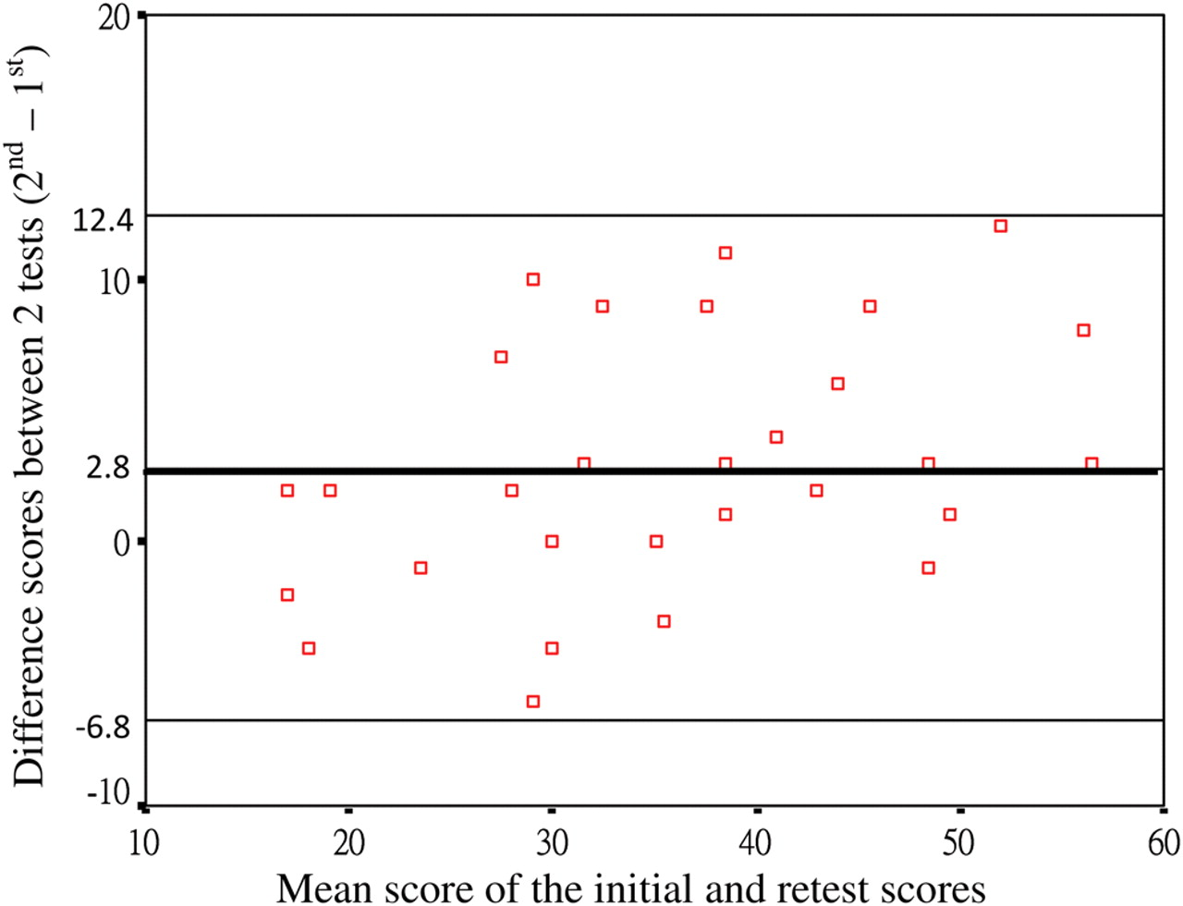
Fig. 1. The Bland–Altman plots shows the agreement of the repeated measures of the oral-format SDMT. The bold line ...
Notes:
Fig. 1. The Bland–Altman plots shows the agreement of the repeated measures of the oral-format SDMT. The bold line represents the mean of the difference. The limits of agreement (mean of the difference ± 1.96 SDdiff) are represented as the two solid lines.
Unless provided in the caption above, the following copyright applies to the content of this slide: © The Author 2011. Published by Oxford University Press. All rights reserved. For permissions, please e-mail: journals.permissions@oup.com.

