Slide 1
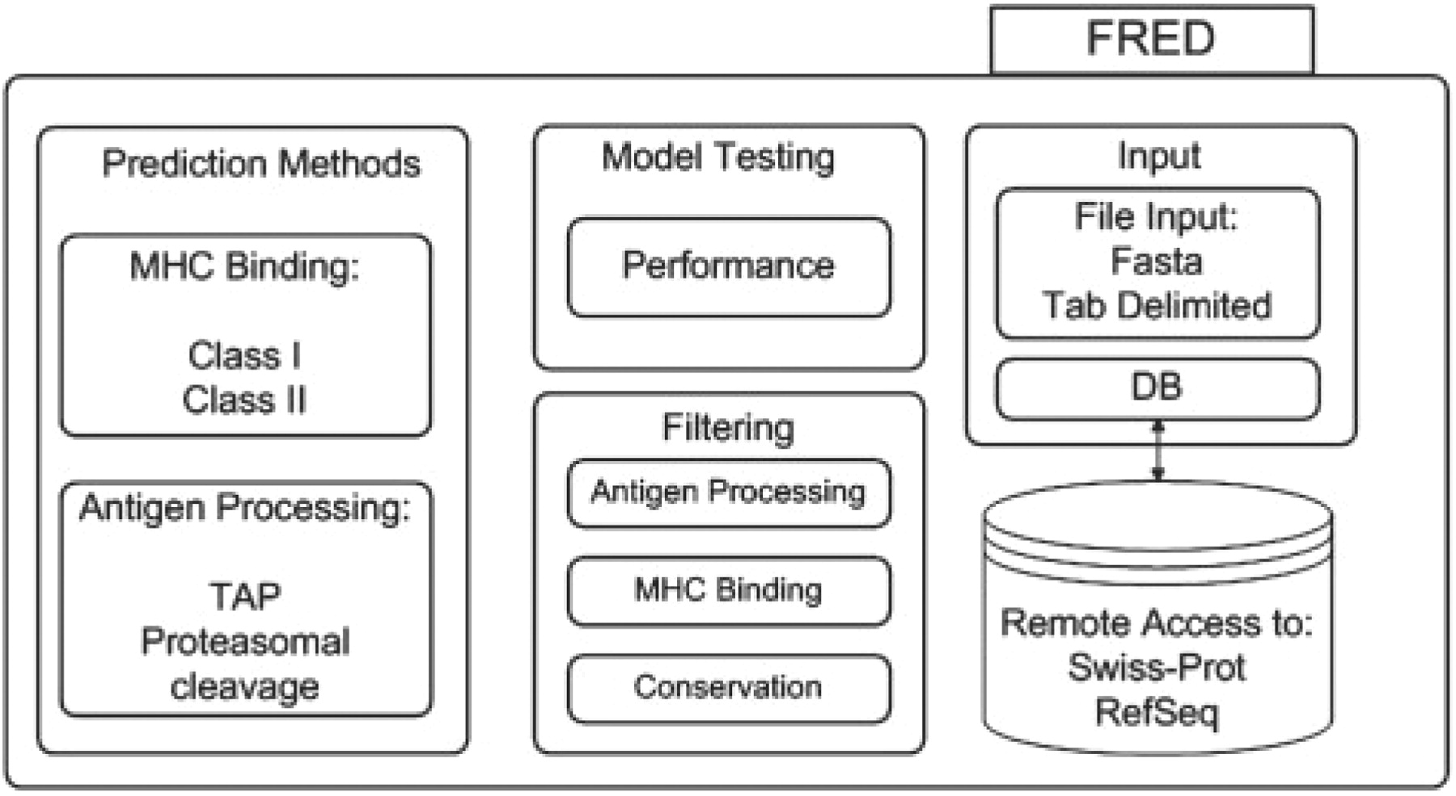
Fig. 1. FRED is organized into four major parts: sequence input, application of prediction methods, filtering of the ...
Notes:
Fig. 1. FRED is organized into four major parts: sequence input, application of prediction methods, filtering of the results and model testing.
Unless provided in the caption above, the following copyright applies to the content of this slide: © 2009 The Author(s)This is an Open Access article distributed under the terms of the Creative Commons Attribution Non-Commercial License (http://creativecommons.org/licenses/by-nc/2.0/uk/) which permits unrestricted non-commercial use, distribution, and reproduction in any medium, provided the original work is properly cited.

