Slide 1
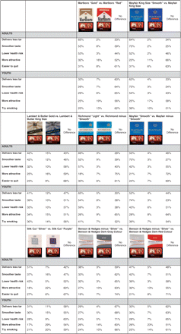
Figure 1 Perceptions of cigarette packs among UK children (n = 806) and adult smokers (n = 516)
Notes:
Figure 1 Perceptions of cigarette packs among UK children (n = 806) and adult smokers (n = 516)
Unless provided in the caption above, the following copyright applies to the content of this slide: © The Author 2009. Published by Oxford University Press on behalf of the European Public Health Association. All rights reserved.

Slide 2
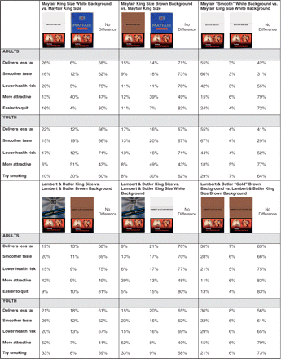
Figure 2 Perceptions of plain packs among UK children (n = 806) and adult smokers (n = 516)
Notes:
Figure 2 Perceptions of plain packs among UK children (n = 806) and adult smokers (n = 516)
Unless provided in the caption above, the following copyright applies to the content of this slide: © The Author 2009. Published by Oxford University Press on behalf of the European Public Health Association. All rights reserved.

