Slide 1
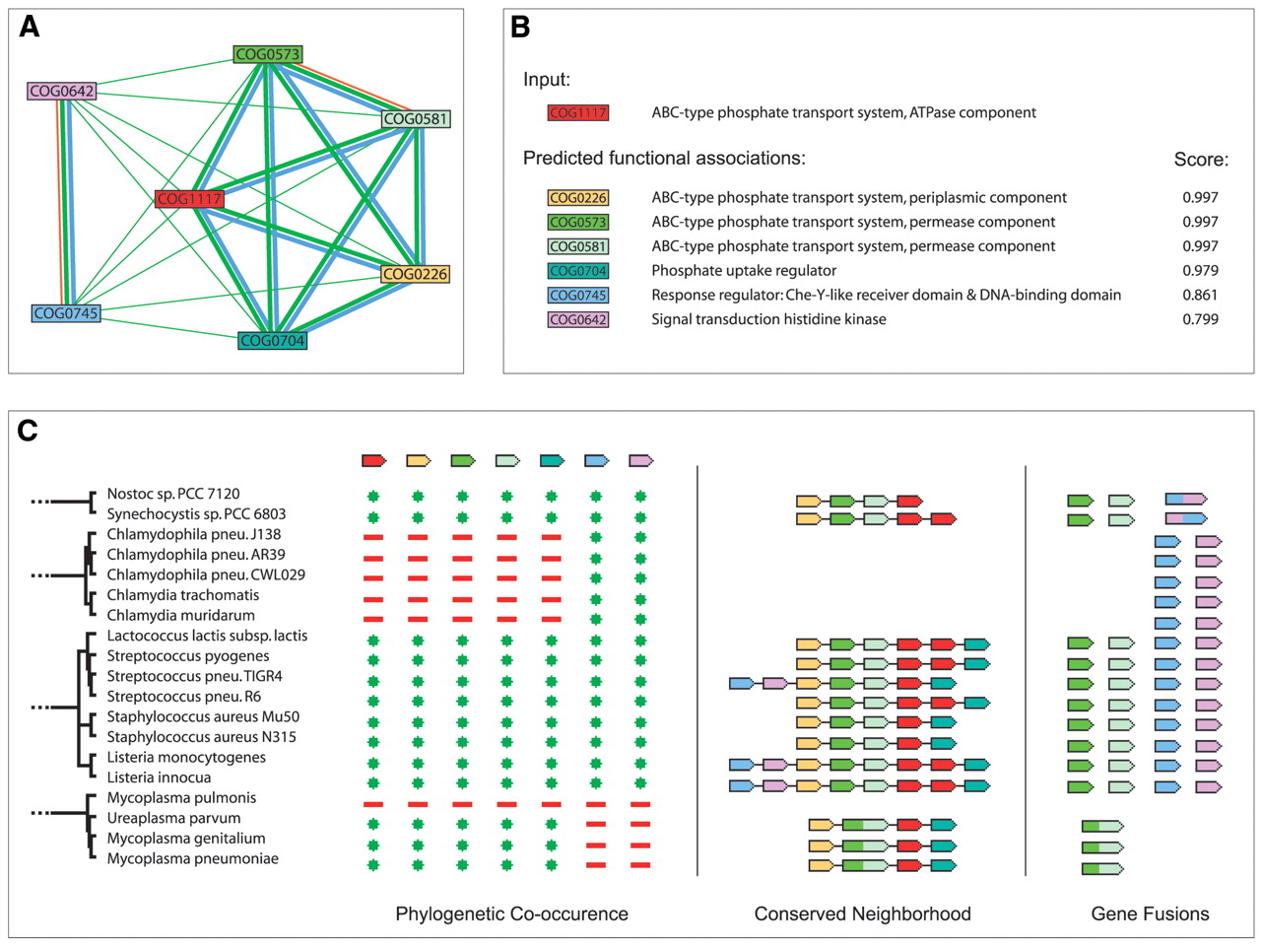
Figure 1. An example of a functional module detected by STRING. The module encompasses the prototypic ...
Notes:
Figure 1. An example of a functional module detected by STRING. The module encompasses the prototypic phosphate-regulon, an active uptake-system for inorganic phosphate found in most, but not all, prokaryotes ( 24 ). ( A ) Network view. Green lines connect proteins which are associated by recurring neighborhood, blue connections are inferred by phylogenetic co-occurence, and red lines indicate gene-fusion events; line thickness is a rough indicator for the strength of the association. The visualization shows that the module is composed of two sub-modules: The larger module to the right contains the structural and immediate regulatory molecules of the transporter; the two proteins to the left form a two-component regulator system controlling the transcription of the other components in response to phosphate starvation. ( B ) Score summary view. Association scores are highest among structural components. ( C ) Evidence view. A subset of the full evidence is shown, visualizing the three types of genomic context links.
Unless provided in the caption above, the following copyright applies to the content of this slide:

Slide 2
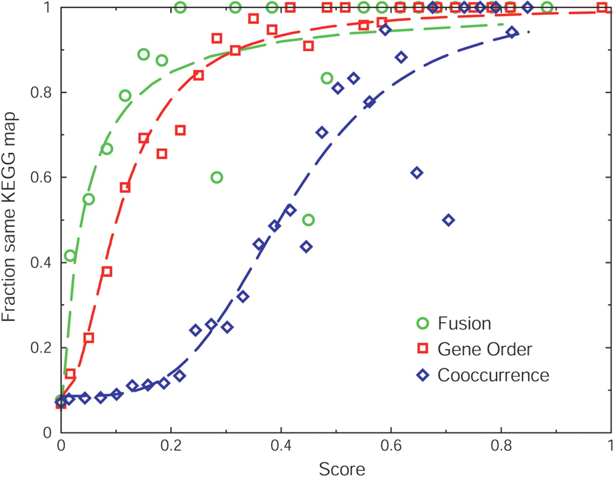
Figure 2. Comparing different types of genomic associations to obtain equivalency. Scores are plotted versus ...
Notes:
Figure 2. Comparing different types of genomic associations to obtain equivalency. Scores are plotted versus the observed accuracy for each genomic association method. Data points indicate the fraction of predicted pairs of orthologous groups that are on the same KEGG map for each type of genomic association. For fusion and gene order, scores indicate the number of non-redundant observations divided by the number of species that contain at least one of the orthologous groups. The dashed lines in the respective colors represent fits of these data to standard saturating hill equations: f ( x )= a +[(1− a ) xb /( cb + xb )], where x represents the score, a the intercept, b the cooperativity, and c the value of x where half of the maximum is reached.
Unless provided in the caption above, the following copyright applies to the content of this slide:

Slide 3
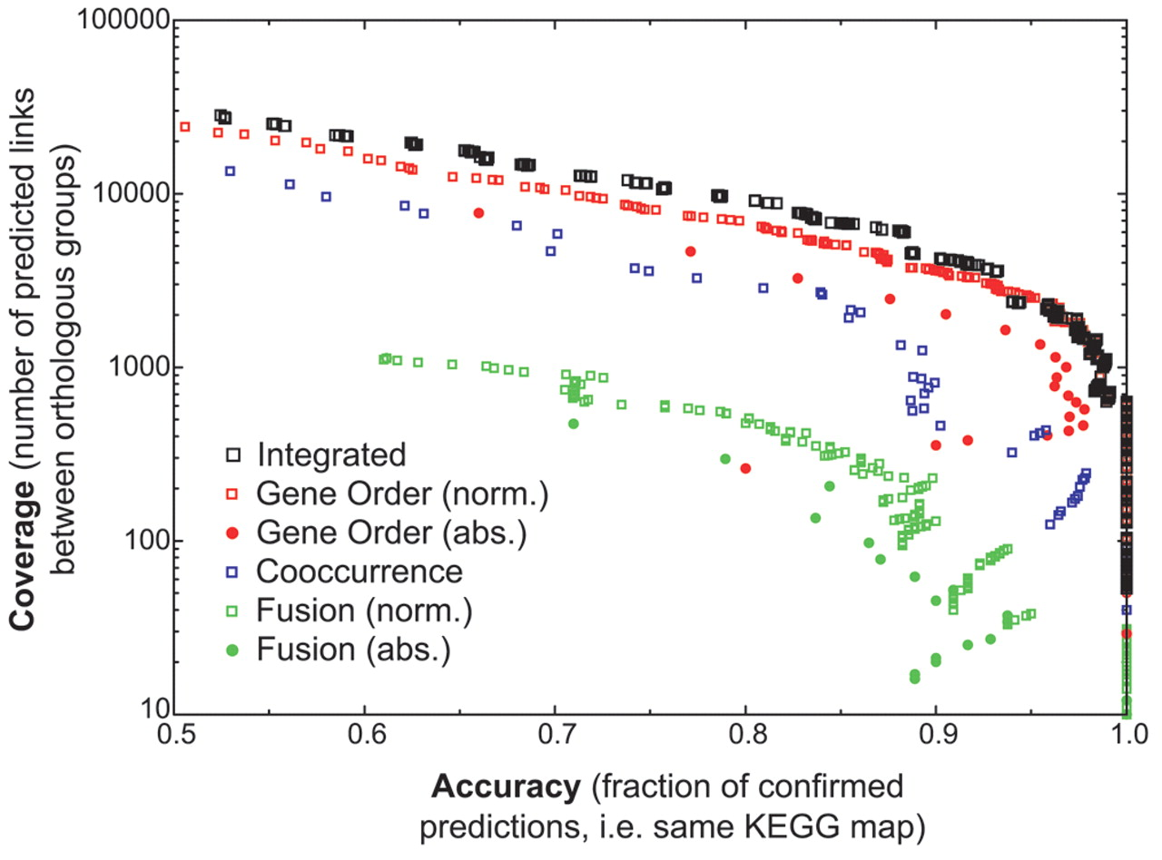
Figure 3. Increased performance of an integrated score relative to the different types of genomic association ...
Notes:
Figure 3. Increased performance of an integrated score relative to the different types of genomic association scores. Coverage and accuracy are plotted using a sliding scale of score thresholds for each genomic association method. Shown are the three individual methods, as well as the integrated score (for fusion and gene order, the absolute count versus the normalized count are shown separately). Methods in general can be said to perform better when their data points are higher and further to the right.
Unless provided in the caption above, the following copyright applies to the content of this slide:

