Slide 1
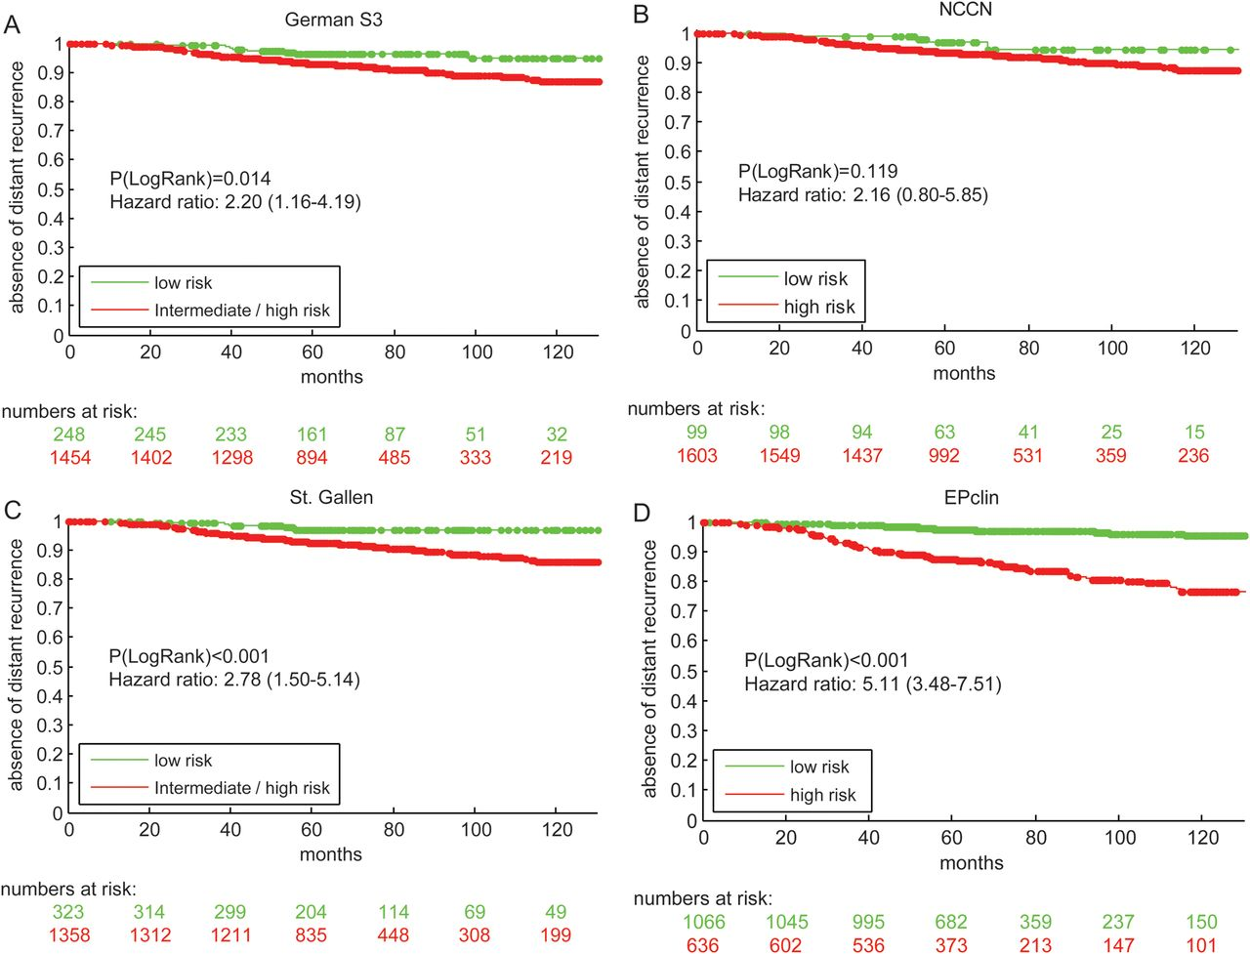
Figure 1 Kaplan–Meier plot of distant metastasis-free survival (MFS) by (A) German S3, (B) National Comprehensive ...
Notes:
Figure 1 Kaplan–Meier plot of distant metastasis-free survival (MFS) by (A) German S3, (B) National Comprehensive Cancer Center Network (NCCN), (C) St Gallen guidelines and (D) EPclin risk groups. 95% confidence intervals (CI) of hazard ratios (HR) are indicated.
Unless provided in the caption above, the following copyright applies to the content of this slide: © The Author 2012. Published by Oxford University Press on behalf of the European Society for Medical Oncology.This is an Open Access article distributed under the terms of the Creative Commons Attribution Non-Commercial License (http://creativecommons.org/licenses/by-nc/3.0), which permits unrestricted non-commercial use, distribution, and reproduction in any medium, provided the original work is properly cited.

Slide 2
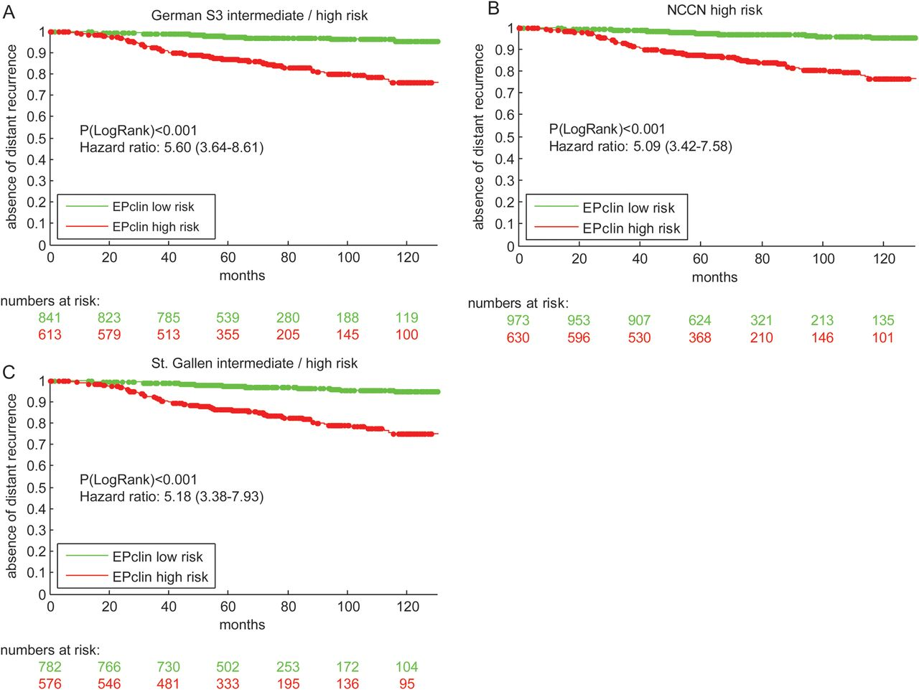
Figure 2 Kaplan–Meier plot of distant metastasis-free survival (MFS) by EPclin risk groups after considering the (A) ...
Notes:
Figure 2 Kaplan–Meier plot of distant metastasis-free survival (MFS) by EPclin risk groups after considering the (A) German S3, (B) National Comprehensive Cancer Center Network (NCCN) and (C) St Gallen guidelines.
Unless provided in the caption above, the following copyright applies to the content of this slide: © The Author 2012. Published by Oxford University Press on behalf of the European Society for Medical Oncology.This is an Open Access article distributed under the terms of the Creative Commons Attribution Non-Commercial License (http://creativecommons.org/licenses/by-nc/3.0), which permits unrestricted non-commercial use, distribution, and reproduction in any medium, provided the original work is properly cited.

Slide 3
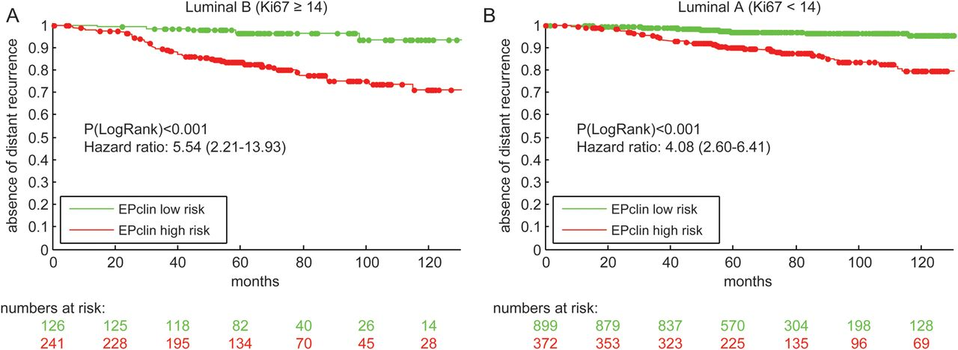
Figure 3 Kaplan–Meier plot of distant metastasis-free survival (MFS) by EPclin risk groups after considering the ...
Notes:
Figure 3 Kaplan–Meier plot of distant metastasis-free survival (MFS) by EPclin risk groups after considering the biological subtypes (A) ‘Luminal B’ and (B) ‘Luminal A’.
Unless provided in the caption above, the following copyright applies to the content of this slide: © The Author 2012. Published by Oxford University Press on behalf of the European Society for Medical Oncology.This is an Open Access article distributed under the terms of the Creative Commons Attribution Non-Commercial License (http://creativecommons.org/licenses/by-nc/3.0), which permits unrestricted non-commercial use, distribution, and reproduction in any medium, provided the original work is properly cited.

Slide 4
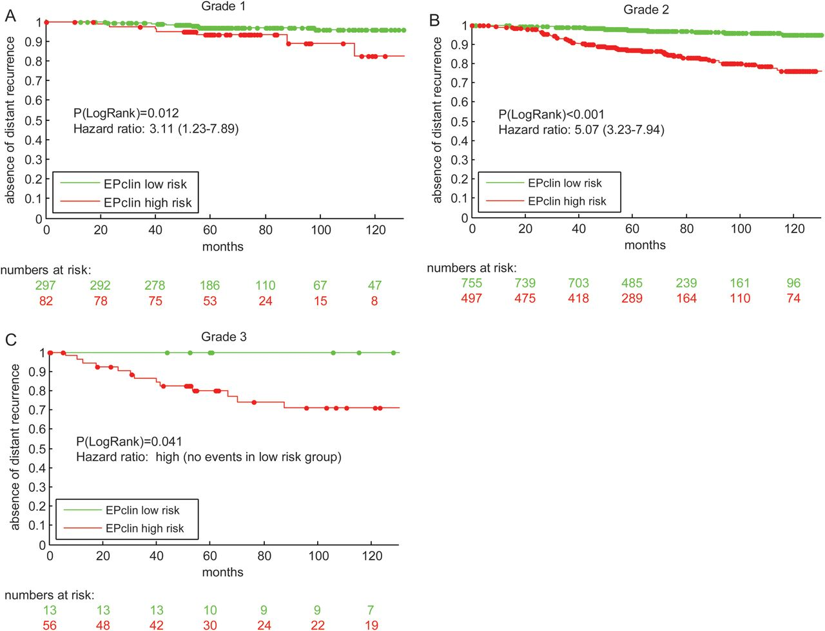
Figure 4 Kaplan–Meier plot of distant metastasis-free survival (MFS) by EPclin risk groups in (A) grade 1 tumors, (B) ...
Notes:
Figure 4 Kaplan–Meier plot of distant metastasis-free survival (MFS) by EPclin risk groups in (A) grade 1 tumors, (B) grade 2 tumors and (C) grade 3 tumors.
Unless provided in the caption above, the following copyright applies to the content of this slide: © The Author 2012. Published by Oxford University Press on behalf of the European Society for Medical Oncology.This is an Open Access article distributed under the terms of the Creative Commons Attribution Non-Commercial License (http://creativecommons.org/licenses/by-nc/3.0), which permits unrestricted non-commercial use, distribution, and reproduction in any medium, provided the original work is properly cited.

Slide 5
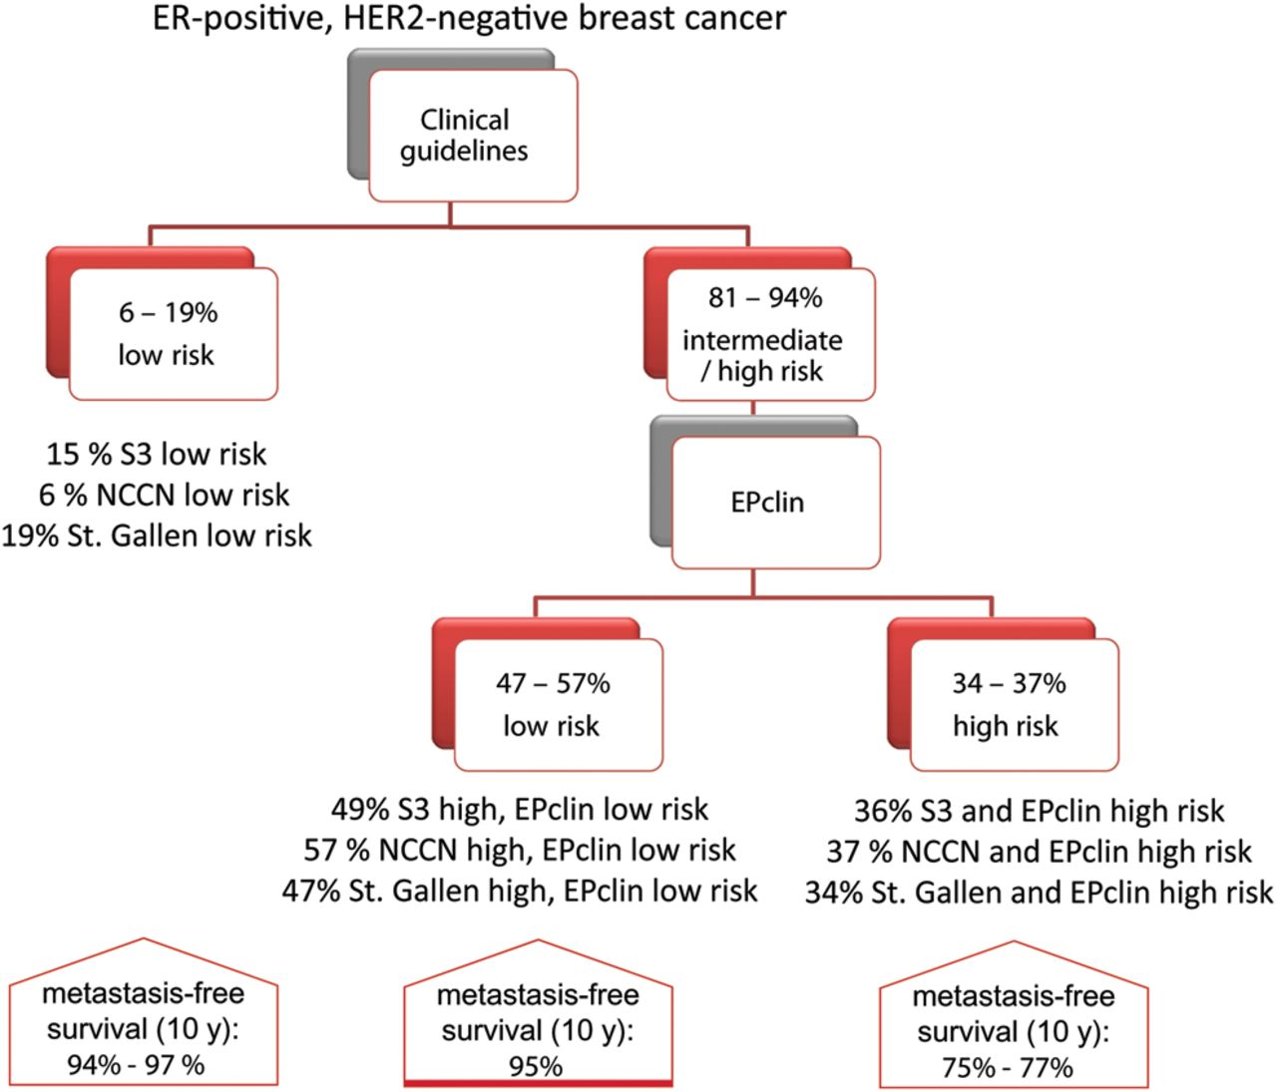
Figure 5 Putative risk classification scheme for estrogen receptor (ER)-positive, HER2-negative breast cancer patients ...
Notes:
Figure 5 Putative risk classification scheme for estrogen receptor (ER)-positive, HER2-negative breast cancer patients by combining clinical guidelines and the EPclin test. Metastasis-free survival (MFS) rates are based on the 1702 ER-positive, HER2-negative breast cancer samples.
Unless provided in the caption above, the following copyright applies to the content of this slide: © The Author 2012. Published by Oxford University Press on behalf of the European Society for Medical Oncology.This is an Open Access article distributed under the terms of the Creative Commons Attribution Non-Commercial License (http://creativecommons.org/licenses/by-nc/3.0), which permits unrestricted non-commercial use, distribution, and reproduction in any medium, provided the original work is properly cited.

