Slide 1
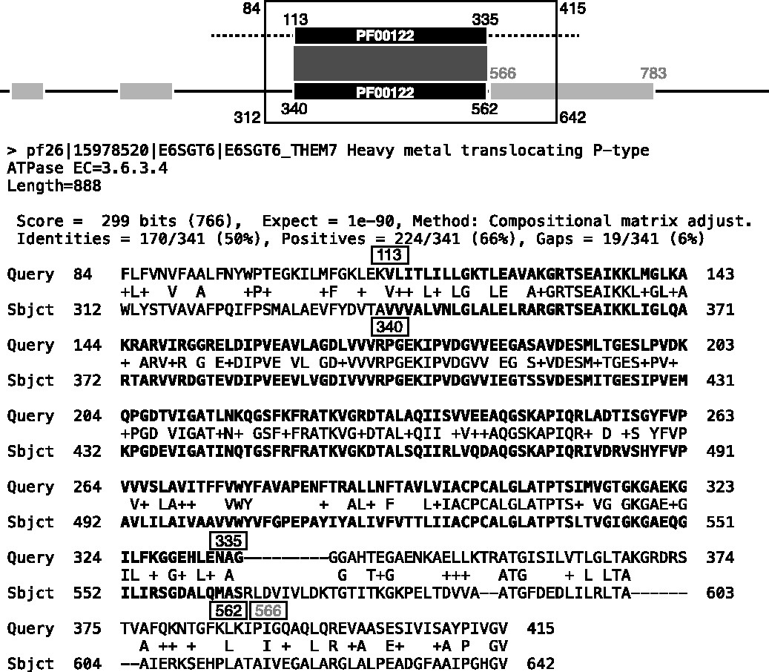
Fig. 1. Homologous overextension. BLASTP with BLOSUM62 was used to create an alignment between a RPD2 query and a ...
Notes:
Fig. 1. Homologous overextension. BLASTP with BLOSUM62 was used to create an alignment between a RPD2 query and a homologous sequence from the RPD2 library. The raw BLASTP output and a schematic of the sequences are shown. Homologous domains in the query (top) and subject (bottom) sequence are represented by black boxes. Light gray boxes in the library sequence indicate other domains. The embedded domain in this query is from B0TE74_HELMI and the sequence in the query outside of the embedded domain is shuffled. Black numbers show the homologous domain boundaries in both the schematic and raw BLASTP output (in boxes); gray numbers indicate the boundaries of the neighboring domain. The boundaries of the alignment are given by the open box, whereas the correct alignment is represented by the dark gray box in the schematic
Unless provided in the caption above, the following copyright applies to the content of this slide: © The Author 2013. Published by Oxford University Press. All rights reserved.This is an Open Access article distributed under the terms of the Creative Commons Attribution Non-Commercial License (http://creativecommons.org/licenses/by-nc/3.0/), which permits non-commercial re-use, distribution, and reproduction in any medium, provided the original work is properly cited. For commercial re-use, please contact journals.permissions@oup.com

Slide 2
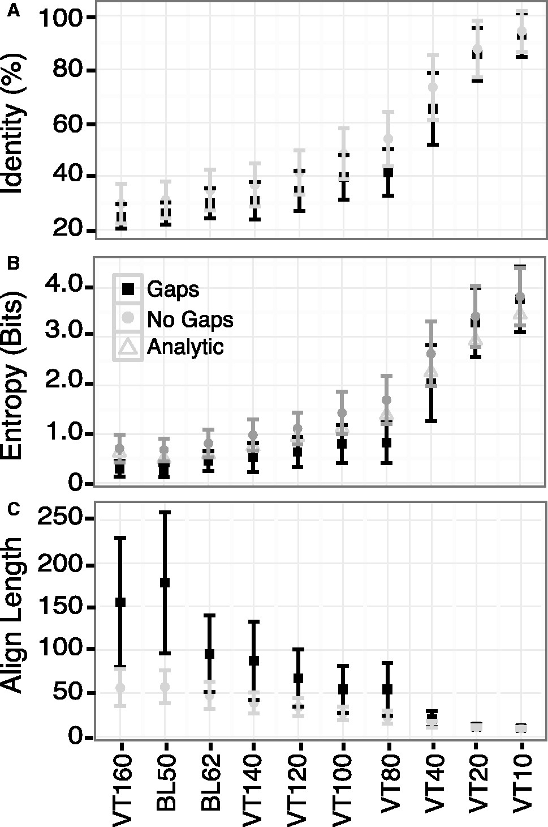
Fig. 3. Scoring matrix target identity, entropy and alignment length. Queries were constructed from 136 shuffled ...
Notes:
Fig. 3. Scoring matrix target identity, entropy and alignment length. Queries were constructed from 136 shuffled protein domains. SSEARCH was used to search against the RPD2 library with these shuffled queries using either the gap penalties given in Table 1 (black squares) or gap penalties of −1000/−1000 for open/extend (gray circles), which effectively creates alignments with no gaps. The identity and alignment length from the highest scoring alignment was selected from each query. The (A) mean identity, (B) mean entropy and (C) mean alignment length is given by the point, and the standard deviation is indicated by the error bars for each scoring matrix. The analytical entropy calculated from the scoring matrix is shown as open triangles in panel (B)
Unless provided in the caption above, the following copyright applies to the content of this slide: © The Author 2013. Published by Oxford University Press. All rights reserved.This is an Open Access article distributed under the terms of the Creative Commons Attribution Non-Commercial License (http://creativecommons.org/licenses/by-nc/3.0/), which permits non-commercial re-use, distribution, and reproduction in any medium, provided the original work is properly cited. For commercial re-use, please contact journals.permissions@oup.com

Slide 3
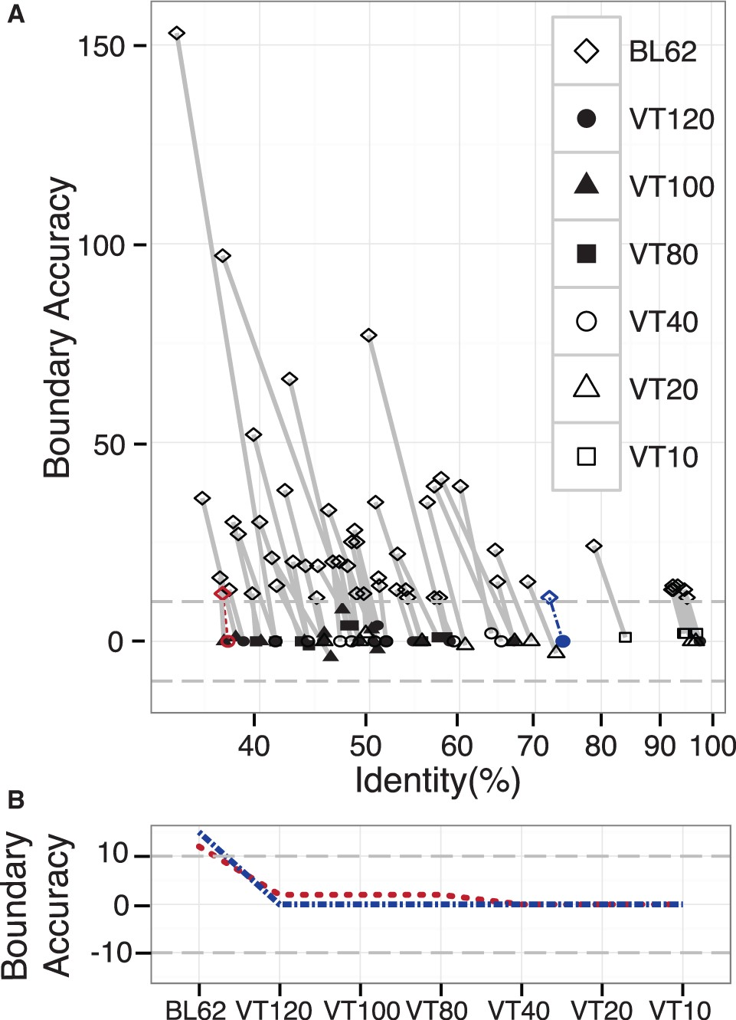
Fig. 4. Selecting the scoring matrix that creates the best alignment. (A) Sequence pairs with >33% identity and ...
Notes:
Fig. 4. Selecting the scoring matrix that creates the best alignment. (A) Sequence pairs with >33% identity and overextended alignment boundaries were selected from the results of the similarity search performed using SSEARCH with BLOSUM62. Each sequence pair was realigned using VT120, 100, 80, 40, 20 and 10 (Table 1). Boundary accuracy was calculated for each alignment and the alignment with the smallest cumulative difference between the embedded domain boundaries and the alignment boundaries was selected. Symbol shape and color (black, open) indicate the scoring matrix used for the alignment; lines connect alignments between the same sequence pairs. (B) Maximum boundary inaccuracy across every scoring matrix for two sequence pairs in (A) is shown. The rounded dashed line to the left in panel (A) and the higher line between VT120 and VT80 in panel (B) show a low identity alignment corrected by VT40; the square dash-dot line to the right in panel (A) and flat between VT120 and VT10 in panel (B) shows a high identity alignment corrected by VT120
Unless provided in the caption above, the following copyright applies to the content of this slide: © The Author 2013. Published by Oxford University Press. All rights reserved.This is an Open Access article distributed under the terms of the Creative Commons Attribution Non-Commercial License (http://creativecommons.org/licenses/by-nc/3.0/), which permits non-commercial re-use, distribution, and reproduction in any medium, provided the original work is properly cited. For commercial re-use, please contact journals.permissions@oup.com

Slide 4
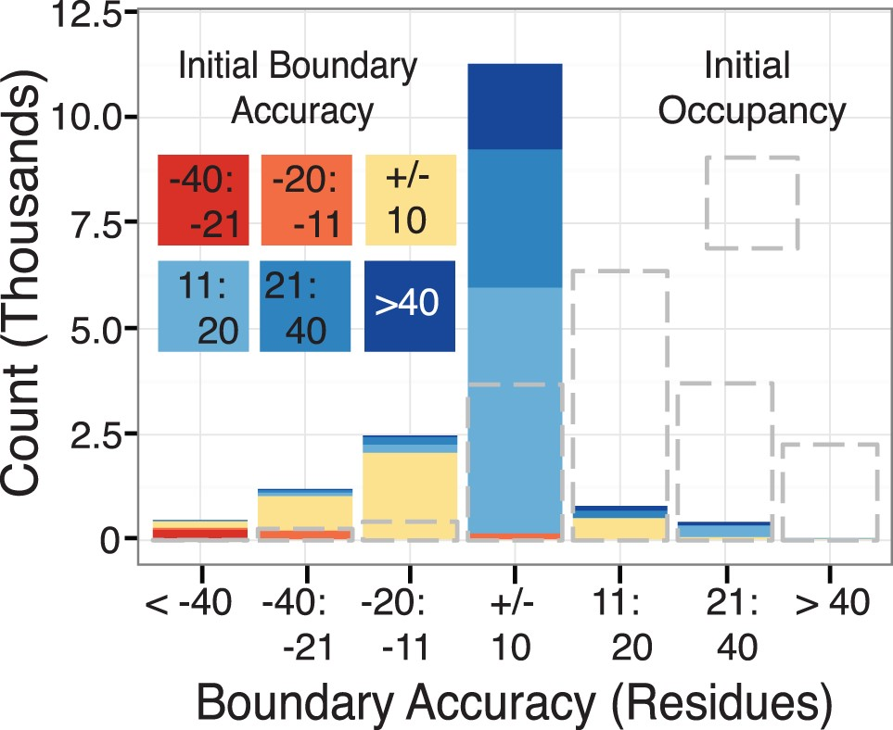
Fig. 5. Realignment algorithm results only results from sequence pairs that were realigned by the algorithm are ...
Notes:
Fig. 5. Realignment algorithm results only results from sequence pairs that were realigned by the algorithm are shown. Gray dashed bars indicate the initial boundary accuracy before realignment; colored bars indicate the final distribution of alignment boundary errors. The colors in the final distribution bars show the original accuracy before realignment
Unless provided in the caption above, the following copyright applies to the content of this slide: © The Author 2013. Published by Oxford University Press. All rights reserved.This is an Open Access article distributed under the terms of the Creative Commons Attribution Non-Commercial License (http://creativecommons.org/licenses/by-nc/3.0/), which permits non-commercial re-use, distribution, and reproduction in any medium, provided the original work is properly cited. For commercial re-use, please contact journals.permissions@oup.com

