Slide 1
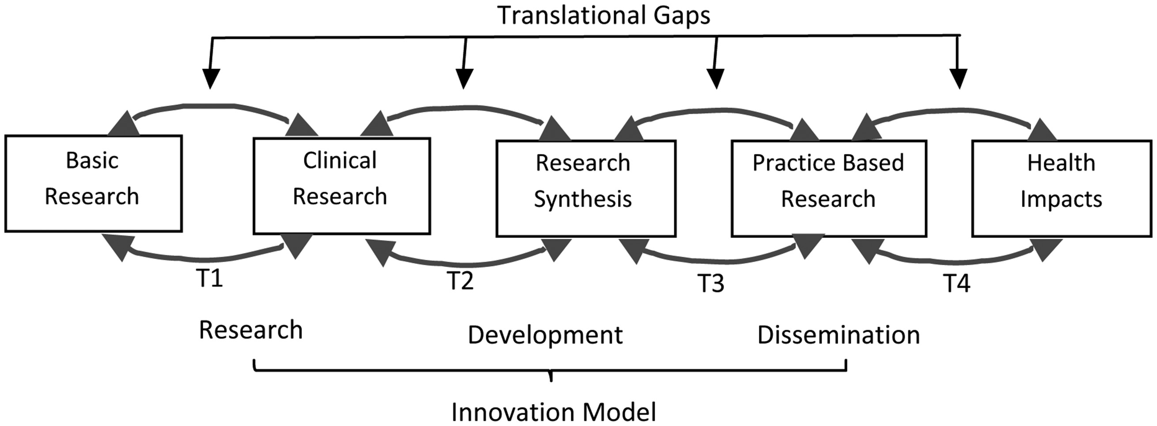
Figure 1. Gaps in translational processes and innovation stages
Notes:
Figure 1. Gaps in translational processes and innovation stages
Unless provided in the caption above, the following copyright applies to the content of this slide: © The Author 2017. Published by Oxford University Press. All rights reserved. For Permissions, please email: journals.permissions@oup.com

