Slide 1
Fig. 1 Process of constructing the cost-function masking images for the spatial normalization of the postoperative ...
Notes:
Fig. 1 Process of constructing the cost-function masking images for the spatial normalization of the postoperative FDG-PET images in a representative case. (A) A postoperative anatomical MRI of each individual was obtained. (B) The surgically resected region was defined manually. (C) The mask image was made with the value of 0 within the resected region and 1 elsewhere. (D) The mask image was expanded using a Gaussian filter of 8 mm FWHM with a 0.1% threshold border and then was coregistered onto the postoperative FDG-PET image of each individual.
Unless provided in the caption above, the following copyright applies to the content of this slide: © The Author (2008). Published by Oxford University Press on behalf of the Guarantors of Brain. All rights reserved. For Permissions, please email: journals.permissions@oxfordjournals.org

Slide 2
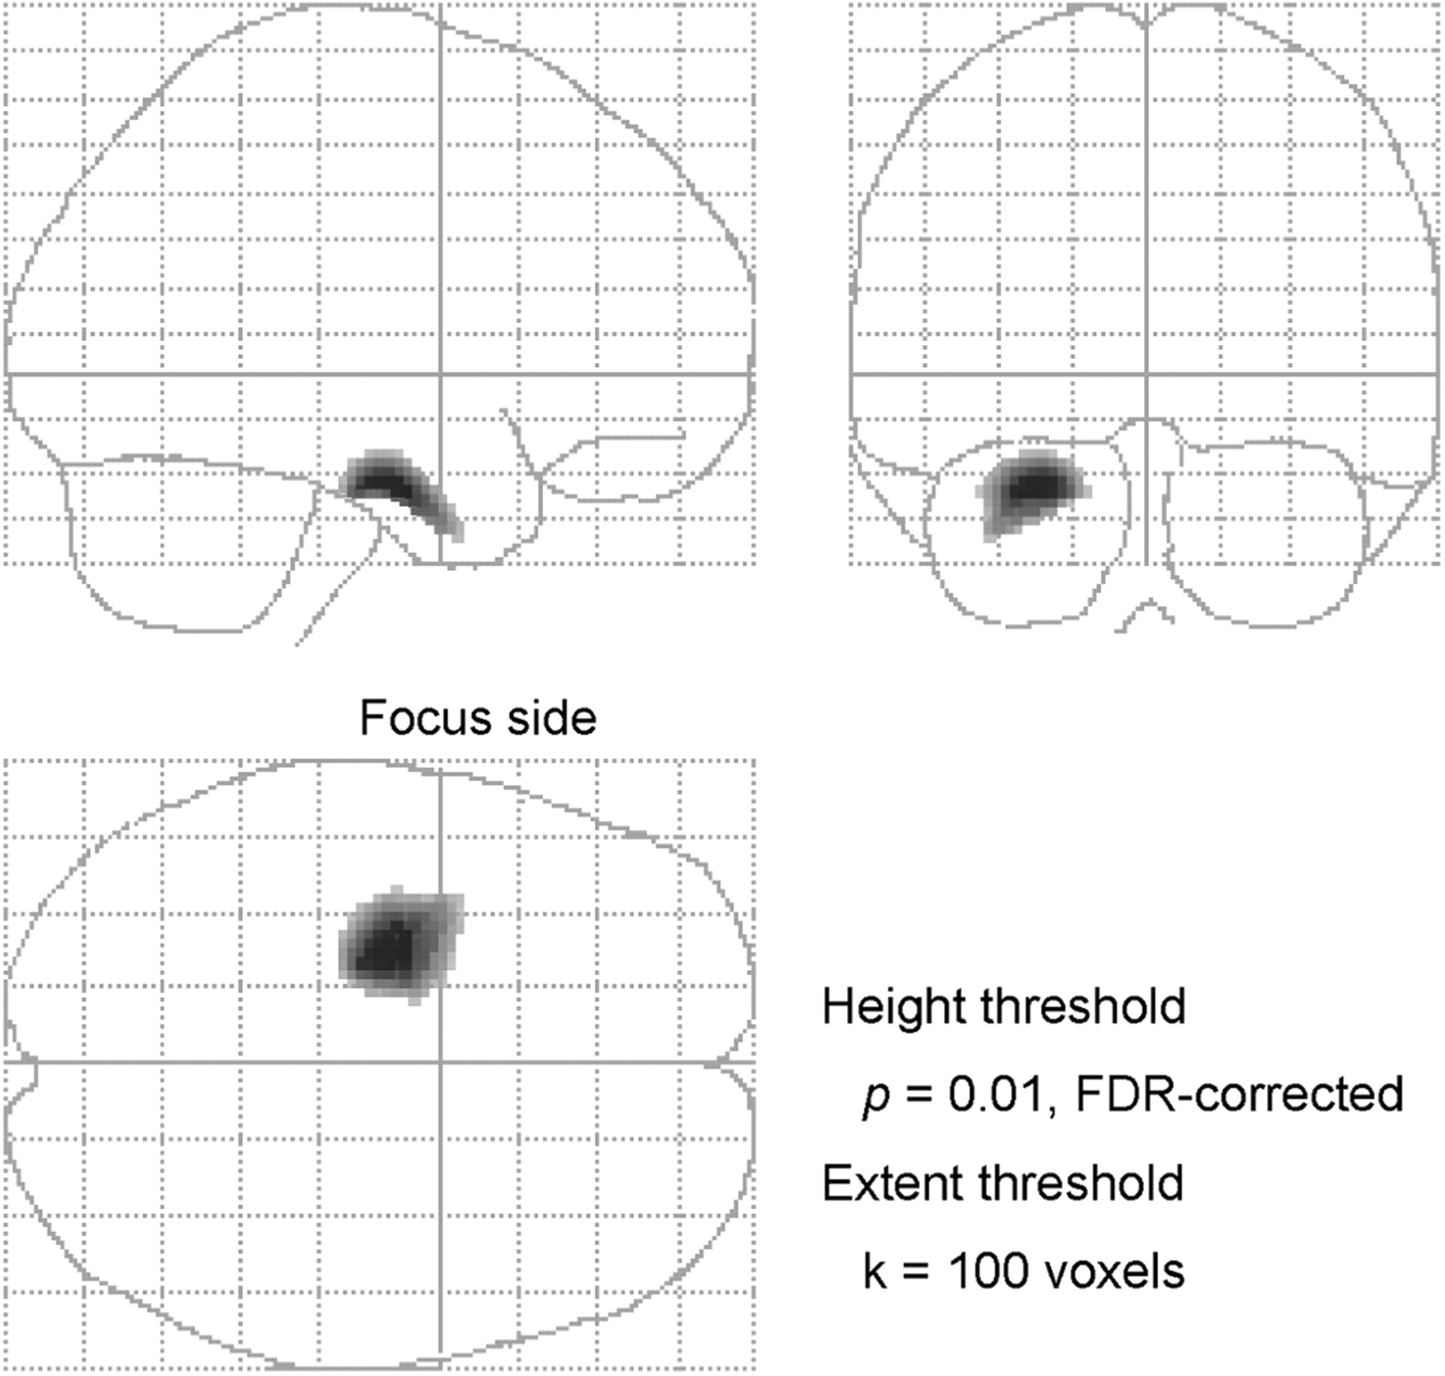
Fig. 2 Three-dimensional orthogonal projection of the areas showing a significant decrease in glucose metabolism ...
Notes:
Fig. 2 Three-dimensional orthogonal projection of the areas showing a significant decrease in glucose metabolism after subtemporal SAH. The analysis was conducted without an explicit mask at a height threshold of P = 0.01, FDR-corrected, and an extent threshold of 100 voxels. Focus side: side of the epileptogenic focus.
Unless provided in the caption above, the following copyright applies to the content of this slide: © The Author (2008). Published by Oxford University Press on behalf of the Guarantors of Brain. All rights reserved. For Permissions, please email: journals.permissions@oxfordjournals.org

Slide 3
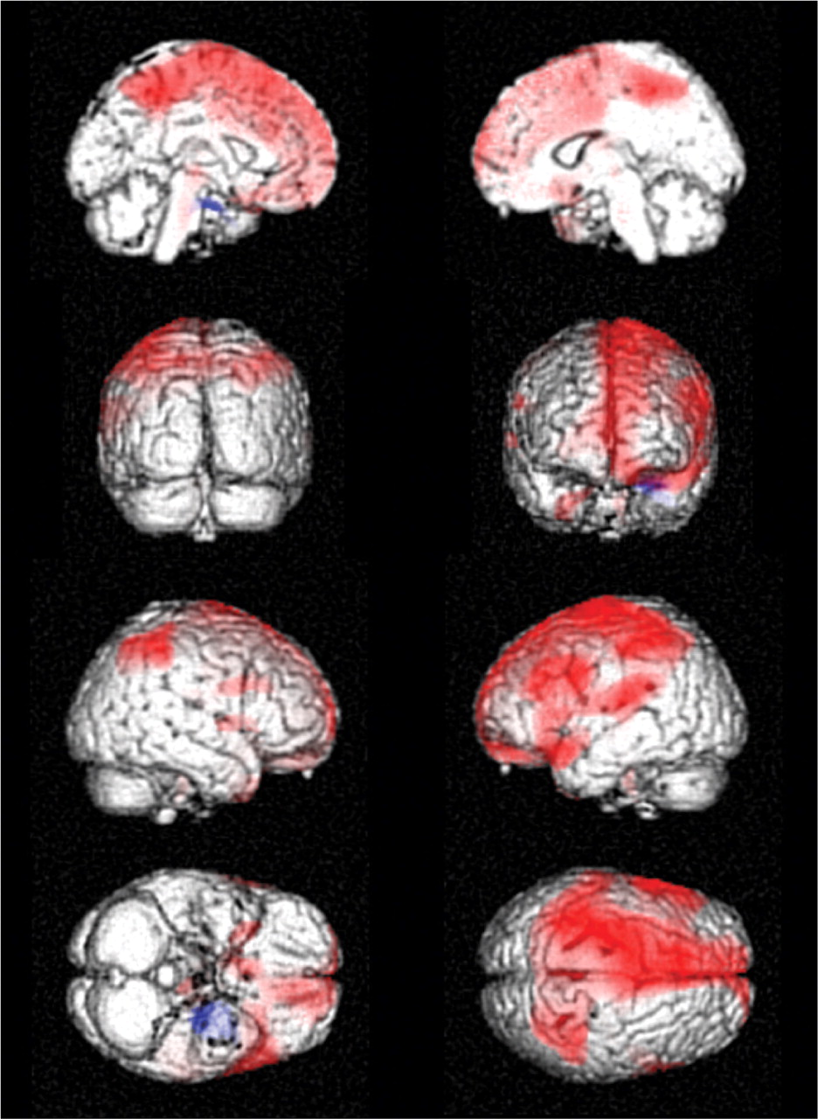
Fig. 3 Brain regions showing a significant increase (red) and decrease (blue) in glucose metabolism after ...
Notes:
Fig. 3 Brain regions showing a significant increase (red) and decrease (blue) in glucose metabolism after subtemporal SAH. The epileptogenic zone was lateralized to the left side. Note that the results of the group-comparison analysis without an explicit mask are displayed for decrease in glucose metabolism, because when the data were reanalysed with an explicit mask no additional brain regions were detected. Height threshold was set at P = 0.05, FDR-corrected for display purposes. Even at the lower statistical threshold, the postoperative decrease in glucose metabolism was limited to the mesial temporal area adjacent to the resected region. n = 13; paired t-test; extent threshold of 100 voxels.
Unless provided in the caption above, the following copyright applies to the content of this slide: © The Author (2008). Published by Oxford University Press on behalf of the Guarantors of Brain. All rights reserved. For Permissions, please email: journals.permissions@oxfordjournals.org

Slide 4
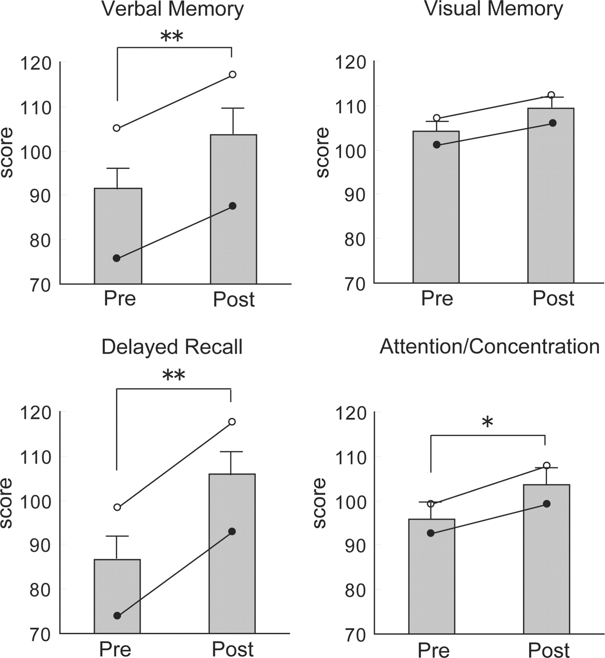
Fig. 4 Bar charts illustrating the mean WMS-R scores of all patients for verbal memory, visual memory, delayed ...
Notes:
Fig. 4 Bar charts illustrating the mean WMS-R scores of all patients for verbal memory, visual memory, delayed recall and attention/concentration at preoperative and postoperative evaluation. Error bars show SEM. Solid circles and open circles indicate the mean scores of patients with language-dominant side and language-non-dominant side MTLE, respectively. The postoperative scores were significantly higher in verbal memory, overall (verbal + visual) delayed recall and attention/concentration (**p < 0.005, *p < 0.05), but there was no time × group interaction in any of the domains.
Unless provided in the caption above, the following copyright applies to the content of this slide: © The Author (2008). Published by Oxford University Press on behalf of the Guarantors of Brain. All rights reserved. For Permissions, please email: journals.permissions@oxfordjournals.org

