Slide 1
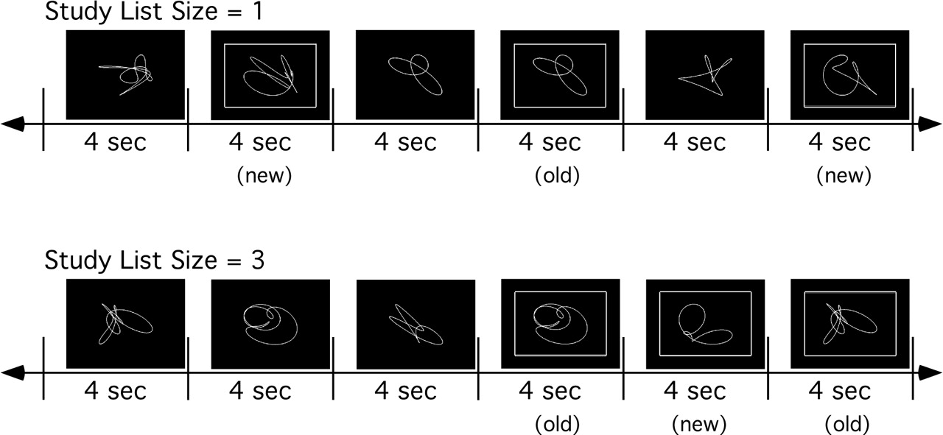
Figure 1. Schematic sketch explaining the task procedure. The upper part of the figure shows the low demand ...
Notes:
Figure 1. Schematic sketch explaining the task procedure. The upper part of the figure shows the low demand task condition with study and test on one item, whereas the lower part shows study and test on a list of three items.
Unless provided in the caption above, the following copyright applies to the content of this slide:

Slide 2
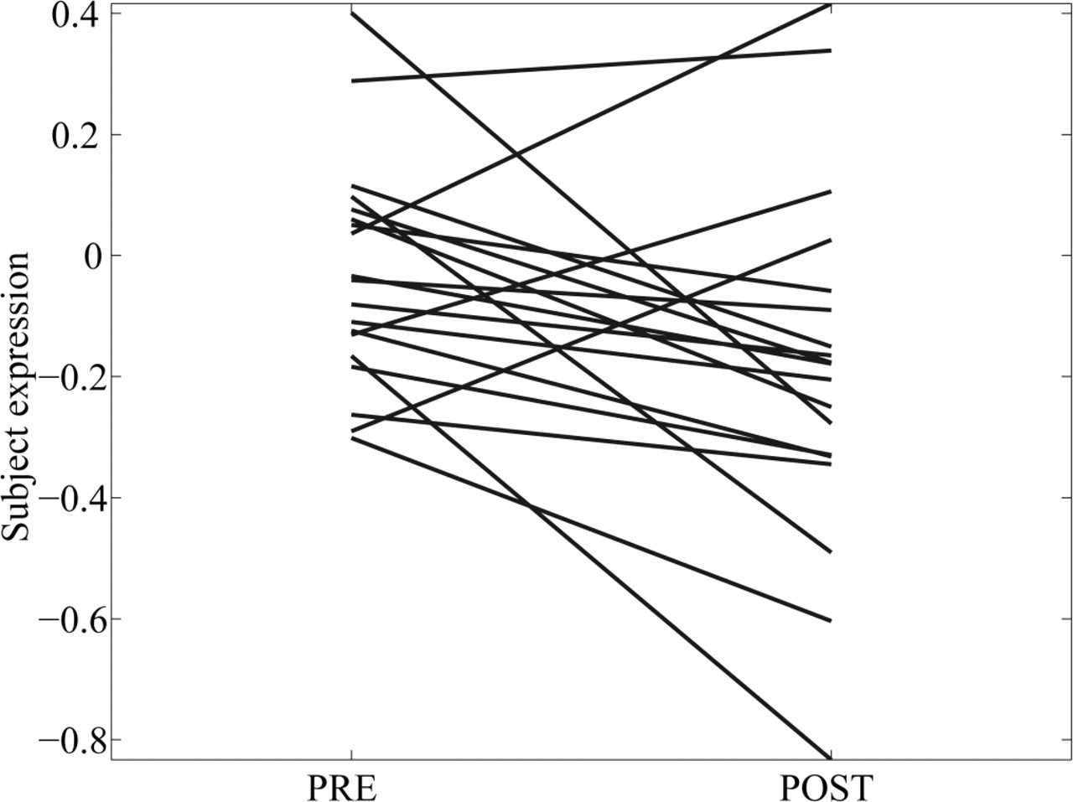
Figure 2. Difference of pattern expression from PRE to POST sleep deprivation. Fifteen of 19 subjects ...
Notes:
Figure 2. Difference of pattern expression from PRE to POST sleep deprivation. Fifteen of 19 subjects displayed a decrease in pattern expression (P < 0.05), affording good confidence that the activity related to the identified covariance pattern is successfully manipulated by the experimental design.
Unless provided in the caption above, the following copyright applies to the content of this slide:

Slide 3
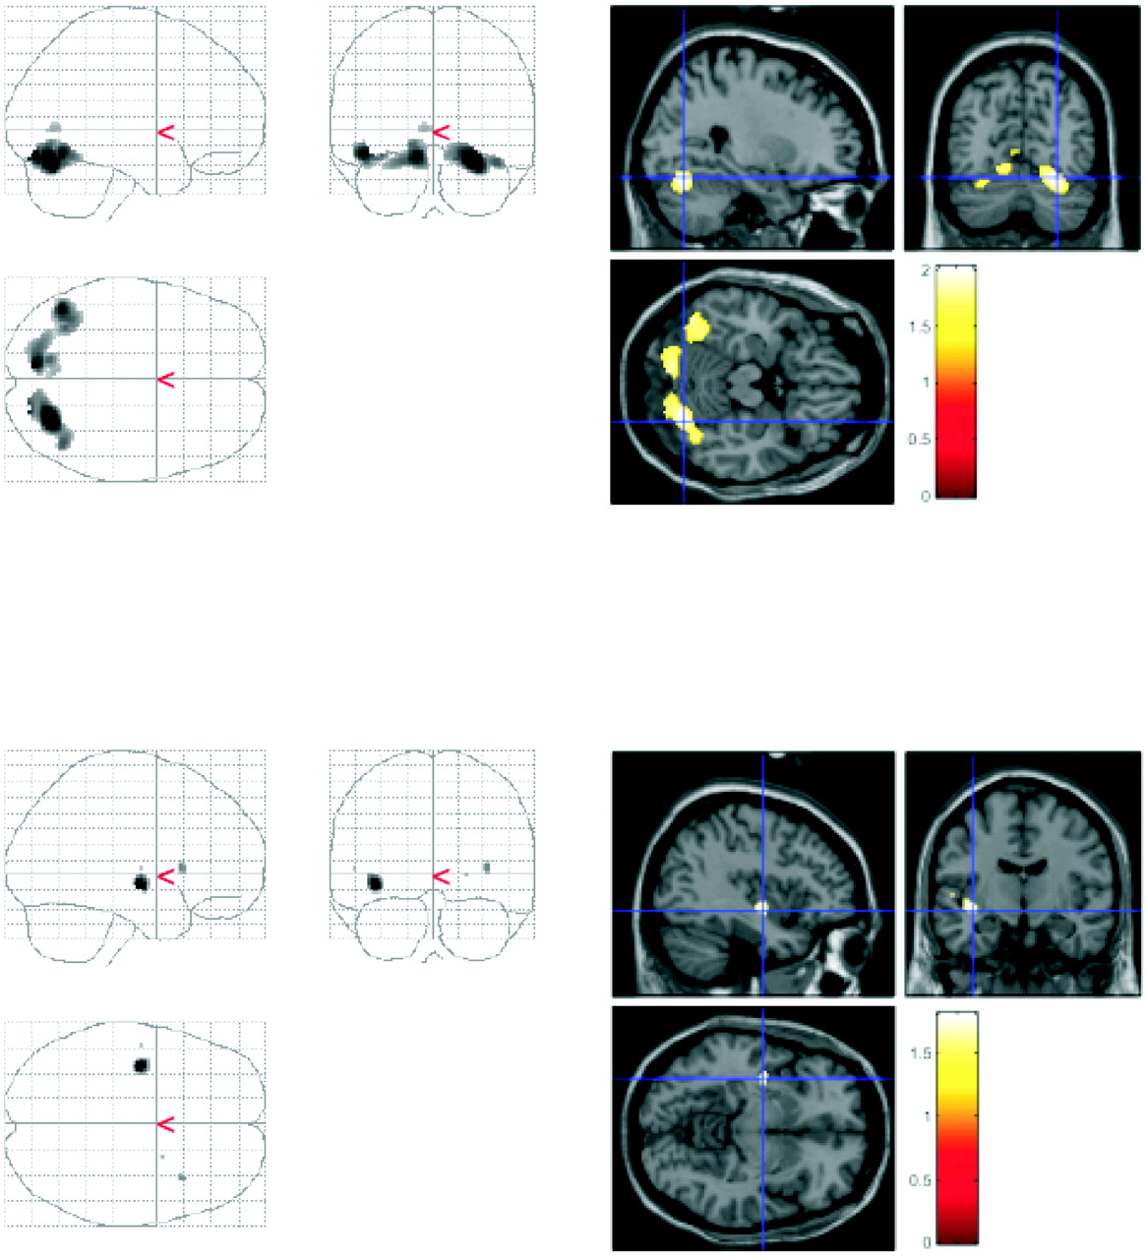
Figure 3. Upper half: glass brain projections and sectional view of selected brain regions that have a ...
Notes:
Figure 3. Upper half: glass brain projections and sectional view of selected brain regions that have a significant positive loading (P < 0.05) (i.e. associated activity decreases for the majority of subjects from PRE to POST) as ascertained by the bootstrap resampling test. Lower half: glass brain projections and sectional view of selected brain regions that have significant negative loadings (P < 0.05).
Unless provided in the caption above, the following copyright applies to the content of this slide:

Slide 4
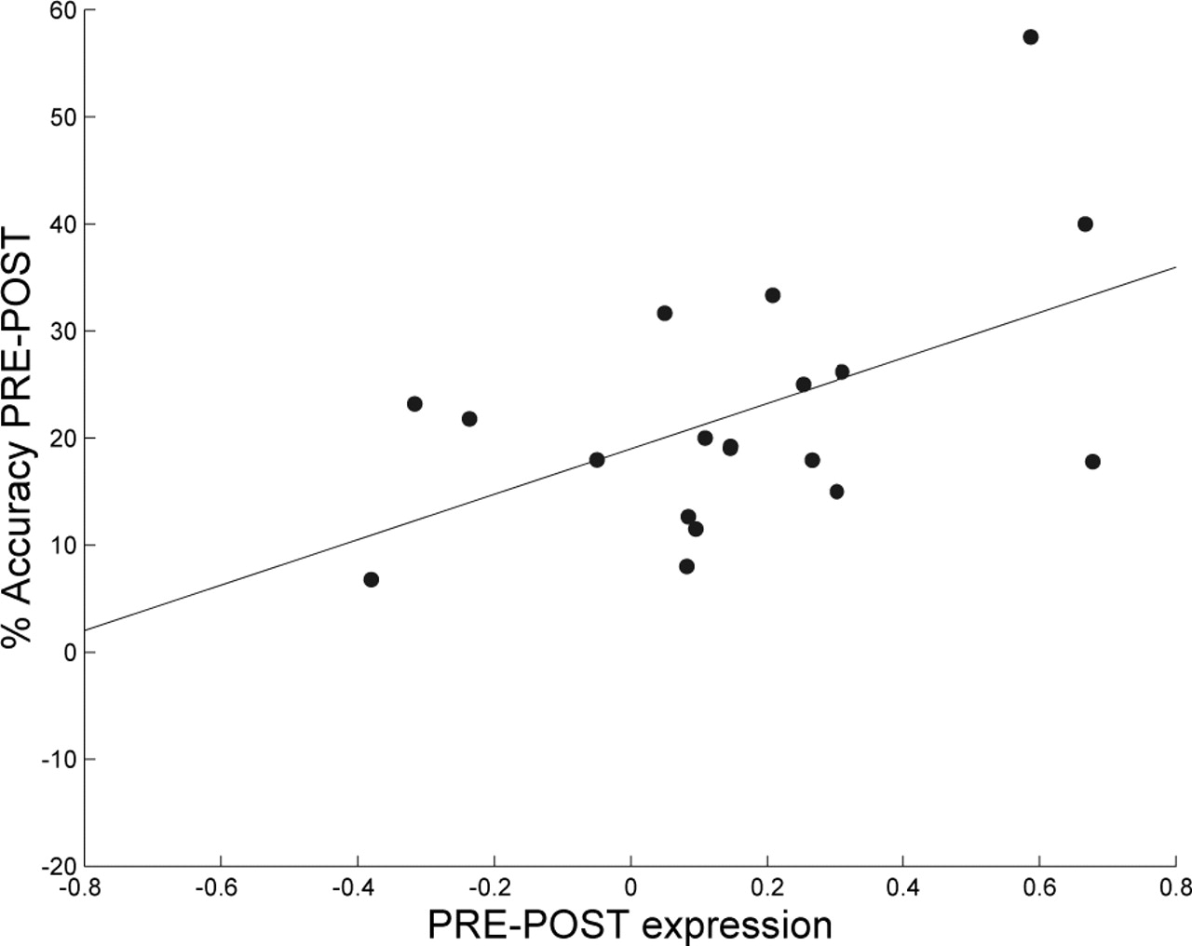
Figure 4. Brain–behavior correlation of pattern expression and worsening recognition accuracy due to sleep ...
Notes:
Figure 4. Brain–behavior correlation of pattern expression and worsening recognition accuracy due to sleep deprivation. The bigger subjects’ decrease of their pattern expression, the worse their drop in performance.
Unless provided in the caption above, the following copyright applies to the content of this slide:

