Slide 1
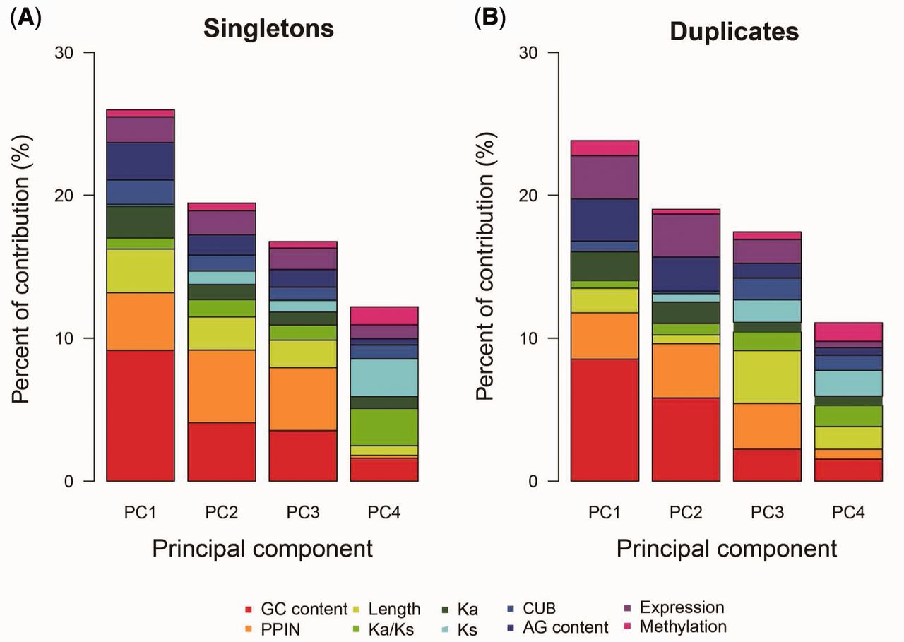
Fig. 2.— Principal component analyses on gene age in singletons and duplicates. The corresponding numerical results ...
Notes:
Fig. 2.— Principal component analyses on gene age in singletons and duplicates. The corresponding numerical results were summarized into supplementary tables S6 and S7, Supplementary Material online.
Unless provided in the caption above, the following copyright applies to the content of this slide: © The Author 2016. Published by Oxford University Press on behalf of the Society for Molecular Biology and Evolution.This is an Open Access article distributed under the terms of the Creative Commons Attribution Non-Commercial License (http://creativecommons.org/licenses/by-nc/4.0/), which permits non-commercial re-use, distribution, and reproduction in any medium, provided the original work is properly cited. For commercial re-use, please contact journals.permissions@oup.com

Slide 2
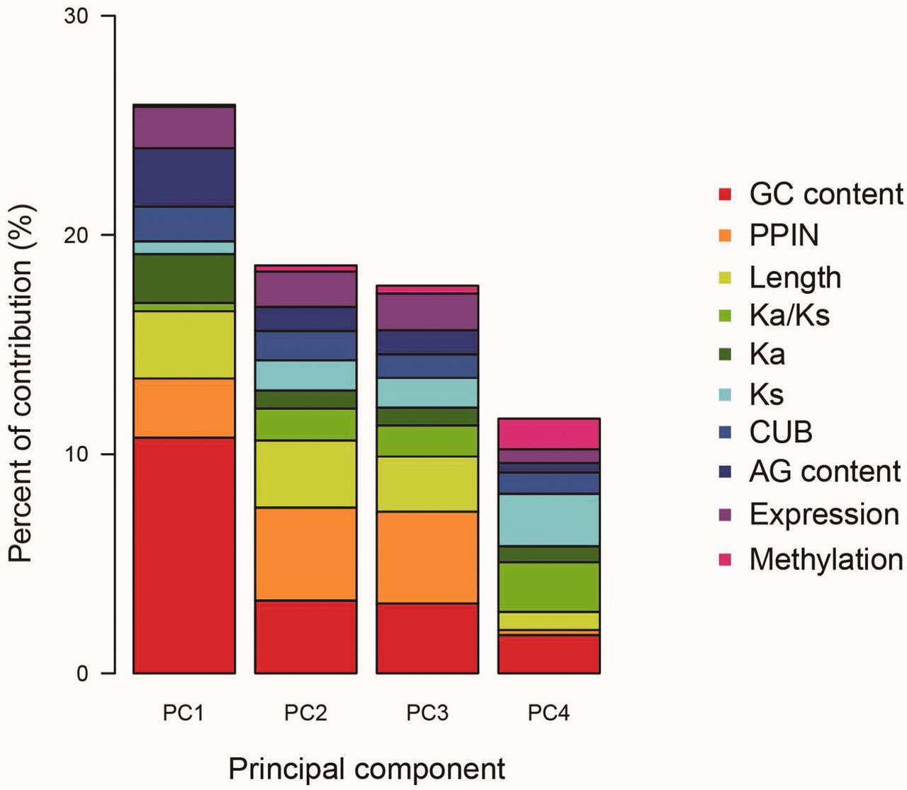
Fig. 1.— Principal component analyses on gene age. The corresponding numerical results were summarized into ...
Notes:
Fig. 1.— Principal component analyses on gene age. The corresponding numerical results were summarized into supplementary table S4, Supplementary Material online.
Unless provided in the caption above, the following copyright applies to the content of this slide: © The Author 2016. Published by Oxford University Press on behalf of the Society for Molecular Biology and Evolution.This is an Open Access article distributed under the terms of the Creative Commons Attribution Non-Commercial License (http://creativecommons.org/licenses/by-nc/4.0/), which permits non-commercial re-use, distribution, and reproduction in any medium, provided the original work is properly cited. For commercial re-use, please contact journals.permissions@oup.com

