Slide 1
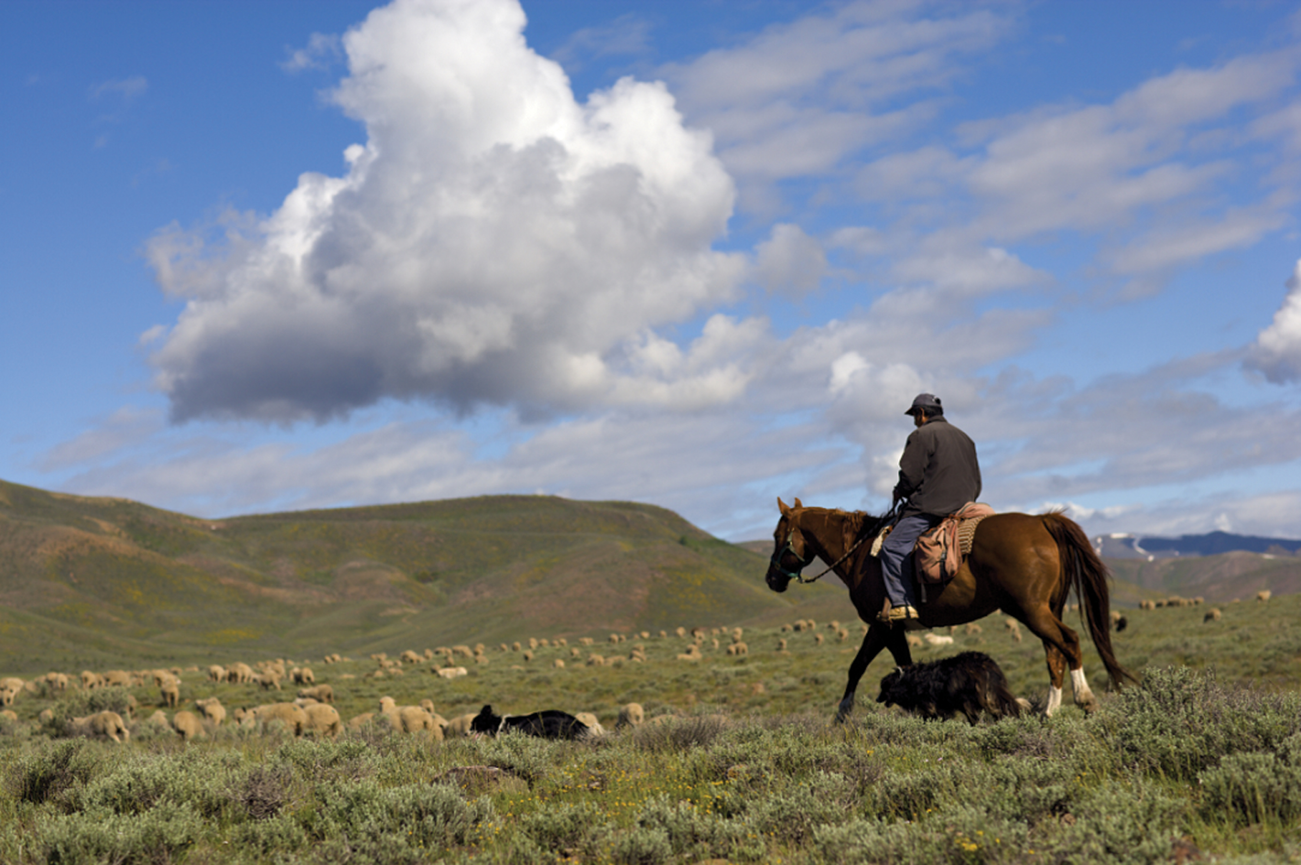
Fig. 1. Lava Lake herder and herding dogs among the sheep. Photo credit: Defenders of Wildlife.
Notes:
Fig. 1. Lava Lake herder and herding dogs among the sheep. Photo credit: Defenders of Wildlife.
Unless provided in the caption above, the following copyright applies to the content of this slide: © 2017 American Society of Mammalogists, www.mammalogy.org

Slide 2
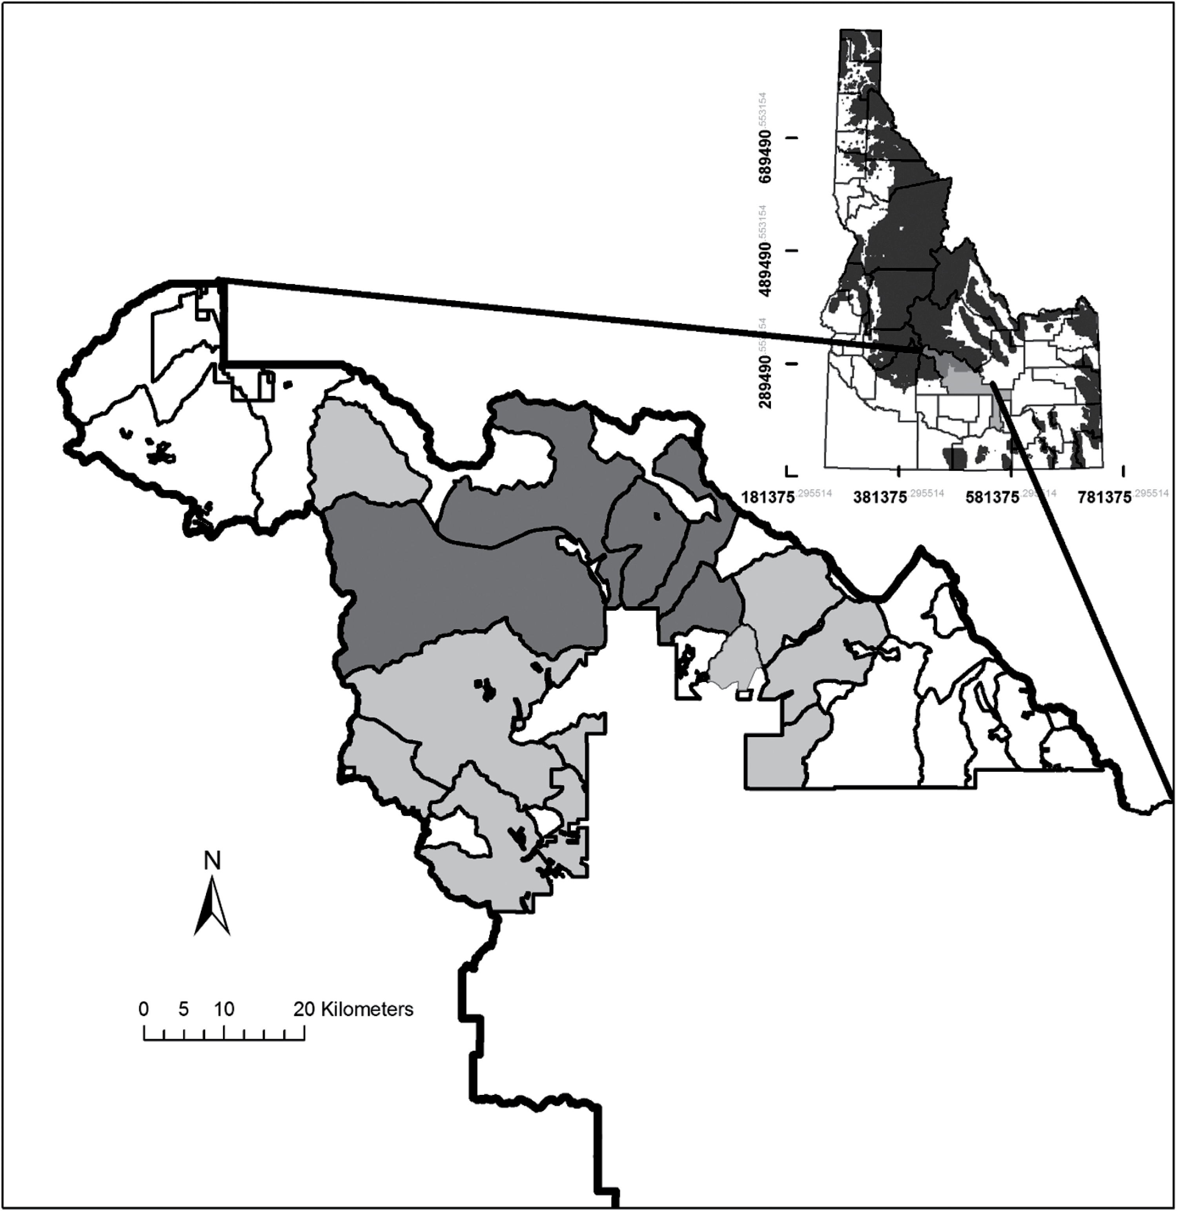
Fig. 2. State of Idaho (inset), showing Blaine County (light gray) and National Forest Service land (dark gray). ...
Notes:
Fig. 2. State of Idaho (inset), showing Blaine County (light gray) and National Forest Service land (dark gray). Northern portion of Blaine County is enlarged to show grazing allotments where Wood River Wolf Project was carried out during Phase 1 (darker gray) and Phase 2 (lighter gray and darker gray).
Unless provided in the caption above, the following copyright applies to the content of this slide: © 2017 American Society of Mammalogists, www.mammalogy.org

Slide 3
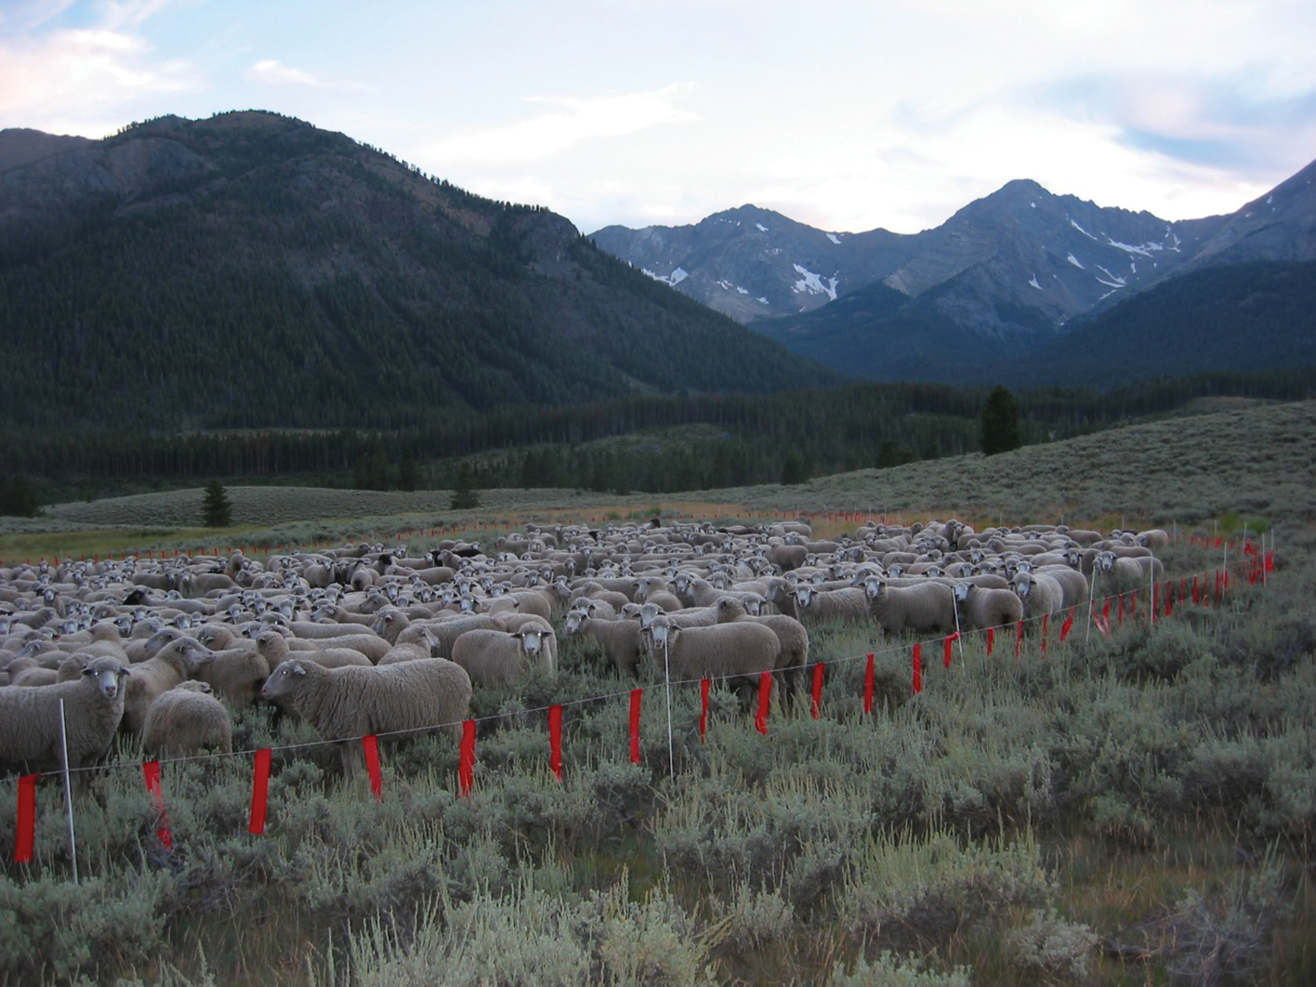
Fig. 3. Lava Lake sheep in fladry. Photo credit: Defenders of Wildlife.
Notes:
Fig. 3. Lava Lake sheep in fladry. Photo credit: Defenders of Wildlife.
Unless provided in the caption above, the following copyright applies to the content of this slide: © 2017 American Society of Mammalogists, www.mammalogy.org

Slide 4
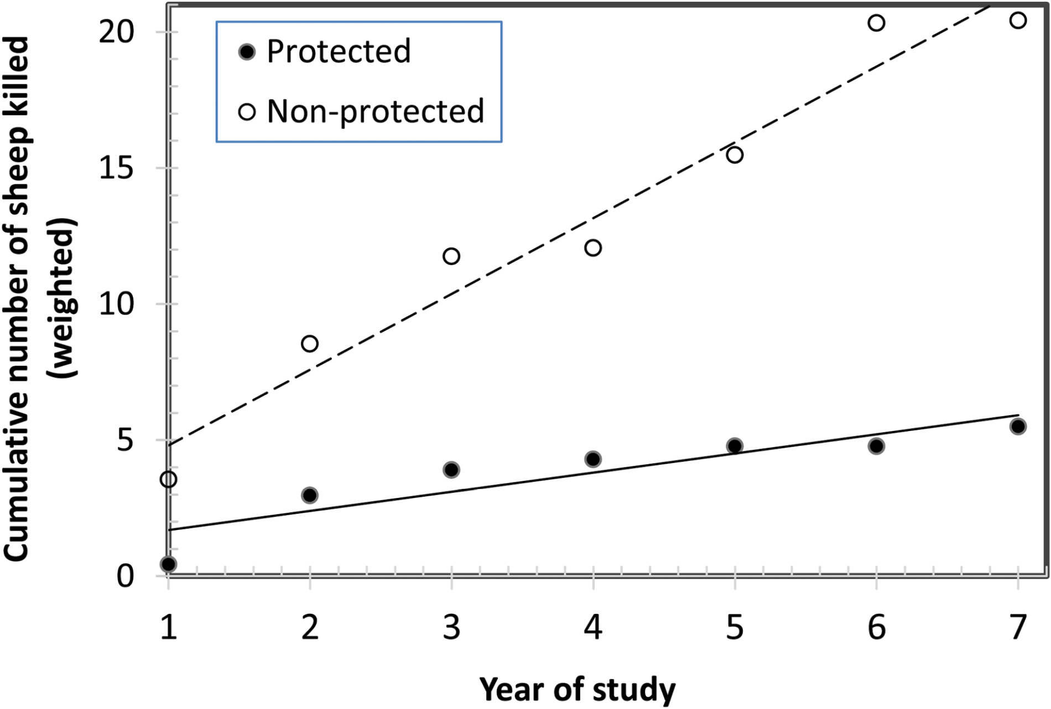
Fig. 4. Killing of sheep (Ovis aries) by wolves (Canis lupus) in Protected and Nonprotected Areas in public grazing ...
Notes:
Fig. 4. Killing of sheep (Ovis aries) by wolves (Canis lupus) in Protected and Nonprotected Areas in public grazing allotments in Blaine County, Idaho, as shown by cumulative weighted number of sheep killed in each year of the study. Lines indicate regression of killings on year.
Unless provided in the caption above, the following copyright applies to the content of this slide: © 2017 American Society of Mammalogists, www.mammalogy.org

