Slide 1
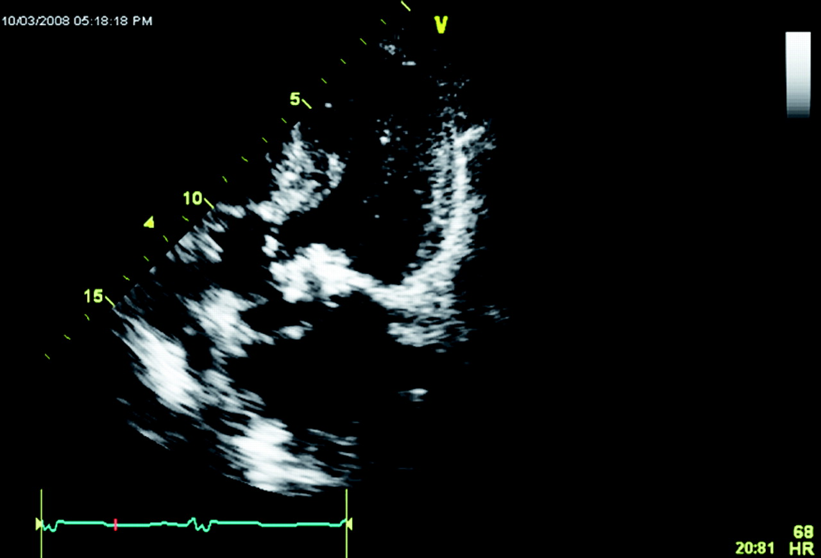
Figure 1 Transthoracic echocardiogram showing partially calcified mitral valve with an immobile anterior lateral ...
Notes:
Figure 1 Transthoracic echocardiogram showing partially calcified mitral valve with an immobile anterior lateral leaflet.
Unless provided in the caption above, the following copyright applies to the content of this slide: Published on behalf of the European Society of Cardiology. All rights reserved. © The Author 2009. For permissions please email: journals.permissions@oxfordjournals.org.

Slide 2
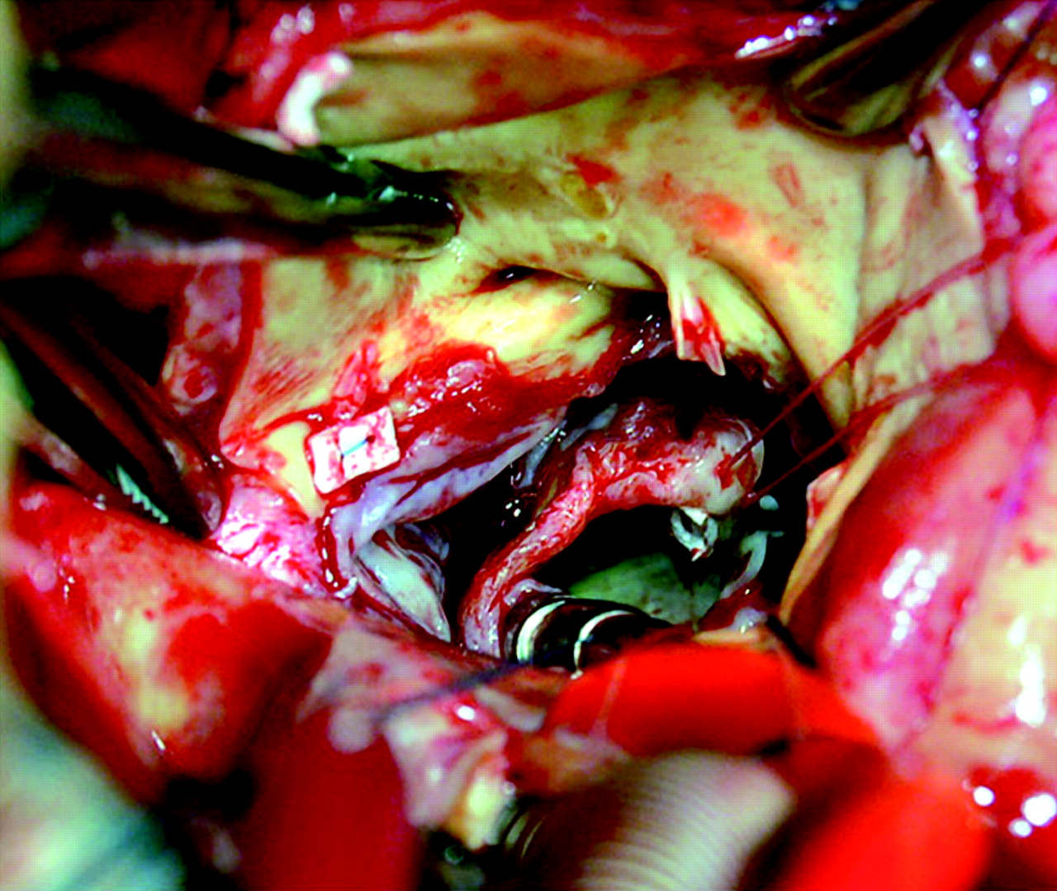
Figure 2 Destroyed mitral–aortic intervalvular fibrosa with perforation of the aortic annulus.
Notes:
Figure 2 Destroyed mitral–aortic intervalvular fibrosa with perforation of the aortic annulus.
Unless provided in the caption above, the following copyright applies to the content of this slide: Published on behalf of the European Society of Cardiology. All rights reserved. © The Author 2009. For permissions please email: journals.permissions@oxfordjournals.org.

Slide 3
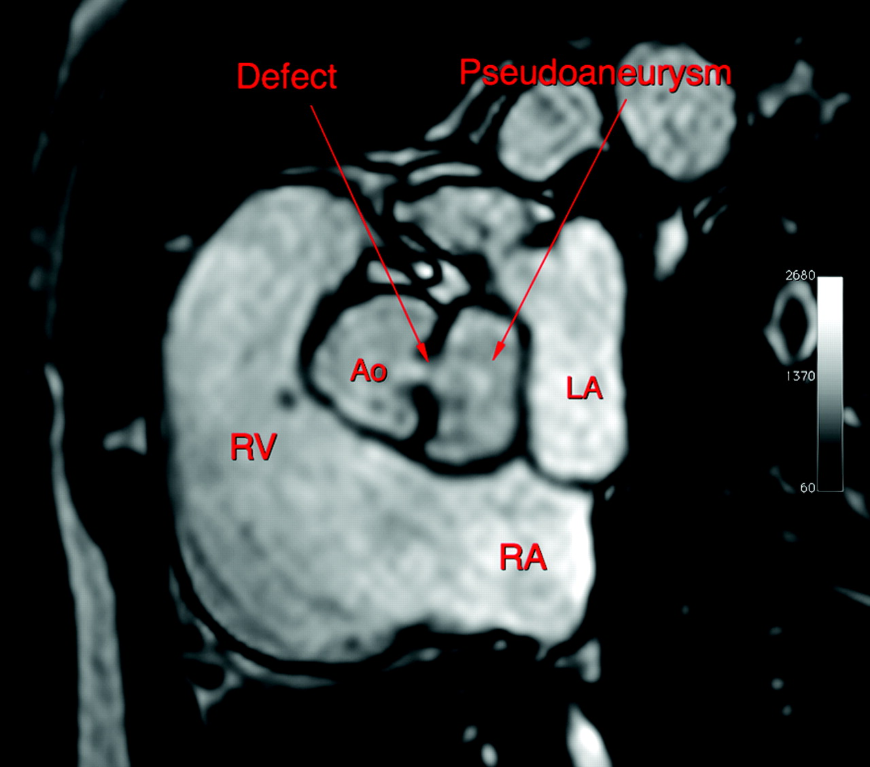
Figure 3 Magnetic resonance imaging showing the organized pseudoaneurysm of the mitral–aortic intervalvular fibrosa ...
Notes:
Figure 3 Magnetic resonance imaging showing the organized pseudoaneurysm of the mitral–aortic intervalvular fibrosa with opening from the aortic outflow tract. AoV, aortic valve; LA, left atrium; RA, right atrium; RV, right ventricle.
Unless provided in the caption above, the following copyright applies to the content of this slide: Published on behalf of the European Society of Cardiology. All rights reserved. © The Author 2009. For permissions please email: journals.permissions@oxfordjournals.org.

