Slide 1
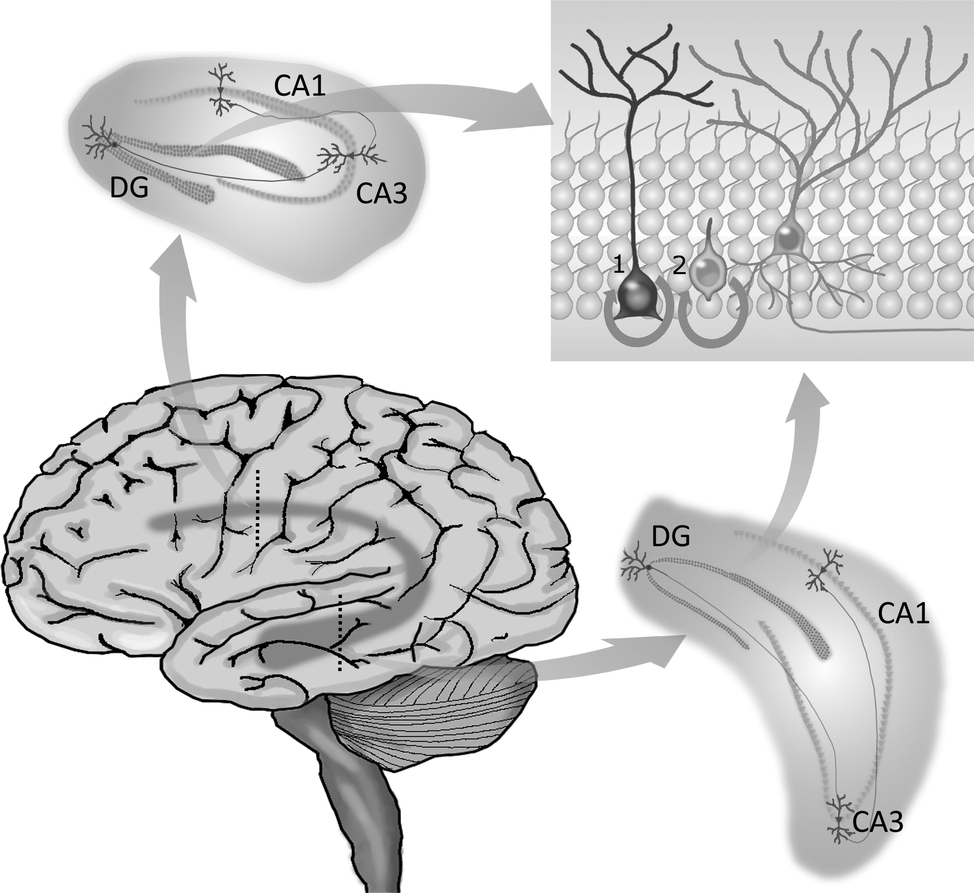
Fig. 1. The hippocampal circuitry. The hippocampus is located within the temporal lobe, extending longitudinally ...
Notes:
Fig. 1. The hippocampal circuitry. The hippocampus is located within the temporal lobe, extending longitudinally across the brain. It is composed of 3 distinct subregions—the DG, CA1, and CA3—each responsible for specific components of information processing. Granule cells in the DG receive inputs from the entorhinal cortex and send projections to CA3 pyramidal neurons, which connect with those of CA1, from where information is distributed to other parts of the brain. The DG is particularly known for its remarkable characteristic of generating new functional neurons throughout adulthood. The process of adult hippocampal neurogenesis starts with type 1 NSCs generating type 2 progenitors, which can differentiate into neuroblasts. Given appropriate microenvironmental conditions, these cells will mature into neurons and integrate local preexisting circuits. Because the hippocampus extends dorsoventrally, newborn neurons that integrate the dorsal circuitry are believed to regulate functions proper to the dorsal hippocampus, such as spatial memory. In turn, those integrating ventral circuits are thought to play a role in the regulation of ventral hippocampus functions, such as those related to mood and emotionality.
Unless provided in the caption above, the following copyright applies to the content of this slide: © The Author(s) 2014. Published by Oxford University Press on behalf of the Society for Neuro-Oncology. All rights reserved. For permissions, please e-mail: journals.permissions@oup.com.

Slide 2
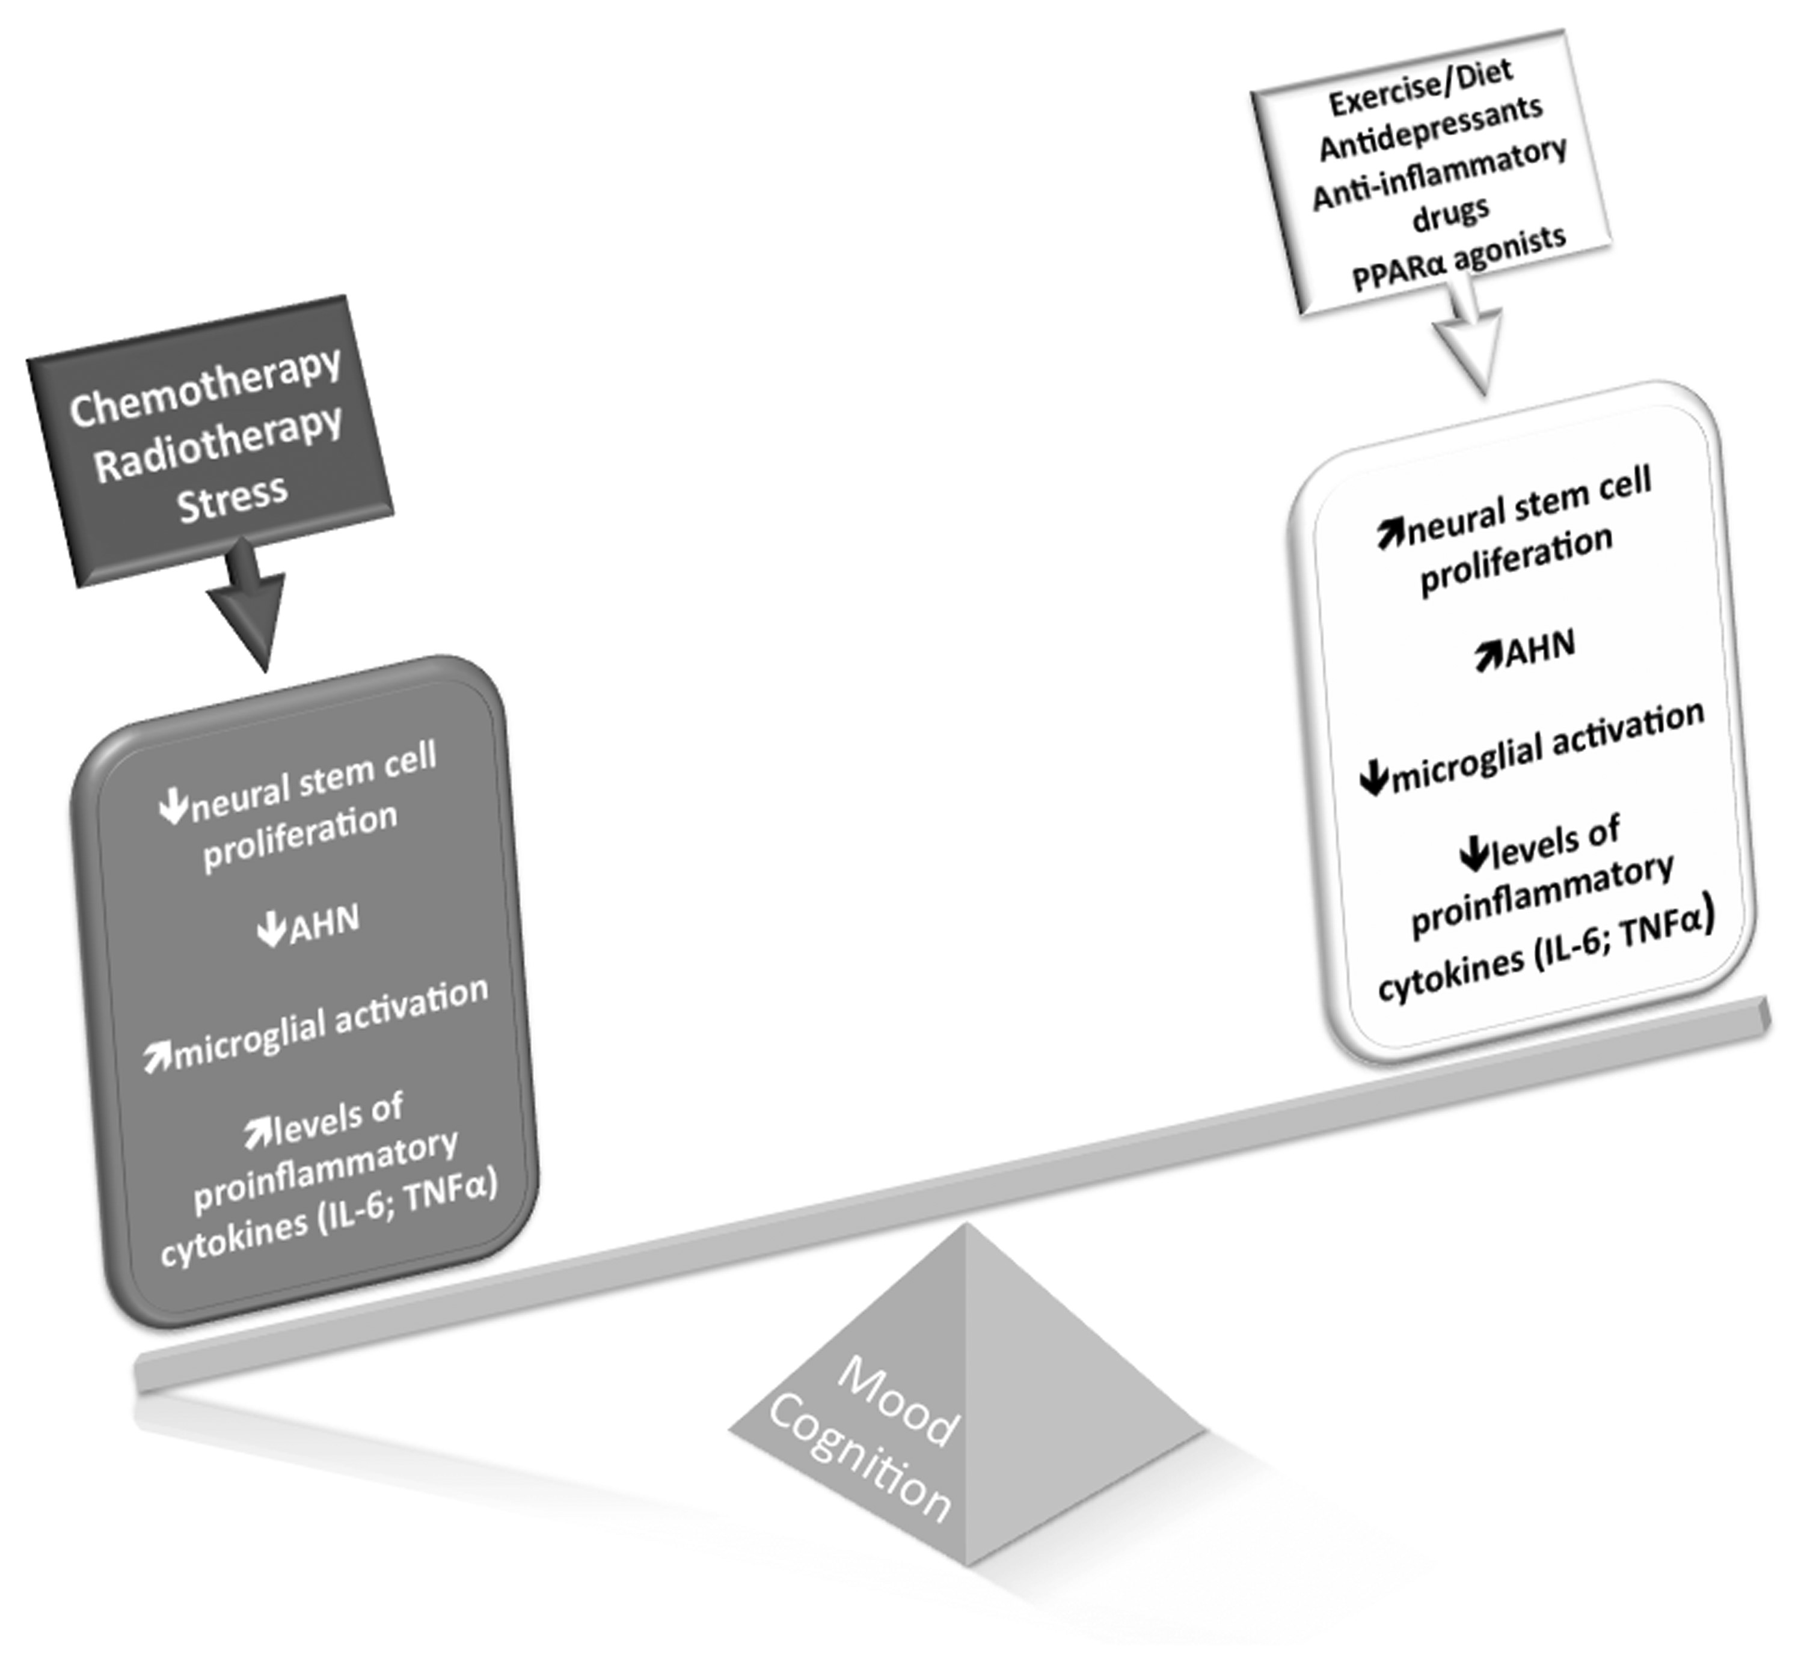
Fig. 2. Consequences of cancer treatments to mental health. Cancer treatments, such as chemotherapy and radiotherapy, ...
Notes:
Fig. 2. Consequences of cancer treatments to mental health. Cancer treatments, such as chemotherapy and radiotherapy, aim at ablating the proliferative activity of tumorous cells. However, given their unspecific action, these treatments also arrest proliferation of desirable cell populations, such as those maintaining the process of neurogenesis in the postnatal/adult brain. Adult hippocampal neurogenesis is thought to underlie an important portion of neural plasticity throughout life, with newly born neurons integrating memory and mood circuits. AHN can be downregulated directly by the antimitotic action of cancer treatments, or indirectly by the pro-inflammatory responses triggered by these agents. Chronic stress is significantly present in the routine of cancer patients and is another important contributor to lower levels of AHN. Decreased AHN, in turn, has been consistently linked with cognitive decline and depression. On the other hand, environmental factors like exercise, diet, and use of antidepressants and anti-inflammatory drugs, as well as peroxisomal proliferator-activated receptor alpha agonists, are known to increase AHN and restore cognitive abilities and mood states. They could, therefore, positively contribute to mental health among cancer patients. Other strategies, such as hippocampal sparing, cognitive stimulation, and treatment with memantine, stimulants, and ramipril, have been shown to exert positive effects on mental health in the context of cancer treatments, a phenomenon that probably occurs via protection or increase of hippocampal neurogenesis.
Unless provided in the caption above, the following copyright applies to the content of this slide: © The Author(s) 2014. Published by Oxford University Press on behalf of the Society for Neuro-Oncology. All rights reserved. For permissions, please e-mail: journals.permissions@oup.com.

