Slide 1
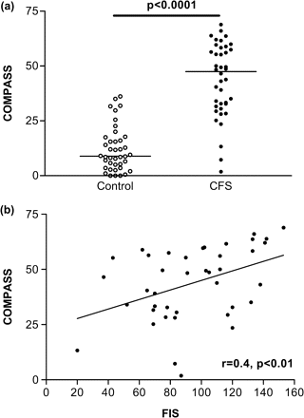
Figure 1. a Individual total COMPASS scores in CFS patients and in case-matched normal controls, in phase 1. b ...
Notes:
Figure 1. a Individual total COMPASS scores in CFS patients and in case-matched normal controls, in phase 1. b Correlation between degree of symptoms of dysautonomia as assessed by COMPASS and severity of fatigue (as assessed by FIS), in phase 1.
Unless provided in the caption above, the following copyright applies to the content of this slide: © The Author 2007. Published by Oxford University Press on behalf of the Association of Physicians. All rights reserved. For Permissions, please email: journals.permissions@oxfordjournals.org

Slide 2
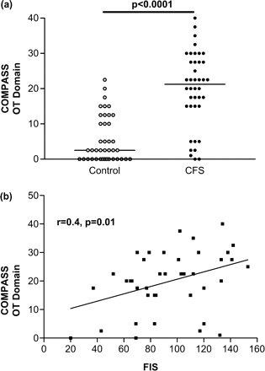
Figure 2. a Individual COMPASS orthostatic tolerance (OT) domain scores in CFS patients and in case-matched normal ...
Notes:
Figure 2. a Individual COMPASS orthostatic tolerance (OT) domain scores in CFS patients and in case-matched normal controls, in phase 1. b Correlation between degree of symptoms of cardiovascular dysautonomia as assessed by COMPASS OT domain and severity of fatigue (as assessed by FIS) in phase 1.
Unless provided in the caption above, the following copyright applies to the content of this slide: © The Author 2007. Published by Oxford University Press on behalf of the Association of Physicians. All rights reserved. For Permissions, please email: journals.permissions@oxfordjournals.org

Slide 3
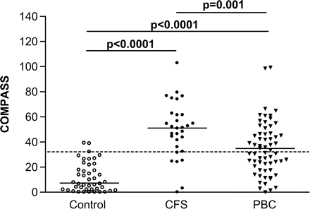
Figure 3. Individual total COMPASS scores in CFS patients, normal controls and PBC patients in phase 2.
Notes:
Figure 3. Individual total COMPASS scores in CFS patients, normal controls and PBC patients in phase 2.
Unless provided in the caption above, the following copyright applies to the content of this slide: © The Author 2007. Published by Oxford University Press on behalf of the Association of Physicians. All rights reserved. For Permissions, please email: journals.permissions@oxfordjournals.org

Slide 4
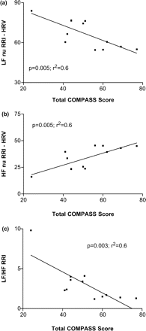
Figure 4. Correlation between total COMPASS Score and: a low-frequency heart rate variability (LF) (normalized units: ...
Notes:
Figure 4. Correlation between total COMPASS Score and: a low-frequency heart rate variability (LF) (normalized units: nu) (predominantly sympathetic function); b high-frequency (HF) (predominantly parasympathetic function); c LF/HF ratio (balance between sympathetic and parasympathetic autonomic nervous system function.
Unless provided in the caption above, the following copyright applies to the content of this slide: © The Author 2007. Published by Oxford University Press on behalf of the Association of Physicians. All rights reserved. For Permissions, please email: journals.permissions@oxfordjournals.org

Slide 5
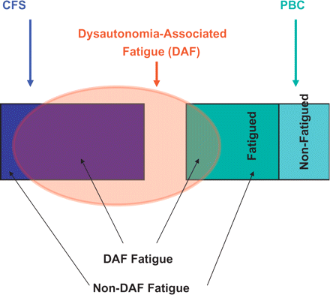
Figure 5. Model for the role played by dysautonomia-associated fatigue (DAF) in the clinical expression of CFS and PBC. ...
Notes:
Figure 5. Model for the role played by dysautonomia-associated fatigue (DAF) in the clinical expression of CFS and PBC. DAF represents a ‘cross-cutting’ phenomenon that can contribute to the expression of fatigue in seemingly disparate conditions. In CFS (in which all patients are by definition fatigued), DAF is present in the majority of patients. The non-DAF minority of CFS presumably have fatigue generated by other pathological processes. In PBC (in which only a proportion of patients are fatigued), DAF is present in a sizeable minority of patients. In contrast to CFS, the pathological processes responsible for the non-DAF fatigue component in PBC have begun to be identified, and include excessive daytime somnolence. The implication of this model is that dysautonomia-directed approaches to therapy should be restricted in CFS (and, indeed, PBC patients) to the DAF subgroup of patients. Failure to restrict the application of these approaches in this way may help explain the apparent lack of efficacy of these approaches in clinical trials to date.
Unless provided in the caption above, the following copyright applies to the content of this slide: © The Author 2007. Published by Oxford University Press on behalf of the Association of Physicians. All rights reserved. For Permissions, please email: journals.permissions@oxfordjournals.org

