Slide 1
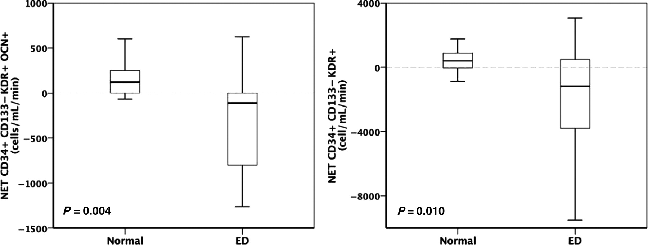
Figure 1 Net gradients of CD34+/CD133−/KDR+/OCN+ and CD34+/CD133−/KDR+ in cells/mL/min. Patients with endothelial ...
Notes:
Figure 1 Net gradients of CD34+/CD133−/KDR+/OCN+ and CD34+/CD133−/KDR+ in cells/mL/min. Patients with endothelial dysfunction showed retention of both cell populations in contrast to controls with positive/equivocal net gradients.
Unless provided in the caption above, the following copyright applies to the content of this slide: Published on behalf of the European Society of Cardiology. All rights reserved. © The Author 2010. For permissions please email: journals.permissions@oxfordjournals.org

