Slide 1
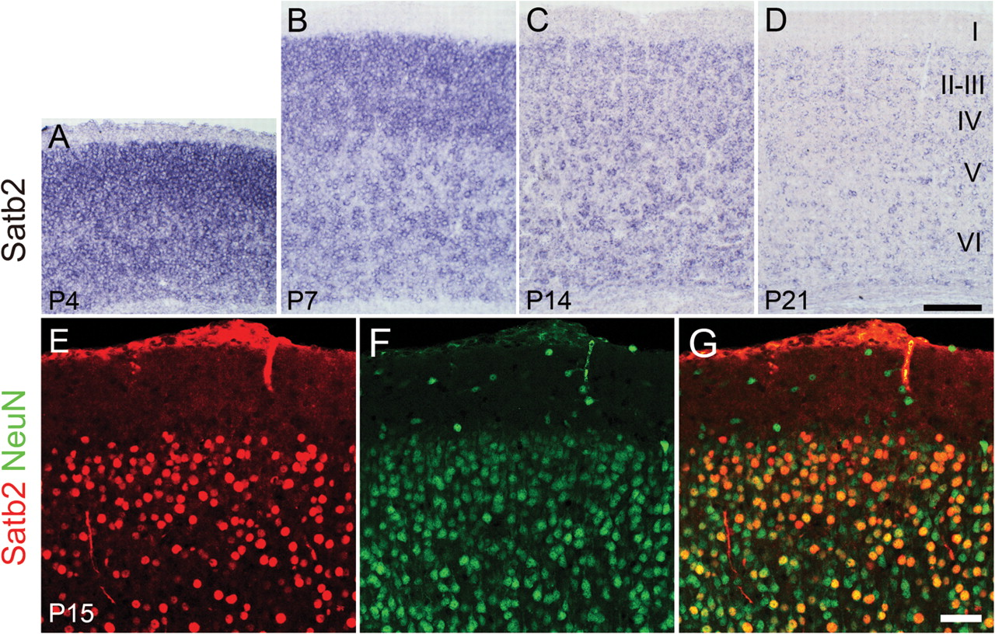
Figure 1. The expression of Satb2 in mouse cerebral cortex at various postnatal stages. (A) At P4, Satb2 is highly ...
Notes:
Figure 1. The expression of Satb2 in mouse cerebral cortex at various postnatal stages. (A) At P4, Satb2 is highly expressed in all cortical layers. (B) At P7, Satb2 is expressed at higher levels in the superficial layers relative to the deep layers. (C, D) At P14 and P21, Satb2 expression is reduced relative to P7 and presents at a homogeneous level in all cortical layers. (E–G) Double immunostaining of Satb2 (red) and NeuN (green) in the cerebral cortex shows that all Satb2-positive neurons are NeuN-positive. I–VI indicate cortical layers. Scale bars: 100 μm (A–D) and 50 μm (E–G).
Unless provided in the caption above, the following copyright applies to the content of this slide: © The Author 2011. Published by Oxford University Press. All rights reserved. For permissions, please e-mail: journals.permissions@oup.com

Slide 2
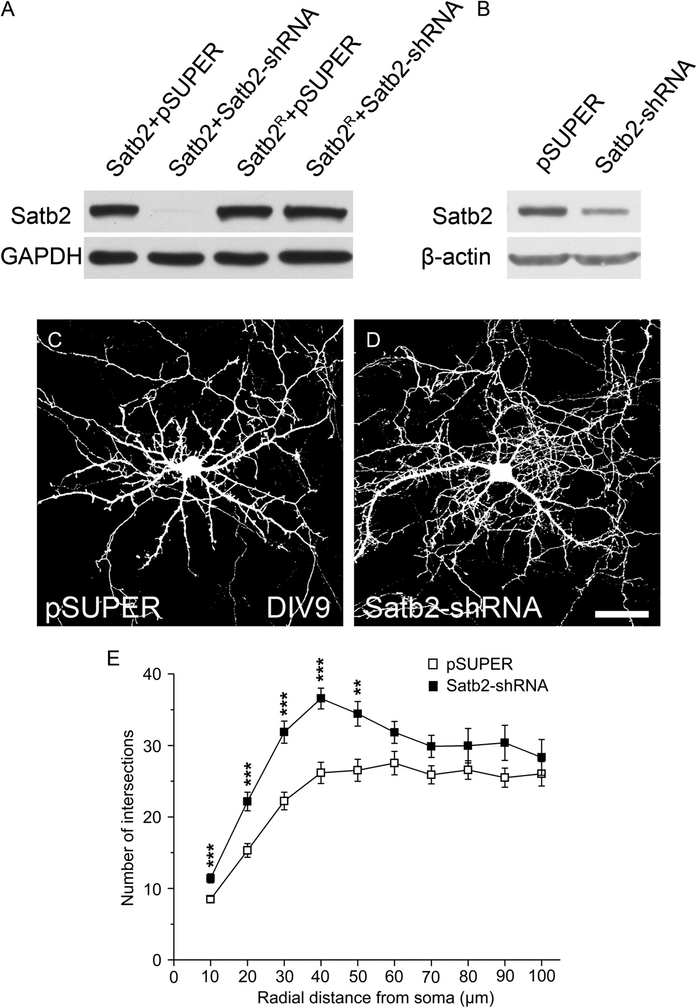
Figure 2. Satb2 knockdown increases dendritic branching in vitro. (A, B) Satb2 western blot. (A) Western blot shows ...
Notes:
Figure 2. Satb2 knockdown increases dendritic branching in vitro. (A, B) Satb2 western blot. (A) Western blot shows that transfection of Satb2-shRNA into HEK293 cells greatly reduces expression of exogenous wild-type Satb2 but not of the shRNA-resistant form of Satb2 (Satb2R). (B) Satb2-shRNA also reduces endogenous Satb2 in cultured mouse cortical neurons. (C, D) Representative images of cultured cortical neurons cotransfected with pSUPER/EGFP or Satb2-shRNA/EGFP at DIV6 and examined at DIV9. Scale bar: 40 μm. (E) Sholl analysis of dendritic branching of cultured cortical neurons cotransfected with pSUPER/EGFP or Satb2-shRNA/EGFP. Error bars represent standard error of the mean, and asterisks indicate significant differences (**P < 0.01 and ***P < 0.001).
Unless provided in the caption above, the following copyright applies to the content of this slide: © The Author 2011. Published by Oxford University Press. All rights reserved. For permissions, please e-mail: journals.permissions@oup.com

Slide 3
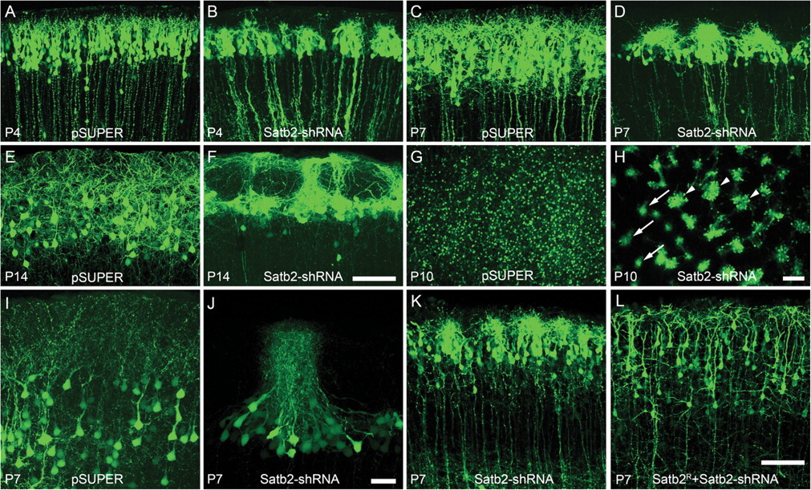
Figure 3. Knockdown of Satb2 results in dendritic fasciculation and soma clumping in the visual cortex. (A–F) At ...
Notes:
Figure 3. Knockdown of Satb2 results in dendritic fasciculation and soma clumping in the visual cortex. (A–F) At postnatal stages P4, P7, and P14, layer II/III pyramidal neurons transfected with Satb2-shRNA display a progressively worsening dendritic fasciculation and soma clumping phenotype (B, D, F). In contrast, dendrites of layer II/III pyramidal neurons in control pSUPER-transfected brains become progressively more complex and expand from P4 to P14 (A, C, E). (G, H) Tangential brain sections of Satb2-shRNA–transfected cortex reveal bundles of apical dendrites in layer I (arrows) and clusters of cell bodies (triangles) in layers II–III (H), whereas pyramidal neurons show the even distribution of somas in control brain (G). (I, J) High magnification of dendritic arborization in control and Satb2-shRNA–transfected brain sections at P7. (K, L) Expression of Satb2R rescues the Satb2-shRNA–induced dendrite arborization and soma spacing phenotypes. Scale bars: 100 μm (A–H, K, L) and 40 μm (I, J).
Unless provided in the caption above, the following copyright applies to the content of this slide: © The Author 2011. Published by Oxford University Press. All rights reserved. For permissions, please e-mail: journals.permissions@oup.com

Slide 4
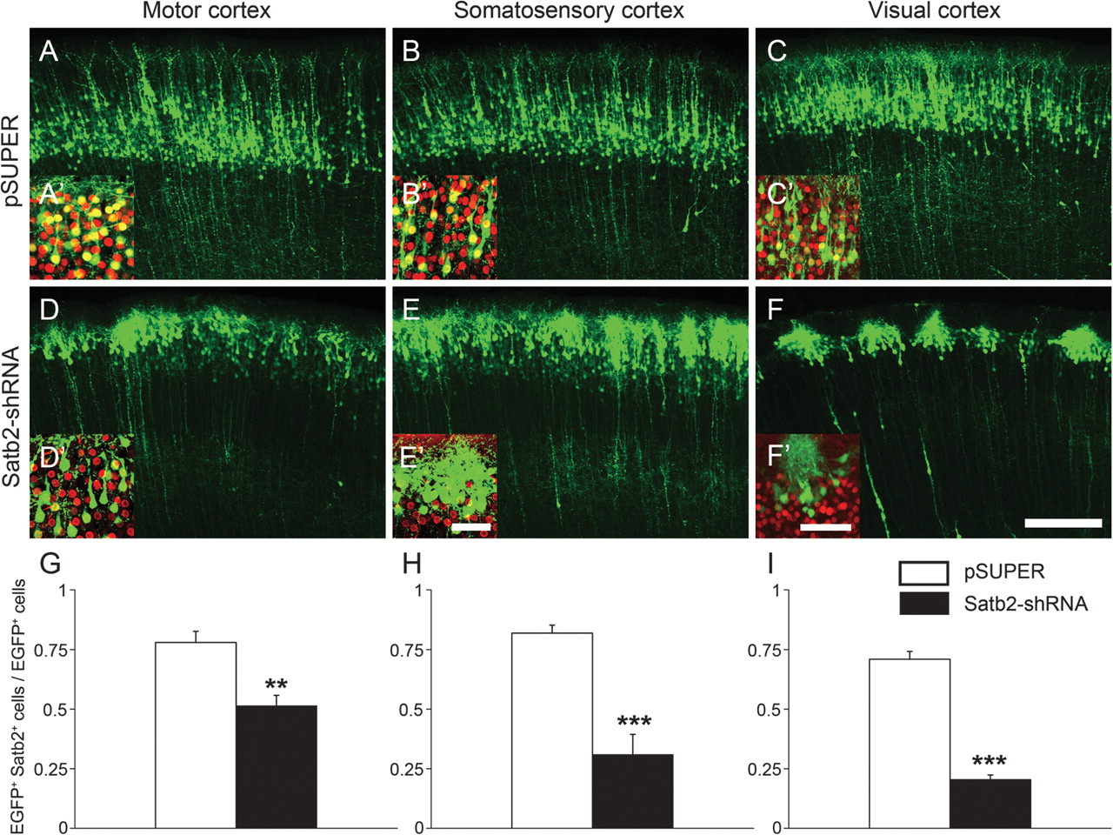
Figure 4. Severity of the Satb2-shRNA phenotype varies along the anterior–posterior axis of the cortex. (A–C) Control ...
Notes:
Figure 4. Severity of the Satb2-shRNA phenotype varies along the anterior–posterior axis of the cortex. (A–C) Control transfected (empty pSUPER) cortical neurons display similar morphologies in different cortical regions. (D–F) The phenotypes resulting from Satb2-shRNA knockdown in the anterior cortex (motor and somatosensory cortices) are less severe than those in the posterior cortex (visual cortex). (A′–F′) Immunolabeling of Satb2 (red) in cortical sections from brains transfected with empty pSUPER or Satb2-shRNA vector in the relevant cerebral regions. (G–I) Quantification of the ratio of Satb2/EGFP-double labeled neurons to the total number of EGFP-labeled neurons in Satb2-shRNA– and empty pSUPER-transfected (control) brains. Error bars represent standard error of the mean, and asterisks indicate significant differences (**P < 0.01 and ***P < 0.001). Scale bars: 200 μm (A–F) and 50 μm (A′–F′).
Unless provided in the caption above, the following copyright applies to the content of this slide: © The Author 2011. Published by Oxford University Press. All rights reserved. For permissions, please e-mail: journals.permissions@oup.com

Slide 5
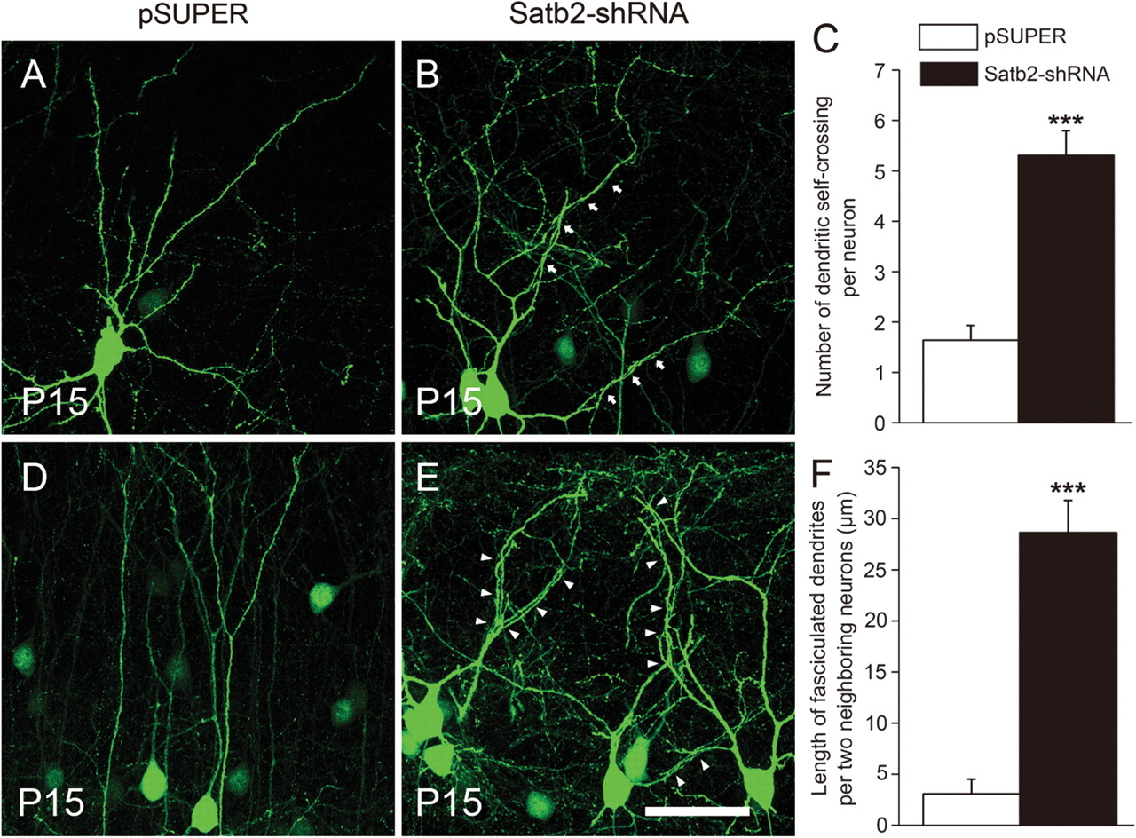
Figure 5. Dendritic fasciculation in Satb2-shRNA–transfected neurons in vivo. (A, B) An isolated control neuron shows ...
Notes:
Figure 5. Dendritic fasciculation in Satb2-shRNA–transfected neurons in vivo. (A, B) An isolated control neuron shows nearly nonoverlapping pattern of dendritic branching, whereas dendrites of Satb2-shRNA–transfected neuron show self-crossing/fasciculation (arrows in B). (C) The number of self-crossing is significantly increased in Satb2-shRNA–transfected neurons compared with control neurons. (D, E) Dendritic fasciculation occurs among neighboring Satb2-shRNA–transfected neurons (triangles in E), but this is hardly present in pSUPER-transfected neurons (D). (F) The length of fasciculated dendrites between 2 neighboring neurons is dramatically increased in Satb2-shRNA–transfected neurons compared with control neurons. Error bars represent standard error of the mean, and asterisks indicate significant differences (***P < 0.001). Scale bar: 50 μm.
Unless provided in the caption above, the following copyright applies to the content of this slide: © The Author 2011. Published by Oxford University Press. All rights reserved. For permissions, please e-mail: journals.permissions@oup.com

Slide 6
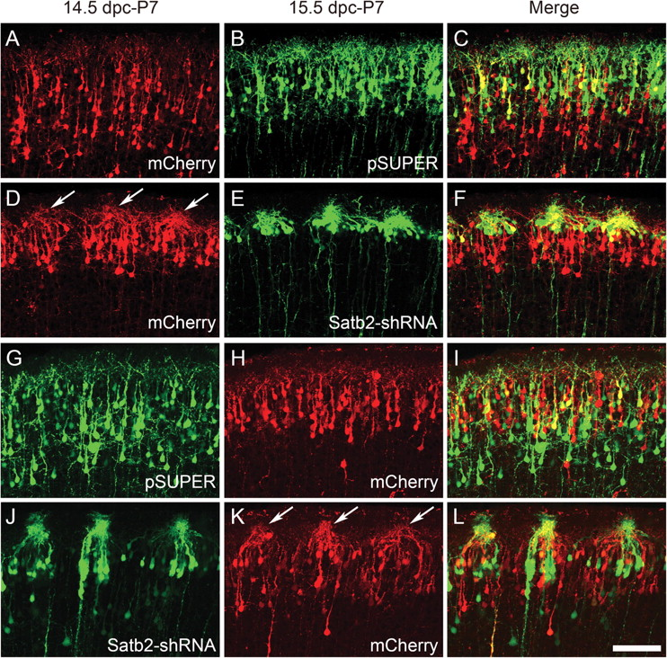
Figure 6. Sequential in utero electroporation reveals a non-cell autonomous component of the Satb2-shRNA–induced ...
Notes:
Figure 6. Sequential in utero electroporation reveals a non-cell autonomous component of the Satb2-shRNA–induced phenotype. (A–F) At P7, neurons transfected with mCherry on 14.5 dpc display similar dendritic arborization and soma spacing as neurons transfected with empty pSUPER on 15.5 dpc in the same cortex (A–C). Note that mCherry-labeled neurons are located deeper in the cortex than control neurons. Neurons transfected with mCherry on 14.5 dpc exhibit impaired dendritic arborization, similar to neurons in the same cortical area transfected with Satb2-shRNA on 15.5 dpc (D–F). (G–L) At P7, neurons transfected with mCherry on 15.5 dpc display dendritic arborization and soma spacing as neurons transfected with empty pSUPER on 14.5 dpc in the same cortical region (G–I). Neurons transfected with mCherry on 15.5 dpc exhibit impaired dendritic arborization, similar to neurons transfected with Satb2-shRNA on 14.5 dpc in the same cortical area (J–L). Arrows indicate the dendritic defects in mCherry-expressing cells, which are located adjacent to Satb2-shRNA–transfected neurons. Scale bar: 100 μm.
Unless provided in the caption above, the following copyright applies to the content of this slide: © The Author 2011. Published by Oxford University Press. All rights reserved. For permissions, please e-mail: journals.permissions@oup.com

Slide 7
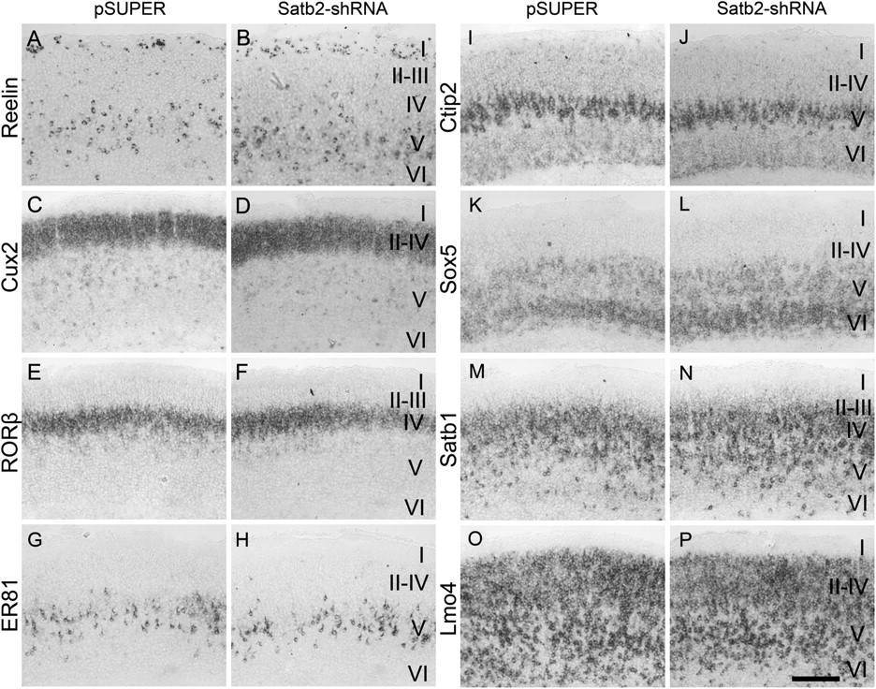
Figure 7. In situ hybridization shows cortical layer–specific gene expression in cortices transfected with Satb2-shRNA ...
Notes:
Figure 7. In situ hybridization shows cortical layer–specific gene expression in cortices transfected with Satb2-shRNA from 15.5 dpc. (A–P) Expression patterns of Reelin (layers I and V), Cux2 (layers II–IV), RORβ (layer IV), ER81 (layer V), Ctip2 (layer V), Sox5 (layers V–VI), Satb1 (layers III–V), and Lmo4 (layers II–VI) are not significantly different between Satb2-shRNA–transfected cortices and that of controls. I–VI indicate cortical layers. Scale bar: 100 μm.
Unless provided in the caption above, the following copyright applies to the content of this slide: © The Author 2011. Published by Oxford University Press. All rights reserved. For permissions, please e-mail: journals.permissions@oup.com

