Slide 1
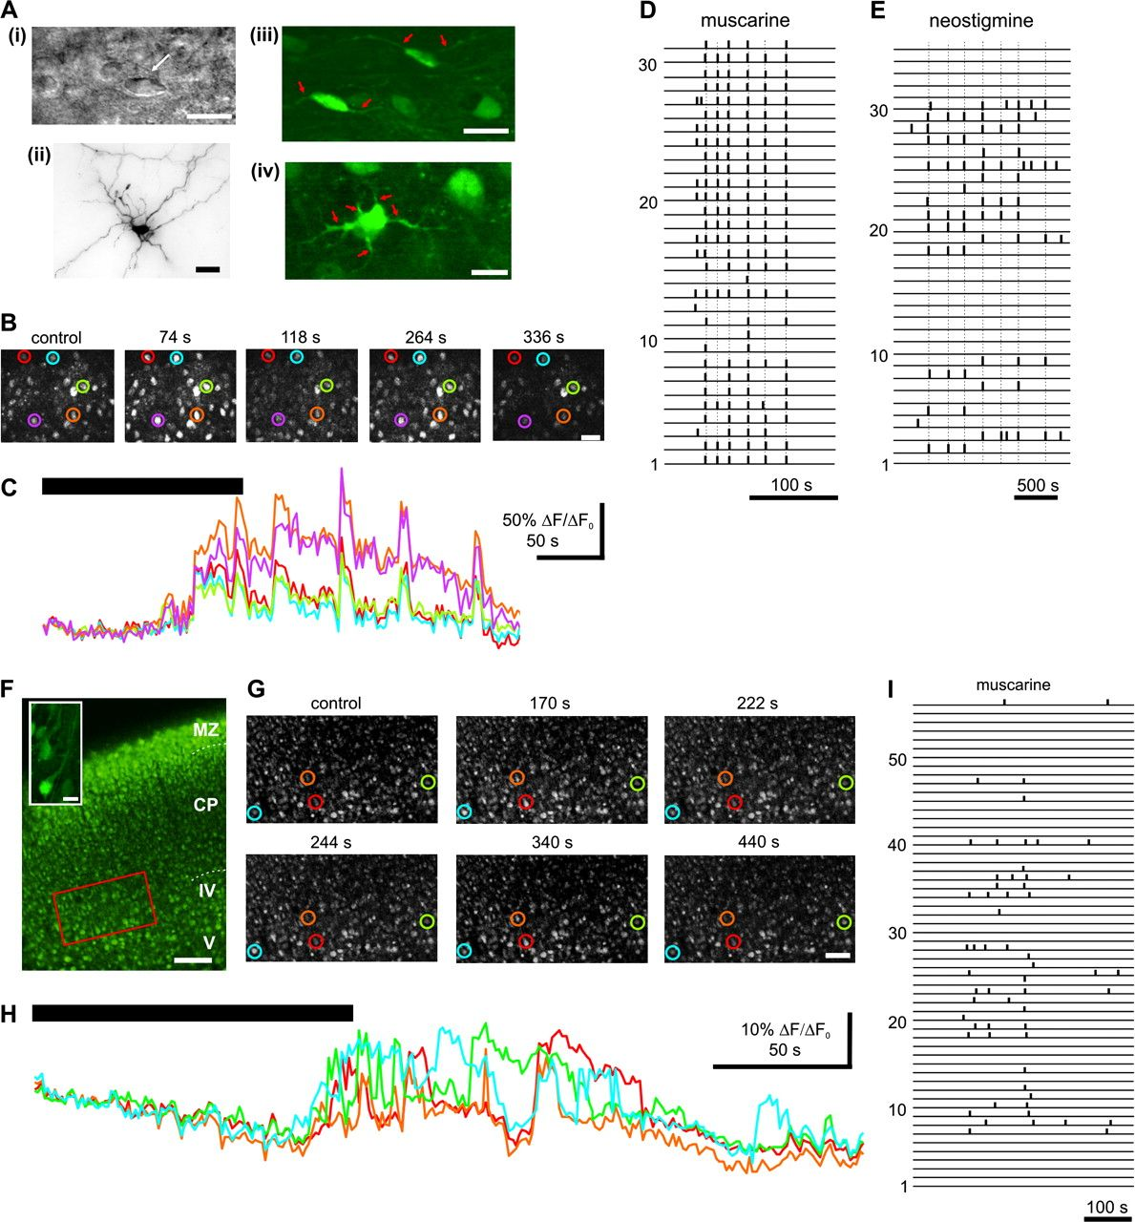
Figure 1. Cholinergic input-dependent calcium transients in the subplate and cortical plate of the newborn rat. (A) ...
Notes:
Figure 1. Cholinergic input-dependent calcium transients in the subplate and cortical plate of the newborn rat. (A) Morphology of subplate neurons. (i) DIC image of a horizontal SPn in a living neocortical slice from a P2 rat. (ii) Photomicrograph of a biocytin-stained SPn with an arborized dendritic tree. (iii)–(iv) Fluorescence images of horizontal and multipolar SPn loaded with 2.5 μM CaGreen at 33 °C for 15 min. Note that the morphology of the soma and of the primary dendrites (red arrows) can be resolved, allowing morphological classification. Scale bar in (i)–(iv) corresponds to 25 μm. (B) Fluorescence images of calcium transients in the subplate of a P1 rat in response to transient bath application of 60 μM (±) muscarine. The image sequence was captured before (control), during (74 s, 118 s) and after (264 s, 336 s) muscarine application (muscarine application onset was considered as t = 0 s). Note the simultaneous rise in the calcium signal in a large population of SPn. Scale bar corresponds to 50 μm. (C) Changes in the fluorescence intensity of 5 CaGreen-loaded SPn (corresponding to the SPn marked by circles in B). Note the synchronized response pattern in all 5 neurons. Muscarine application is marked by black bar. (D) Binary raster plot of muscarine-induced calcium transients recorded simultaneously in 31 randomly selected SPn from the slice shown in B. Note synchronized responses in all recorded SPn. (E) Binary raster plot of spontaneous calcium transients recorded simultaneously in 35 SPn from a P2 rat after blockade of AChE with neostigmine (10 μM). Note the correlated spontaneous activity in the majority of the SPn. (F) Fluorescence image from immature cortical neurons of a P1 rat, taken with a 10x objective in a focal plane 40 μm below the surface of the coronal slice. The region marked by the red box is shown at higher magnification in (G). Scale bar corresponds to 200 μm. Inset, fluorescence image of pyramidal cortical plate neurons (CPn) loaded with CaGreen. Note that the morphology of soma and primary dendrites can be resolved. Scale bar corresponds to 25 μm. (G) Fluorescence images of calcium transients in CPn in response to transient muscarine application. The image sequence was captured before (control), during (170 s) and after (222 s, 244 s, 340 s, 440 s) muscarine application. Scale bar corresponds to 50 μm. The Ca2+ transients from the cells marked by colored circles are shown in (H). (H) Changes in the fluorescence level of 4 CaGreen-loaded immature CPn marked in (G). Muscarine application is marked by black bar. (I) Binary raster plot of muscarine-induced calcium transients recorded simultaneously in 56 randomly selected cortical neurons from the slice shown in (F) and (G). In (D), (E), and (I) data were reduced to a binary form by using the first derivate of the fluorescence (ΔF/ΔF0) signal and setting a threshold from the resting fluorescence of 0.03 and 0.01, respectively. Each horizontal line represents a cell and each vertical black bar represents the onset of a calcium transient. The synchronized coactivation of more than 10 neurons is marked by dotted lines. Note that the muscarine-induced activity in the cortical plate (I) reveals a less synchronized pattern than the activity recorded in the subplate (D, E).
Unless provided in the caption above, the following copyright applies to the content of this slide: © The Author 2008. Published by Oxford University Press. All rights reserved. For permissions, please e-mail: journals.permissions@oxfordjournals.org

Slide 2
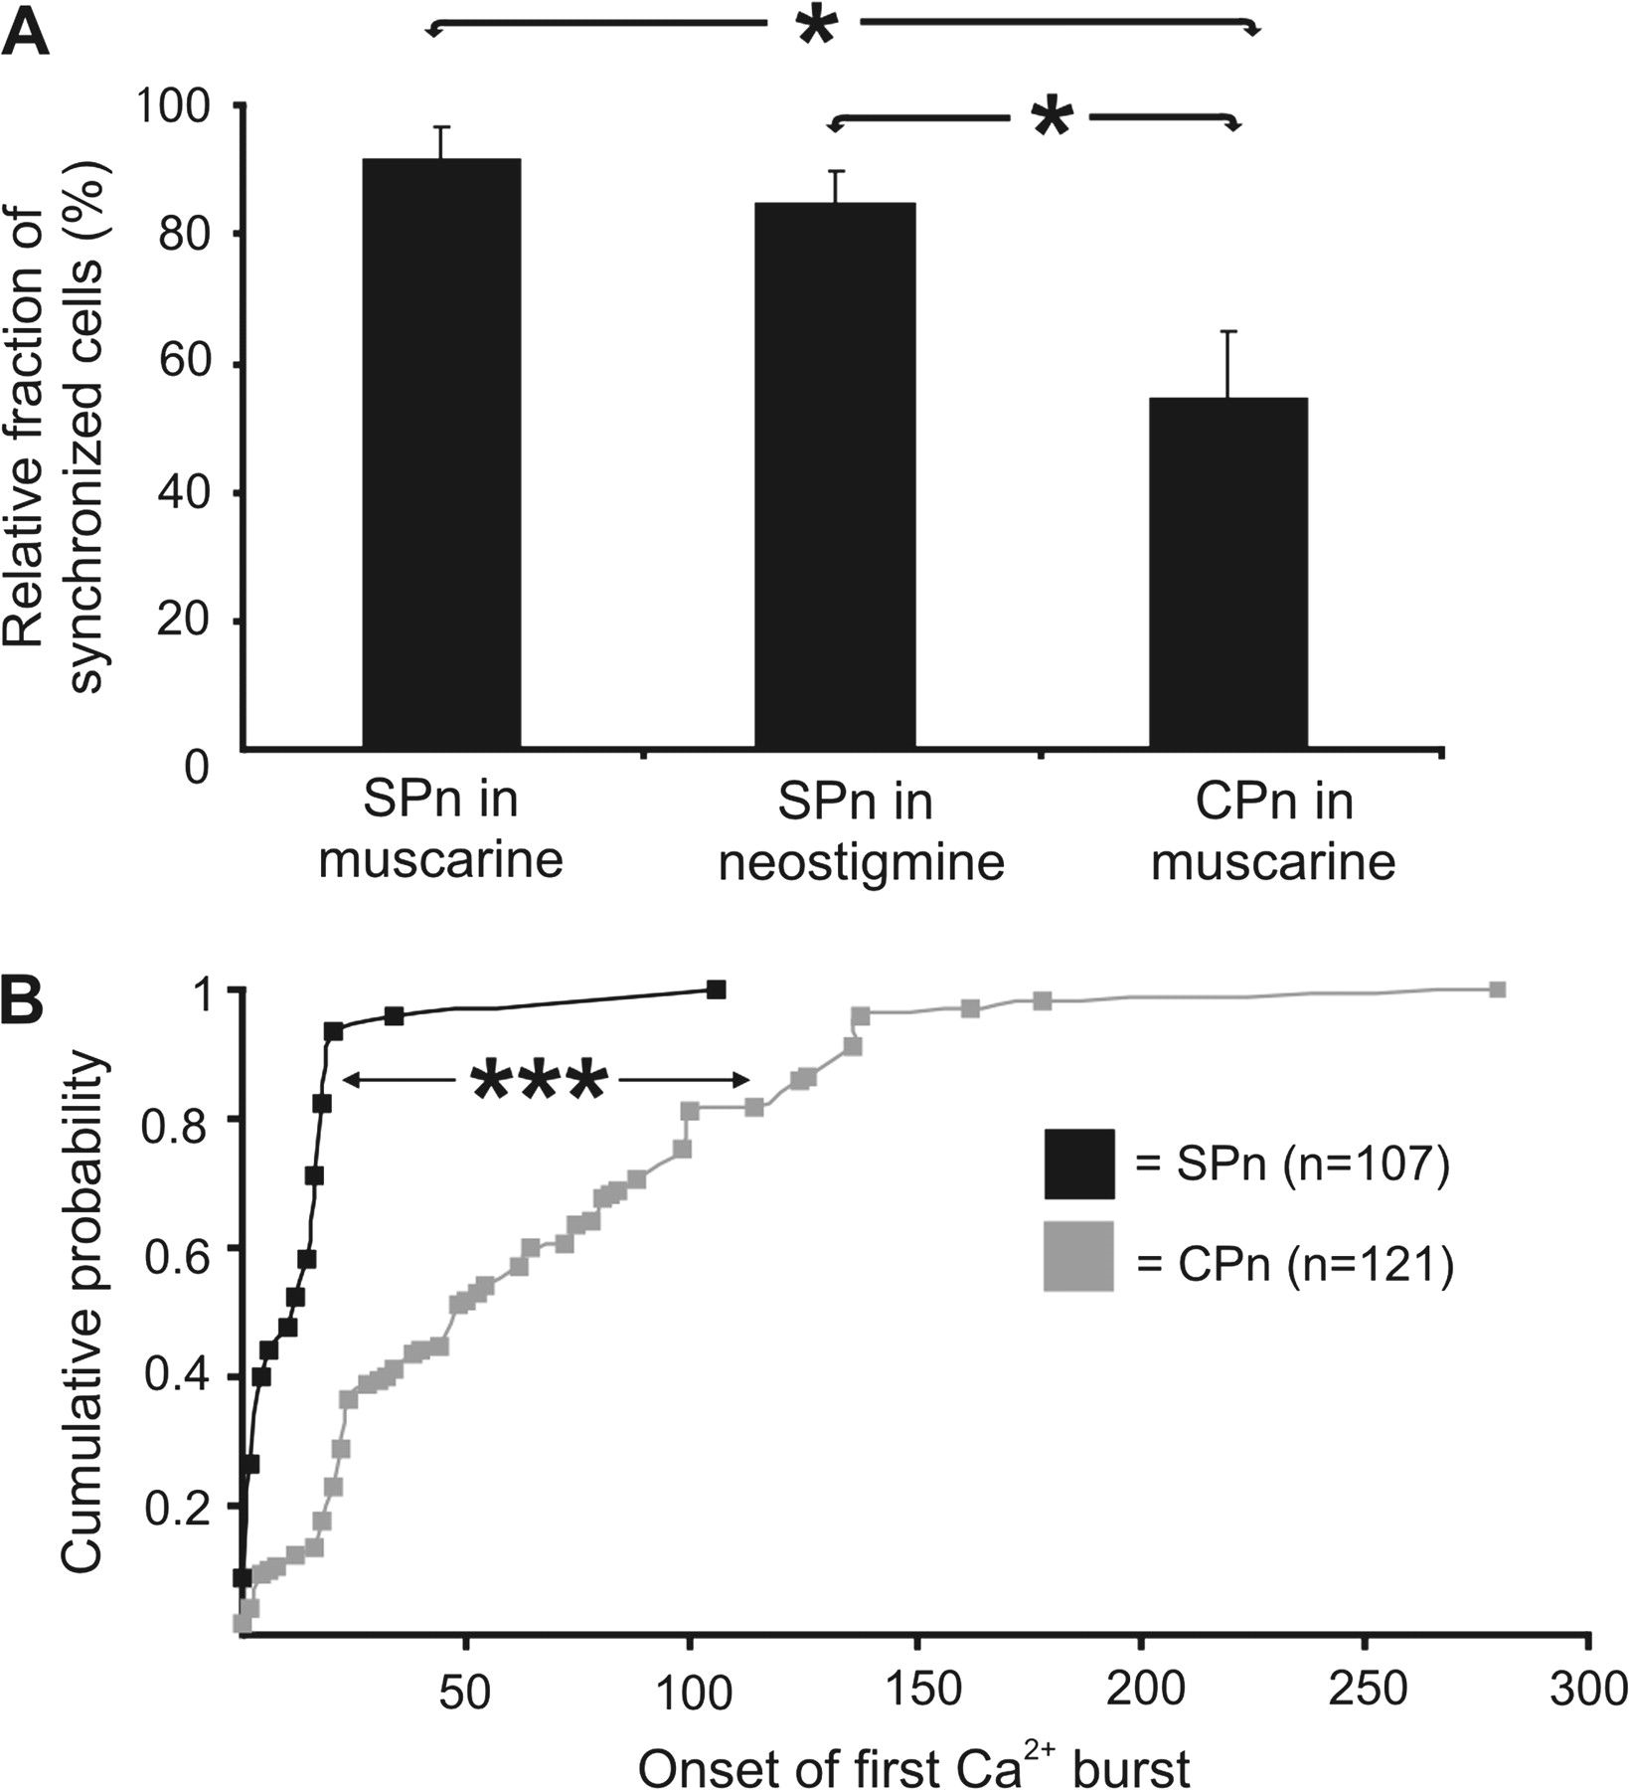
Figure 2. Temporal pattern of muscarine-induced calcium transients in all investigated SPn (n = 107) and immature CPn ...
Notes:
Figure 2. Temporal pattern of muscarine-induced calcium transients in all investigated SPn (n = 107) and immature CPn (n = 121). (A) Bar diagram displaying the averaged fraction of SPn and CPn per slice that showed repetitive synchronized calcium transients in response to muscarine and neostigmine. (B) Plot diagram displaying the cumulative probability of the first burst onset in SPn (black dots) and in immature CPn (gray dots). Note the higher degree of synchronization in SPn as compared with CPn. Significance levels of P < 0.05 (*) and P < 0.01 (***) were considered.
Unless provided in the caption above, the following copyright applies to the content of this slide: © The Author 2008. Published by Oxford University Press. All rights reserved. For permissions, please e-mail: journals.permissions@oxfordjournals.org

Slide 3
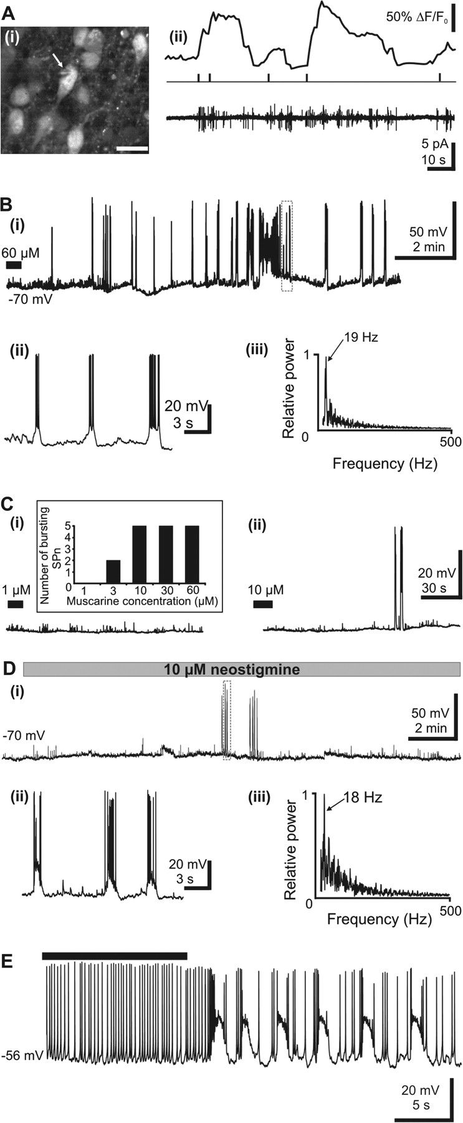
Figure 3. Cellular characteristics of the cholinergic activity in SPn. (A) Simultaneous imaging of calcium transients ...
Notes:
Figure 3. Cellular characteristics of the cholinergic activity in SPn. (A) Simultaneous imaging of calcium transients and recording of action currents in cell-attached patch-clamp configuration in SPn and CPn. (i) Fluorescence image of a CaGreen-loaded neuron from a P4 rat. Note the tip of the pipette (white arrow) contacting the cell to establish the cell-attached configuration. Scale bar corresponds to 25 μm. (ii) Calcium transients (upper trace) and the corresponding binary raster plot of their onset (middle trace) simultaneously recorded with bursts of action currents in cell-attached configuration (bottom trace). Note that several bursts of action currents correspond to each calcium transient. (Bi) Current-clamp whole-cell recording from a P3 SPn at a holding potential of −70 mV. Note the long-lasting burst discharge (up states) after a single 30 s-long bath application of muscarine (marked by a black bar). The recording marked by the dashed box is shown at higher magnification in (Bii). (Bii) Muscarine-induced up states from the trace shown in Ai displayed at larger scale. Note the variable duration of the up states. (Biii) Frequency power spectrum of the AP discharge within one representative up state from the trace shown in Ai. (C) Current-clamp whole-cell recordings from a P2 SPn displaying the effects of 1 μM (i) and 10 μM (ii) (±) muscarine. Note the absence of up state discharge in the presence of 1 μM muscarine and the reduced duration of up state phase when 10 μM muscarine was applied. Inset, effects of different muscarine concentrations on the number of SPn showing muscarine-induced up states. (Di) Current-clamp whole-cell recording from a P2 SPn at a holding potential of −70 mV displaying the effects of 10 μM neostigmine. Up state discharge appeared 10 min after the beginning of the neostigmine application. The recording marked by the dashed box is displayed at higher magnification in (Cii). (Dii) Neostigmine-induced up states displayed at larger scale from the trace shown in (Ci). (Diii) Frequency power spectrum of the AP discharge within one up state from the trace shown in (Di). Note the similar frequency of the discharge in muscarine- and neostigmine-induced up states. (E) Muscarine increases the firing discharge and modifies the firing pattern in SPn. Current-clamp whole-cell recordings from a P3 SPn at RMP of −56 mV. Note the change in discharge pattern from regular firing to repetitive bursting. Muscarine application is marked by black bar.
Unless provided in the caption above, the following copyright applies to the content of this slide: © The Author 2008. Published by Oxford University Press. All rights reserved. For permissions, please e-mail: journals.permissions@oxfordjournals.org

Slide 4
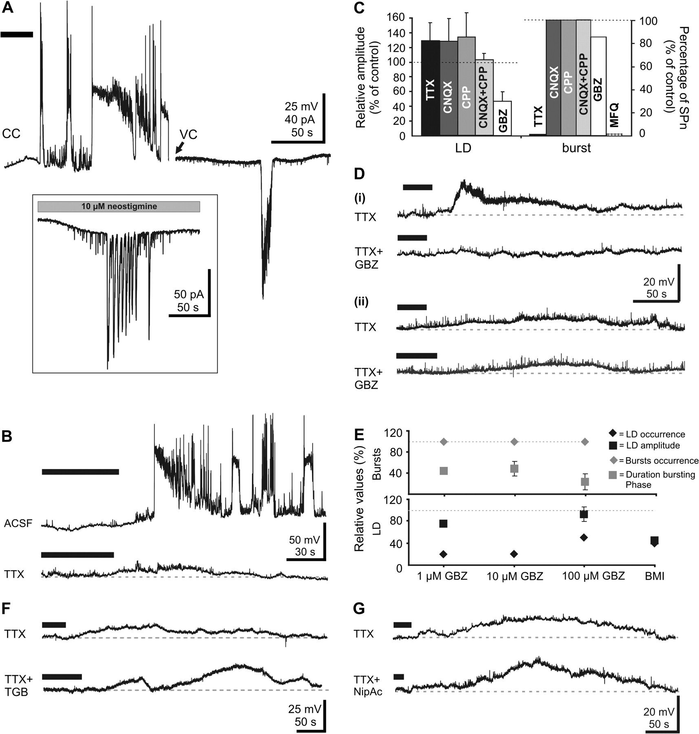
Figure 4. Pharmacology of muscarine-induced responses in SPn. (A) Successive current-clamp (CC) and voltage-clamp (VC) ...
Notes:
Figure 4. Pharmacology of muscarine-induced responses in SPn. (A) Successive current-clamp (CC) and voltage-clamp (VC) whole-cell recordings from a P2 SPn. Note the up state discharge in response to muscarine application (marked by horizontal bar) in both recording configurations. The back arrow marks the switch between current-clamp and voltage-clamp mode. Inset, voltage-clamp recording from a P0 SPn after 20 min bath application of 10 μM neostigmine. (B) Effects of AP blockade on muscarine-induced responses. Current-clamp recordings of muscarine-induced responses under control conditions (upper trace) and in the presence of 1 μM TTX (lower trace) in a P4 SPn. Note blockade of up state discharge but persistence of LD in the presence of TTX. (C) Pharmacological profile of muscarine-induced responses in SPn. Bar diagram displaying the relative amplitude of the LD and the relative incidence of up states after blockade of APs (TTX), glutamatergic (CNQX, CPP) and GABAergic (gabazine, GBZ) synaptic transmission, as well as after neuronal gap junction blockade (mefloquine, MFQ). Data are expressed as relative values from the total number of SPn investigated for each antagonist. (D) Different effects of GABAA receptor blockade on muscarine-induced LD recorded in SPn. (i) Current-clamp recordings displaying the blockade of the TTX-insensitive LD in the presence of 100 μM gabazine in a P3 SPn. (ii) Current-clamp recordings displaying the persistence of the TTX-insensitive LD in the presence of 100 μM gabazine in a P2 SPn. (E) Effects of different gabazine concentrations (1, 10, 100 μM) and bicuculline (10 μM) on the LD (black) occurrence and amplitude as well as on the up states (gray) occurrence and duration of bursting phase. Data are expressed as relative values compared with control recordings in the absence of the antagonists. (F) Effects of GABA uptake blockade by tiagabine on the LD in SPn. Current-clamp recordings of the LD recorded in the presence of TTX and after addition of 50 μM tiagabine (TGB) in a P3 SPn. Note the augmentation of the LD after blockade of GABA uptake. (G) Effects of GABA uptake blockade by nipecotic acid (NipAc) on the LD in SPn. Current-clamp recordings of the LD recorded in the presence of TTX and after addition of 500 μM nipecotic acid in a P4 SPn. Note the augmentation of the LD in the presence of nipecotic acid. In (A), (B), (D), (F), (G) muscarine application is marked by black bar.
Unless provided in the caption above, the following copyright applies to the content of this slide: © The Author 2008. Published by Oxford University Press. All rights reserved. For permissions, please e-mail: journals.permissions@oxfordjournals.org

Slide 5
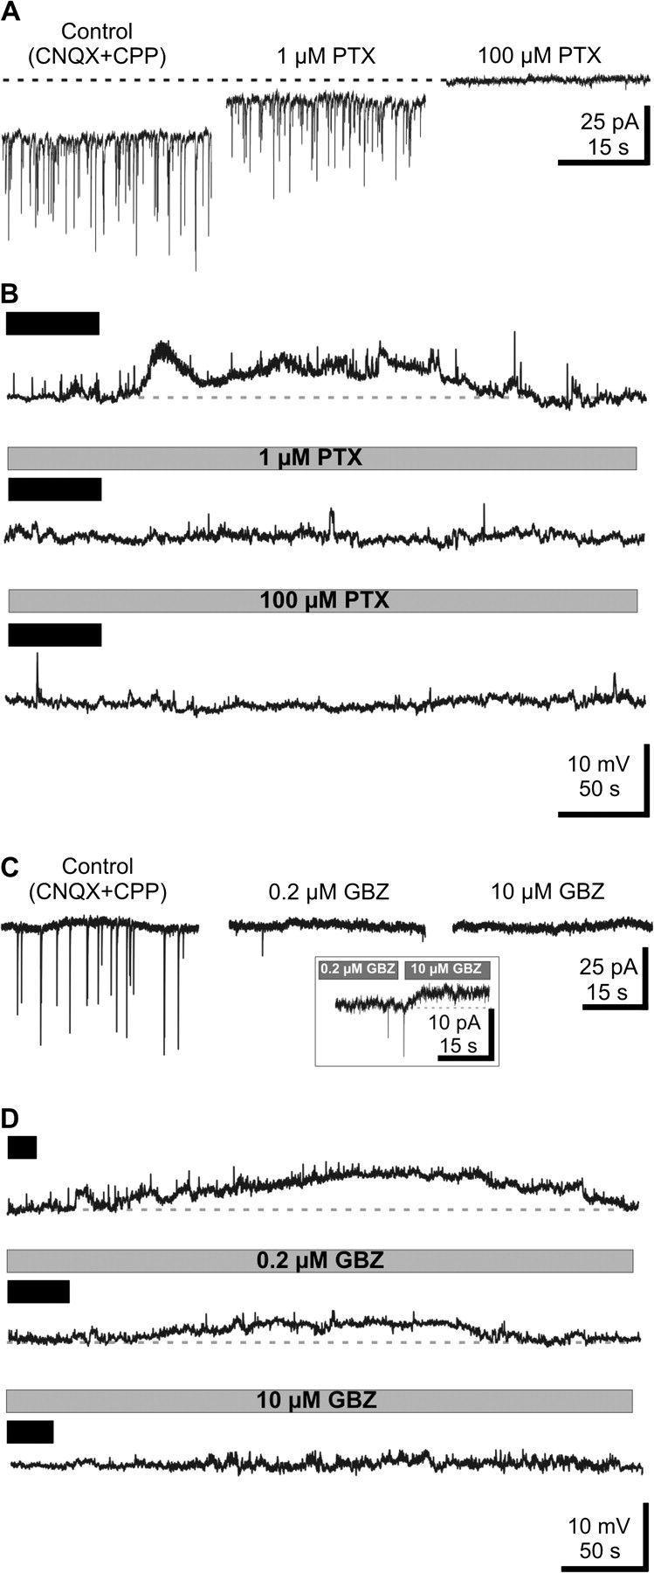
Figure 5. Contribution of ambient GABA on the muscarine-induced LD. (A) Voltage-clamp recordings of the spontaneous ...
Notes:
Figure 5. Contribution of ambient GABA on the muscarine-induced LD. (A) Voltage-clamp recordings of the spontaneous synaptic activity in a P4 SPn showing the effects of increasing concentrations of picrotoxin (PTX) on the holding current and on pharmacologically isolated GABAergic sPSCs recorded in the presence of CNQX and CPP. (B) Current-clamp recordings of the muscarine-induced LD in the presence of increasing concentrations of PTX. Note the abolishment of the LD by 1 μM PTX. (C) Voltage-clamp recordings of the spontaneous synaptic activity in a P4 SPn showing the effects of 0.2 and 10 μM gabazine (GBZ) on the in CNQX- and CPP-isolated GABAergic sPSCs. Inset, voltage-clamp recording displaying the current shift induced by 10 μM GBZ. (D) Current-clamp recordings of the muscarine-induced LD in the presence of 0.2 and 10 μM GBZ. Note the persistence of LD in the presence of 0.2 μM GBZ and its abolishment by 10 μM GBZ. In (B) and (D) muscarine application is marked by black bar.
Unless provided in the caption above, the following copyright applies to the content of this slide: © The Author 2008. Published by Oxford University Press. All rights reserved. For permissions, please e-mail: journals.permissions@oxfordjournals.org

Slide 6
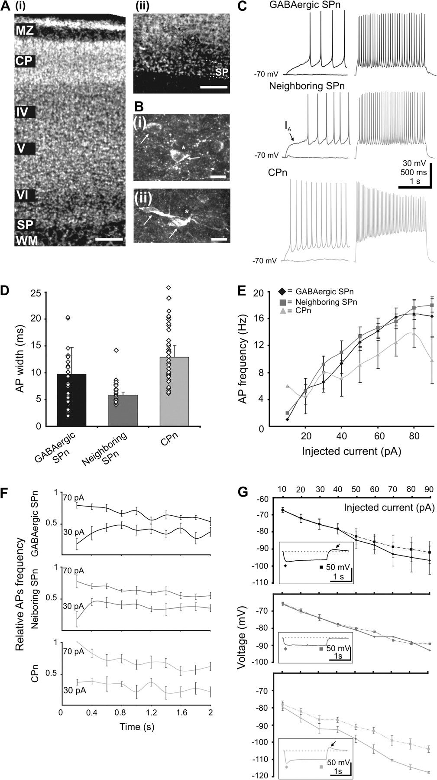
Figure 6. Morphological and membrane properties of the neuronal populations that participate to burst discharge in the ...
Notes:
Figure 6. Morphological and membrane properties of the neuronal populations that participate to burst discharge in the neonatal cerebral cortex. (A) Hoechst 33259 DNA staining (i) combined with GAD67 immunocytochemistry (ii) demonstrating the presence of GABAergic cells in the subplate. Scale bars correspond to 100 μm. (B) High magnification digital images of GAD67-positive SPn (marked by white arrows) showing inverted pyramidal (i) and horizontal (ii) morphology. Note the presence of neighboring black spots (marked by asterisk) that are likely to be non-GABAergic SPn. Scale bars correspond to 25 μm. (C) Current-clamp recordings showing the firing patterns of the GABAergic SPn (black traces), neighboring SPn (dark gray traces) and cortical plate neurons (CPn) (light gray traces) in response to injection of small (30 pA, left-hand traces) and large (80 pA, right-hand traces) depolarizing currents. (D) Bar diagram of the averaged AP widths and their individual distributions in GABAergic SPn (black bar), neighboring SPn (dark gray bar) and CPn (light gray bar). Note the scattered distribution of AP widths in CPn when compared with SPn. (E) Diagram displaying firing frequency versus injected current for GABAergic SPn (black dots), neighboring SPn (dark gray dots) and CPn (light gray dots). (F) Adaptation of AP discharge during depolarizing current steps of various amplitudes. The values were normalized to the maximal firing frequency in each neuron. (G) Current–voltage plots for the GABAergic SPn (black), neighboring SPn (dark gray) and cortical plate neurons (CPn) (light gray). Voltage was measured at the beginning (diamond, solid line) and at the end (square, dotted line) of the hyperpolarizing pulses. Inset, current-clamp recordings showing the more prominent Ih voltage-sag in CPn when compared with SPn. Rebound depolarization present in both SPn and CPn is marked by arrows.
Unless provided in the caption above, the following copyright applies to the content of this slide: © The Author 2008. Published by Oxford University Press. All rights reserved. For permissions, please e-mail: journals.permissions@oxfordjournals.org

Slide 7
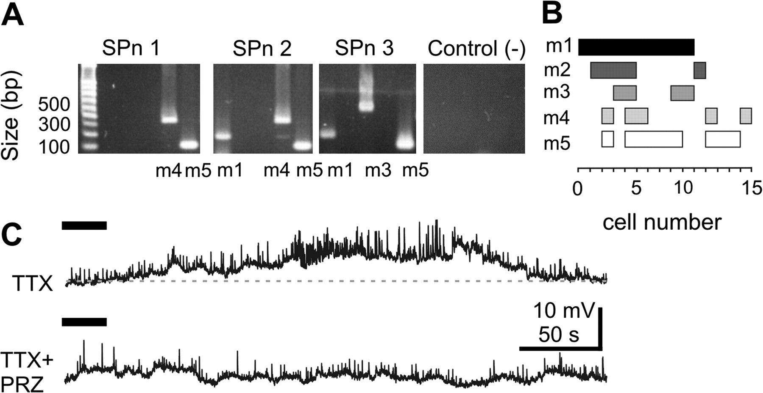
Figure 7. Expression and function of mAChR subtypes in SPn. (A) Expression of mAChR subunits m1 to m5 in SPn. ...
Notes:
Figure 7. Expression and function of mAChR subtypes in SPn. (A) Expression of mAChR subunits m1 to m5 in SPn. Photographs of ethidium bromide-stained agarose gels showing the mAChR mRNAs detected after RT-PCR in 3 different SPn and the absence of mAChR mRNA in negative controls (expelled cytoplasma replaced by water). (B) Bar diagram displaying the expression pattern of the 5 mAChR subunits in 15 SPn. Overlap of the horizontal bars illustrates coexpression of the mAChR subunits within single SPn. (C) Functional postsynaptic mAChR in SPn analyzed in the presence of TTX. Current-clamp recording of the postsynaptic muscarine-induced response under control conditions and after blockade of the m1 receptor with 1 μM pirenzepine (PRZ). Muscarine application is marked by horizontal black bar.
Unless provided in the caption above, the following copyright applies to the content of this slide: © The Author 2008. Published by Oxford University Press. All rights reserved. For permissions, please e-mail: journals.permissions@oxfordjournals.org

Slide 8
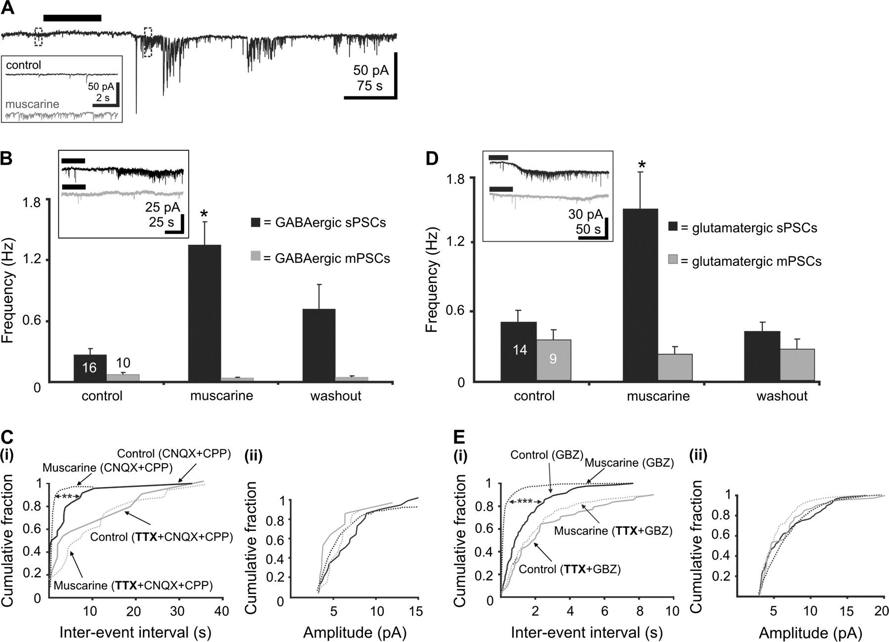
Figure 8. Effects of mAChR activation on spontaneous synaptic activity of SPn. (A) Voltage-clamp whole-cell recording ...
Notes:
Figure 8. Effects of mAChR activation on spontaneous synaptic activity of SPn. (A) Voltage-clamp whole-cell recording from a P2 SPn before, during and after transient bath application of 60 μM (±)-muscarine (marked by horizontal bar). Note the burst-grouped increase in the frequency of sPSCs. Recordings marked by dotted boxes are shown at higher magnification in the inset. (B) Muscarine-mediated modulation of GABAergic sPSCs recorded in SPn in the presence of 10 μM CNQX and 20 μM CPP. Bar diagram displaying the effects of muscarine on isolated GABAergic sPSCs (black) and on isolated GABAergic miniature PSCs (mPSCs) recorded in TTX (gray). Inset, voltage-clamp recordings displaying the muscarine effect on GABAergic sPSCs (black trace) and mPSCs (gray trace). (C) Interevent interval (i) and amplitude (ii) cumulative distribution plots for GABAergic sPSCs (black) and mPSCs (gray) recorded from a P2 SPn under control conditions (solid lines) and after muscarine application (dotted lines). (D) Effects of muscarine on glutamatergic sPSCs recorded in the presence of 100 μM gabazine to block GABAA receptors. Bar diagram showing the effects of muscarine on glutamatergic sPSCs (black) and on isolated glutamatergic miniature PSCs (mPSCs) recorded in TTX (gray). Inset, voltage-clamp recordings displaying the muscarine effect on glutamatergic sPSCs (black trace) and mPSCs (gray trace). (E) Interevent interval (i) and amplitude (ii) cumulative distribution plots for glutamatergic sPSCs (black) and glutamatergic mPSCs (gray) recorded from a P3 SPn under control conditions (solid lines) and after muscarine application (dotted lines).
Unless provided in the caption above, the following copyright applies to the content of this slide: © The Author 2008. Published by Oxford University Press. All rights reserved. For permissions, please e-mail: journals.permissions@oxfordjournals.org

Slide 9
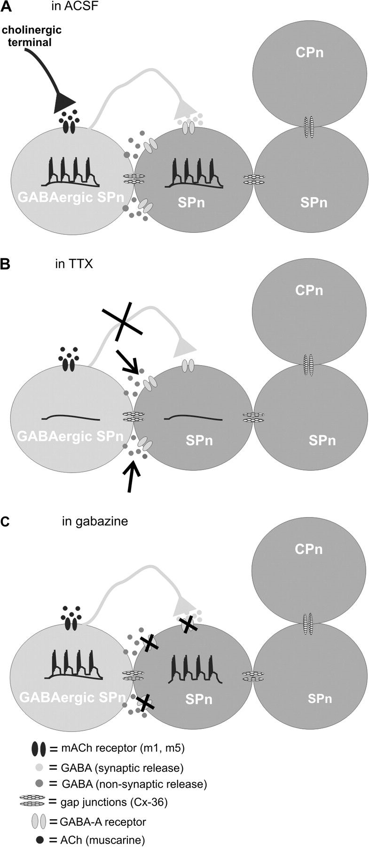
Figure 9. Summary diagram of the mechanisms and the cellular interactions, which are likely to underlie the generation ...
Notes:
Figure 9. Summary diagram of the mechanisms and the cellular interactions, which are likely to underlie the generation of cholinergic-dependent network activity in the neonatal cerebral cortex. (A) Activation of mAChR by the cholinergic input leads to a LD in GABAergic SPn that underlies the up states. The up states propagate to the neighboring cells mainly through gap junctions, whereas their LD is induced by tonic GABA release. (B) When the APs are blocked with TTX, the LD is caused by the cholinergic drive in GABAergic SPn and by the tonic GABA release in the neighboring neurons. (C) Blockade of GABAA receptors by gabazine has no effect on the GABAergic SPn receiving cholinergic input (LD and up states are hardly affected), but contributes to the abolishment of the tonic GABA-induced LD in the neighboring cells. Because the up states propagate mainly through gap junctions, they are not affected.
Unless provided in the caption above, the following copyright applies to the content of this slide: © The Author 2008. Published by Oxford University Press. All rights reserved. For permissions, please e-mail: journals.permissions@oxfordjournals.org

